Slide 1




Otwarte zasoby edukacyjne w kształceniu osób starszych
Jubileuszowa, X edycja konferencji Rozwój e-edukacji w ekonomicznym szkolnictwie wyższym
21 listopada 2013 r. Uniwersytet Ekonomiczny w Poznaniu
Anna Grabowska
Politechnika Gdańska
PRO-MED sp. z o.o.

Slide 2
Projekty 2005-2014
Socrates Grundtvig, ABLE - Adult Blended Learning, 2005-2007
Grundtvig Multilateral Project, MindWellness - Improving learning capacities and mental health of elder people, 2008-2010
Meetings with Computers for Seniors from Gdansk University of Technology, 2008-
Magazine online, 2008-
Grundtvig Partnership, Connecting +55, 2008-2010
Grundtvig Partnership, EuBiA - EU Broadening people's mind in ageing, 2008-2010
Grundtvig Partnership, IMPROGE - Improving Opportunities for Older People in Work and Community Activity - Winning the Generation Game, 2008-2010
e-senior.eu w akcji, 2009-2010
Grundtvig Partnership, LLLab - Lifelong Learning for Active Citizenship and Capacity Building, 2009-2011
Active Citizens, 2010-2011
Grundtvig Partnership, LISTEN - Learning Innovative Styles and Active Citizens, 2011-2013
Grundtvig Partnership, LLLE - Learning in Later Life in Europe, 2011-2013
Grundtvig Network Project, ForAge – Forage for later-life learning: Building on European experience, 2012-2014
Grundtvig Multilateral Project, MATURE - Making Adult Teaching Useful, Relevant and Engaging, 2013-2014
Grundtvig Senior Volunteering Project, SenAcT - Seniors Acting Together, 2013-2014

Slide 3
Linki
http://blanka.moodle.pl/
http://utw.moodle.pl/
http://magazinefactory.edu.fi/magazines/e_senior/
http://utwpg.gda.pl/
http://www.europeansharedtreasure.eu/search.php?txt_school=PRO-MED&txt_town=Gda%C5%84sk
http://www.mindwellness.eu/
http://www.foragenetwork.eu/en/
http://matureproject.eu/

Slide 4
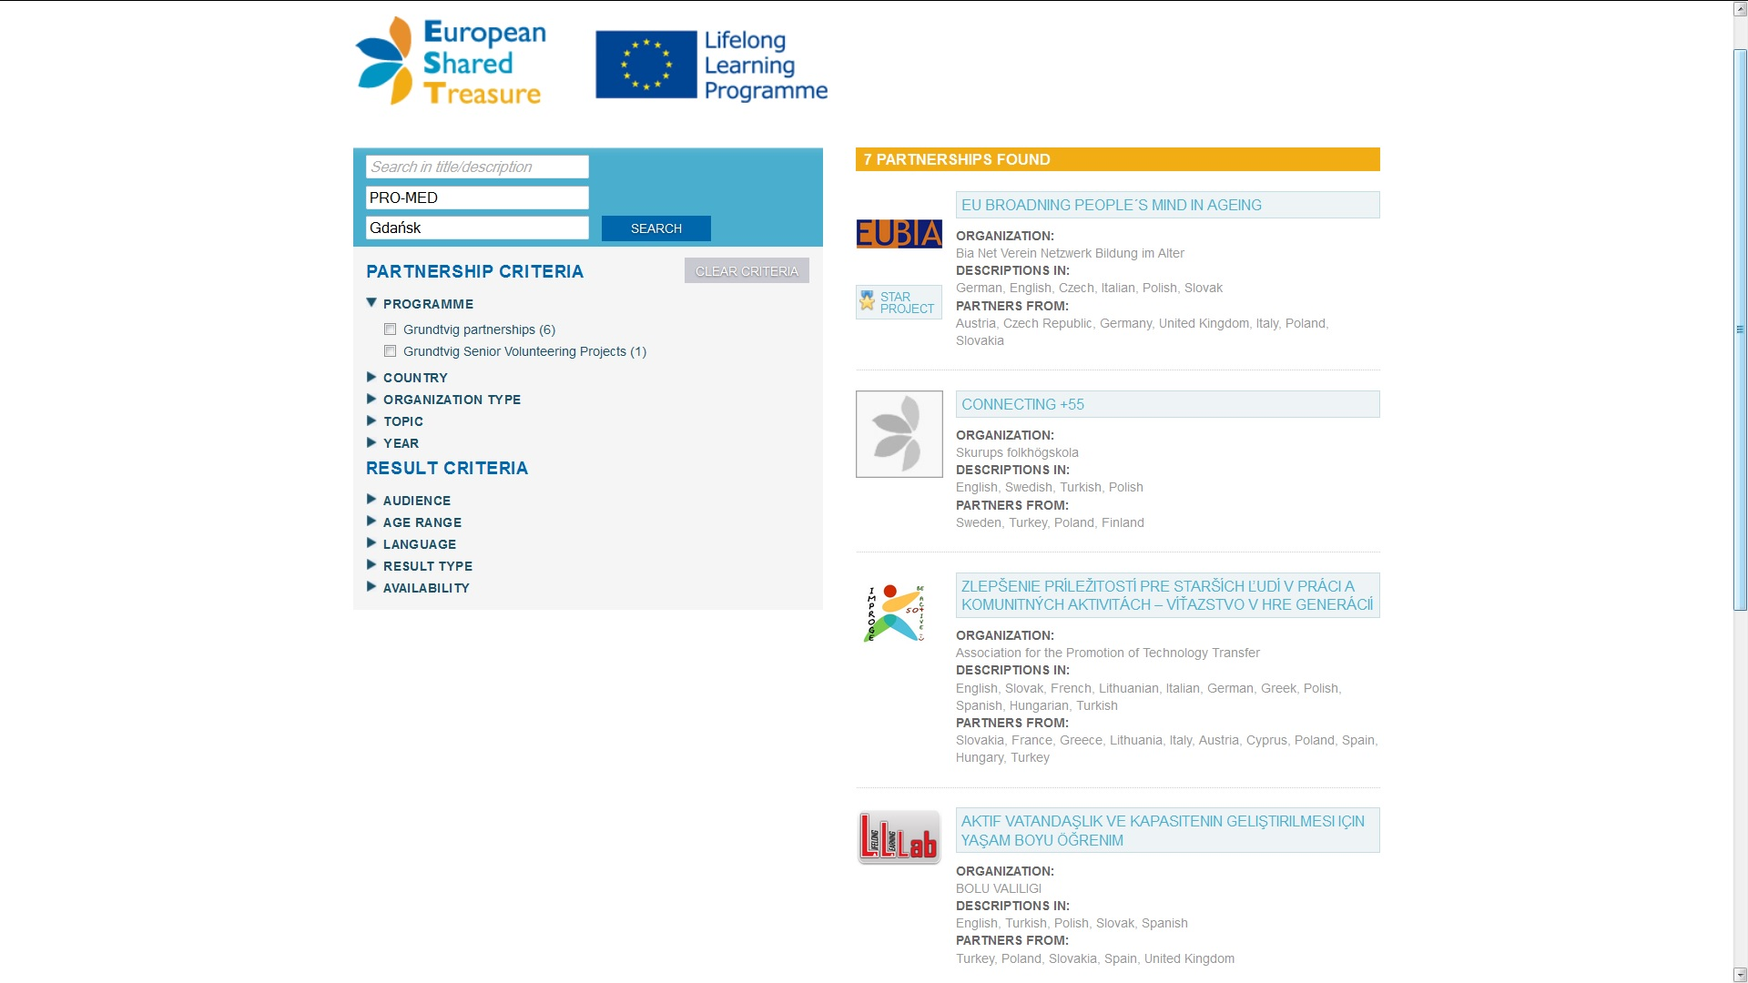
Projekty partnerskie Grundtviga

Slide 5
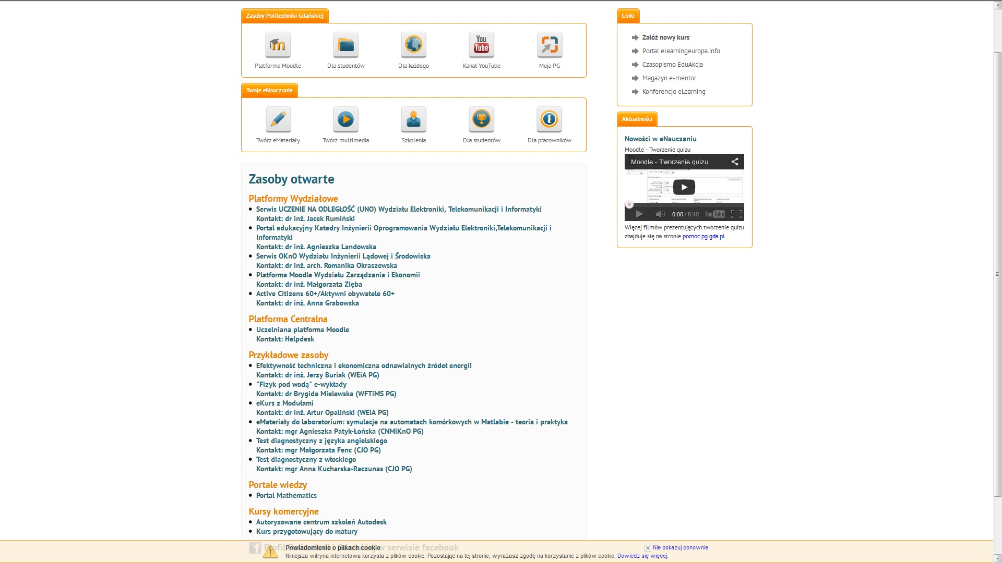
Materiały na serwerach PG http://enauczanie.pg.gda.pl/#otwarte

Slide 6
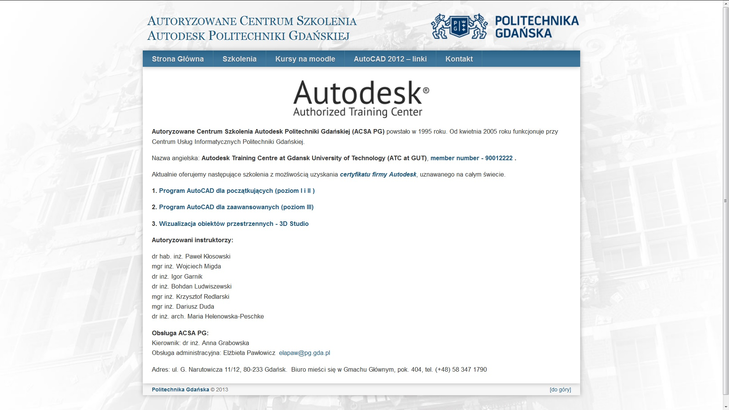
Autoryzowane Centrum Szkolenia Autodesku PG - http://acsa.pg.gda.pl/

Slide 7

AutoCAD

Slide 8
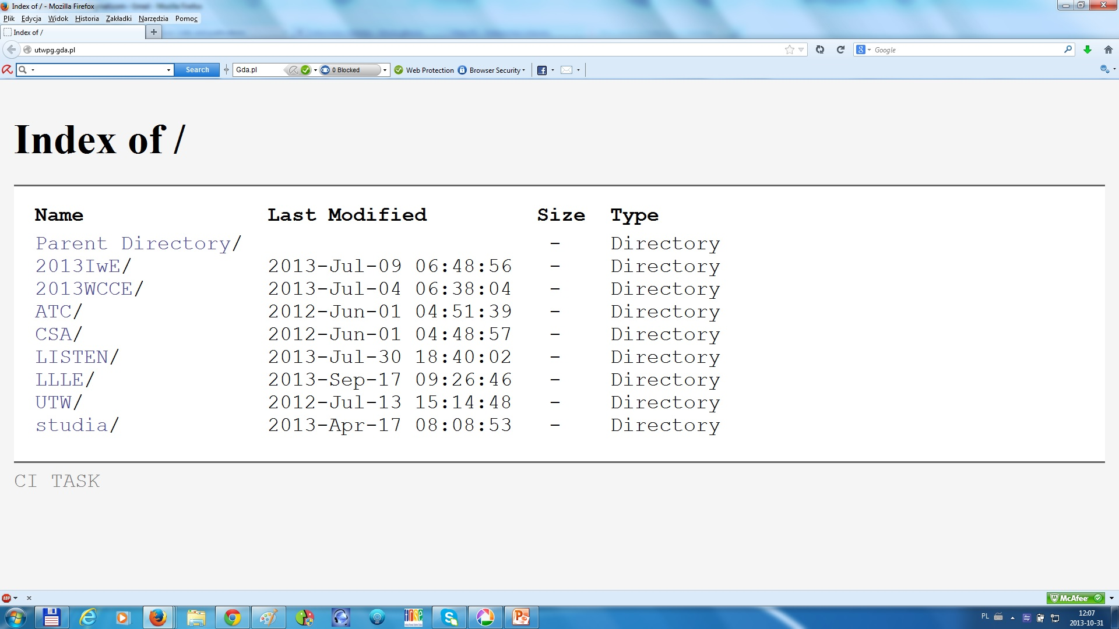
Materiały na serwerze TASK

Slide 9
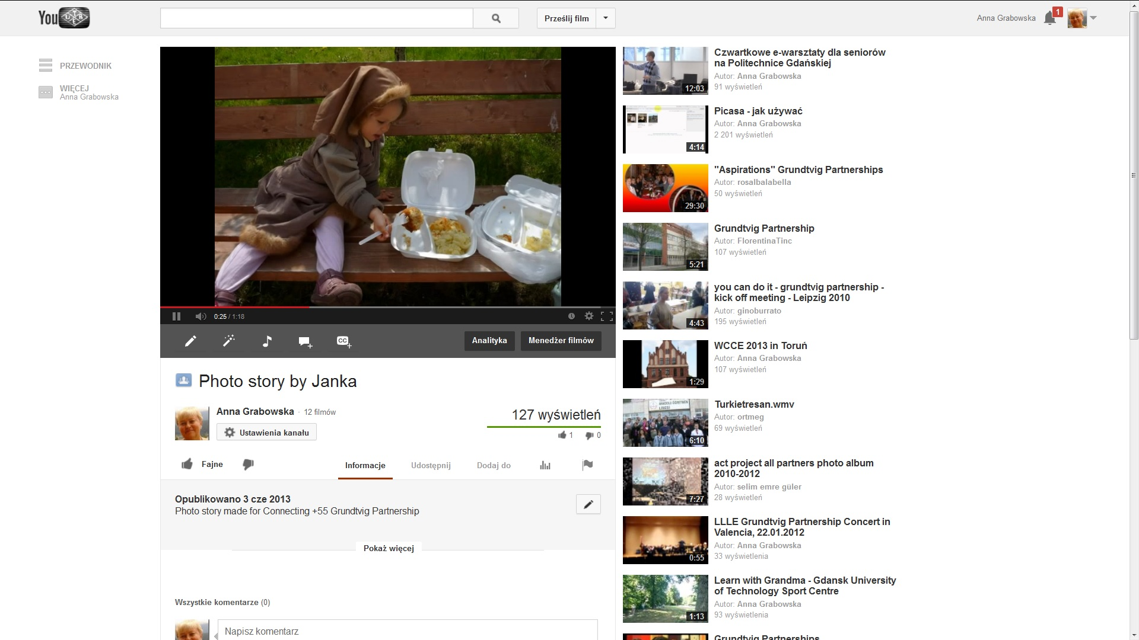
Materiały na YouTube http://www.youtube.com/user/ankagra52

Slide 10
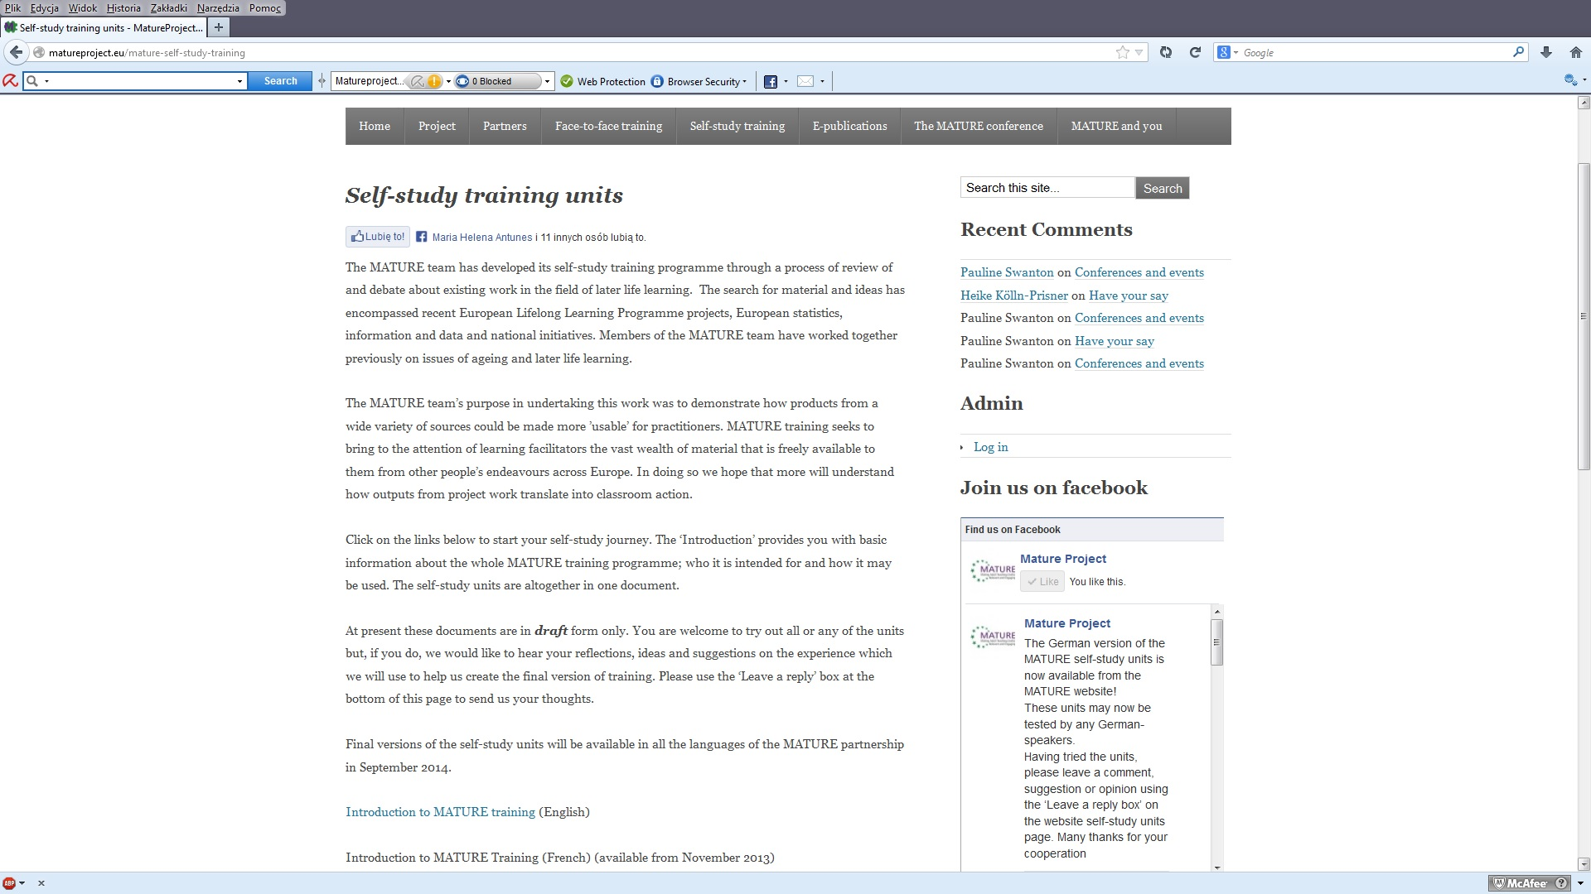
Zaproszenie do MATURE online http://matureproject.eu/wp-content/uploads/2013/10/MATURE-training-programme-Draft-Introduction.pdf http://matureproject.eu/wp-content/uploads/2013/10/MATURE-draft-1-self-study-training-units.pdf

Slide 11
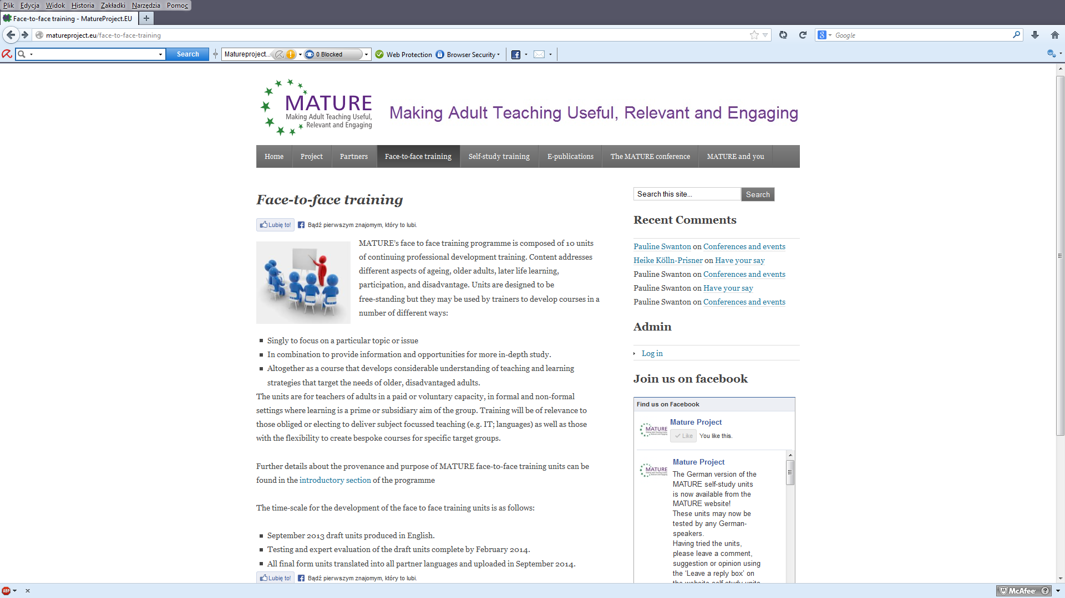
Zaproszenie do MATURE F2F

Slide 12

Dziękuję za uwagę
anka.grabowska@gmail.com
http://annagrabowska.pl/

