Slide 1
Making Adult Education Useful, Relevant and Engaging
Anna Grabowska
Gdansk University of Technology
PRO-MED sp. z o.o.

Slide 2
Making Adult Education Useful, Relevant and Engaging – why?
Maintaining mental health is essential for the well‐being of each human being.
In older age in tandem with other physiological changes, there is a tendency to experience losses of mental functions.
Some of these changes are due to various diseases or irreversible ageing procedures.

Slide 3
However
many of these changes can be prevented
or slowed down by leading an active life,
considering several factors which are crucial:
Continuous learning
Physical fitness
Healthy diet
Social contacts

Slide 4
If not reinvent the wheel...
http://www.mindwellness.eu/
http://www.foragenetwork.eu/en/
http://matureproject.eu/

Slide 5
Mindwellness, 2008-2010 http://www.mindwellness.eu/
Mindwellness project was concentrated at developing innovative training material aimed at older people (working or retired) to help them retain mental flexibility.
The outcomes of the Mindwellness project include:
A national and comparative analysis on the current position of older citizens and learning in higher age.
A collection of good examples and best practice related to brain training.
Online training material with exercises on brain training.
A handbook on brain training for older people, providing a theoretical basis for use by trainers and experts.

Slide 6
Good practice http://www.mindwellness.eu/descargas/Collection_of_Best_Practices_and_Exercises.pdf

Slide 7
Good practice http://klubseniorapg.blog.onet.pl/

Slide 8
Mindwellness training modules

Slide 9
ForAge, 2012-2014 http://www.foragenetwork.eu/en/
ForAge for later-life learning: Building on European experience project is a European multi-lateral network with the central aim of communicating and promoting experiences of learning for older people.
The main goal of the ForAge is to help raise standards of practice throughout Europe and beyond.

Slide 10
What can we share in ForAge?

Slide 11
Newsletters in ForAge

Slide 12
Send your message to ForAge

Slide 13
MATURE, 2012-2014 http://matureproject.eu/
MATURE - Making Adult Education Useful, Relevant and Engaging aims and objectives are the following:
Identify and analyse the barriers to engagement in learning faced by older adults who feature in national data on non-participatory groups.
Seek out from our own resources and from national, European and international sources examples of good practice in engaging hard to reach older adults.
Extrapolate from this research key and common concepts and strategies to form the basis of a European response to the engagement of disadvantaged older people.
Explore the role of intermediary agencies, organisations and individuals in supporting older people to take action and publish information and advice about that role.
Analyse the potential role of intermediaries in overcoming barriers to participation in learning.

Slide 14
Case study Computer breakfast in Hamburg since 2010

Slide 15
Case study Meeting with computers at Gdansk University of Technology

Slide 16
Invitation to MATURE self-study http://matureproject.eu/wp-content/uploads/2013/10/MATURE-training-programme-Draft-Introduction.pdf http://matureproject.eu/wp-content/uploads/2013/10/MATURE-draft-1-self-study-training-units.pdf

Slide 17
Invitation to MATURE F2F training

Slide 18
e-College, e-learning, OER https://moja.pg.gda.pl/auth/portal/start/home

Slide 19
e-learning at GUT http://enauczanie.pg.gda.pl/

Slide 20
OER at GUT http://enauczanie.pg.gda.pl/#otwarte

Slide 21
Autodesk Traning Centre at GUT http://acsa.pg.gda.pl/

Slide 22
OER for AutoCAD

Slide 23
Co-operation with TASK - OER

Slide 24
TASK – what is this?

Slide 25
Our learners in YouTube http://www.youtube.com/user/ankagra52

Slide 26
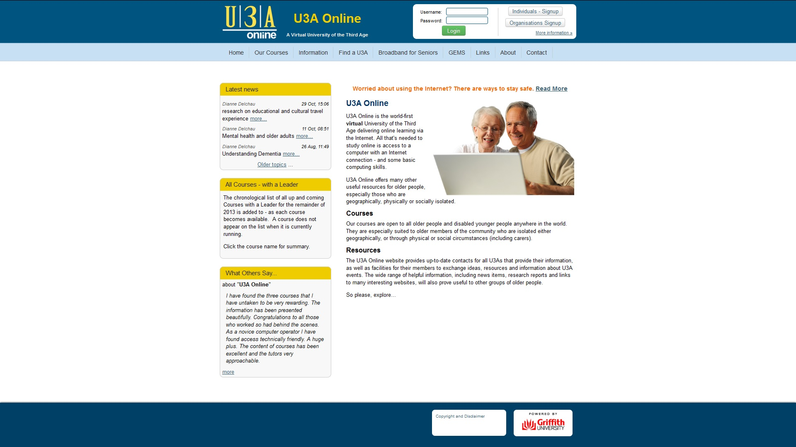
Why not U3A online?

Slide 27
Why not MOOC?

Slide 28
Thank you for your attention ☺
anka.grabowska@gmail.com
http://utw.moodle.pl/

