Slide 1
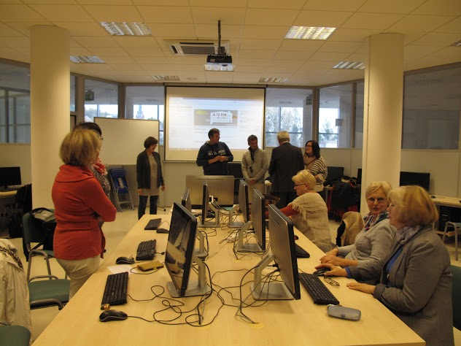
ACTIVE AGING AND NEW TECHNOLOGIES
Dr Anna Grabowska
anka.grabowska@gmail.com
PRO-MED sp. z o. o.

Slide 2
BLENDED LEARNING AND ONLINE LEARNING IN ACTIVE AGING
http://utw.moodle.pl/
http://jatobym.moodle.pl/
http://www.u3aonline.org.au/

Slide 3
City games – Active Citizens 60+ http://jatobym.moodle.pl/

Slide 4
U3A Online http://www.u3aonline.org.au/

Slide 5
Let’s prepare invitation
Logo and Invitation
What is all about
Where is the venue
Sponsors

Slide 6
Thank you for your attention
anka.grabowska@gmail.com
http://utw.moodle.pl/
http://jatobym.moodle.pl/

