Slide 1
Is the orthopaedic operation necessary...? Ortopedik operasyon gerekli mi ? Orthopaedic problems in the hip and knee arthroplasties in Elderly
DAWID MROZIK M.D., Ph.D.
Hand & reconstructive surgery
Orthopaedic & Trauma
Medical Practice, Gdańsk, POLAND

Slide 2
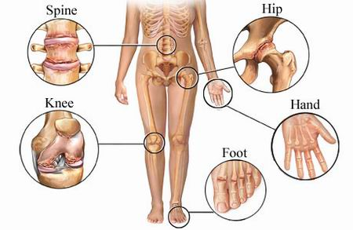
The most commonly orthopaedic problems
hip and knee artritis
hip fractures
radius fractures
spine arthritis
Hallux valgus
RZS

Slide 3
The most commonly performed orthopaedic operations
knee arthroscopy
total hip endoprothesis
total knee endoprothesis
ORIF/CRIF of distal radius
I metatarsal bone osteotomy

Slide 4
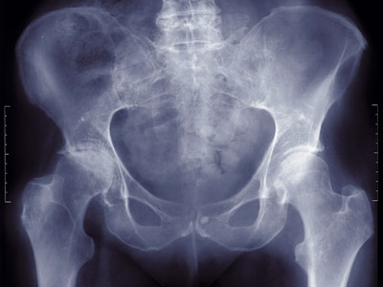
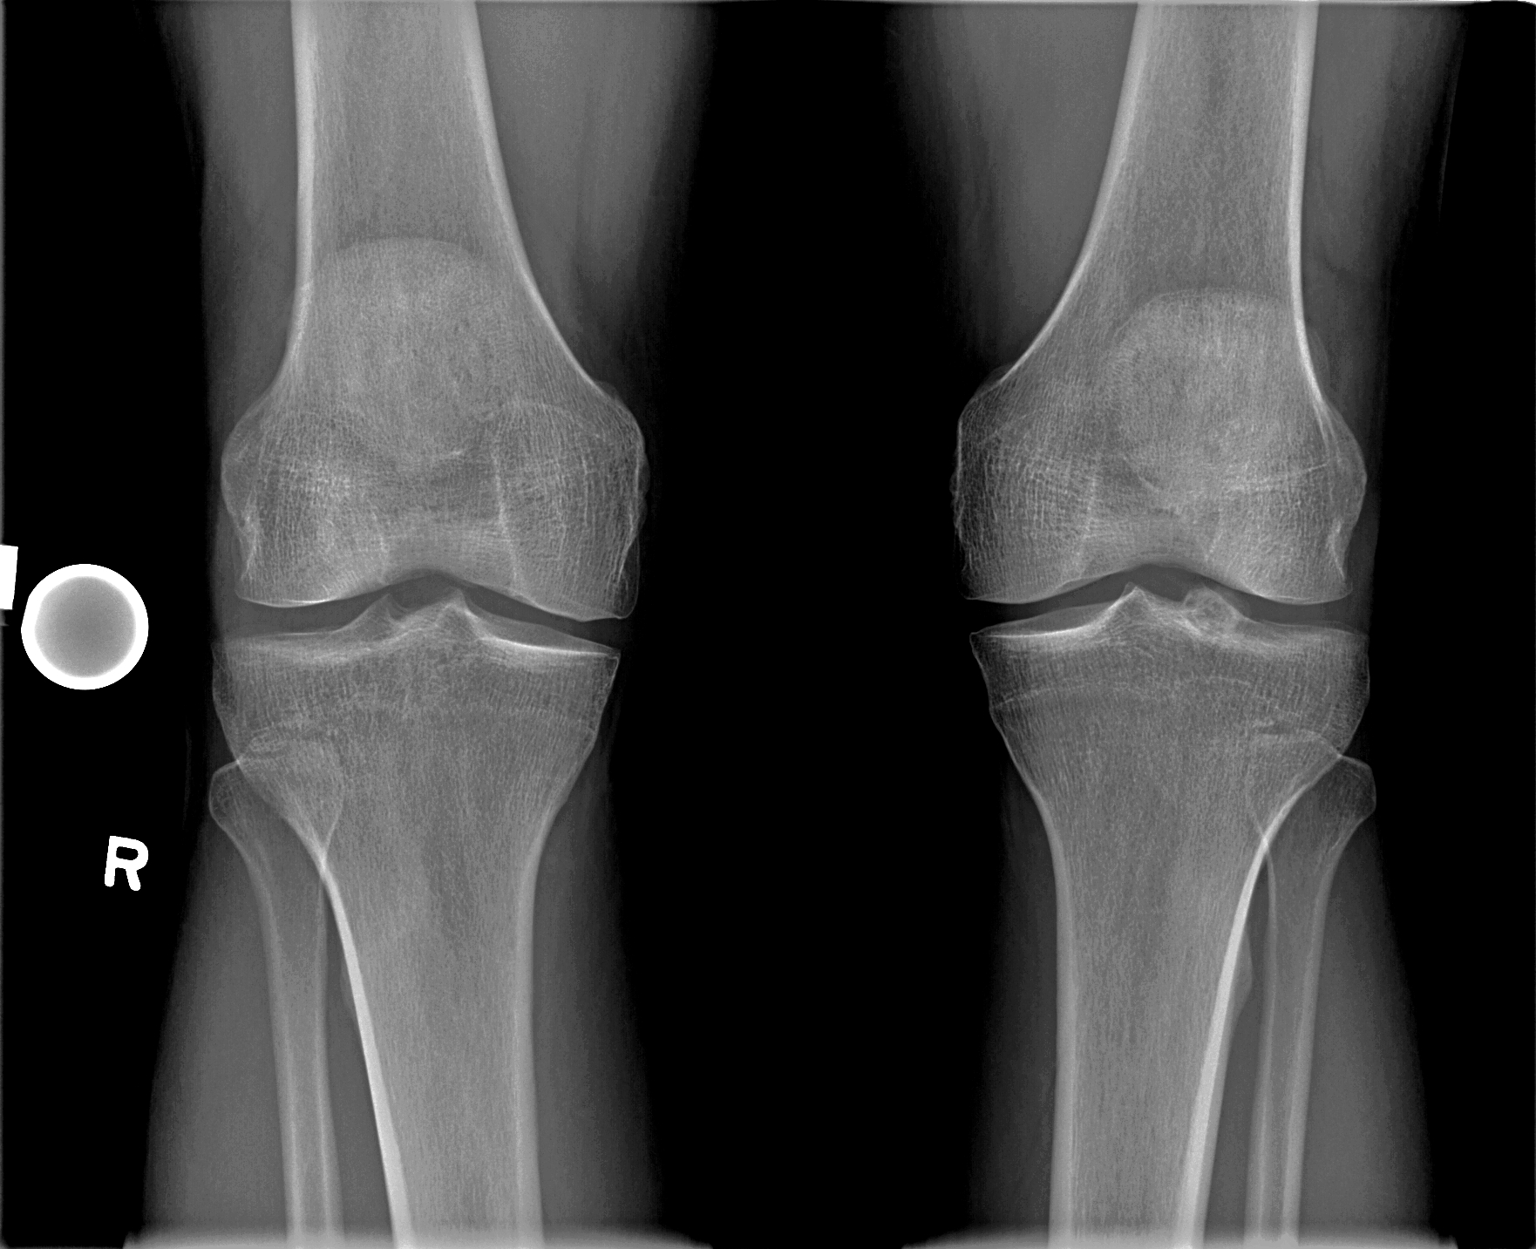
What do You need when You're going to orthopaedist?
Tell me what's wrong
When did the symptoms start?
Did You have any trauma...?
X-rays pictures important
CT or MRI scans
What kind of medications do You take? important e.g. aspirin (antitrombotic drugs)

Slide 5
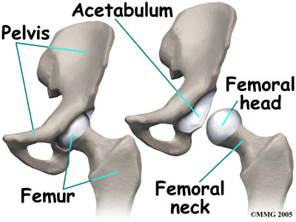
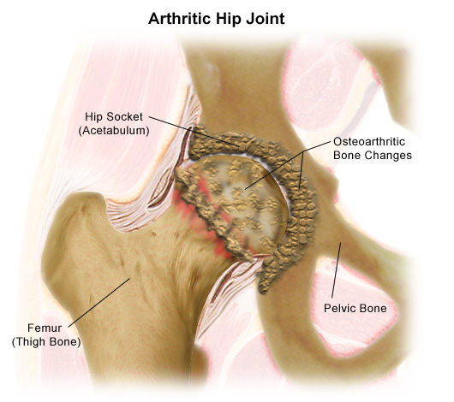
DIAGNOSIS hip arthrosis:

Slide 6
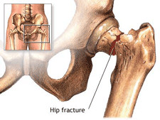
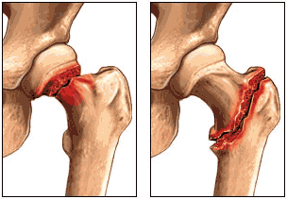
DIAGNOSIS hip fractures:

Slide 7
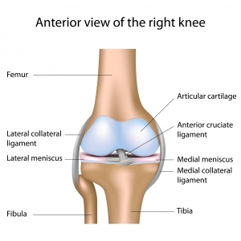
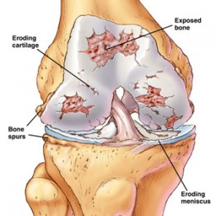
DIAGNOSIS knee arthrosis:

Slide 8
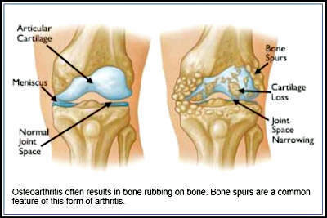
DIAGNOSIS knee arthrosis:

Slide 9
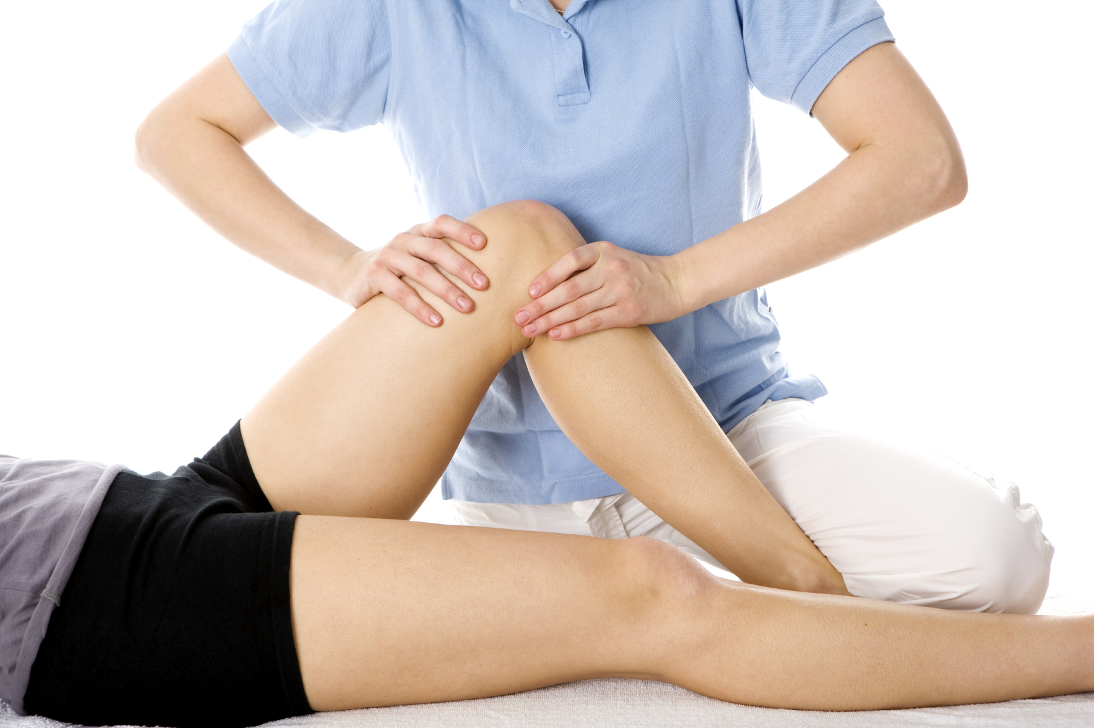
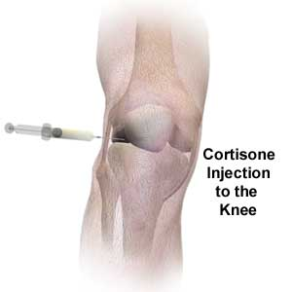
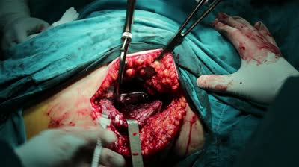
AFTER DIAGNOSIS choice of procedure:
leave it
NSAID
physiotherapy
injection of hialuronic acids, kolagens, PRP
steroidal injection
arthroscopy
endoprothesis

Slide 10
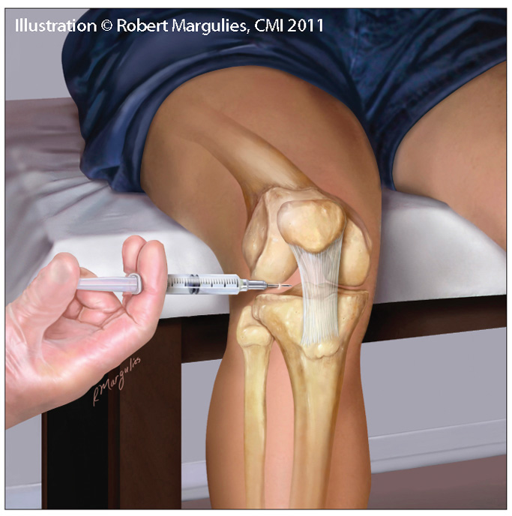
Minimally invasive procedures
injection of hialuronic acids, kolagens, PRP (1-5x)
restoration of structures
restoration of the articular surface
improve the slip
elimination of pain
steroidal injection (1-3x)
elimination of pain
anti-inflammatory
temporary solution

Slide 11
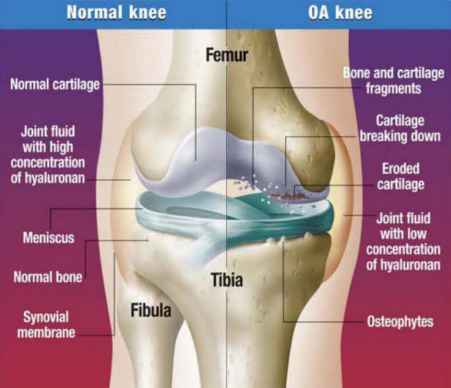
Minimally invasive procedures

Slide 12
When You need an operation:
hip fractures (fractures of colli femoris)
pain wakes you up at night
you need to take 4 or more painkillers per day
injection of steroids, collagen, hyaluronic acid do not work
you can't no longer walk

Slide 13
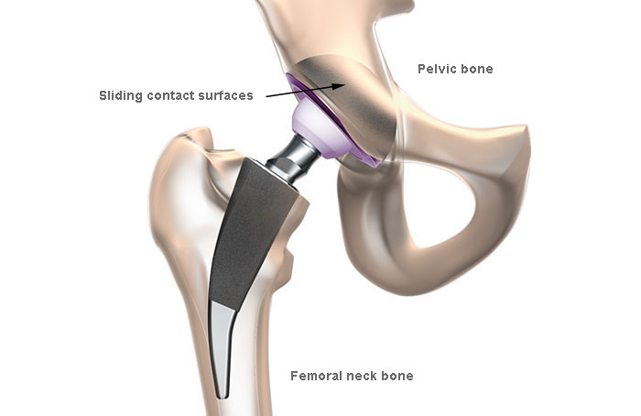
HIP ENDOPROTHESIS

Slide 14
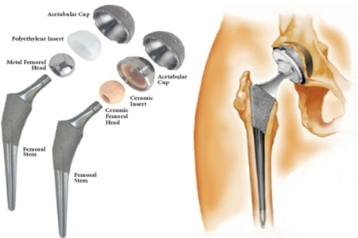
HIP ENDOPROTHESIS

Slide 15
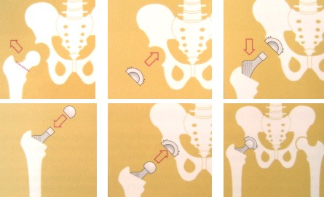
HIP ENDOPROTHESIS

Slide 16
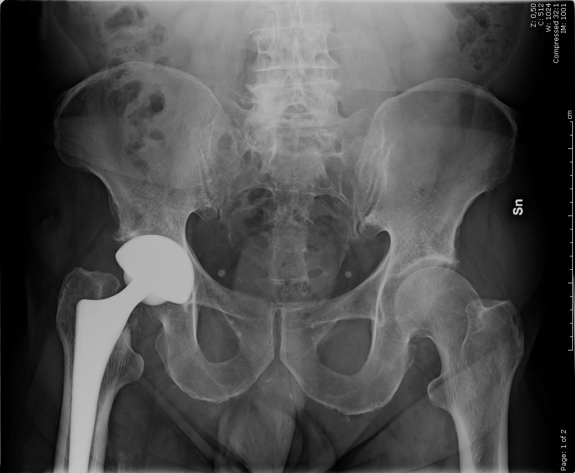
HIP ENDOPROTHESIS

Slide 17
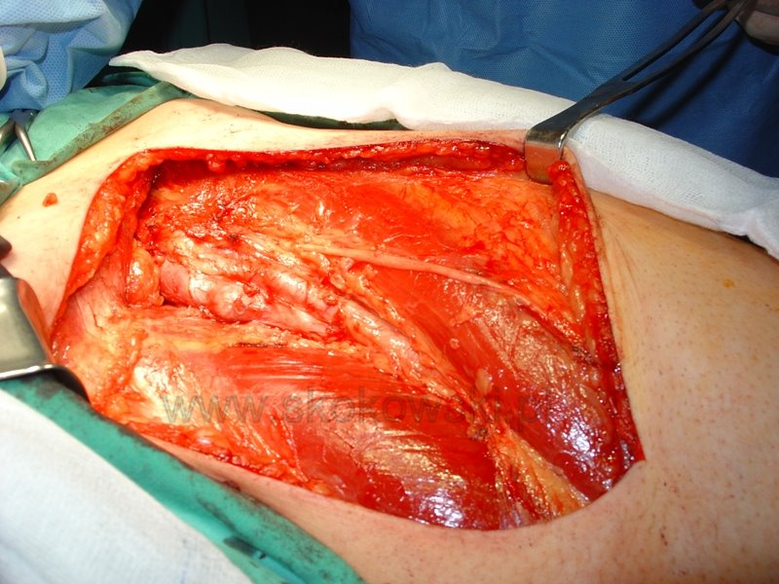
HIP ENDOPROTHESIS

Slide 18
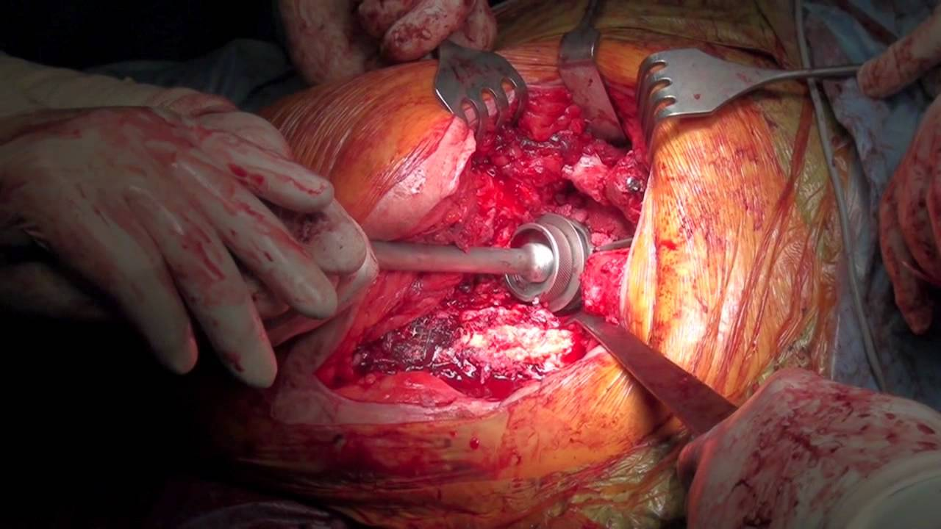
HIP ENDOPROTHESIS

Slide 19
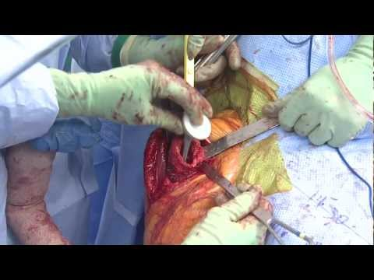
HIP ENDOPROTHESIS

Slide 20
HIP ENDOPROTHESIS

Slide 21
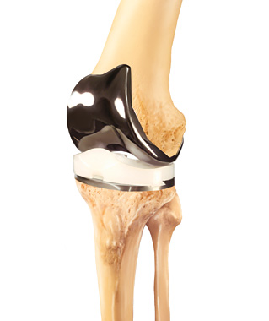
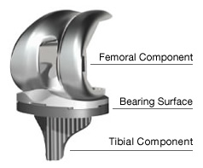
KNEE ENDOPROTHESIS

Slide 22
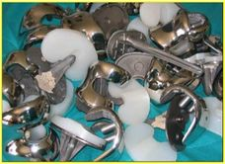
KNEE ENDOPROTHESIS

Slide 23
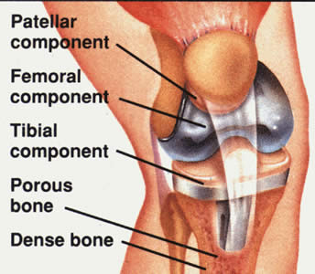
KNEE ENDOPROTHESIS

Slide 24
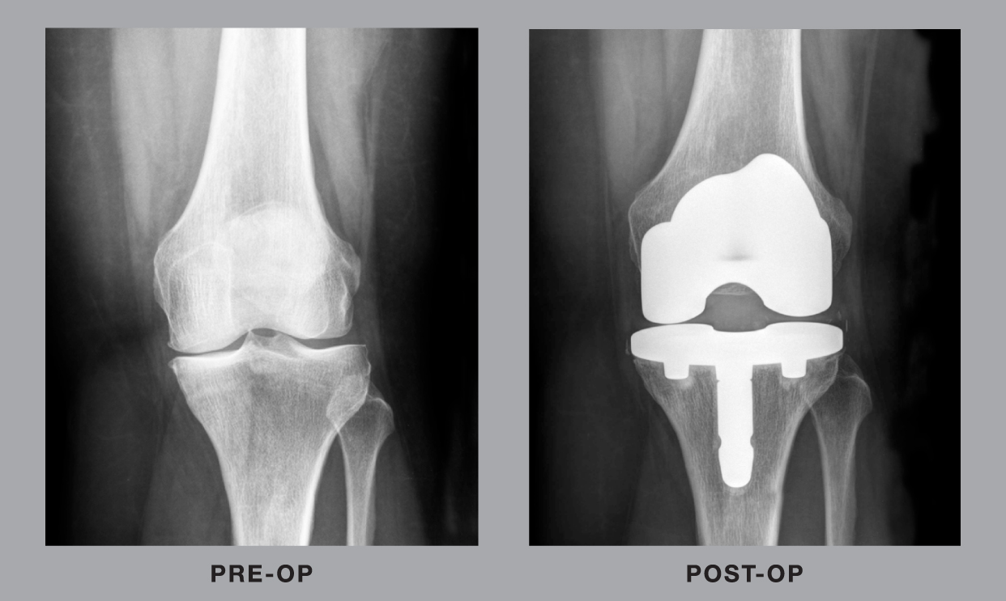
KNEE ENDOPROTHESIS

Slide 25
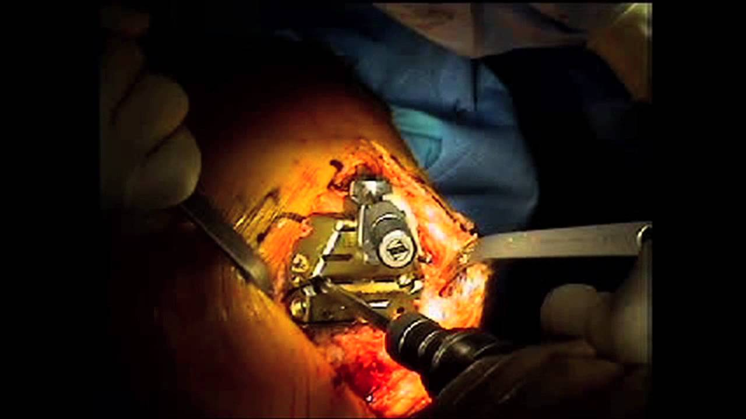
KNEE ENDOPROTHESIS

Slide 26
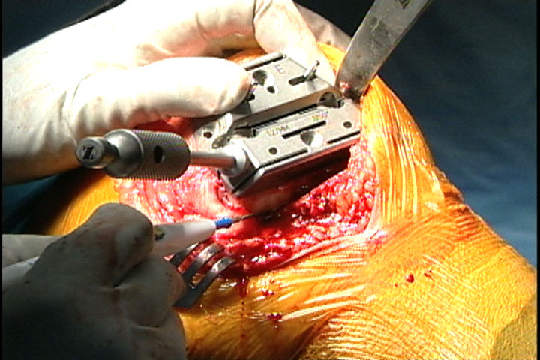
KNEE ENDOPROTHESIS

Slide 27
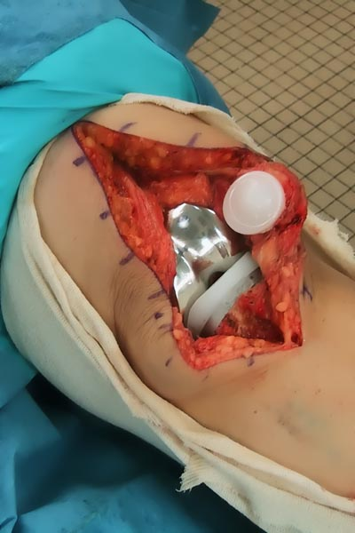
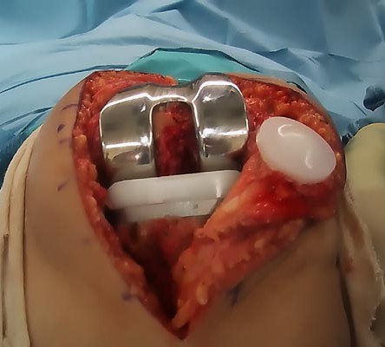
KNEE ENDOPROTHESIS

Slide 28
KNEE ENDOPROTHESIS
What after operation?

Slide 29
AFTER hip nad knee operation:
fast rehabilitaction (think about it before operation)
14 days after operation remove the sutures
wound healing
Antitrombotic injection
6 weeks walking with sticks
X-ray pictures 6 week after operation
fast rehabilitation

Slide 30
COMPLICATIONS during operation
loss of blood (hemorrhage) -> stroke
hip fracture (pelvis & femur)
knee fracture (femur & tibia)
bacterial infection
nerves dysfuntions
intestine perforation

Slide 31
COMPLICATIONS AFTER OPERATION
Pain (6 weeks) 50% -> after 15%
Leg lengthening or shortening 10%
It can be worse stiffness
10%
hematoma 5-10%
Bacterial infection
2-10%
Implant dislocations
5%
Periprostetic fractures
5%
Nerves dysfuntions
5%
Bad wound healing
2%

Slide 32
IMPORTANT
Knee replacement is more bigger operation than hip replacement
2-3 months before operation you can give your blood to the Bank of blood for future for you if it will be necessary during/after operation:
Your blood is better for You than blood from other people
Time: waiting for operation in our city:
2-6 years depent of the hospital

Slide 33
IMPORTANT
Take your medication with yourself to the hospital e.g. HA drugs
Don’t forget about stick which help you walking after operation
Find good rehabilitation department
Go to pharmacy and buy:
Sterile dressings
Disinfectants (need after operation)

Slide 34
IMPORTANT before operation
You must be healthly:
No bacterial infection (14days prior operation)
No viruses infection
Normal blood pressure
No renal failure
Good glucose levels
Skin before operation must be clean, dry without any changes e.g. (scratches, bruises)

Slide 35
THINK ABOUT?
Rehabilitation
Bacterial infection
Your disorders: HA, renal failure, diabetes
try to lose weight
Hialuronic or steroidal injection to prevent your joint before operation
Find a good orthopedic hospital
Go there and check
how much time you must wait for this operation

Slide 36
QUESTION?
Do I really need the hip or knee endoprosthesis?

Slide 37
THANK YOU for attention

