Slide 1



Activities, experiences in creativity and enterpreneurship support
anka.grabowska@gmail.com

Slide 2
The main activities
Organising workshops, trainings, meetings, seminars in the intergenerational teams.
Developing innovative ICT-based educational content, services and practice.
Supporting mobility of adults and youth.
Improving the quality of learning and strengthening co-operation between educational organisations.
Developing e-courses, e-workshops Learning Management System based.
Enabling older people have an access to adult education.

Slide 3
Lifelong Learning for All
Authorised Traning Centre at Gdańsk University of Technology (established in 1995) http://acsa.pg.gda.pl/
Making Adult Teaching Useful, Relevant and Engaging http://matureproject.eu/
Forage for later-life learning: Building on European experience http://www.foragenetwork.eu/en/ http://forage.elwg.eu/
24 hours online services http://blanka.moodle.pl http://utw.moodle.pl/ http://jatobym.moodle.pl

Slide 4
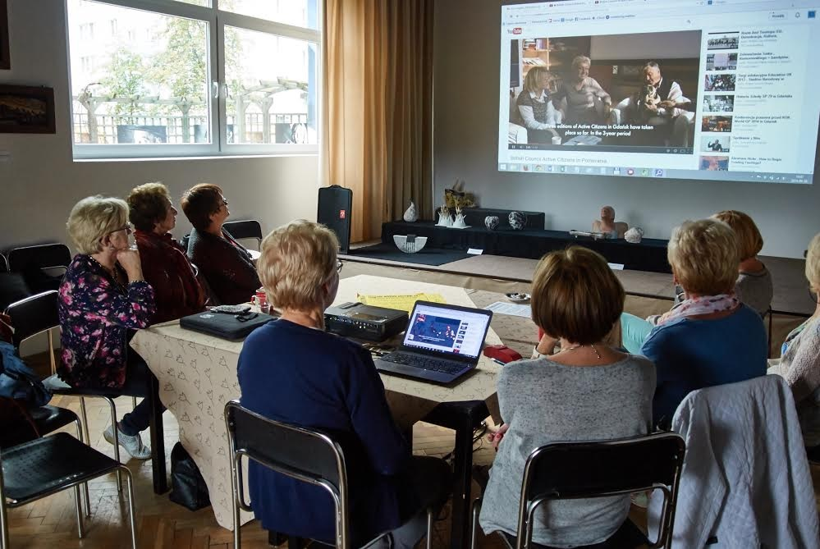
Example of Creativity – City Games (1) http://jatobym.moodle.pl

Slide 5
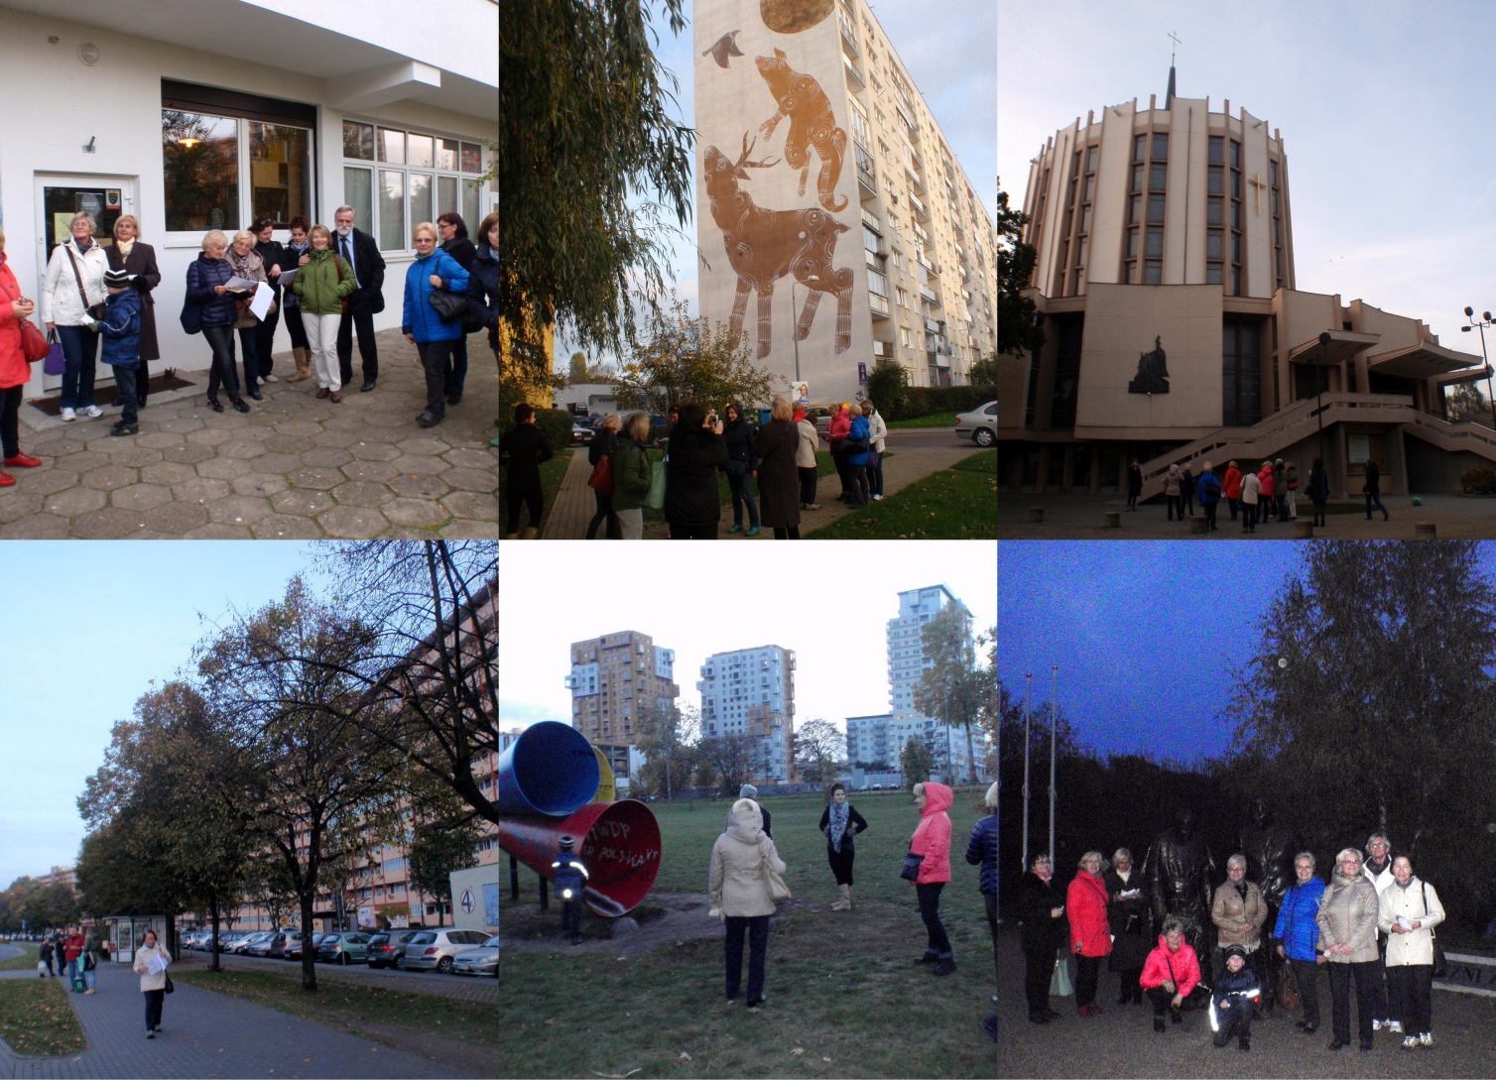
Example of Creativity – City Games (2) http://utwpg.gda.pl/2014jatobym/gra-miejska-Zaspa-Przymorze-Park-Reagana-bez-odpowiedzi-30-10-2014.pdf

Slide 6
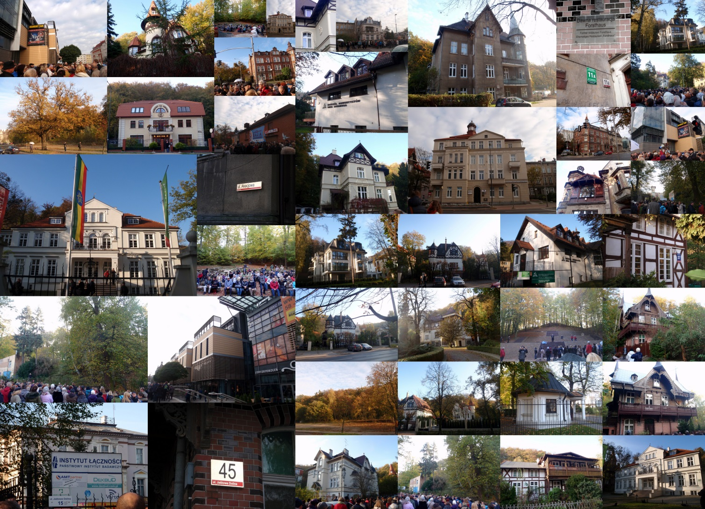
Example of Creativity – City Games (3) http://utwpg.gda.pl/2014jatobym/dokumentacja-zdjeciowa-gry-miejskie.pdf

Slide 7
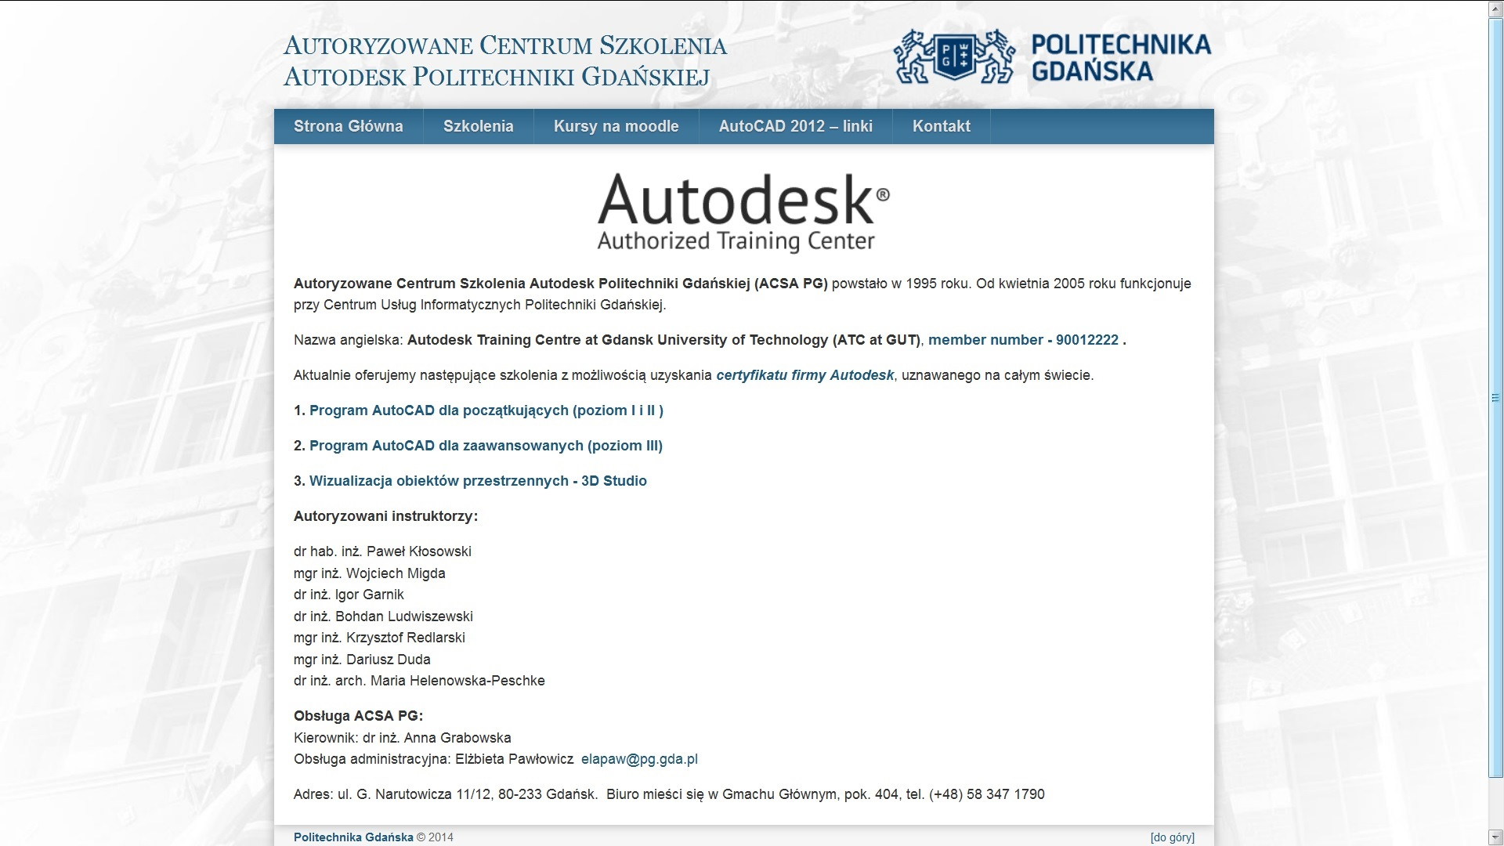
ACSA PG established in 1995

Slide 8
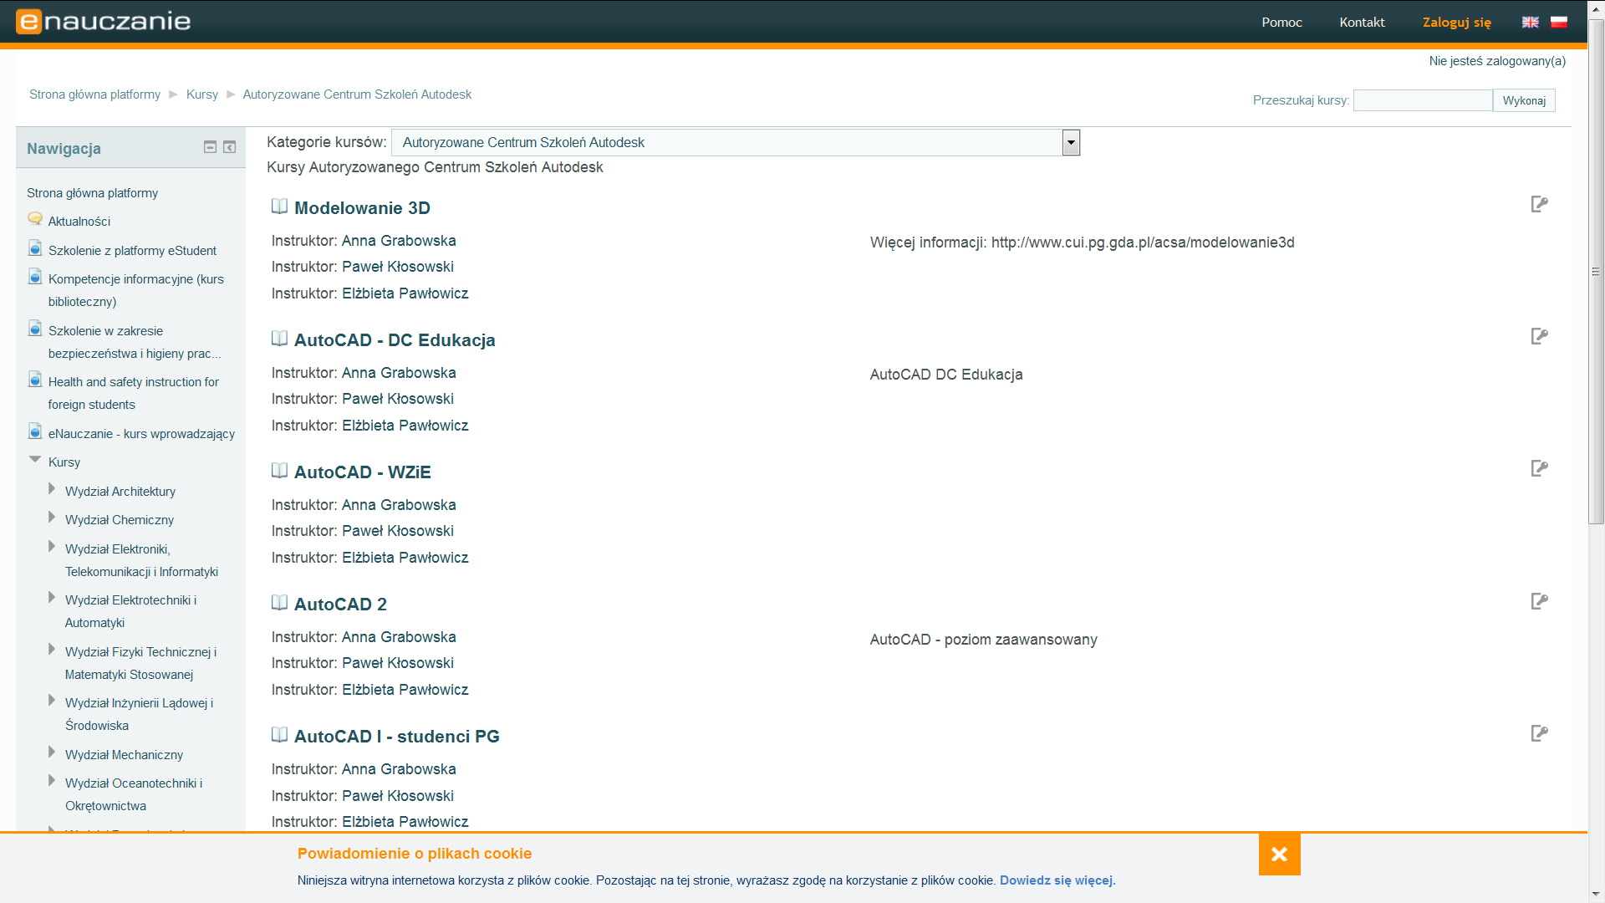
Example courses in Moodle

Slide 9
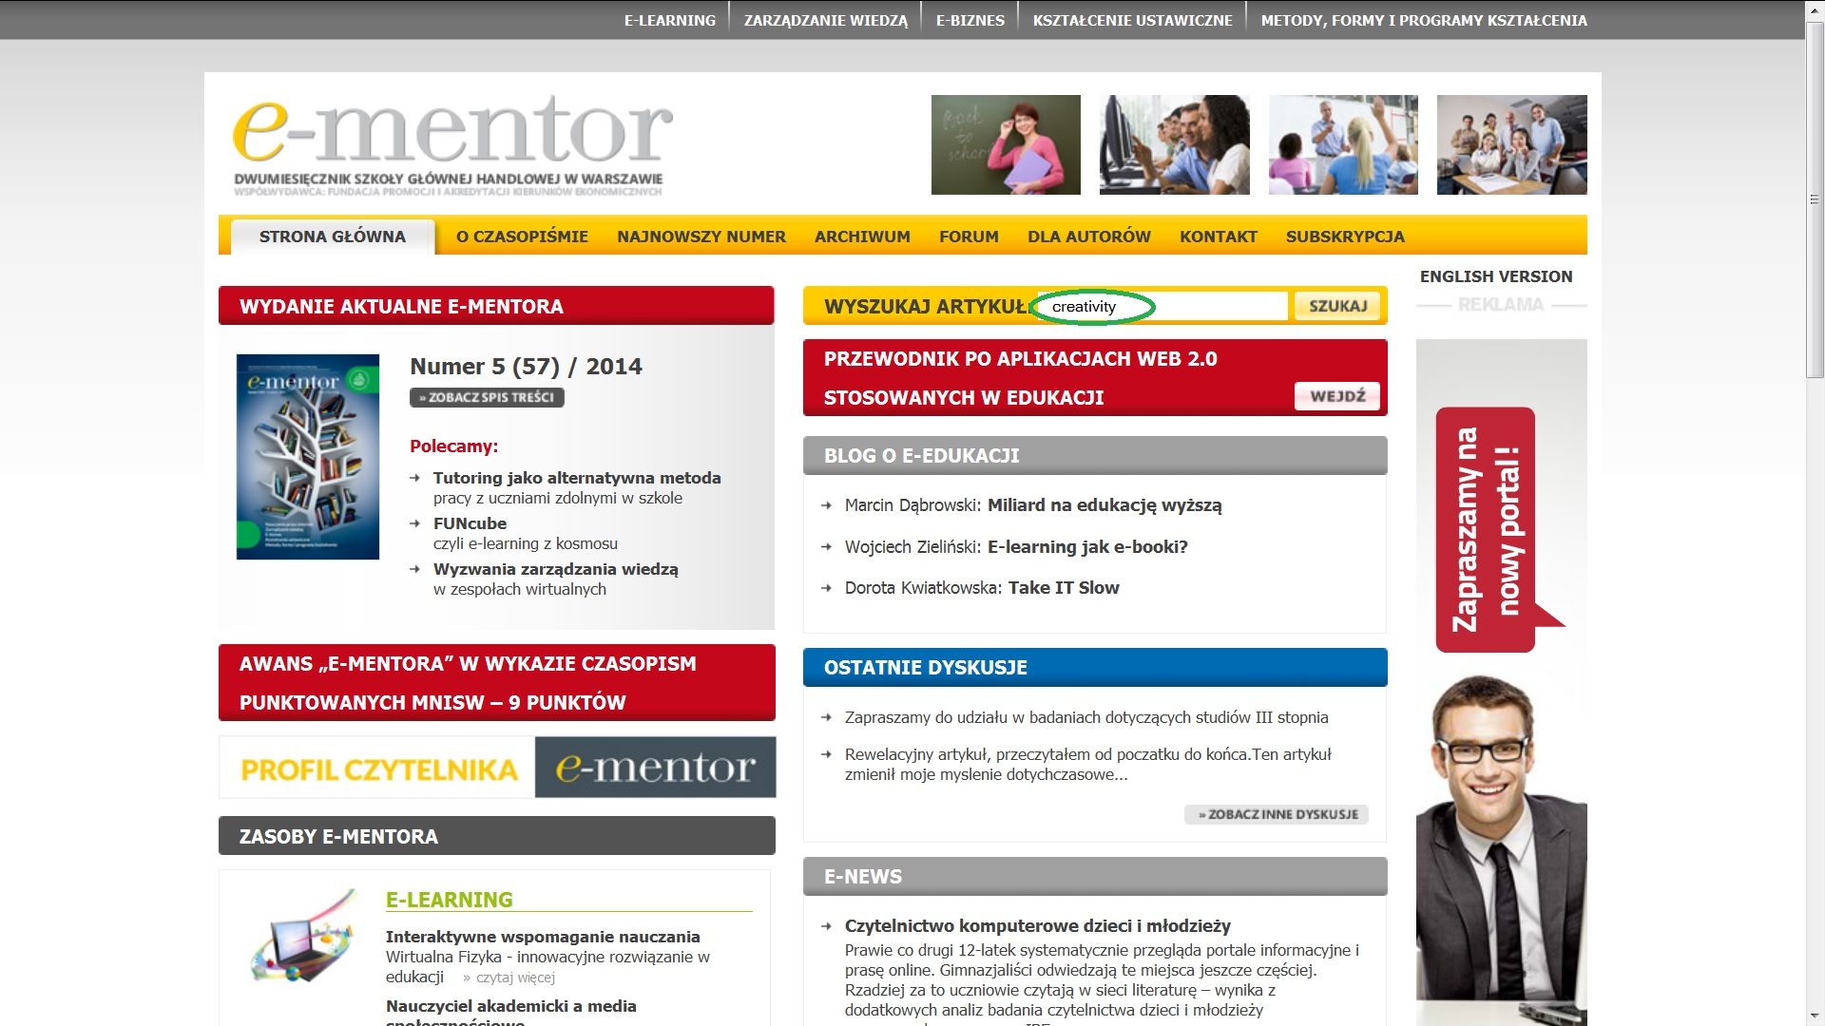
Resources in http://www.e-mentor.edu.pl/

Slide 10
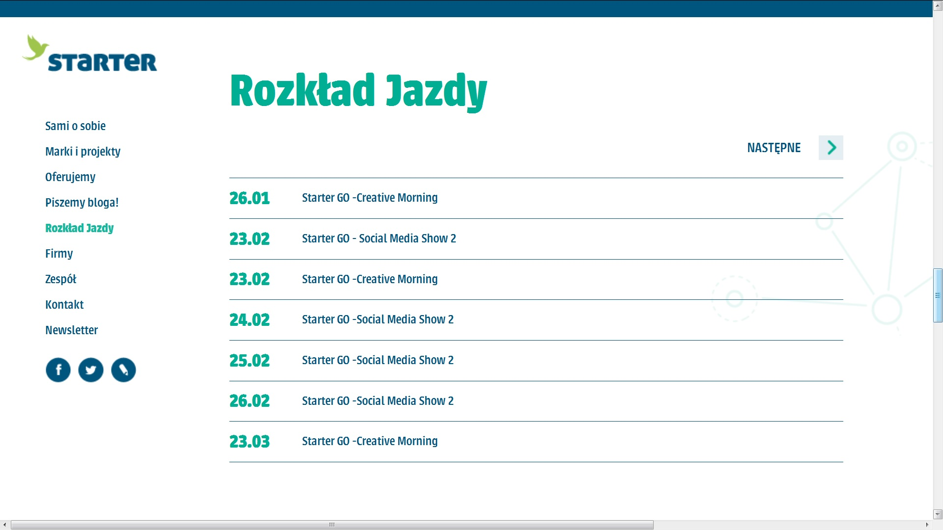
Contact with Starter =
Space, Knowledge, Networking http://www.inkubatorstarter.pl/

Slide 11
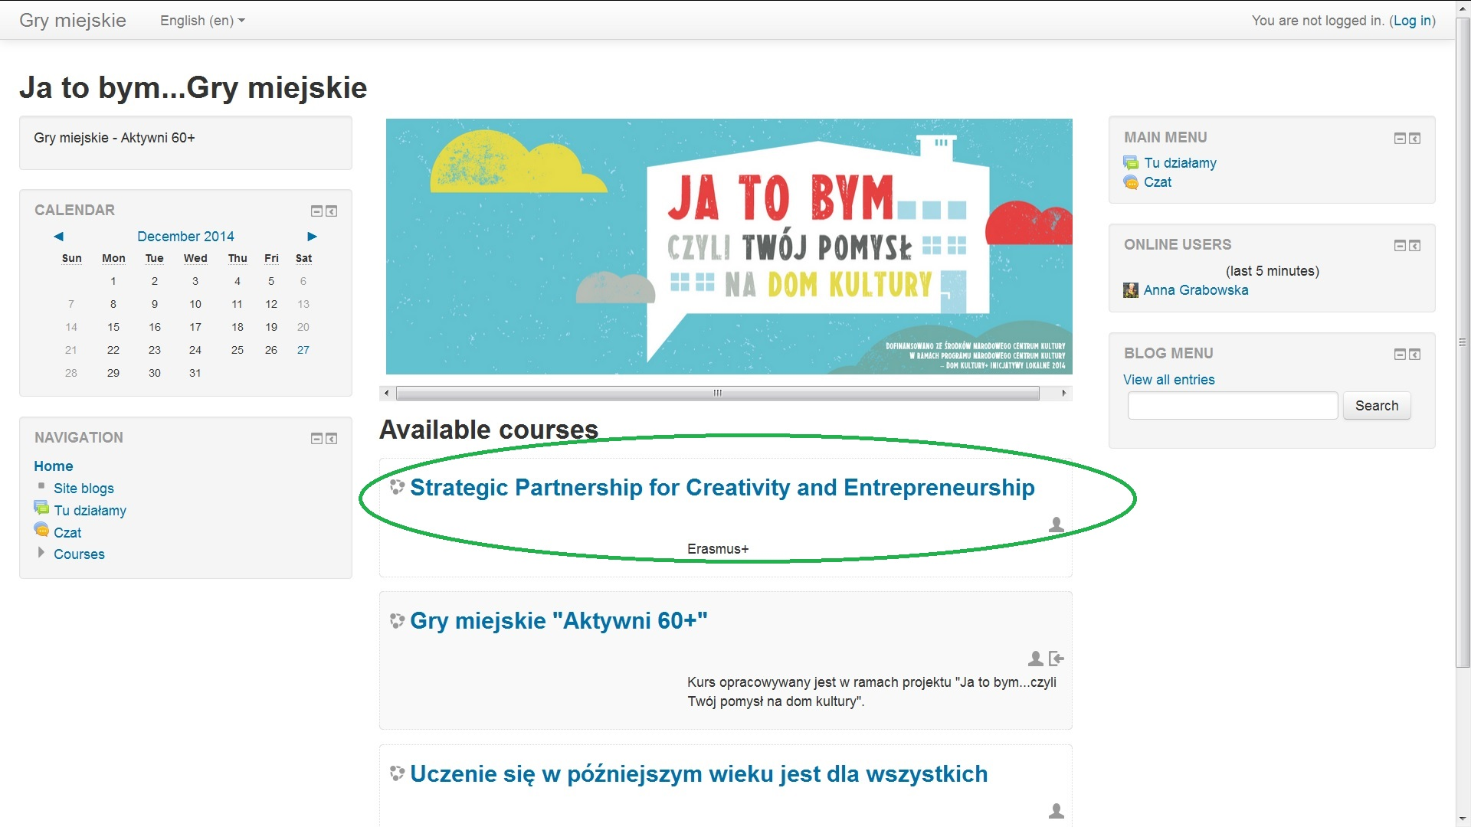
Introducing platform http://jatobym.moodle.pl

Slide 12
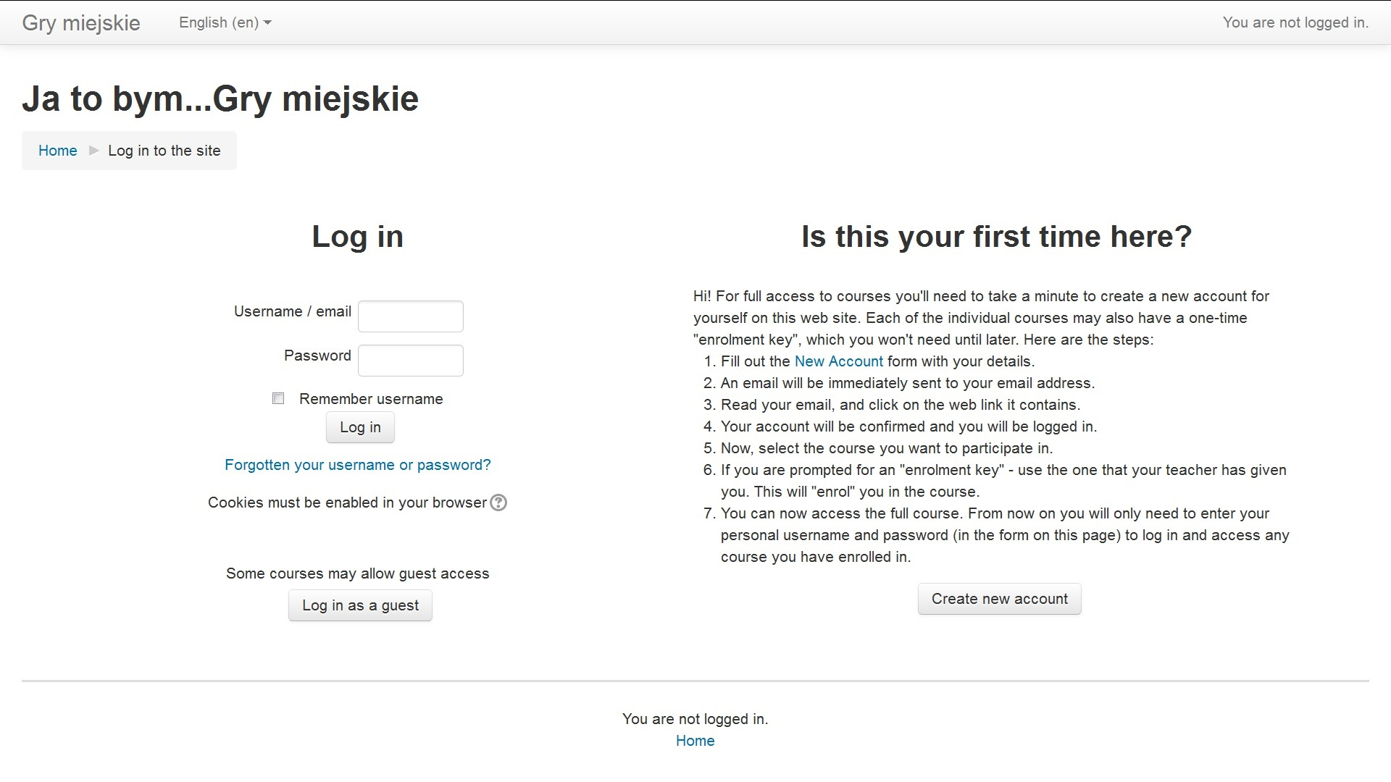
Registration at http://jatobym.moodle.pl

Slide 13
Thank you for your attention

