Slide 1
Intellectual Output 1: SP4CE Learning portal A1 – SP4CE portal preparation A2 – Implementation of SP4CE portal
PRO-MED sp. z o.o.
anka.grabowska@gmail.com

Slide 2
SP4CE project timetable

Slide 3
A1-O1 (TUKE) 01.09.2014 – 30.06.2015
TUKE - initial concept, shape design, functional specification
PRO-MED - initial development, portal functionality and graphic concepts
PIAP - analysis of all target users needs, portal policy and testing condition definitions
IDEC - concept and specification from consultants needs point of view.
All partners - participation in testing, feedback collection and will support system specification

Slide 4
A1-O2 (PRO-MED) 01.05.2015 – 31.08.2016
Partners’ roles:
PRO-MED – initial development of portal functionality, software solutions
PIAP - analysis of target users needs
TUKE - pedagogical content
IDEC - consultants approach
PIAP - materials selection and integration
PIAP, TREBAG - collaboration with enterprises
All partner - participation in portal development including content creation, elaboration of cases, internal and external testing

Slide 5
O1-A2
No | Activity | Partner(s) | Date | Status
1 | Developing SP4CE portal and Learning Rooms | PRO-MED | 16.10-30.11.2015 | Done
2 | Taking part in Moodle MOOC 7 | All | 1-28.11.2015 | Done
3 | Introducing SP4CE portal at http://www.kre.edu.pl/ | PRO-MED, PIAP | 18 - 19.11.2015 | Done
4 | Evaluation and recommendations by PIAP, improvements by PRO-MED | PRO-MED, PIAP | 24-29.11.2015 | Done
5 | Introducing SP4CE portal including the common Learning Room (ENG - Welcome SP4CE Testers) | PRO-MED | 24-29.11.2015 | Done
6 | Testing Partners' Learning Rooms | All | 30.11.2015 - 31.12.2016 | Done
7 | SP4CE portal evaluation, recommendations | All | 1.01.2016 - 17.01.2016 | Done
8 | SP4CE portal improvements | All | 18.01.2016 - 16.02.2016 | Done
9 | Taking part in Learn Moodle MOOC | All | 17.01-17.02.2016 | Done

Slide 6
LR for SP4CE portal evaluation http://jatobym.moodle.pl/course/view.php?id=24

Slide 7
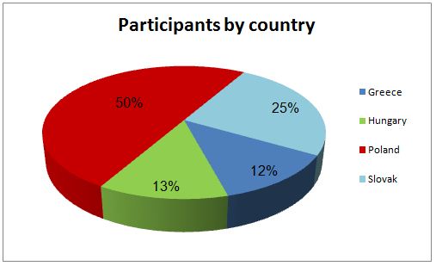
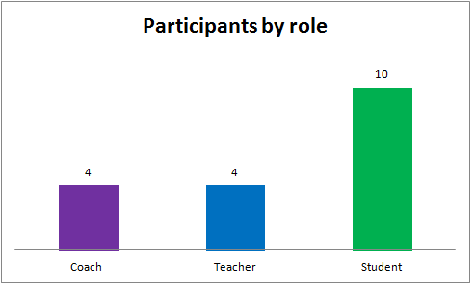
Results of SP4CE portal evaluation (1)

Slide 8
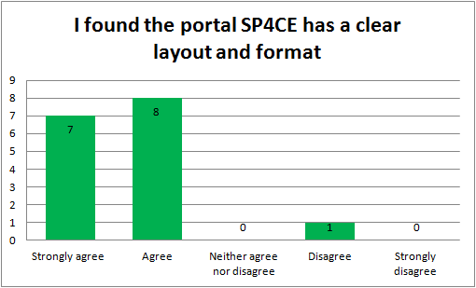
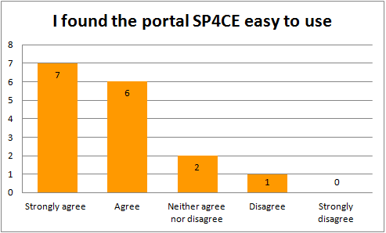
Results of SP4CE portal evaluation (2)

Slide 9
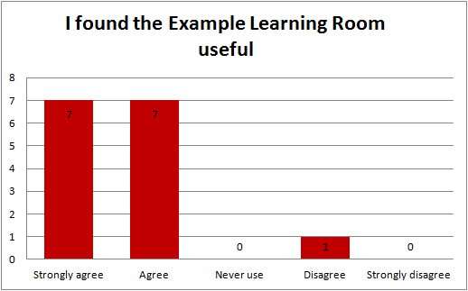
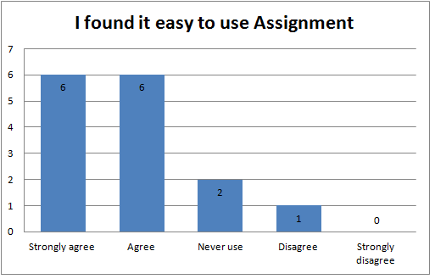
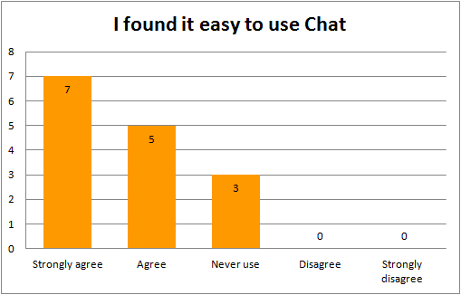
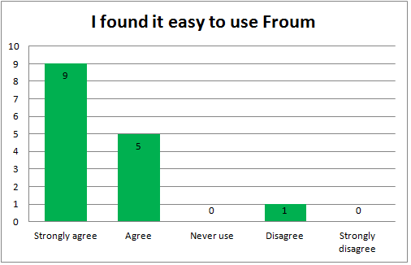
Results of SP4CE LR evaluation (3)

Slide 10
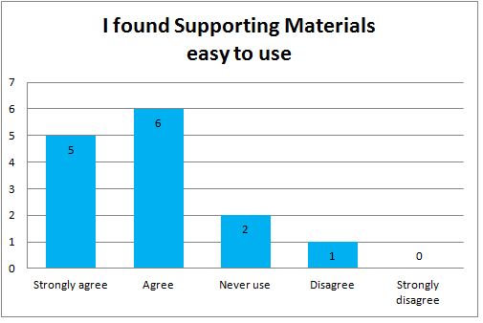
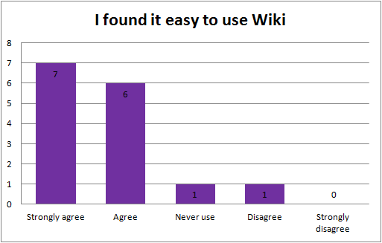
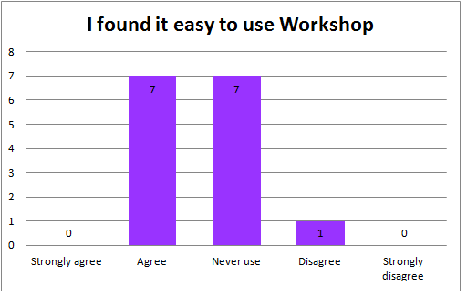
Results of SP4CE LR evaluation (4)

Slide 11
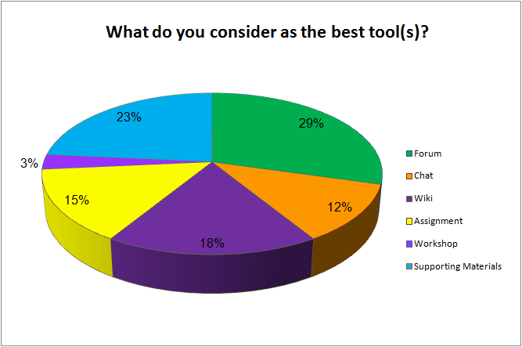
Results of SP4CE LR evaluation (5)

Slide 12
What did you particular like concerning structure and functionality of the portal?
I like short enough menu.
Easy to find out the content
Clear structure
Clear and easy
The portal is user-friendly, easy to use and there are clear instructions how to use it
The structure is clear with visible and understandable menu points, easy to find the concrete subpoints needed, it is great that the comments can be seen directly on the first page
Forum, simple design, easy to upload and download staff
The easiness of navigation and clear layout

Slide 13
What did you find as missing? What should be improved?
I would add a few photos from project's meetings (maybe in the banner)
Just add the content
We must think how to make the portal appearance more attractive to the users. Current version is simple and functional but should be improved to attract users attention.
Graphics/pictures could be added to make the interface more attractive
I don't find the connection between project proposal and functioning of the learning room. I couldn't edit the name of project and couldn't invite participants. I cannot see the list of students on the main page. I cannot switch on the coach role.
I have not found any missing functionalities. Platform works efficiently, for students is easy to understand and use.
The flags are too big to me, and I prefer their position somewhere in the right top corner and propose to move logos to bottom of the page
References mostly lead to only the banners in click on. I think a national opening page would be useful (consisting of more than banners), with a few words of navigation.

Slide 14
What do you consider as weakness of the Learning Room(s)?
How to push teacher to be active and answer my questions.
Lack of blog
It's not completely intuitive to add new materials, we need better guide
Interface and lack of tools for users collaboration
Forum and wiki have very similar usability and it could be confusing where to post a comment
I didn't have permission to try out a lot of things, and I could't guess just how to be able to. I could't find workshops. What I was able to access worked very well for me.
Invitation of others, changing the name of project proposal, the structure of assignment was not understandable for me
There are no weakness from my point of view
It works porperly

Slide 15
What kind of tools would you like to implement in the Learning Room(s) in the national version?
Forum, Chat, Supporting Materials
Fourm, Chat, Wiki, Assignment, Supporting Materials
Fourm, Chat, Wiki, Assignment, Supporting Materials
Forum, Blog, Supporting Materials
All of the already implemented
The existing tools are very helpful and there is no need for additional ones. I am not sure how to use the block "Upcoming event", what kind of events are we supposed to announce?
Forum, Chat, Wiki
Maybe more freedom to students. Something like votes, what they want to study, give them chance to attach some files, news, articles,…, which are important for them and which they find interesting. And also give chance to students to evaluate their teachers to improve education system. It is important to know what students think about way of teaching, what is good and what is need to be improved.
Activities - Forum, Wiki, Chat, Glossary, Database, Choice, Resources - all kind
Supporting materials, forums
Forum, Assignment

Slide 16
Taking part in Learn Moodle MOOC 17.01-17.02.2016

Slide 17
WP1 STATE OF ART (2)
10 | Implementing Portal and Learning Rooms (in local languages) | All | 17.02 - 31.04.2016 | In progress
11 | Summing up O1 state of art during the Meeting in Kosice | PRO-MED, All | 8.04.2016 | In progress
12 | Taking part in Moodle MOOC 8 | All (optional) | 1-31.05.2016 | In progress
13 | Dissemination at the conference eTEE in Cracow http://etee.edu.pl/ | PRO-MED | 11.04.2016 | In progress
14 | Dissemination at the EDEN conferences in Budapest LINK | PRO-MED, PIAP | 14-17.06.2016 | In progress
15 | Dissemination at the GUIDE conference in Madrit LINK | PRO-MED | 22-24.06.2016 | In progress
16 | Dissemination at http://www.druckerforum.org/ | All | 17-18.11.2016 | Proposal

Slide 18
SP4CE Portal in 5 languages

Slide 19
Learning Rooms in 5 languages

Slide 20
Portal ADMs
Name | E-mail | Institution | Country | Status
Anna Czaja | amhgrabowska@gmail.com | PRO-MED | Poland | Main ADM
Dana Palova | dana.palova@tuke.sk | TUKE | Slovakia | Local ADM
Olga Anagnostaki | olga@idec.gr | IDEC | Greece | Local ADM
Anka Grabowska | ankagra52@gmail.com | PRO-MED | Poland | Local ADM
Jacek Zieliński | jzielinski@piap.pl | PIAP | Poland | Local ADM
Gabriella Kengyel | gabriella.kengyel@trebag.hu | TREBAG | Hungary | Local ADM

Slide 21
Learning Rooms ADMs
Name | E-mail | Institution | Country | Status
Anna Grabowska | anka.grabowska@gmail.com | PRO-MED | Poland | Main ADM
Dana Palova | dana.palova@tuke.sk | TUKE | Slovakia | Local ADM
Olga Anagnostaki | olga@idec.gr | IDEC | Greece | Local ADM
Ewa Kozłowska | ewakozlo2@gumed.edu.pl | GUT | Poland | Local ADM
Jacek Zieliński | jzielinski@piap.pl | PIAP | Poland | Local ADM
Gabriella Kengyel | gabriella.kengyel@trebag.hu | TREBAG | Hungary | Local ADM

Slide 22
Last but not least (1)
No | Activity | Partners | Date | Status
10 | Implementing Portal sp4ce.eu and Learning Rooms (in local languages) sp4ce.moodle.pl | All | 17.02-31.04.2016 | In progress

Slide 23
Last but not least (2)
Dear Partners,
in a short while you will receive an email that activates your account on sp4ce page.
Please follow the short instructions that I recorded for you here: https://youtu.be/9S5kNfK_juE In case of any questions please contact me.
Best wishes,
Anna Czaja
Anna Czaja <amhgrabowska@gmail.com>

Slide 24
Thank you for you attention
anka.grabowska@gmail.com

