Slide 1
O1 – A2 Implementation of SP4CE portal Warsaw, 15.10.2015
anka.grabowska@gmail.com

Slide 2
About…
„Result of the project will be designed and developed by the partners innovative common tools for collaboration between students, enterprises and schools (teachers).
Those tools will be available as ICT solution with WWW interface designed for use in three main target groups:
Coaches (enterprises, industry)
Mentors (vocational school, university, high school)
Students (vocational school, university, high school)
Project activities will concentrate on developing relations between students and enterprises for identification of students’ and enterprises’ needs and supporting their collaboration through mentoring and consulting activities.”

Slide 3
Project timetable

Slide 4
A1 by TUKE
SP4CE portal in 5 languages (English, Greek, Hungarian, Polish, Slovak):
web2.0 based creativity enhancing site created according to the Open Innovation concept
will host the Knowledge Generating House with Innovation e-Learning Rooms
online spaces for brainstorming and mind-mapping
generating & publishing ideas and making solutions to the published problems & questions
online collaboration spaces for mentoring and coaching
repository of accepted and/or implemented solutions

Slide 5
A1 by TUKE
TUKE -leader
PRO-MED –initial development, portal functionality and graphic concepts
PIAP - analysis of all target users needs, portal policy and testing condition definitions
TUKE - initial concept, shape design, functional specification
IDEC - concept and specification from consultants needs point of view.
All partners will participate in testing, feedback collection and will support system specification
from 01-09-2014 till 30-06-2015

Slide 6
A1 by TUKE Planned portal functions and content
Problems to be solved, questions to be answered
o these can be published by anybody; within the project the enterprises will publish them
Creation of the teams which want to work towards the problem solution
o discussion room, blog.
Work for teams or individuals to develop the solution
Mentoring & coaching
o Teams‘ support provided by mentors (from among the teacher) and coaches (from among the enterprises staff) & communication with them
Presentation of developed solutions
Publishing of the chosen solution
Repository of the accepted and implemented solutions to the various problems available to general public
Support of international cooperation towards the solutions to various problems in 5 languages, including English language

Slide 7
A2 by PRO-MED
User requirements for SP4CE portal were formulated by TUKE, the questionnaire was filled in and sent.
On the basis of research and consultations with ICT experts from CI TASK (Academic Computer Centre in Gdansk) and GUT (Gdansk University of Technology) the choice of Open Source solution for SP4CE platform was done.
As a result the platform Moodle was chosen.
References:
http://etee2015.pg.edu.pl/documents/27955100/0/ZN_WEiA_PG_41.pdf
http://slideplayer.com/slide/7061209/

Slide 8
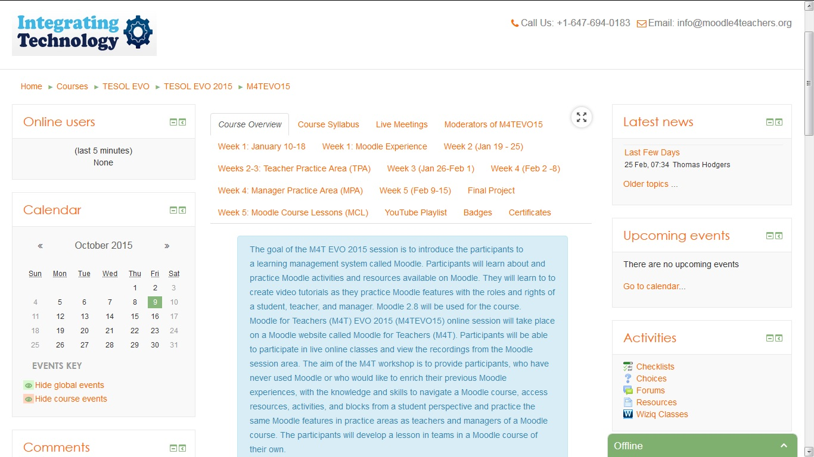
A2 by PRO-MED January – February 2015

Slide 9
A2 by PRO-MED April 2015

Slide 10
A2 by PRO-MED from January 2015
Choose your language

Slide 11
SP4CE Moodle platform (ENG)

Slide 12
SP4CE Moodle platform (HU)

Slide 13
SP4CE Moodle platform (PL)

Slide 14
SP4CE Moodle platform (SK)

Slide 15
SP4CE Moodle platform (EL)

Slide 16
What is next?

Slide 17
Moodle MOOC (1) https://learn.moodle.net/

Slide 18
Moodle MOOC (2)

Slide 19
Let’s gather experiences, change ideas, build the prototype…

Slide 20
Registered users

Slide 21
Thank you for your attention anka.grabowska@gmail.com

