Slide 1



O2 – A1
Guidelines for consultants (enterprises)
Warsaw, 15.10.2015
anka.grabowska@gmail.com

Slide 2
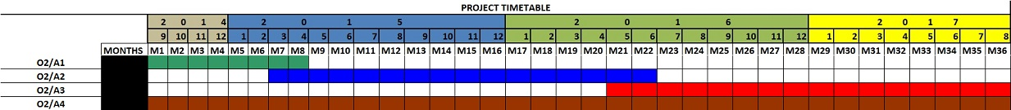
Timetable

Slide 3
The guideline description
This guideline will be dedicated to users of SP4CE portal - consultants from enterprises.
It will contain general informations about portal idea and functionality, manual dedicated for consultants and usage scenarios.
In preparation phase form and shape of this methodology will be developed.

Slide 4
The guideline preparation
Before start of Preparation of Guidelines for consultants concept of this Guidelines will be consulted with persons from target group (at least 20 persons).
After preparation of initial version guidelines it will be evaluated by internal and external experts and end users.
First version of the guideline will be available together with first working version of portal for external evaluation.

Slide 5
Tasks
PRO-MED will responsible for initial version of Guidelines.
Next versions will be adapted by all Partners and synchronized with another project documents and methodologies.
PRO-MED will be responsible for part dedicated to portal.
PIAP will be responsible for collaboration with enterprises.
TUKE will be responsible for pedagogic approach.
TREBAG will be responsible for collaboration with coaches.
IDEC will be responsible for consulting.

Slide 6
Expected outcome
A video guide developed for those who would like to see relatively in details the different functions of the portal and getting familiar with them in a short time.
Examples:
  1st example - OpenInn for teachers http://openinn.eu/, https://youtu.be/4yx4WxD6u_Q
  2nd example – Creative Morning http://slidespeech.com/s/p44cYgoMen/#slide0-slide
  3rd example – Navigating Moodle
  https://www.youtube.com/watch?feature=player_embedded&v=Nhg0XyvXBR8 https://www.youtube.com/watch?v=KH2BvLG22W0

Slide 7
Lessons learnt from OpenInn
Trebag made an analysis of popular video guides on youtube and measured how long an attention span holds both for students and for teachers.
Trebag found that most popular video lengths range between 1-7 minutes, but viewers loose their attention after 2 minutes.
There is a need for additional pictures shared in the video apart from only screenshots so that the video would be more interesting.
It was discovered that a video guide which creates interest towards the sites instead of watching all of its details working is more interesting.
Language barriers could restrain the target groups from watching the videos if it is not directly subtitled in their own language, thus we needed to present the video subtitles directly in all partners’ languages.

Slide 8
Some links
https://en.wikipedia.org/wiki/Comparison_of_screencasting_software
http://www.ghacks.net/overview-best-video-screen-capture-software/
https://www.youtube.com/watch?v=zcisgteMKxQ

Slide 9
Send your proposal regarding free software
anka.grabowska@gmail.com
Subject: SP4CE – A1
screencast-o-matic
Dowloading http://www.screencast-o-matic.com/
Learn how to use
https://www.youtube.com/watch?v=jADJ_OoSnm8
https://www.youtube.com/watch?v=D4rk5ACdGk4
slidespeech
Dowloading http://slidespeech.com/
Learn how to use
https://sites.google.com/a/slidespeech.com/slidespeech-faq/home
https://www.youtube.com/watch?v=RDuLNvbppGI&feature=youtu.be

Slide 10
Suggestions regarding content
About SP4CE project
About SP4CE portal
Info about additional support
Anything to add?
Let’s discuss....

Slide 11
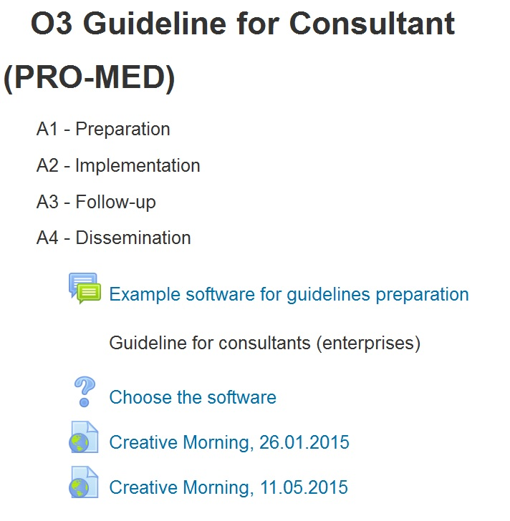
Why not in Moodle?

Slide 12
Thank you for your attention anka.grabowska@gmail.com

