Slide 1
O3 - Guidelines for consultants/enterprises A1 – preparation phase
PRO-MED sp. z o.o.
anka.grabowska@gmail.com

Slide 2
SP4CE project timetable

Slide 3
Proposal send 24th February 2016
General part – about portal idea (common for O3, O4, O5)
Technical part - portal interface and functionalities
Pedagogical concept - example usage scenario

Slide 4
Output O3 – Guidelines for consultants/enterprises
Content
About portal SP4CE
How to use SP4CE portal
Portal usage scenarios
Learning Rooms usage scenarios

Slide 5
Output O3 – doc template (1)

Slide 6
Output O3 – doc template (2)

Slide 7
Technical part – How to use SP4CE portal Portal interface and functionalities & example screen shots
The portal menu consists of the following options:
Send us your project proposal
Welcome to SP4CE
Guides
Learning Rooms
Learning Materials
Conferences
Contact us

Slide 8
Technical part – local ADMs of sp4ce.eu
Name | Institution | E-mail | Country | Status
Anna Czaja | PRO-MED | amhgrabowska@gmail.com | Poland | Main ADM
Dana Palova | TUKE | dana.palova@tuke.sk | Slovakia | Local ADM
Olga Anagnostaki | IDEC | olga@idec.gr | Greece | Local ADM
Anna Grabowska | PRO-MED | ankagra52@gmail.com | Poland | Local ADM
Jacek Zieliński | PIAP | jzielinski@piap.pl | Poland | Local ADM
Gabriella Kengyel | TREBAG | gabriella.kengyel@trebag.hu | Hungary | Local ADM

Slide 9
Send us your project proposal

Slide 10
Wyślij propozycję projektu (1)

Slide 11
Wyślij propozycję projektu (2)

Slide 12
Στείλτε μας την πρόταση έργου σας

Slide 13
Küldje el projektötletét

Slide 14
Pošlite nám svoj návrh projektu

Slide 15
Other functionalities (ENG, PL)
Welcome to SP4CE
Guides
Learning Rooms
Learning Materials
Conferences
Contact us

Slide 16
Welcome to SP4CE (ENG)

Slide 17
Witaj w SP4CE (PL)

Slide 18
Guides (ENG)

Slide 19
Poradniki (PL)

Slide 20
Learning Rooms (ENG)

Slide 21
Pokoje nauki (PL)

Slide 22
Learning Materials (ENG)

Slide 23
Materiały szkoleniowe (PL)

Slide 24
Conferences (ENG)

Slide 25
Konferencje (PL)

Slide 26
Contact (ENG)

Slide 27
Kontakt (PL)

Slide 28
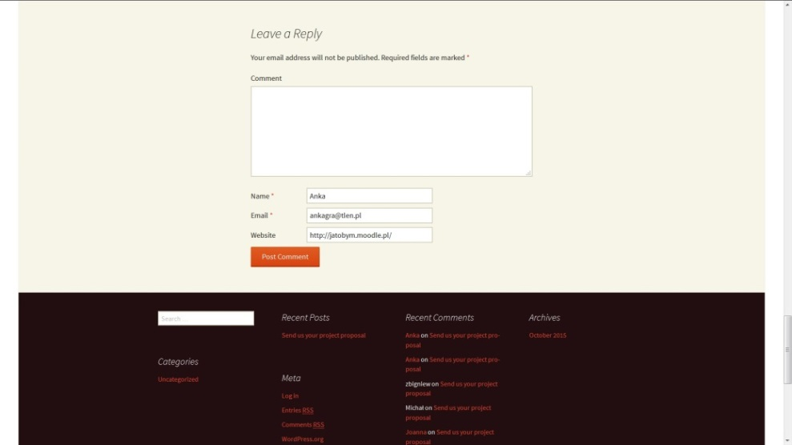
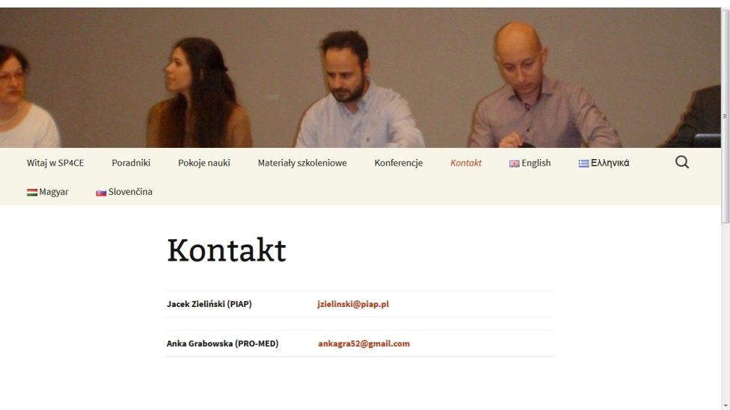
Pedagogical concept – example usage scenarios
If you are a coach put the project proposal in Leave a Reply or Contact us.

Slide 29
Learning Rooms (1)

Slide 30
Learning Rooms (2)

Slide 31
LR usage scenario (1)
If you are a coach and you would like to start your Learning Room please contact a local ADM. Your local ADM will order LR for you.
Name | Institution | E-mail | Country | Status
Anna Grabowska | PRO-MED | anka.grabowska@gmail.com | Poland | Main ADM
Dana Palova | TUKE | dana.palova@tuke.sk | Slovakia | Local ADM
Olga Anagnostaki | IDEC | olga@idec.gr | Greece | Local ADM
Ewa Kozłowska | GUT | ewakozlo2@gumed.edu.pl | Poland | Local ADM
Jacek Zieliński | PIAP | jzielinski@piap.pl | Poland | Local ADM
Gabriella Kengyel | TREBAG | gabriella.kengyel@trebag.hu | Hungary | Local ADM

Slide 32
LR usage scenario (2)

Slide 33
LR usage scenario (3)

Slide 34
LR usage scenario (4)

Slide 35
LR usage scenario (5)

Slide 36
LR usage scenario (6)

Slide 37
LR usage scenario (7)

Slide 38
LR usage scenario (8)

Slide 39
LR usage scenario (9)

Slide 40
Thank you for you attention
Welcome to
sp4ce.eu
sp4ce.moodle.pl
Send your comments to anka.grabowska@gmail.com

