Slide 1


O3 - Guidelines for consultants/enterprises
O4 - Guidelines for mentors/school teachers
O5 - Guidelines for general public
PRO-MED sp. z o.o.
anka.grabowska@gmail.com

Slide 2
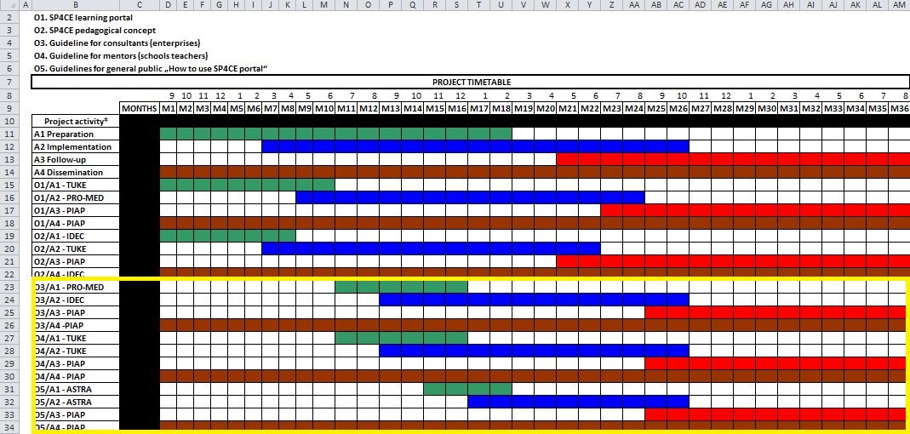
SP4CE project timetable

Slide 3
Proposal send by PRO-MED
24th February 2016
General part – about portal idea (common for O3, O4, O5)
Technical part - portal interface and functionalities
Pedagogical concept - example usage scenario

Slide 4
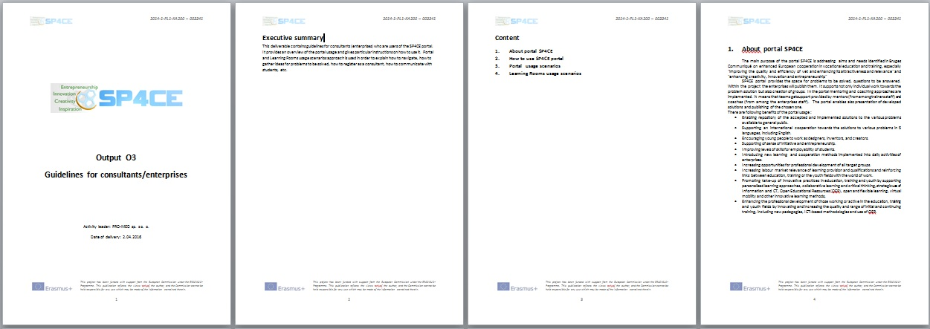
Proposal for O3 (4.04.2016)

Slide 5
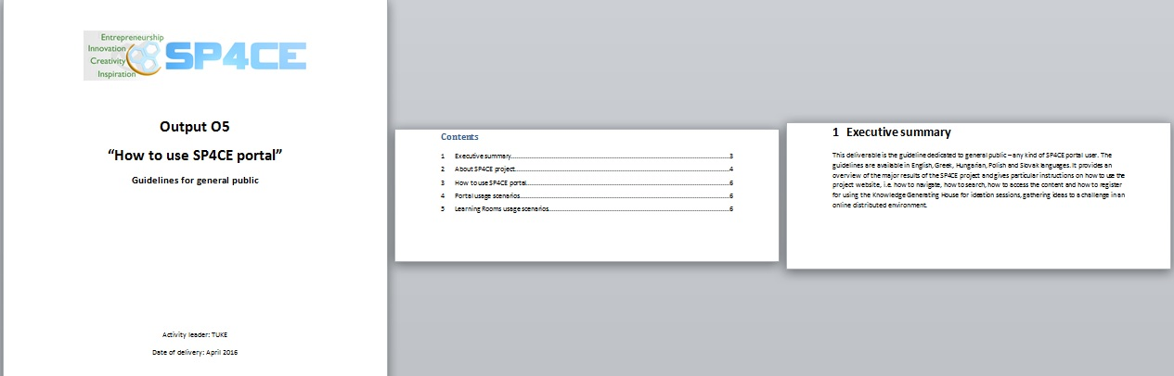
Proposal for O5 (5.04.2016)

Slide 6
Content for O3, O4, O5
No | Item | Status
1 | Executive summary | Done
2 | About SP4CE project | Done
3 | How to use SP4CE portal | In progress
4 | Portal usage scenarios | In progress
5 | Learning Rooms usage scenarios | In progress

Slide 7
O3, O4, O5
Follow up Actions: Translation and Adaptation
Executive summary (T)
About SP4CE project (T)
How to use SP4CE portal including screen shots (T&A)
Learning Room usage scenario including screen shots (T&A)
7

Slide 8
Executive summary
O3 | O4 | O5
This deliverable is the guideline dedicated to consultants from enterprises who are users of the SP4CE portal. The guideline is available in English, Greek, Hungarian, Polish and Slovak languages. It contains general information about the SP4CE project, portal idea and functionality, as well as a set of instructions how to use it. Portal and Learning Rooms usage scenarios approach is used in order to explain how to navigate, how to gather ideas for problems to be solved, how to register as a consultant, how to communicate with students, etc. . | This deliverable is the guideline dedicated to the following users of SP4CE portal: teachers from VET schools and HEI which act as mentors. The guidelines is available in English, Greek, Hungarian, Polish and Slovak languages and it contains general information about the SP4CE project, portal idea and functionality, and set of instructions how to use it. Portal and Learning Rooms usage scenarios approach is used in order to explain how to navigate, where and how to send a project proposal, how to gather ideas for problems to be solved, how to register as a mentor in Learning Rooms, how to communicate with students, etc. | This deliverable is the guideline dedicated to general public – any kind of SP4CE portal user. The guidelines are available in English, Greek, Hungarian, Polish and Slovak languages. It provides an overview of the major results of the SP4CE project and gives particular instructions on how to use the project website, i.e. how to navigate, how to search, how to access the content and how to register for using the Knowledge Generating House for ideation sessions, gathering ideas to a challenge in an online distributed environment.

Slide 9
Portal interface and functionalities & example screen shots
The portal menu consists of the following options:
Send us your project proposal
Welcome to SP4CE
Guides
Learning Rooms
Learning Materials
Conferences
Contact us

Slide 10
Local ADMs of sp4ce.eu
Name | Institution | E-mail | Country | Status
Anna Czaja | PRO-MED | amhgrabowska@gmail.com | Poland | Main ADM
Dana Palova | TUKE | dana.palova@tuke.sk | Slovakia | Local ADM
Olga Anagnostaki | IDEC | olga@idec.gr | Greece | Local ADM
Anna Grabowska | PRO-MED | ankagra52@gmail.com | Poland | Local ADM
Jacek Zieliński | PIAP | jzielinski@piap.pl | Poland | Local ADM
Gabriella Kengyel | TREBAG | gabriella.kengyel@trebag.hu | Hungary | Local ADM

Slide 11
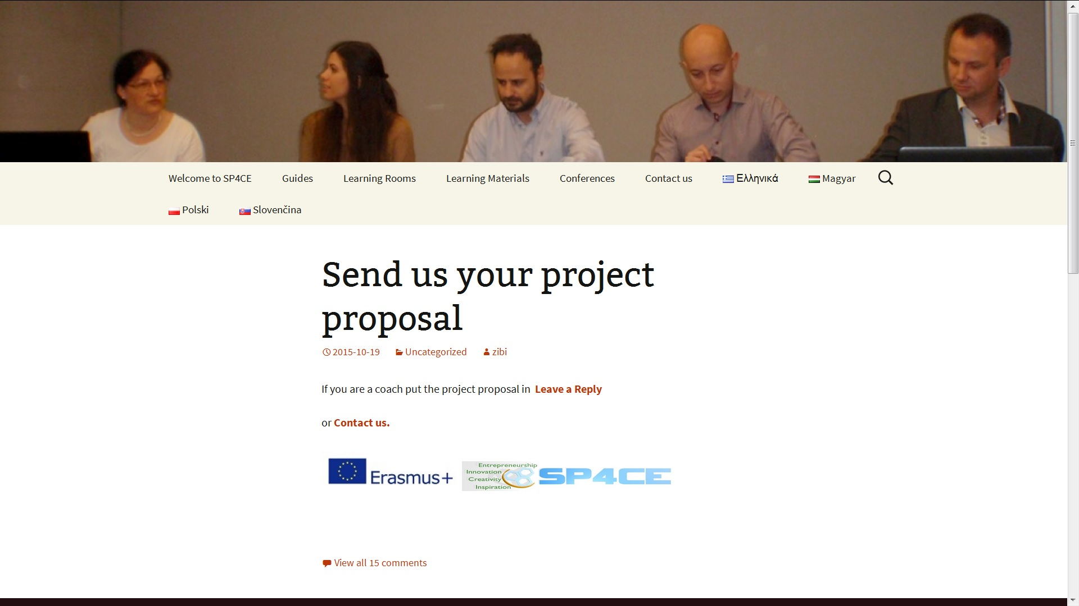
Send us your project proposal

Slide 12
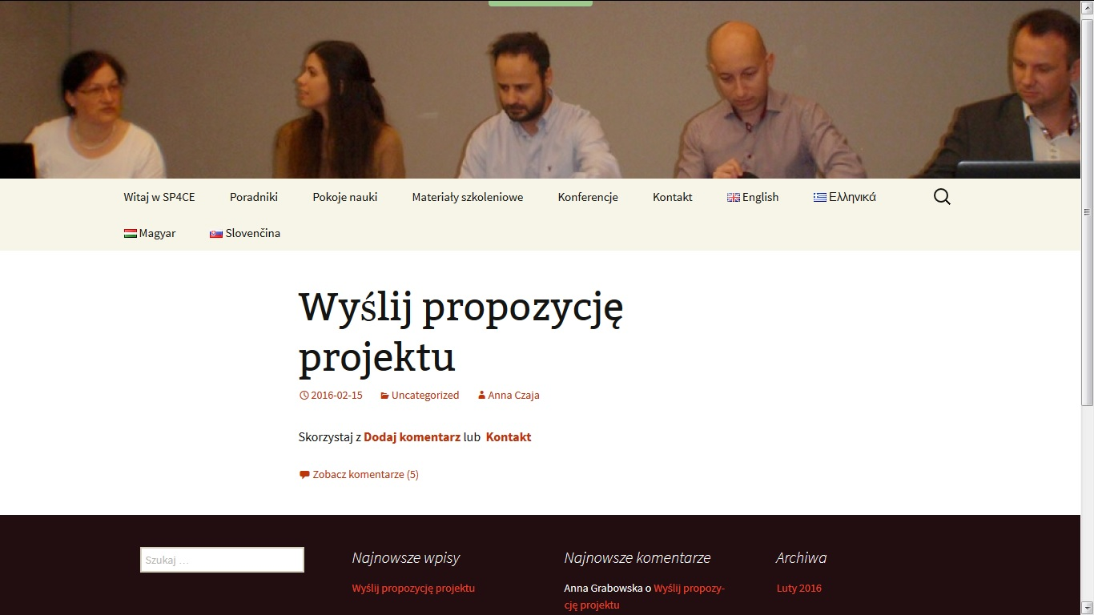
Wyślij propozycję projektu (1)

Slide 13
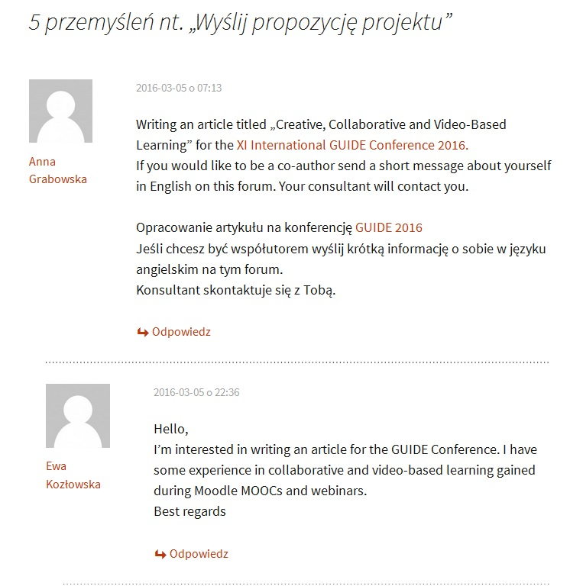
Wyślij propozycję projektu (2)

Slide 14
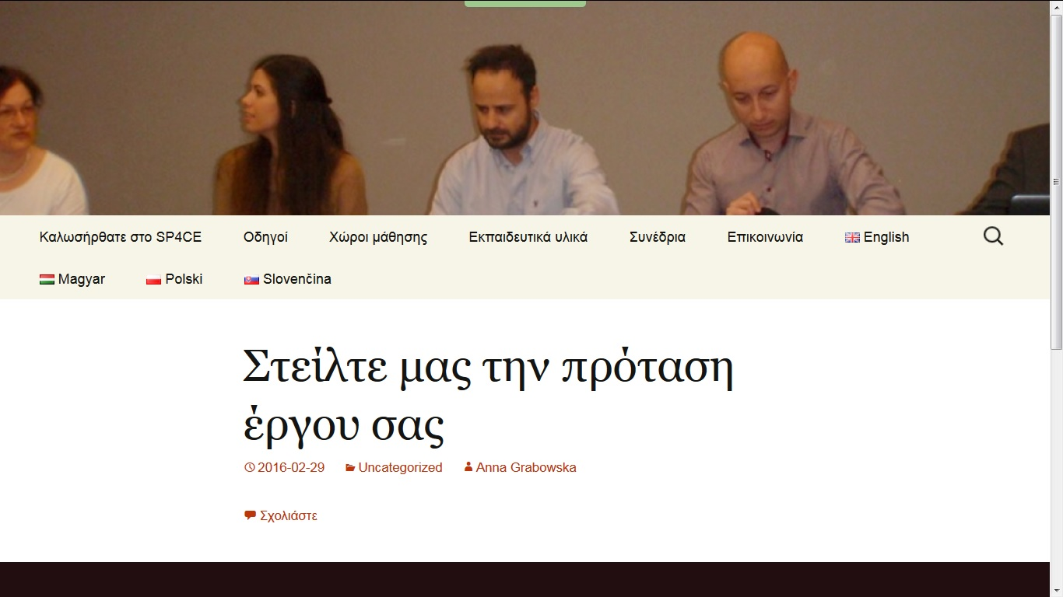
Στείλτε μας την πρόταση έργου σας

Slide 15
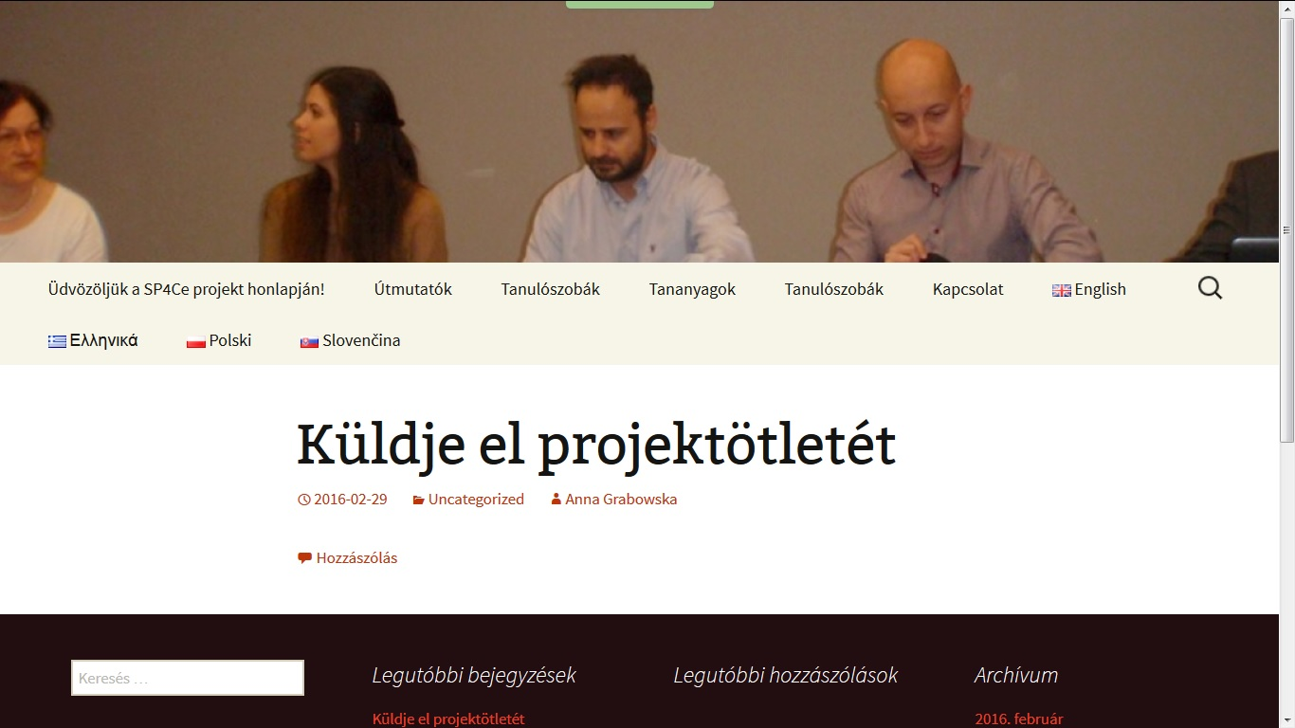
Küldje el projektötletét

Slide 16
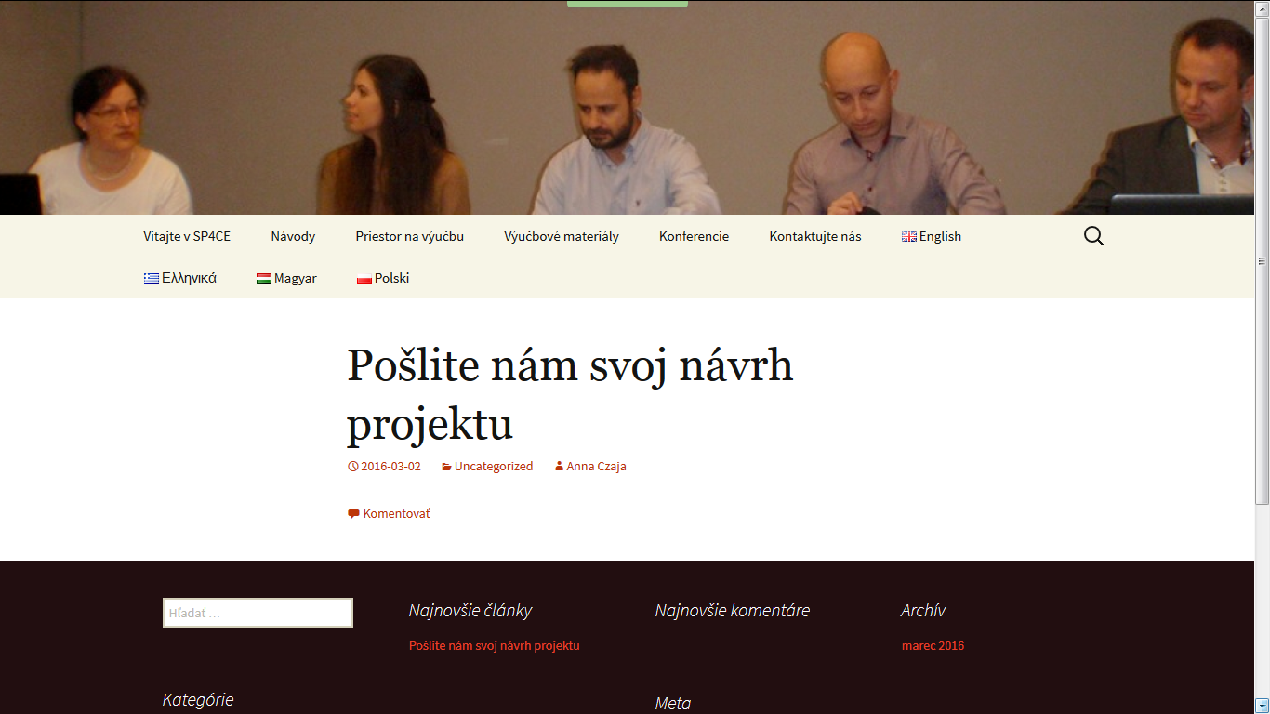
Pošlite nám svoj návrh projektu

Slide 17
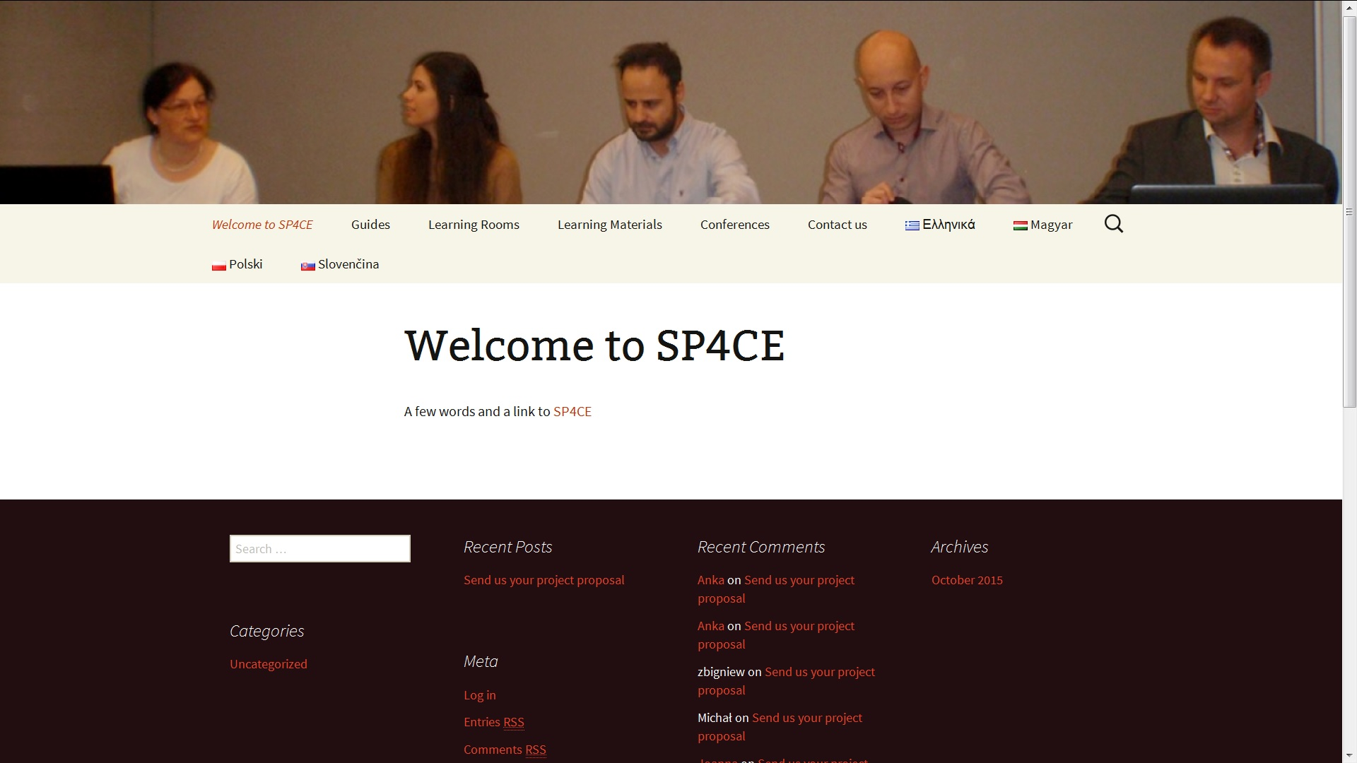
Welcome to SP4CE (ENG)

Slide 18
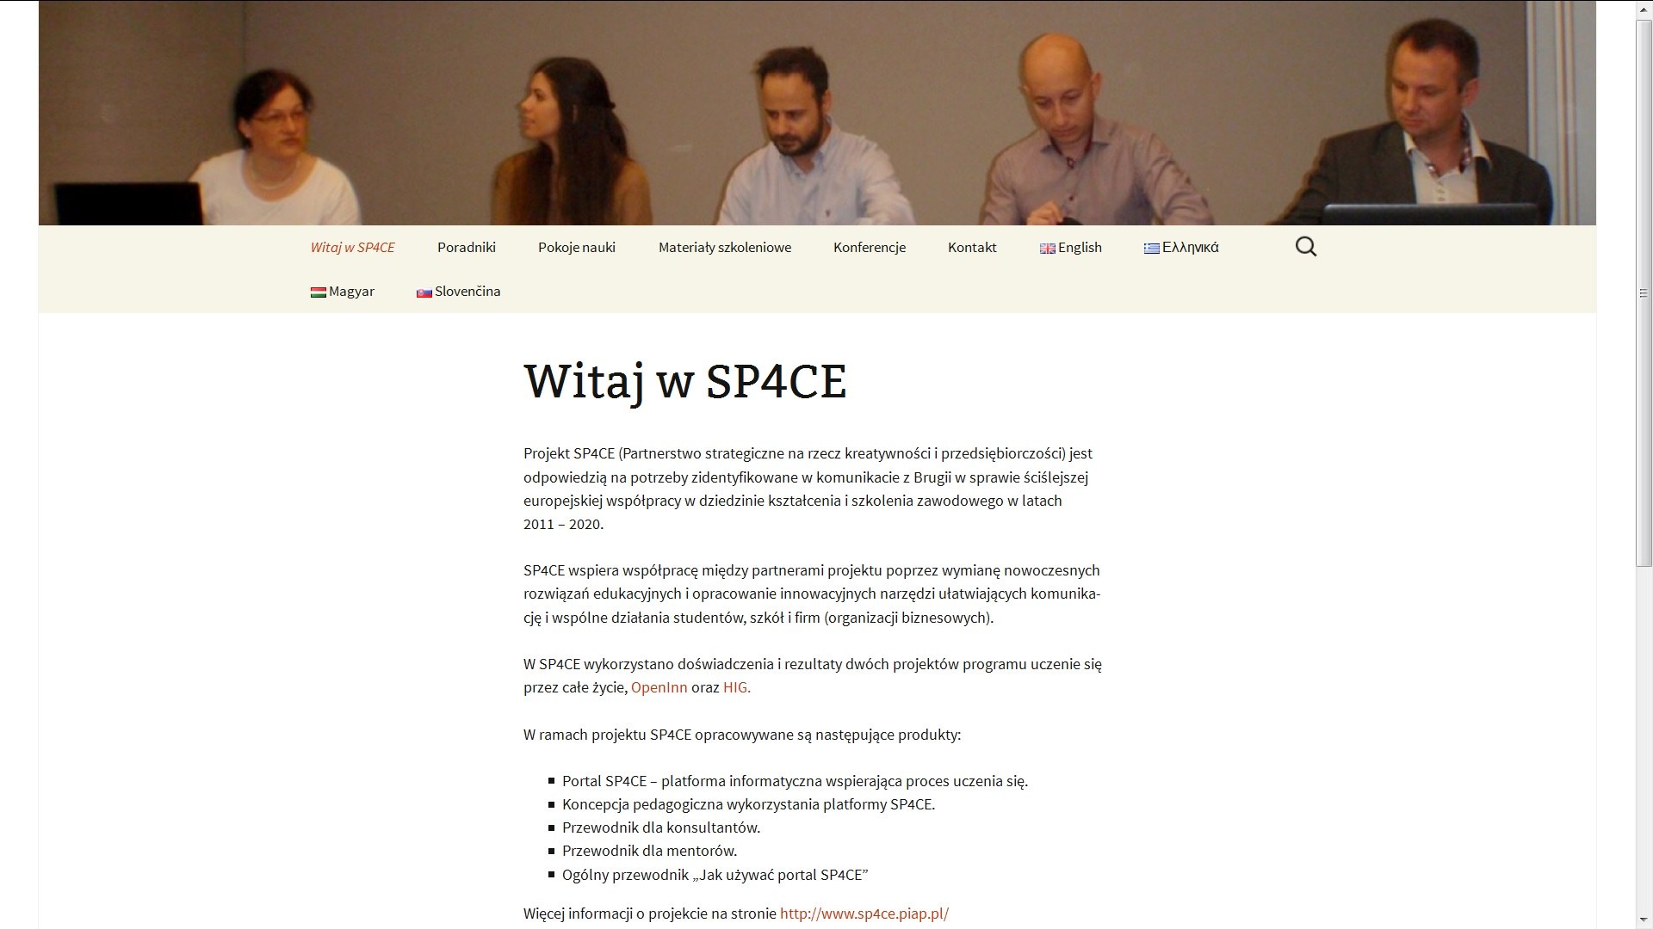
Witaj w SP4CE (PL)

Slide 19
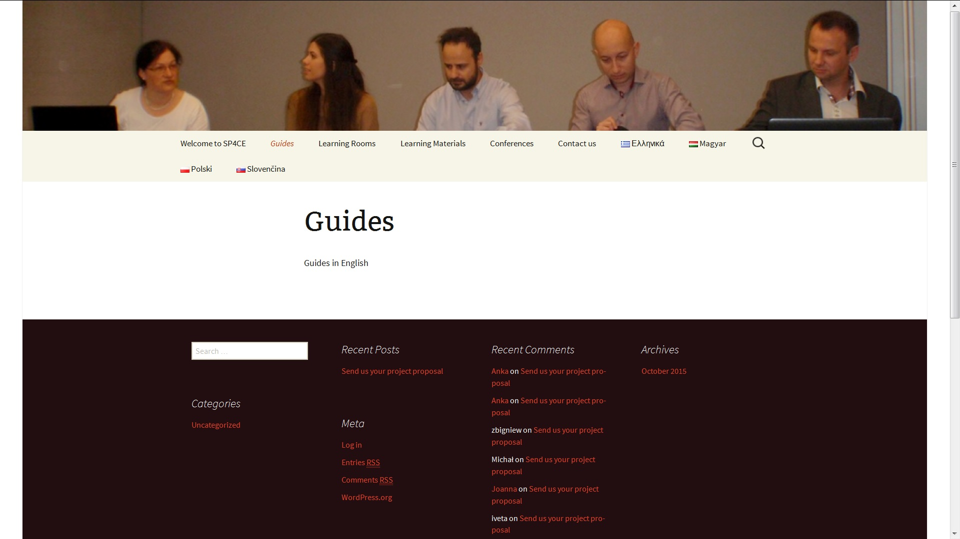
Guides (ENG)

Slide 20
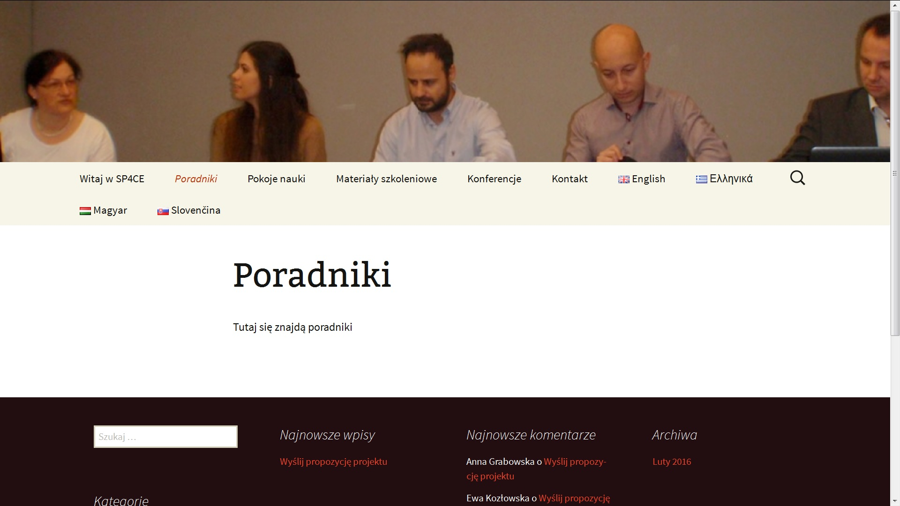
Poradniki (PL)

Slide 21
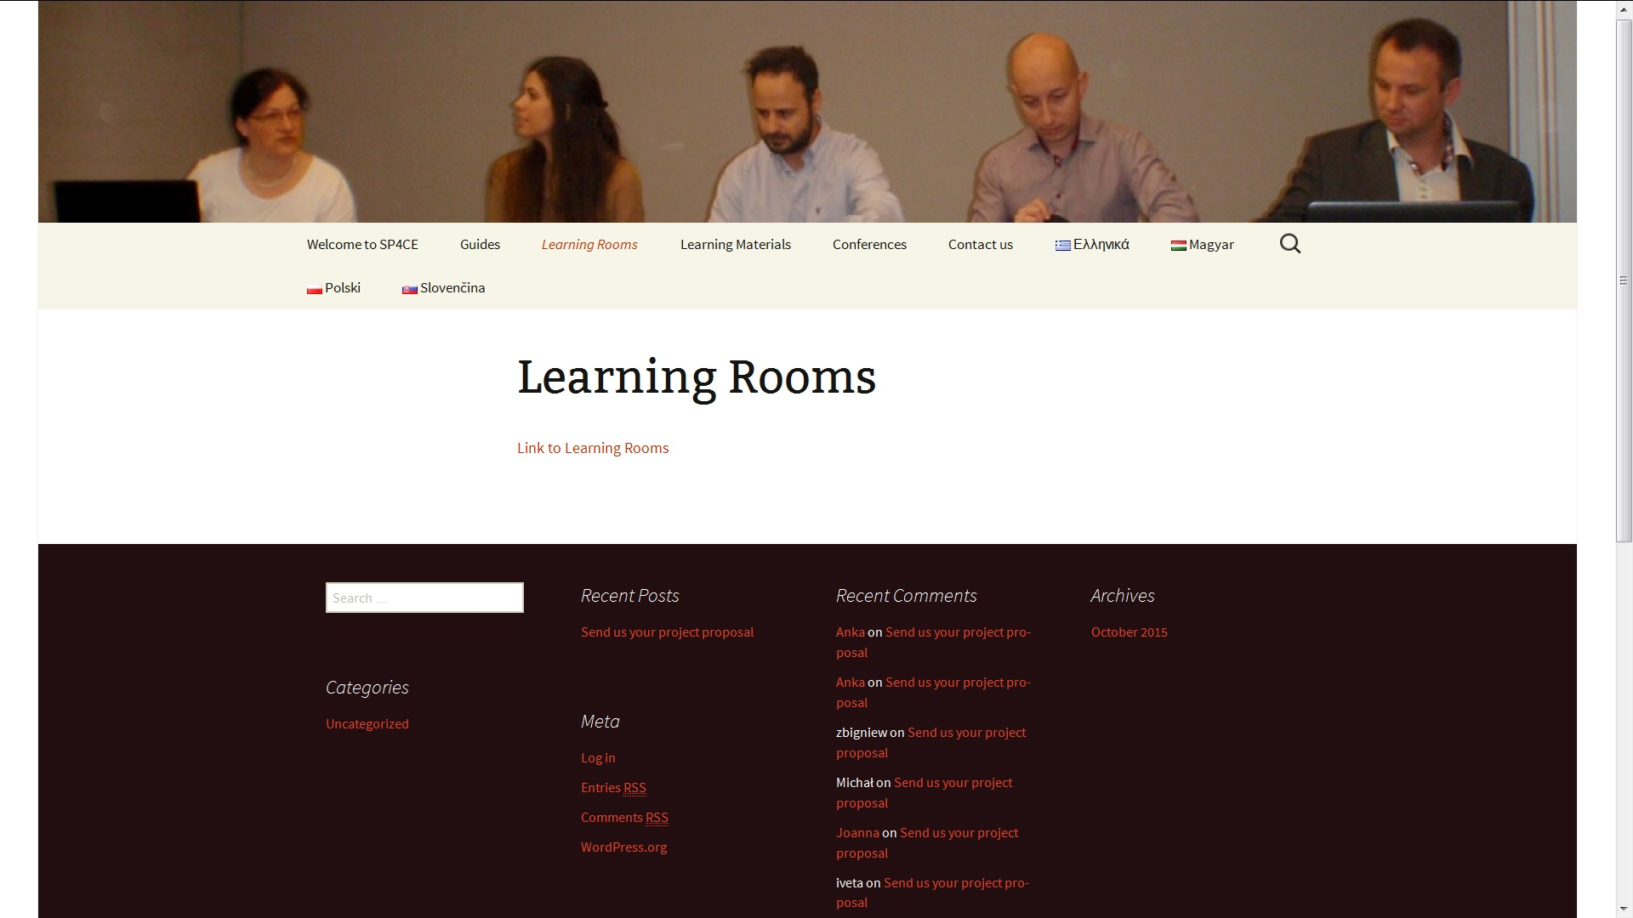
Learning Rooms (ENG)

Slide 22
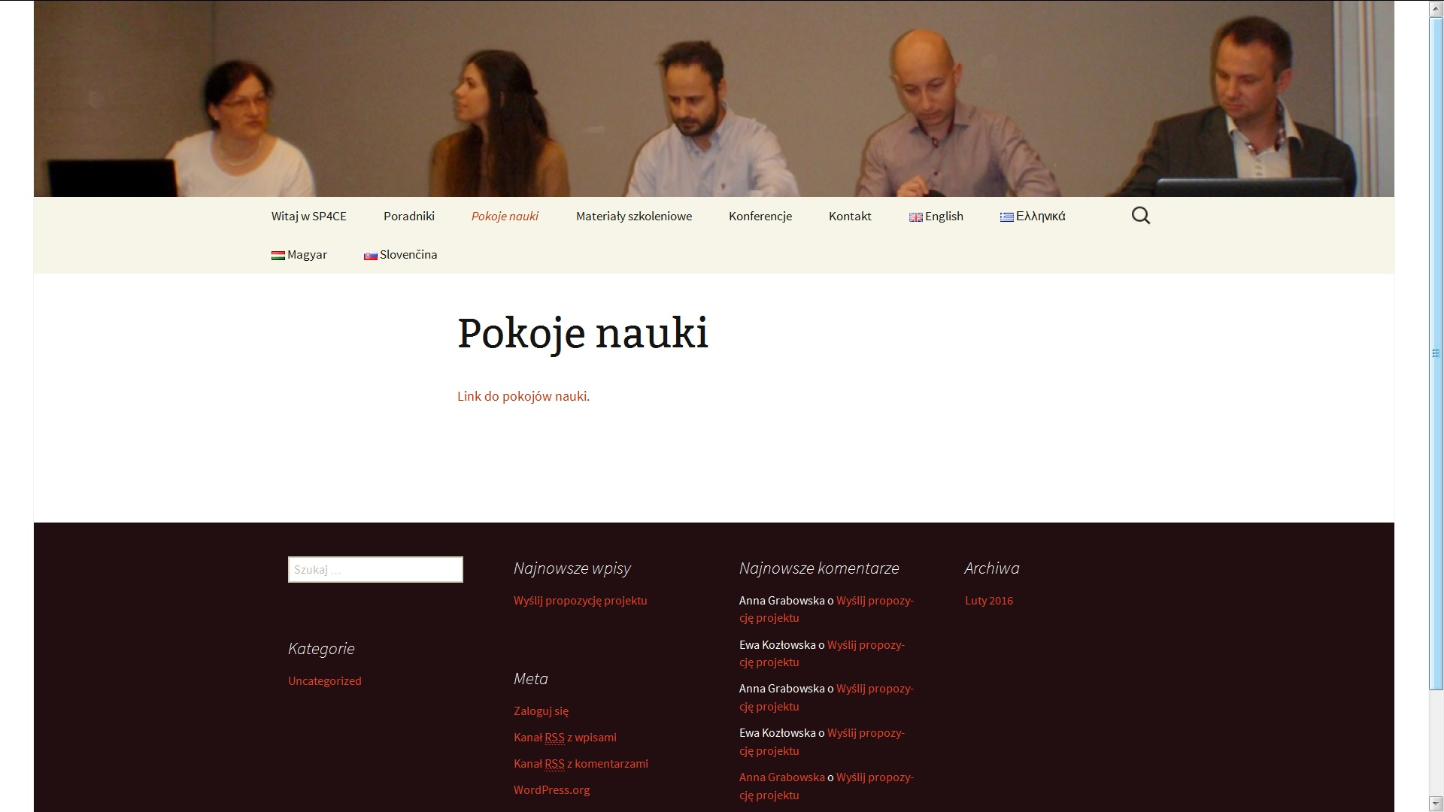
Pokoje nauki (PL)

Slide 23
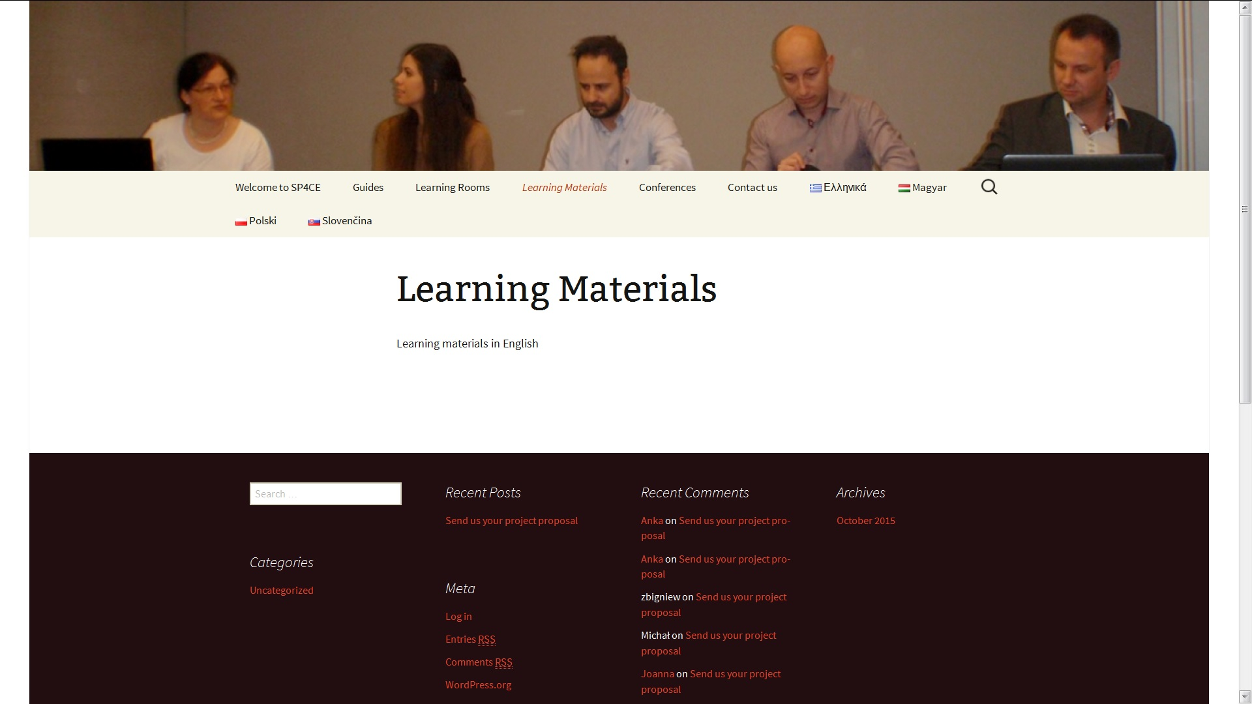
Learning Materials (ENG)

Slide 24
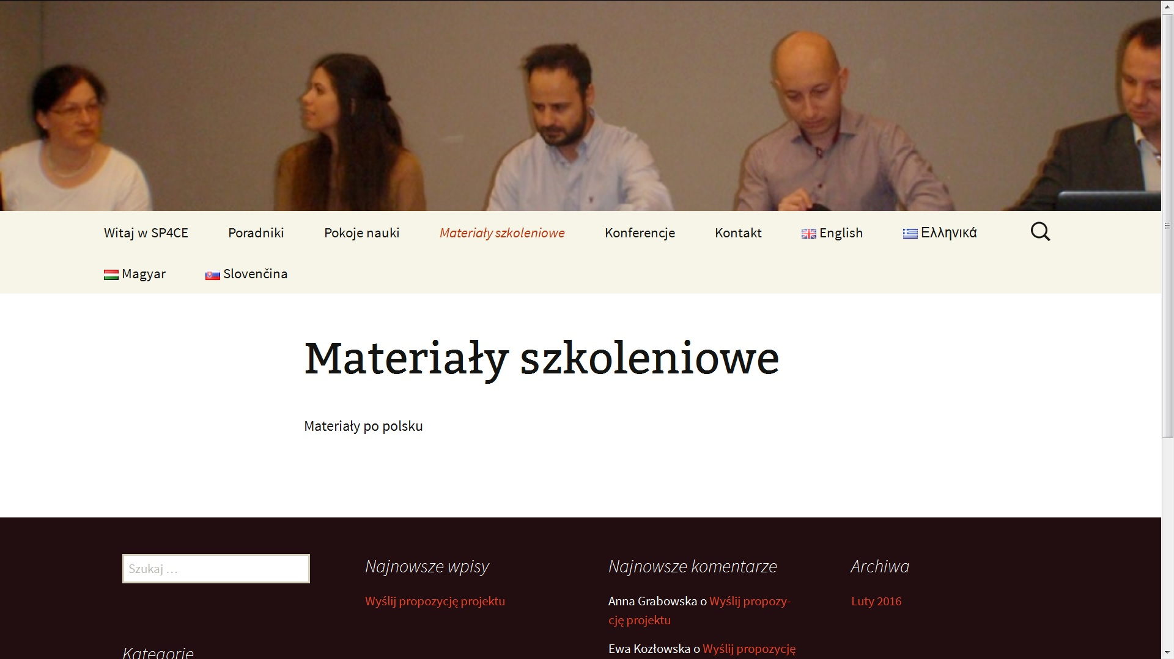
Materiały szkoleniowe (PL)

Slide 25
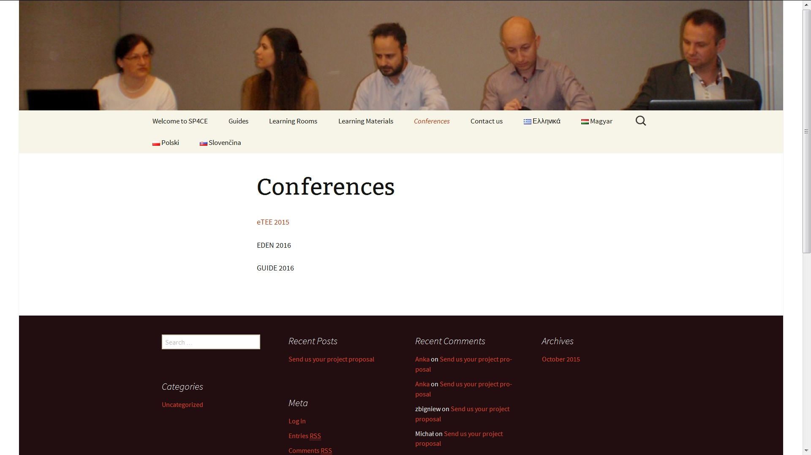
Conferences (ENG)

Slide 26
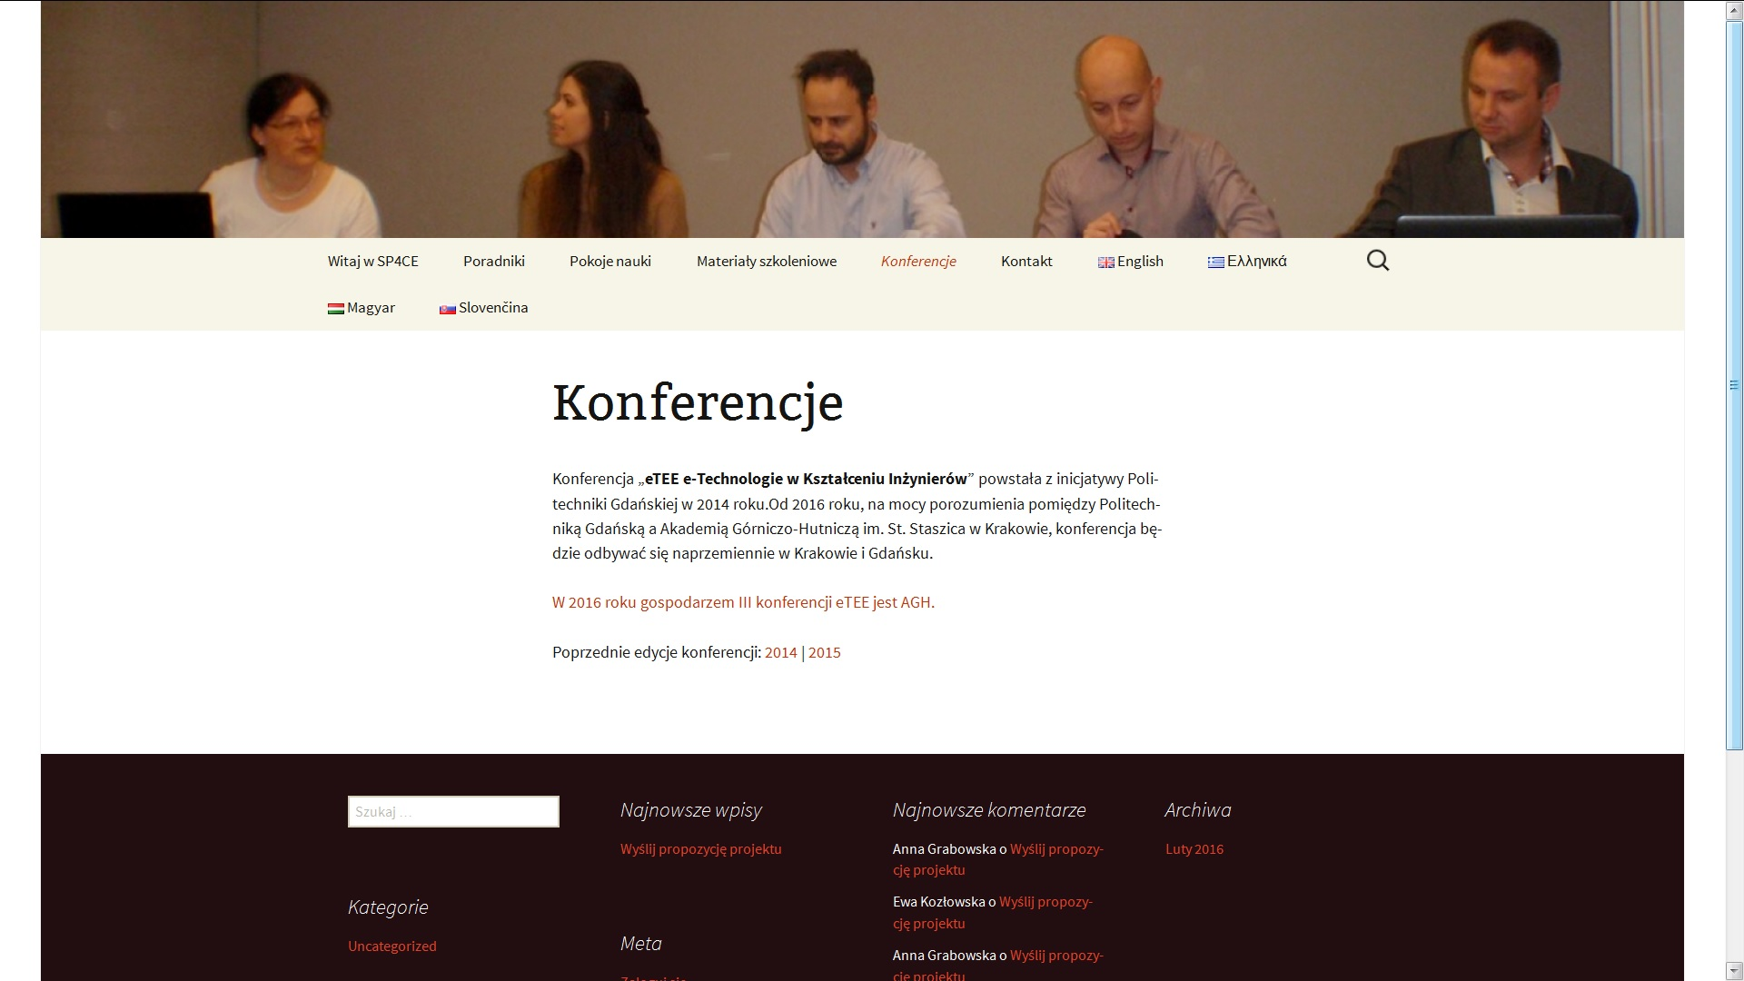
Konferencje (PL)

Slide 27
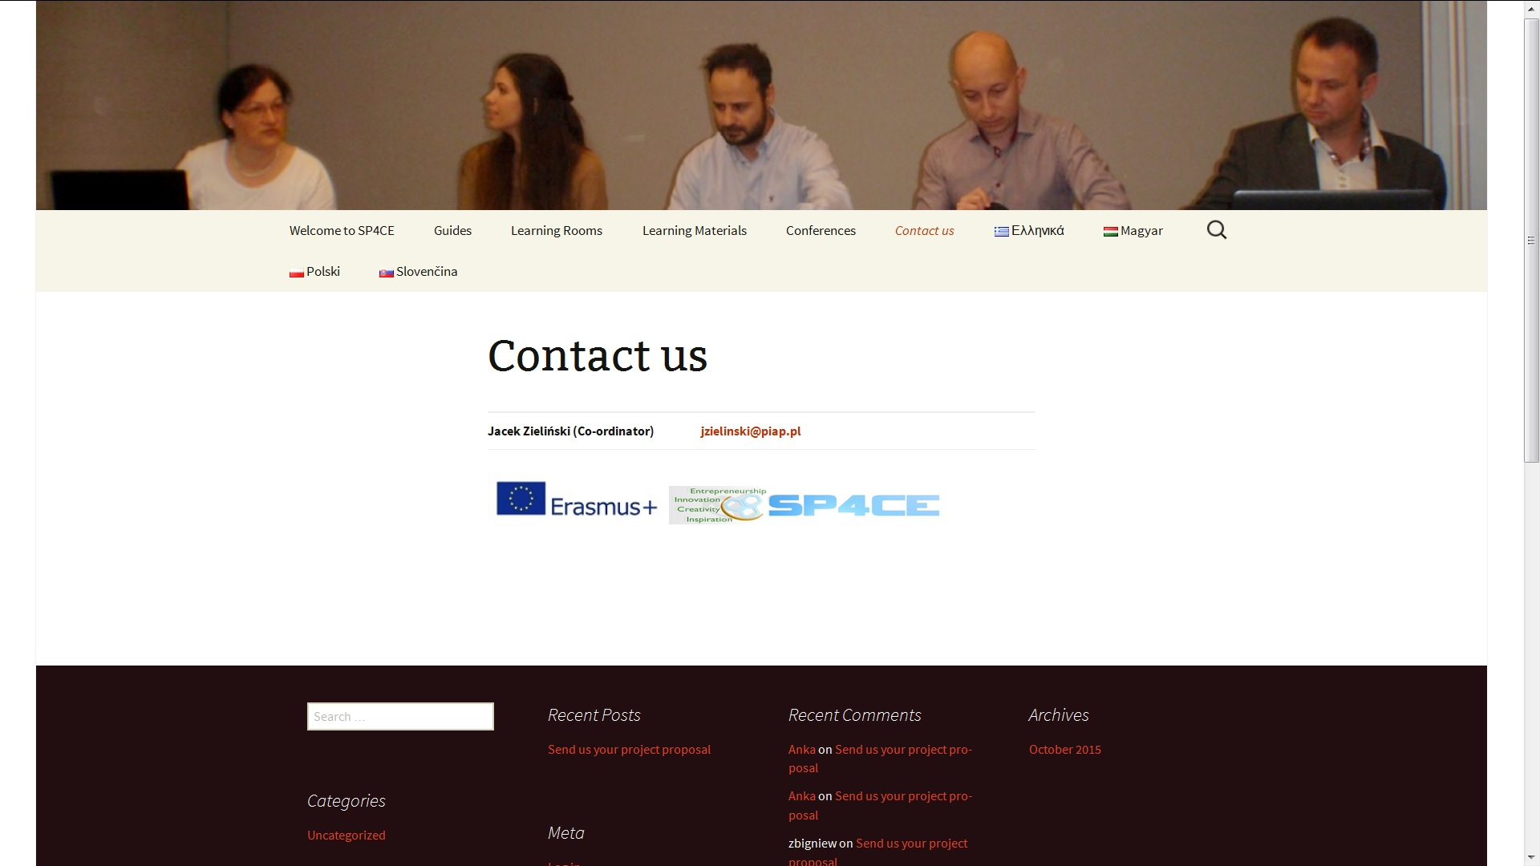
Contact (ENG)

Slide 28
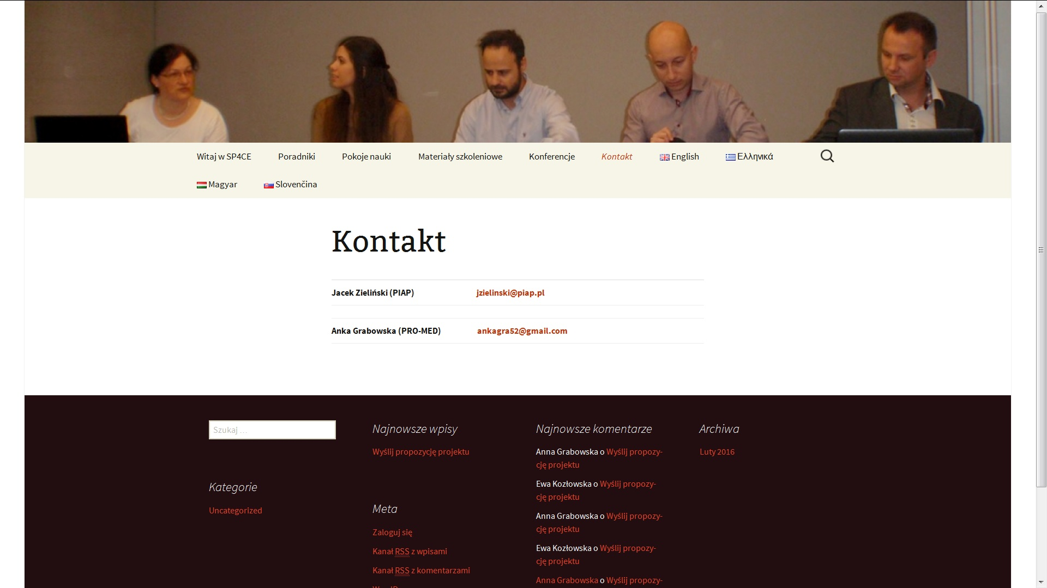
Kontakt (PL)

Slide 29
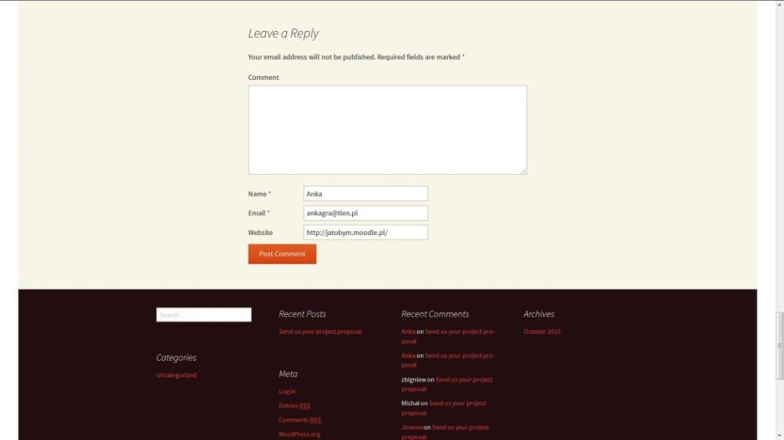
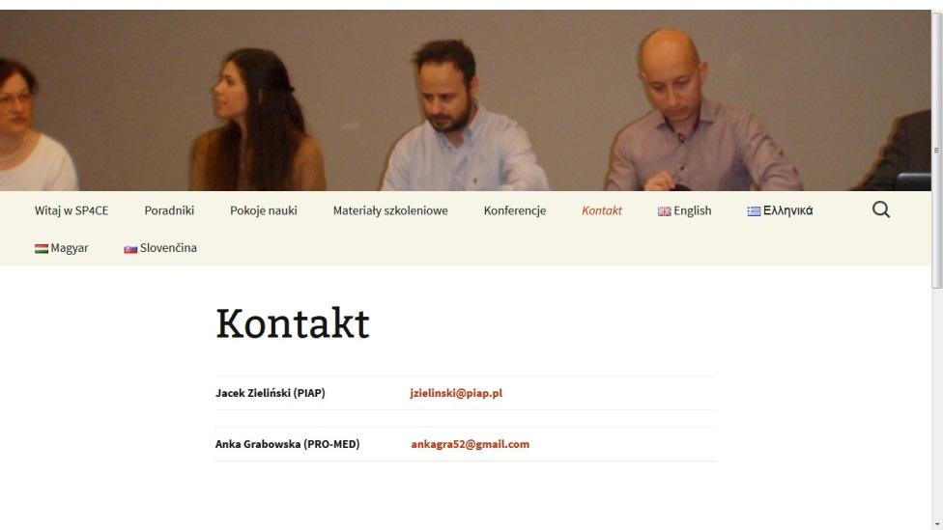
Portal and Learning Rooms usage scenarios (example screen shots)
If you are a coach put the project proposal in Leave a Reply or Contact us.

Slide 30
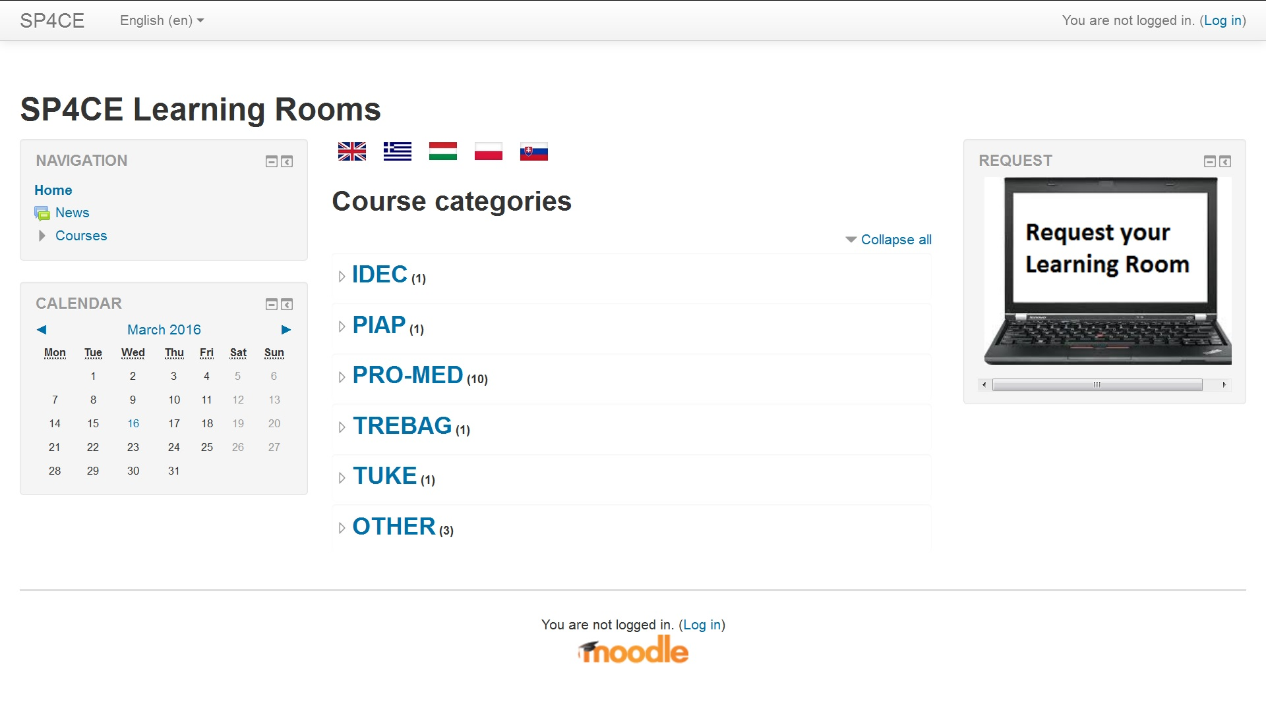
Learning Rooms (1)

Slide 31
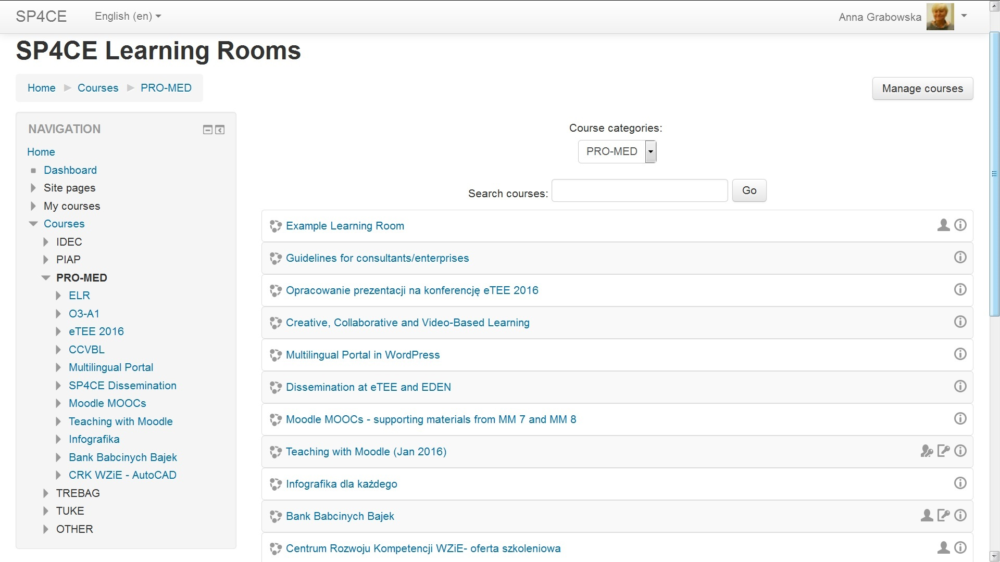
Learning Rooms (2)

Slide 32
LR usage scenario (1)
If you are a coach and you would like to start your Learning Room please contact a local ADM. Your local ADM will order LR for you.
Name | Institution | E-mail | Country | Status
Anna Grabowska | PRO-MED | anka.grabowska@gmail.com | Poland | Main ADM
Dana Palova | TUKE | dana.palova@tuke.sk | Slovakia | Local ADM
Olga Anagnostaki | IDEC | olga@idec.gr | Greece | Local ADM
Ewa Kozłowska | GUT | ewakozlo2@gumed.edu.pl | Poland | Local ADM
Jacek Zieliński | PIAP | jzielinski@piap.pl | Poland | Local ADM
Gabriella Kengyel | TREBAG | gabriella.kengyel@trebag.hu | Hungary | Local ADM

Slide 33
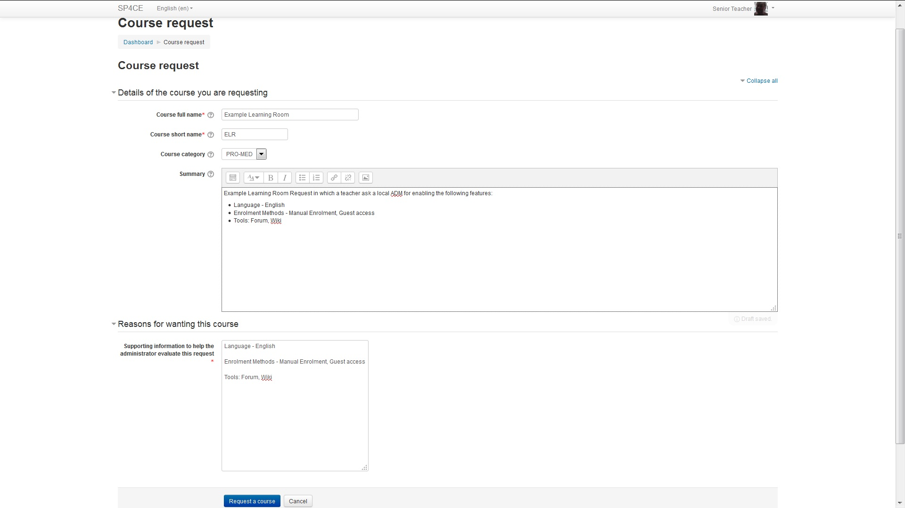
LR usage scenario (2)

Slide 34
LR usage scenario (3)

Slide 35
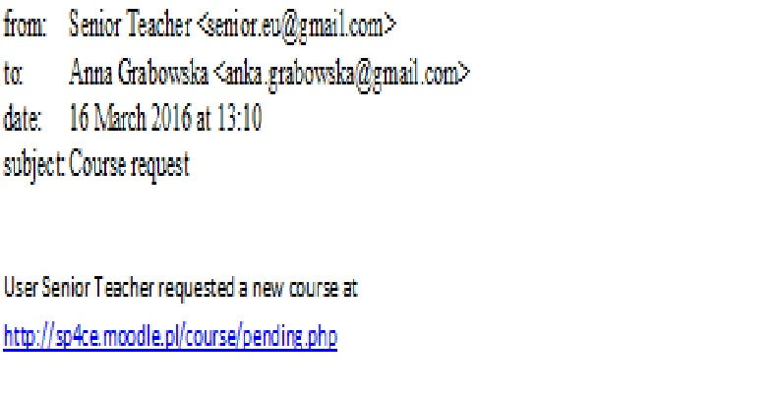
LR usage scenario (4)

Slide 36
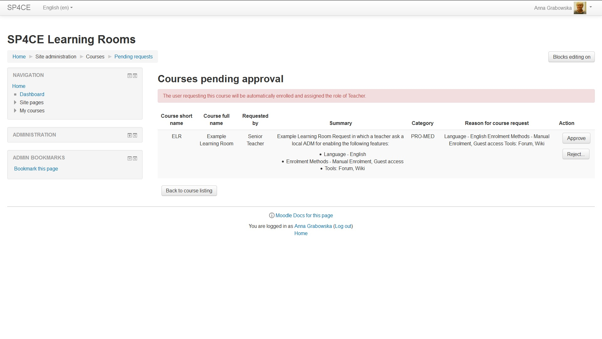
LR usage scenario (5)

Slide 37
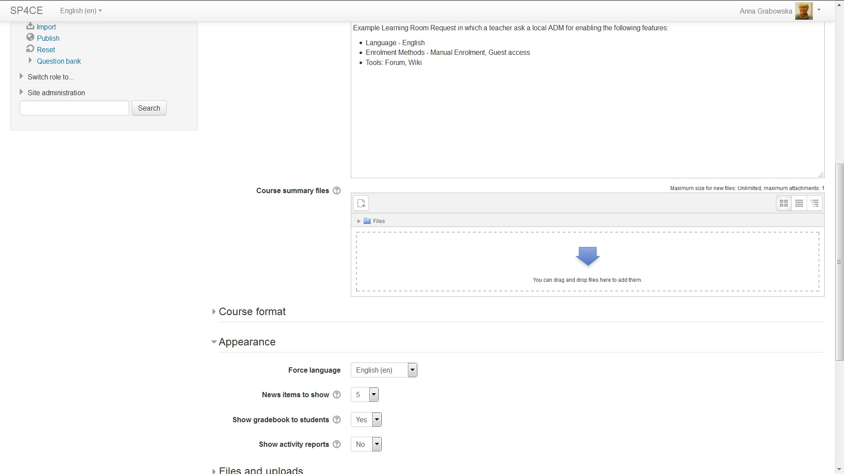
LR usage scenario (6)

Slide 38
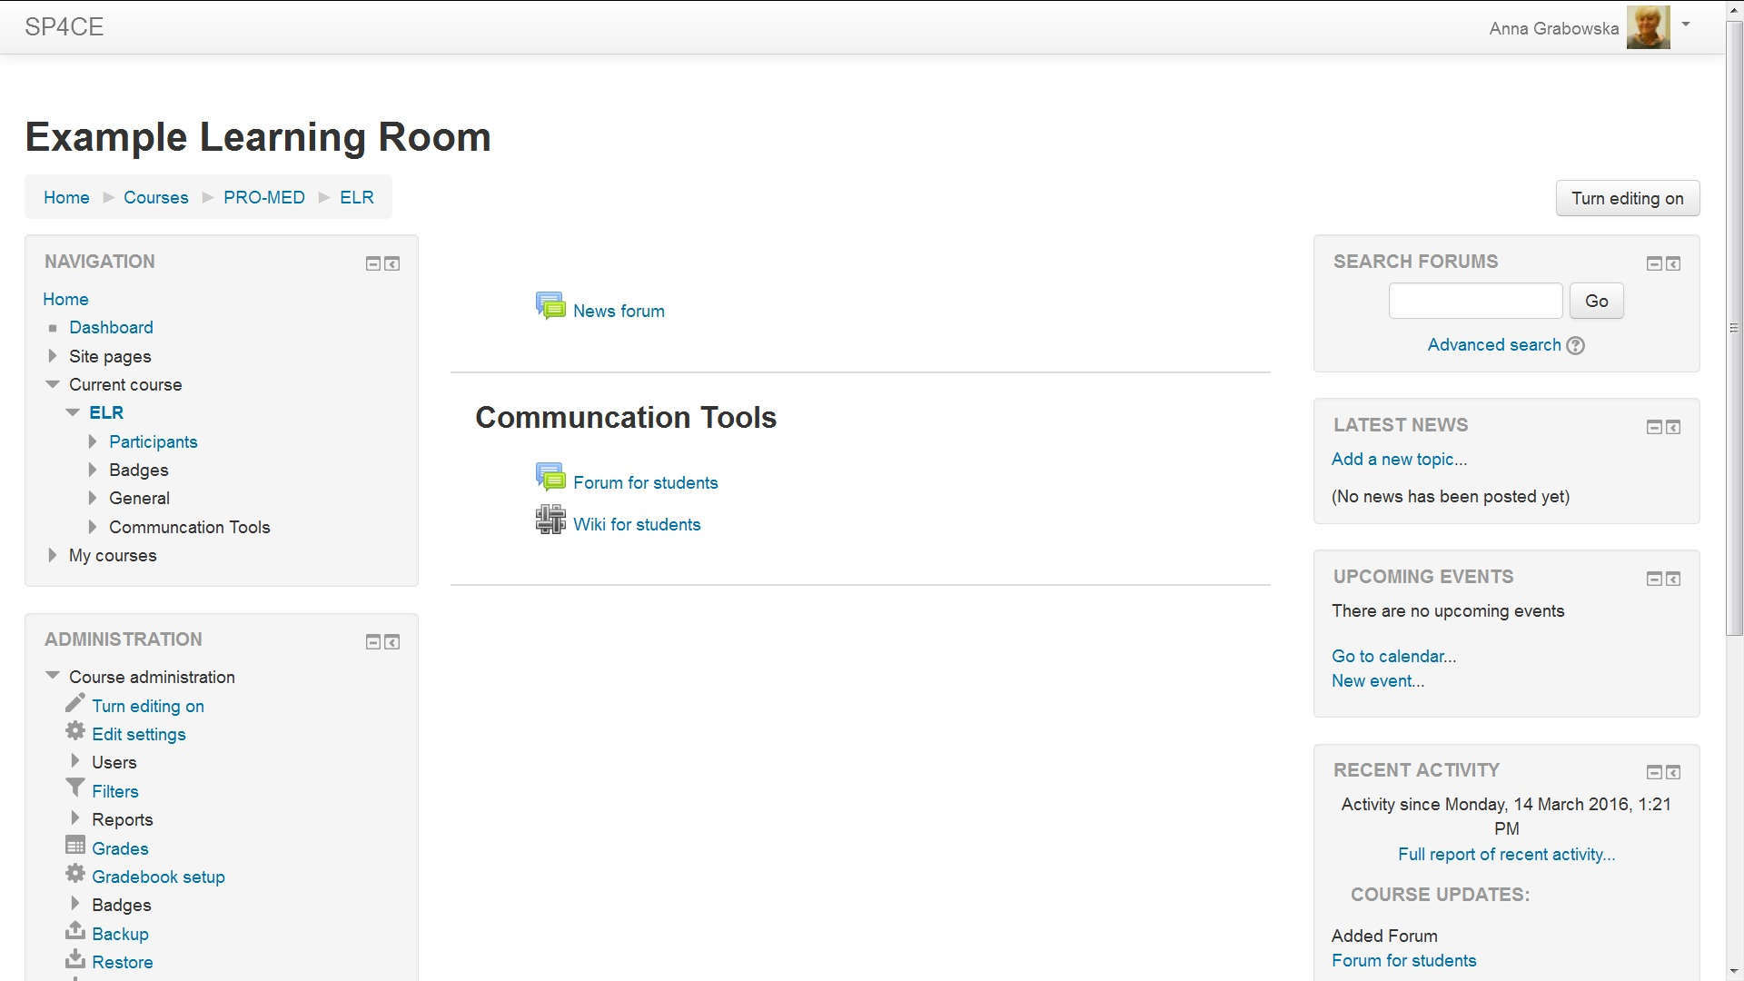
LR usage scenario (7)

Slide 39
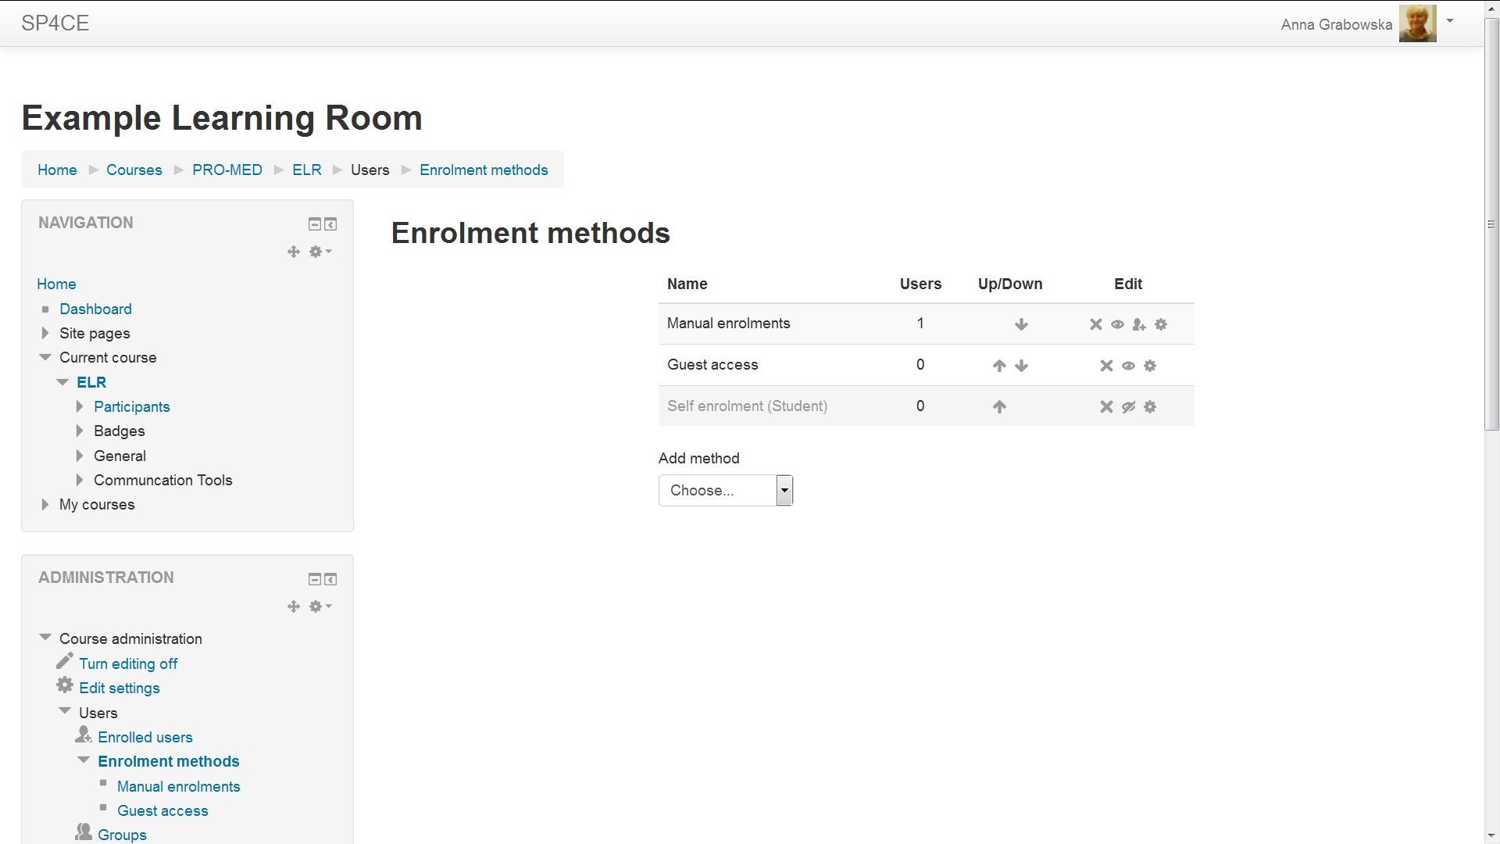
LR usage scenario (8)

Slide 40
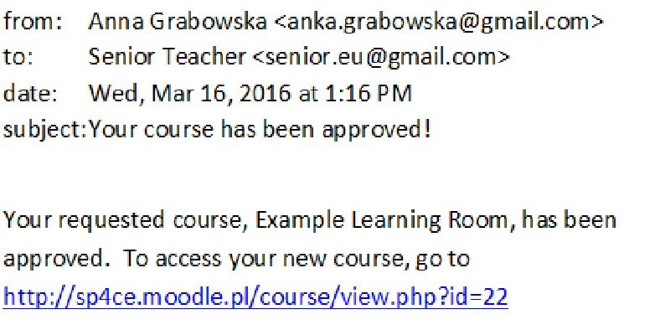
LR usage scenario (9)

Slide 41
Thank you for you attention
Welcome to
sp4ce.eu
sp4ce.moodle.pl
Send your comments to anka.grabowska@gmail.com

