Slide 1
About project
Strategic Partnership for Creativity and Entrepreneurship (SP4CE) has been funded with support from the European Commission under the ERASMUS+ Programme. Project started on 1 September 2014 and will end on 31 August 2017.
The main purpose of the project:
Designing innovative common e-learning tools for collaboration between students, enterprises and teachers.
It concentrates on identifying users’ needs and supports the development of relations between them by mentoring and consulting activities.
Those tools are available as ICT solution with WWW interface designed for three main target groups: Coaches, Mentors (Teachers) and Students.
Notes:
Those tools should support the following steps:
Formulating problems to be solved, questions to be answered.
Creating of the teams which want to work towards the problem solution.
Organising work for teams or individuals in order to develop the solution.
Mentoring and coaching.
Presentation of developed solutions.
Publishing of the chosen solution.

Slide 2
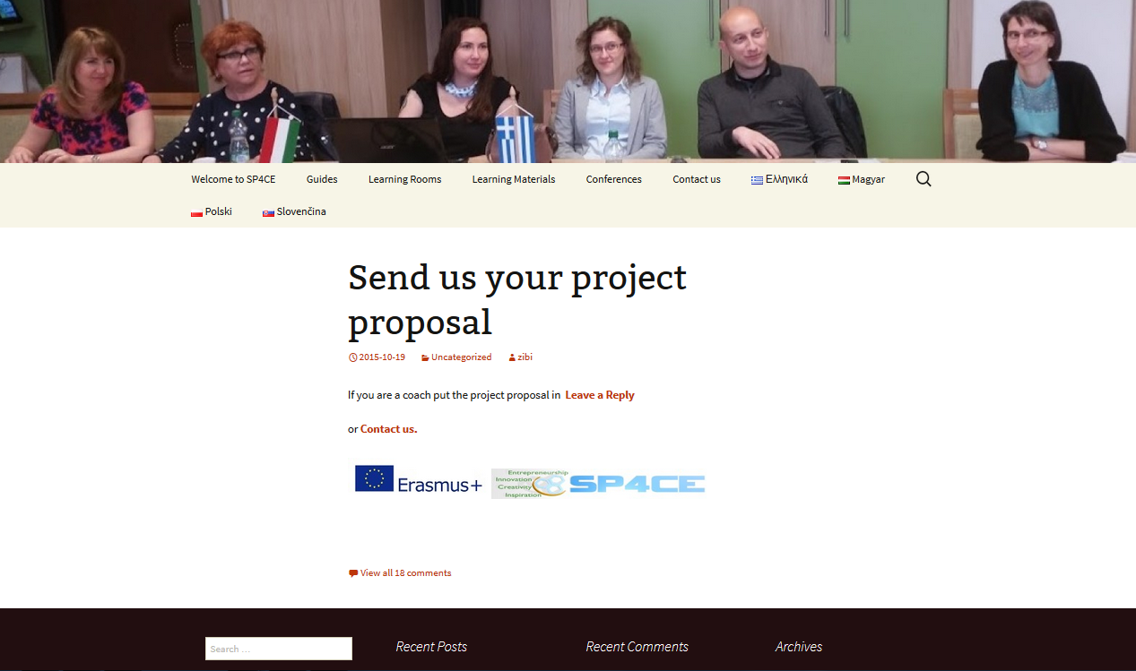
SP4CE Learning Portal
http://sp4ce.eu

Slide 3
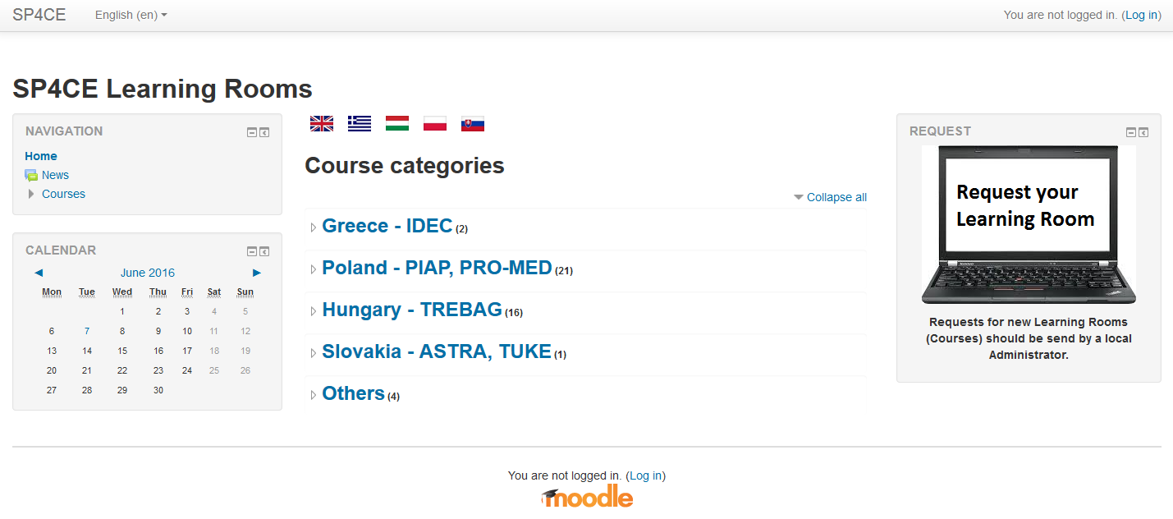
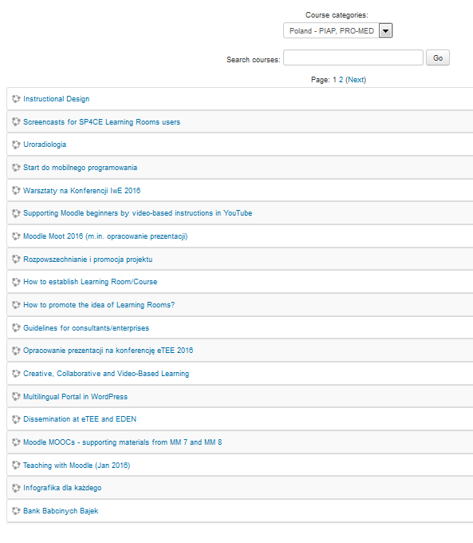
SP4CE Learning Rooms in Moodle
http://sp4ce.moodle.pl
Notes:
There were created some learning rooms which are the subject to evaluation. Each partner group has been given a learning room in their native language. In the first stage English was proposed as a cooperative language.
Students are available to make a self-enrolment in a selected course. Each learning room contains forum, chat and wiki for students, consultants and teachers and space for supported materials needed in a specific topic. There is also a possibility to add another tools to make the cooperation more comfortable to each target group.

Slide 4
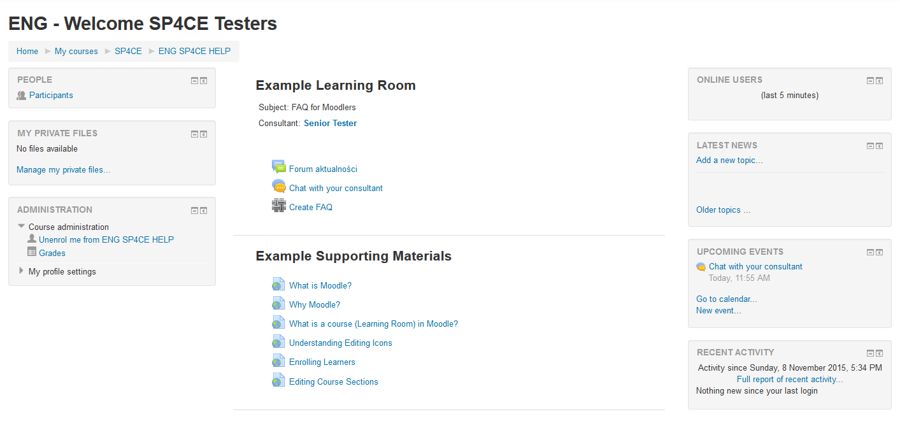
Example Learning Room

Slide 5
Project Evaluation
In order to evaluate the actual project progression all the participant were asked to fill in the questionnaire prepared by PRO-MED. The Feedback Questionnaire objectives were following:
to obtain the participants opinion on SP4CE portal itself;
its design, usability, functionality: what was missed and what needs to be added;
to obtain the participants opinion on tools for collaboration: what was missed and what needs to be added
The Feedback Questionnaire was filled in by 16 SP4CE participants from 4 countries.

Slide 6
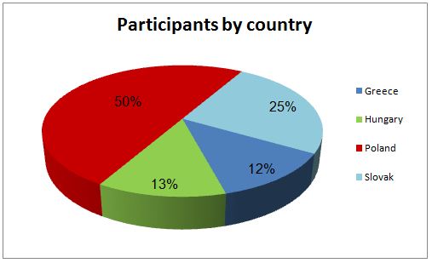
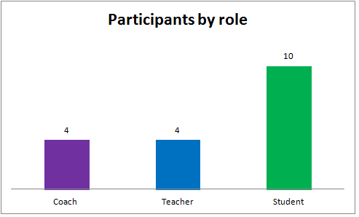
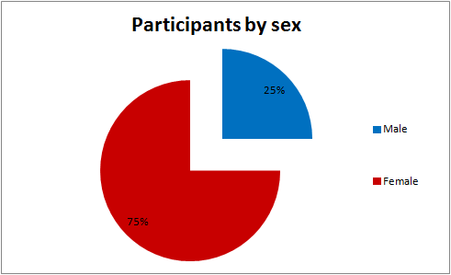
The Results of the Project Evaluation

Slide 7
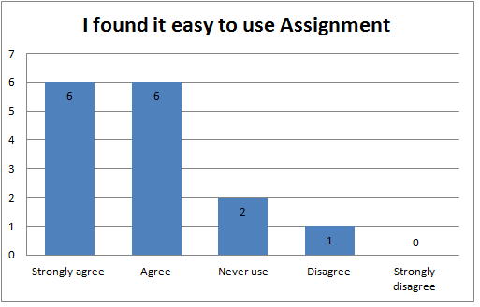
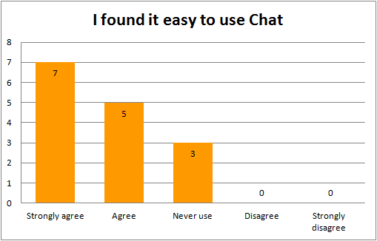
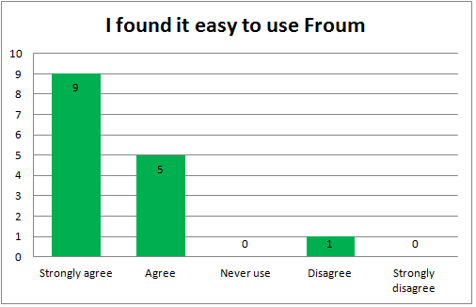
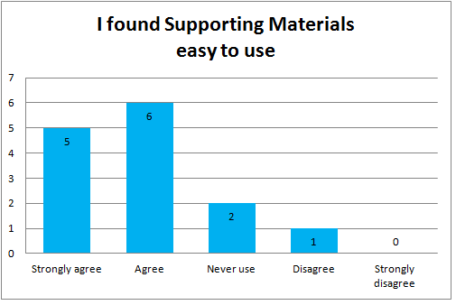

Slide 8
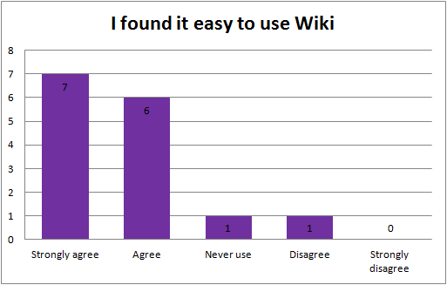
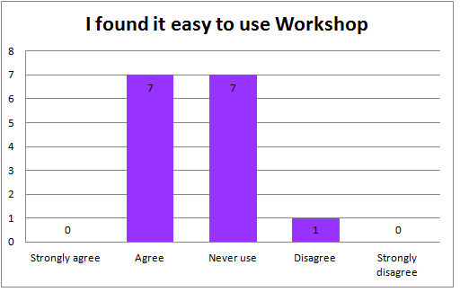
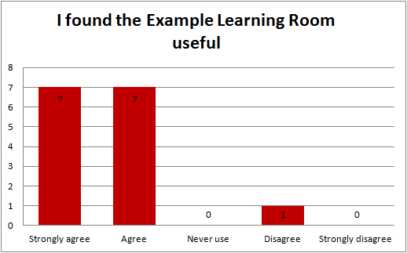
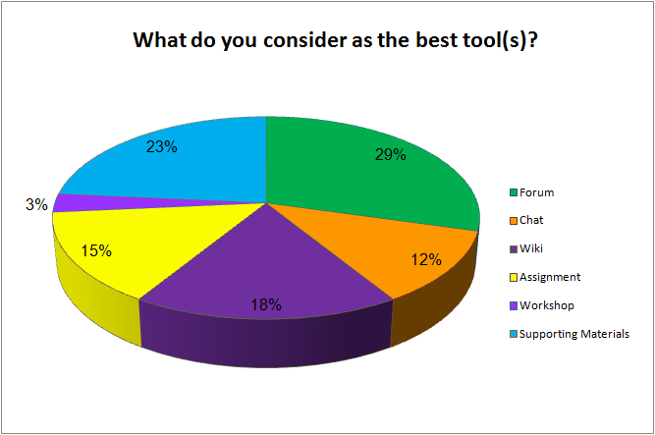

Slide 9
