Slide 1
Creative, Collaborative and Video-Based Learning in SP4CE Anna Grabowska, Anna Czaja, Ewa Kozłowska Gdansk University of Technology PRO-MED sp. z o.o.

Slide 2
What is all about
SP4CE stands for Strategic Partnership for Creativity and Entrepreneurship project which has been funded with support from the European Commission under the ERASMUS+ Programme.
The project has started on 1 September 2014.
SP4CE will end on 31 August 2017.

Slide 3
The main purpose of the project
Designing innovative common e-learning tools for collaboration between students, enterprises and teachers.
It concentrates on identifying users’ needs and supports the development of relations between them by mentoring and consulting activities.
Those tools are available as ICT solution with WWW interface designed for three main target groups: Coaches, Mentors (Teachers) and Students.

Slide 4
The SP4CE portal is dedicated for companies
and young people who want to enter the labour market
and supports the following actions:
Coaches from companies formulate and submit the problem.
Students from different location chose problem(s), look for a solution and send a short proposal.
Based on the proposed solutions mentors (teachers) are allocated to students and they assist the problem solving process within so called Learning Rooms.

Slide 5
To achieve a good collaboration
between all target groups there is a need to train them by using handbook and guidelines available online.
The handbook prepared for SP4CE users is titled “SP4CE pedagogical concept” and covers the following subjects:
Results and lessons learned from already implemented projects;
Collaborative learning for creativity and innovation;
Online mentoring and coaching.

Slide 6
Final solution
As a final ICT solution for the portal development WordPress and Moodle are proposed.
In order to make familiar all target groups with the functionalities of the portal the video based training is offered.
It should be stressed that experience gathered by authors during Moodle MOOCs courses (Moodle MOOC 7, Moodle MOOC 8, Teaching with Moodle, Moodle in Cloud) is implemented.

Slide 7
Our repository at CI TASK Academic Computer Centre in Gdansk - https://task.gda.pl/centre-en/

Slide 8
Video based learning in Moodle MOOCs
Moodle for teachers
Teaching with Moodle (Jan 2016)
Moodle in SP4CE ERASMUS+
Moodle in Cloud

Slide 9
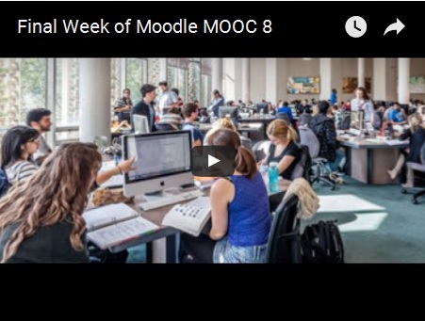
MM8 - Example Videos

Slide 10
Moodle MOOC (Jan 2016) - Example Videos https://www.youtube.com/watch?v=n4JUMSx7r4I

Slide 11
Moodle in SP4CE ERASMUS+

Slide 12
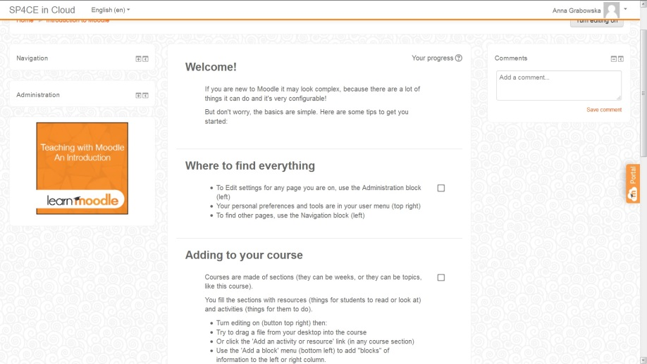
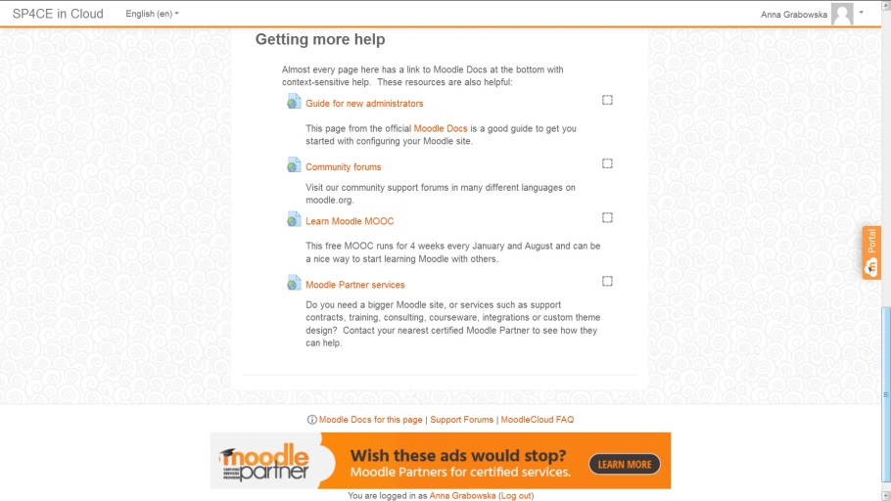
Why not Moodle in Cloud ...

Slide 13
Welcome to https://sp4ce.moodlecloud.com/

Slide 14
Last but not least ...

Slide 15
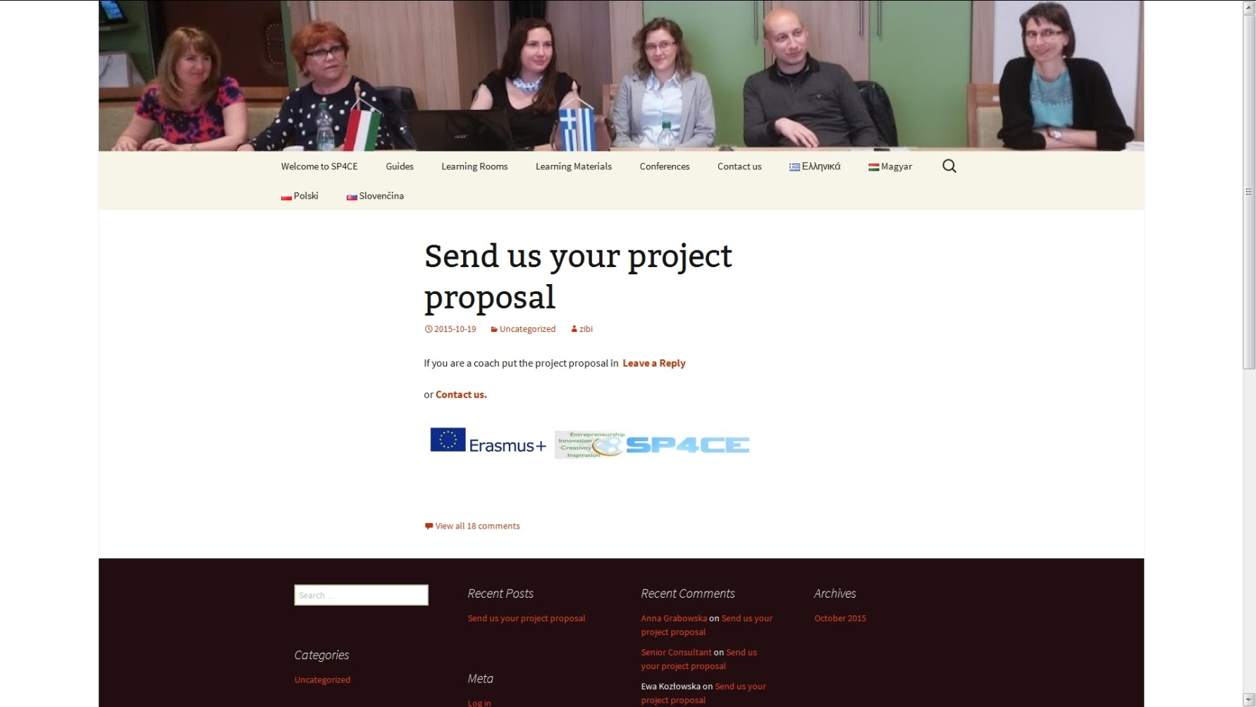
Thank you for your attention http://sp4ce.eu/en/

