Slide 1
MOOCs in SP4CE - case studies (Strategic Partnership for Creativity and Entrepreneurship) Anna Grabowska anka.grabowska@gmail.com PRO-MED sp. z o. o.

Slide 2
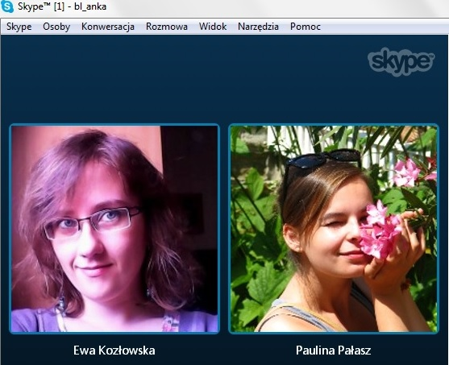
Runtime: September 2014 – August 2017 Supported / co-funded by: ERASMUS+
Partners
Co-ordinator - PIAP (Poland)
PRO-MED (Poland)
TUKE (Slovakia)
ASTRA (Slovakia)
TREBAG (Hungary)
IDEC (Greece)
Case Study Team

Slide 3
The project SP4CE aims at design and elaboration of innovative common tools for collaboration between students, enterprises and schools.

Slide 4
The main impacts of SP4CE
Students have an opportunity to learn about enterprises’ activities and they can interact with coaches.
They are able to enter the labour market having real professional experience.
Enterprises receive required knowledge and possibility to recruit students who have concrete skills and competences.

Slide 5
SP4CE portal – sp4ce.eu

Slide 6
SP4CE Learning Materials
Output O2
SP4CE pedagogical concept
Activity leader: Technical University of Košice -TUKE
Date of delivery: 26/01/2016
CONTENT
Short executive summary 3
1.Results and lessons learned from already implemented projects 4
1.1 OpenInn2.0: A Knowledge Generating House and e-Assessment Model 5
1.2 i-LAB2 – Innovation Laboratories for the quality assurance of vocational education and training 11
1.3 The High Growth Coach project 14
1.4 TeleCAD project 21
1.5 SIGOLD project 25
1.6 INNOVATRAIN TRANSFER project 28
2.Collaborative learning for creativity and innovation 32
2.1 Using ICT for teaching and learning 32
2.2 Creativity techniques 39
2.3 Adult education – innovative didactics 45
2.4 Collaborative learning from consultants’ needs point of view 50
2.5 Strengthening competencies with MOOCs 54
2.7 Methods of identification of enterprise’s needs 58
3.Online mentoring and coaching 64
3.1 The ‘virtual company pedagogical model’ 64
3.2Open Educational resources 70
3.3Assessing creative results 74
3.4Supporting personalised learning processes 78
4.Further reading 83
5.References 85
By PRO-MED
By PRO-MED
By PRO-MED

Slide 7
Learning Rooms in Moodle

Slide 8
The best tools for communication that can be used in Learning Rooms

Slide 9
Why Local Administrators?
Administrators of sp4ce.eu (WordPress)
Administrators of Learning Rooms sp4ce.moodle.pl (Moodle)
Name | Institution | Country | Status
Anna Czaja | PRO-MED | Poland | Main ADM
Dana Palova | TUKE | Slovakia | Local ADM
Olga Anagnostaki | IDEC | Greece | Local ADM
Anna Grabowska | PRO-MED | Poland | Local ADM
Jacek Zieliński | PIAP | Poland | Local ADM
Gabriella Kengyel | TREBAG | Hungary | Local ADM
Name | Institution | Country | Status
Anna Grabowska | PRO-MED | Poland | Main ADM
Dana Palova | TUKE | Slovakia | Local ADM
Olga Anagnostaki | IDEC | Greece | Local ADM
Ewa Kozłowska | PG | Poland | Local ADM
Jacek Zieliński | PIAP | Poland | Local ADM
Gabriella Kengyel | TREBAG | Hungary | Local ADM

Slide 10
An Example Learning Room for ICETA 2016

Slide 11
MOOCs in SP4CE
In SP4CE project the subject about MOOCs appears in the training module "Strengthening competencies with MOOCs”.
This module contains the definitions, history of development and examples of good practice connected with Massive Open Online Courses.
The training materials will be available on the SP4CE project portal in 5 languages.
Learning Rooms were developed in Moodle and there was a need for ADMs training.

Slide 12
Moodle MOOC certificate – an example

Slide 13
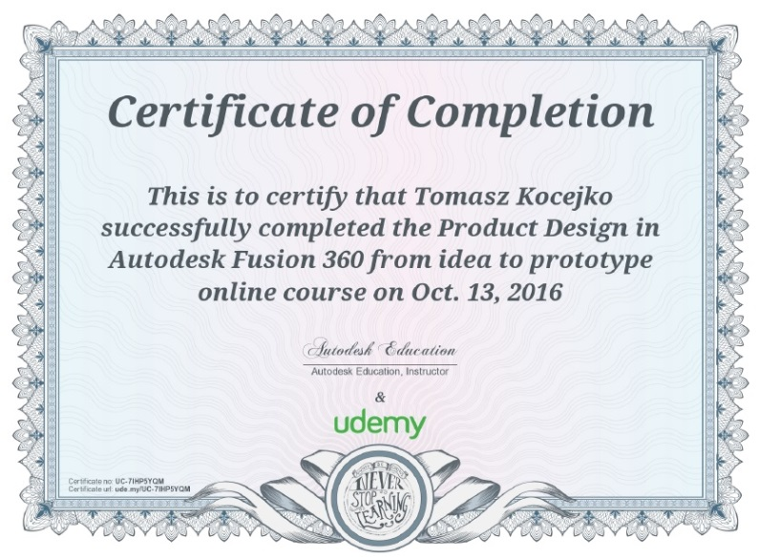
Fusion 360 MOOC
https://www.udemy.com/product-design-fusion-360/
Lectures - 33
Length - 4 hours
Skill Level - All Levels
Languages - English
Available on iOS and Android Certificate of Completion

Slide 14
What is Fusion 360?
Fusion 360 is a cloud-based CAD/CAM tool for collaborative product development.
Fusion 360 is free for students, educators, and academic institutions.
Using Fusion 360, students can develop their skills in order to become tomorrow’s engineers, product designers, and industrial designers.
https://www.youtube.com/results?search_query=what+is+fusion+360

Slide 15
We plan to develop MOOC Fusion 360 in SP4CE (Polish)

Slide 16
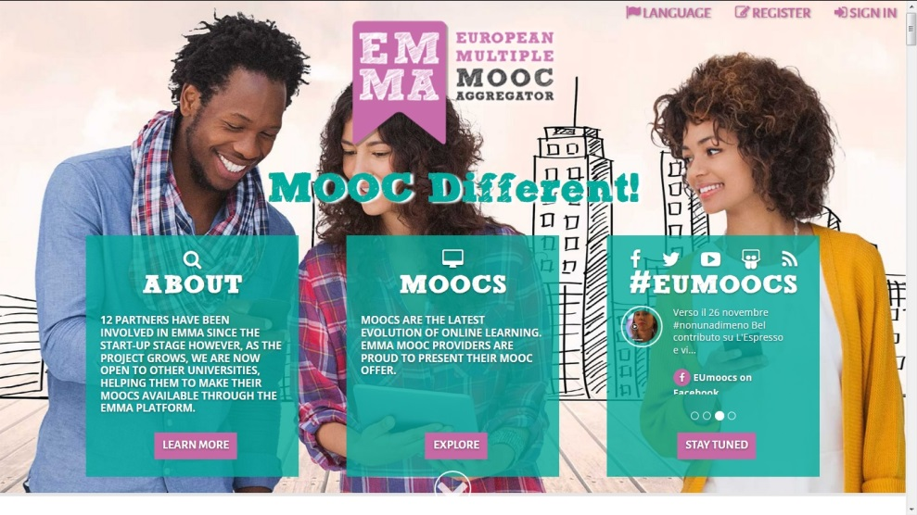
We plan to develop MOOC Fusion 360 in EMMA (English)
The European Multiple MOOC Aggregator called EMMA for short, is a 30 month pilot action supported by the European Union.
It aims to showcase excellence in innovative teaching methodologies and learning approaches through the large-scale piloting of MOOCs on different subjects.
EMMA provides a system for the delivery of free, open, online courses in multiple languages from different European universities to help preserve Europe’s rich cultural, educational and linguistic heritage and to promote real cross-cultural and multilingual learning.

Slide 17
EMMA providers

Slide 18
Introducing ACSA PG as a MOOC provider in EMMA

Slide 19
Case Study (1) Co-operation in clouds
Creating projects in the cloud and using the idea of distance communication give the possibility of interdisciplinary cooperation between medical academic centres and technical institutions.
Transferring the communication and work to the cloud reduces the time of the project's creation and realization.
Working in clouds enables diagnostics and medical consultation, surgical treatment planning, creating new solutions and methods, discussing the use of biocompatible materials etc.

Slide 20
Case Study (2) The patient comes to the doctor and gives the asymmetry within the right side of the face, it is probably tumor. MDCT (MultiDetector ComputedTomography) examination is done

Slide 21
Case Study (3) Modelling treatment - surgeons and engineers propose a solution that will remove the tumor

Slide 22
Case Study (4) An engineer translates 3D computed tomography for the Fusion 360 program in order to help design and print the implant.
Designing in Fusion 360
3D printing

Slide 25
Thank you for your attention
Welcome to SP4CE portal
sp4ce.eu
This presentation reflects the views only of the authors. The Commission cannot be responsible
for any use which may be made of the content/information contained in the article.

