Slide 1
MoodleMOOT Virtual Conference August 5-7, 2016 Using MOOCs for Moodle users training - SP4CE case Anna Grabowska, Ewa Kozłowska PRO-MED, Gdansk University of Technology
http://moodlemoot.integrating-technology.org/course/view.php?id=2
Notes:
http://moodlemoot.integrating-technology.org/course/view.php?id=2

Slide 2
SP4CE - what is all about http://ec.europa.eu/youth/programme/index_en.htm
SP4CE stands for Strategic Partnership for Creativity and Entrepreneurship project which has been funded with support from the European Commission under the ERASMUS+ Programme.
The project has started on 1 September 2014.
SP4CE will end on 31 August 2017.
Notes:
http://ec.europa.eu/youth/programme/index_en.htm

Slide 3
The main purposes of SP4CE http://www.sp4ce.piap.pl/
Improving the quality and efficiency of vet and enhancing its attractiveness and relevance.
Enhancing creativity, innovation and entrepreneurship.
http://ec.europa.eu/education/policy/vocational-policy/doc/brugescom_en.pdf
Notes:
http://ec.europa.eu/education/policy/vocational-policy/doc/brugescom_en.pdf

Slide 4
Main target groups:
Coaches,
Mentors (Teachers),
Students.
Notes:
http://www.sp4ce.piap.pl/

Slide 5
SP4CE pedagogical concept
Results and lessons learned from already implemented projects;
Collaborative learning for creativity and innovation;
Online mentoring and coaching.
Notes:
http://sp4ce.eu/

Slide 6
Implementing Moodle MOOCs in SP4CE http://www.integrating-technology.org/course/index.php?categoryid=20
Notes:
http://www.integrating-technology.org/course/index.php?categoryid=20

Slide 7
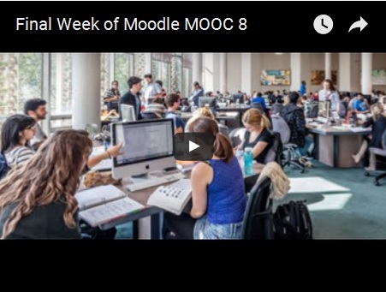
MM8 - Example tutorials https://padlet.com/nelliemuller/9j2mrdrou9ax
Notes:
https://padlet.com/nelliemuller/9j2mrdrou9ax

Slide 8
Moodle MOOC - January, August 2016 https://learn.moodle.net/
Notes:
https://learn.moodle.net/

Slide 9
SP4CE final solution
http://sp4ce.eu/en/
http://sp4ce.moodle.pl/
Notes:
http://sp4ce.eu/en/
http://sp4ce.moodle.pl/

Slide 10
Learning Rooms in SP4CE ERASMUS+ http://sp4ce.moodle.pl/
Notes:
http://sp4ce.moodle.pl

Slide 11
Example Learning Room http://sp4ce.moodle.pl/course/view.php?id=63
Notes:
http://sp4ce.moodle.pl/course/view.php?id=63

Slide 12
Welcome to https://sp4ce.moodlecloud.com/
Notes:
https://sp4ce.moodlecloud.com/

Slide 13
Our repository at CI TASK - Academic Computer Centre in Gdansk http://utwpg.gda.pl/
MMVC15
http://utwpg.gda.pl/?dir=2015MMVC
MMVC16
http://utwpg.gda.pl/?dir=2016MMVC
13
Notes:
http://utwpg.gda.pl/
http://utwpg.gda.pl/?dir=2015MMVC
http://utwpg.gda.pl/?dir=2016MMVC

Slide 14
Thank you for your attention and send us your proposal/comments in FB https://www.facebook.com/groups/1648317032157787/ or ask for your Learning Room http://sp4ce.moodle.pl/course/request.php e-mail: anka.grabowska@gmail.com
Notes:
https://www.facebook.com/groups/1648317032157787/ http://sp4ce.moodle.pl/course/request.php anka.grabowska@gmail.com

