Slide 1
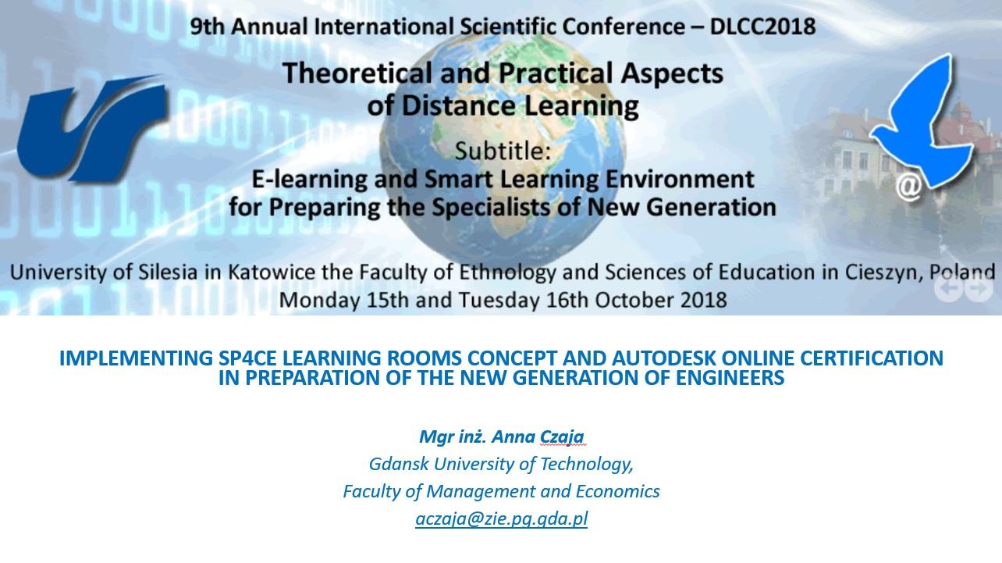

Slide 2
History
1995 Authorized Autodesk Training Centre (ACSA PG)
1996 – 1998 TeleCAD created
1998 – 2003 TeleCAD platform is used by over 1000 students
2003 Moodle replaces TeleCAD
2003 – 2017 ACSA PG issues 1802 AutoCAD certificates
2016 ACSA PG gets a statute of the Authorized Academic Partner
2017 Autodesk Open Doors at Gdańsk University of Technology
Notes:
Authorized Autodesk Training Centre was established in 1995 at Gdansk University of Technology.
A year later the centre started to deliver first AutoCAD to students from Civil Engineering Department.
Course proved to be a great success among students but there were not enough academic instructors.
It rapidy became clear something had to be done.

Slide 3
History
1995 Authorized Autodesk Training Centre (ACSA PG)
1996 – 1998 TeleCAD is created
1998 – 2003 TeleCAD platform is used by over 1000 students
2003 Moodle replaces TeleCAD
2003 – 2017 ACSA PG issues 1802 AutoCAD certificates
2016 ACSA PG gets a statute of the Authorized Academic Partner
2017 Autodesk Open Doors at Gdańsk University of Technology
Notes:
Centre creators started to look for LMS that would suport their needs but at that time there were only commercial versions of LMSs not available to University. So they applied to Leonardo da Vinci Programme and with cooperation with four other instituions from Greece, Finland, Italy and Poland they written their own LMS called TeleCAD.

Slide 4
History
1995 Authorized Autodesk Training Centre (ACSA PG)
1996 – 1998 TeleCAD is created
1998 – 2003 TeleCAD platform is used by over 1000 students
2003 Moodle replaces TeleCAD
2003 – 2017 ACSA PG issues 1802 AutoCAD certificates
2016 ACSA PG gets a statute of the Authorized Academic Partner
2017 Autodesk Open Doors at Gdańsk University of Technology
Notes:
Even though they were not free of charge, online AutoCAD trainings became quite popular.
Course materials consisted of 10 modules that covered basic skills of drawing in AutoCAD.
Every module included a set of exercises with solutions.
available both on and off-line.
For the final exam students had to e-mail their project and few days later in the presence of the instructor prove their autorship by making some changes in their project.

Slide 5
History
1995 Authorized Autodesk Training Centre (ACSA PG)
1996 – 1998 TeleCAD is created
1998 – 2003 TeleCAD platform is used by over 1000 students
2003 Moodle replaces TeleCAD
2003 – 2017 ACSA PG issues 1802 AutoCAD certificates
2016 ACSA PG gets a statute of the Authorized Academic Partner
2017 Autodesk Open Doors at Gdańsk University of Technology

Slide 6
History
1995 Authorized Autodesk Training Centre (ACSA PG)
1996 – 1998 TeleCAD is created
1998 – 2003 TeleCAD platform is used by over 1000 students
2003 Moodle replaces TeleCAD
2003 – 2017 ACSA PG issues 1802 AutoCAD certificates
2016 ACSA PG gets a statute of the Authorized Academic Partner
2017 Autodesk Open Doors at Gdańsk University of Technology
Notes:
The small offer of ACSA PG certificates has been gradually expanding.

Slide 7
History
1995 Authorized Autodesk Training Centre (ACSA PG)
1996 – 1998 TeleCAD is created
1998 – 2003 TeleCAD platform is used by over 1000 students
2003 Moodle replaces TeleCAD
2003 – 2017 ACSA PG issues 1802 AutoCAD certificates
2016 ACSA PG gets a statute of the Authorized Academic Partner
2017 Autodesk Open Doors at Gdańsk University of Technology
Notes:
Since 2016 ACSA PG has had a statute of the Authorized Academic Partner, which means that for educational purposes participants can have
a free access to Autodesk’s design software,
creativity apps and
learning resources (Autodesk University).

Slide 8
History
1995 Authorized Autodesk Training Centre (ACSA PG)
1996 – 1998 TeleCAD is created
1998 – 2003 TeleCAD platform is used by over 1000 students
2003 Moodle replaces TeleCAD
2003 – 2017 ACSA PG issues 1802 AutoCAD certificates
2016 ACSA PG gets a statute of the Authorized Academic Partner
2017 Autodesk Open Doors at Gdańsk University of Technology
Notes:
In 2017, Autodesk Open Doors was held at the Gdansk University of Technology. The event was related to conducting a series of examinations. They were carried out in the computer laboratories of the Faculty of Management and Economics under the supervision of proctors. If they passed, students received certificates issued by Certiport.

Slide 9
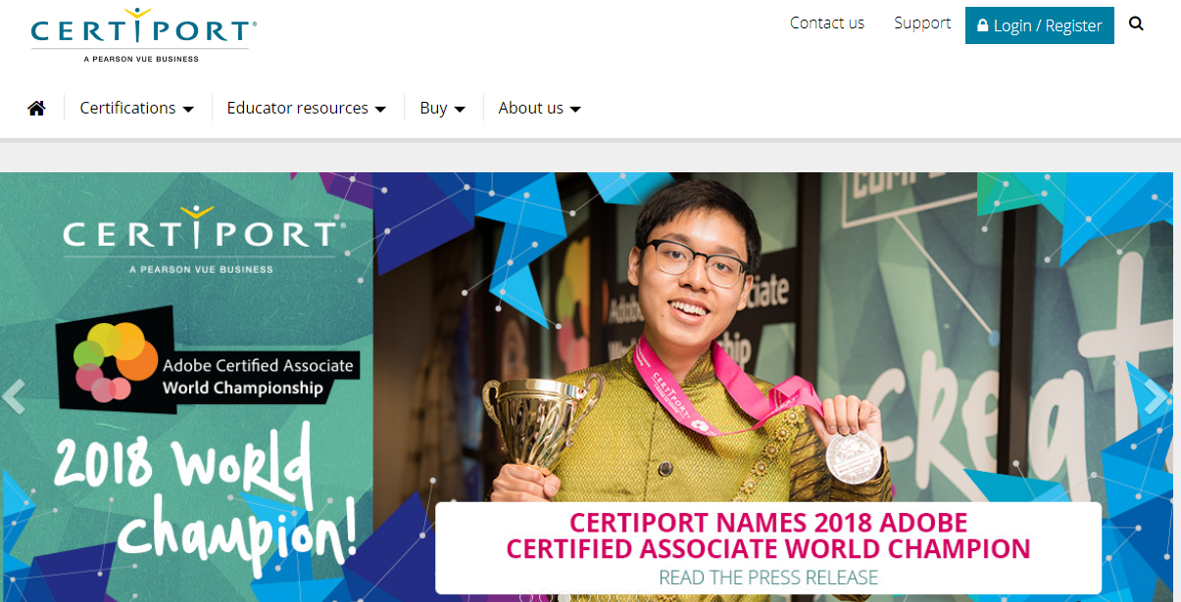
Notes:
Certiport has a network of over 14,000 Authorized Testing Centers in 148 countries and is a world-recognized certification brand.
Among Certiport‘s associates are Microsoft, Adobe, Autodesk and Quickbooks.
Certificates issued by them are widely recognized in the industry.

Slide 10
Results of examination between 1st November 2017 and 18th July 2018
Exam | Number of passed | Number of failed attempts
Inventor Certified Professional Exam |  | 1
3d Max Certified Professional Exam |  | 1
Certified Professional: Revit for Mechanical Building Systems - Metric Exam | 1
Autodesk AutoCAD Certified User Exam | 2
AutoCAD Certified Professional Exam | 4 | 2
Fusion 360 Certified User Exam | 1 | 1
Source: Own work
Notes:
Thanks to AutoCAD offer students gota chance to learn software solutions that are not included in their curriculum. Unfortunately, as can be seen, learning independently is challenging and does not always lead to gaining a certificate.

Slide 11
Learning rooms
Notes:
The passive methods of lecturing do not promote skills such as: problem solving and creativity. On the other hand in virtual "knowledge rooms" rather than just accumulating knowledge, students learn how to manage it.

Slide 12
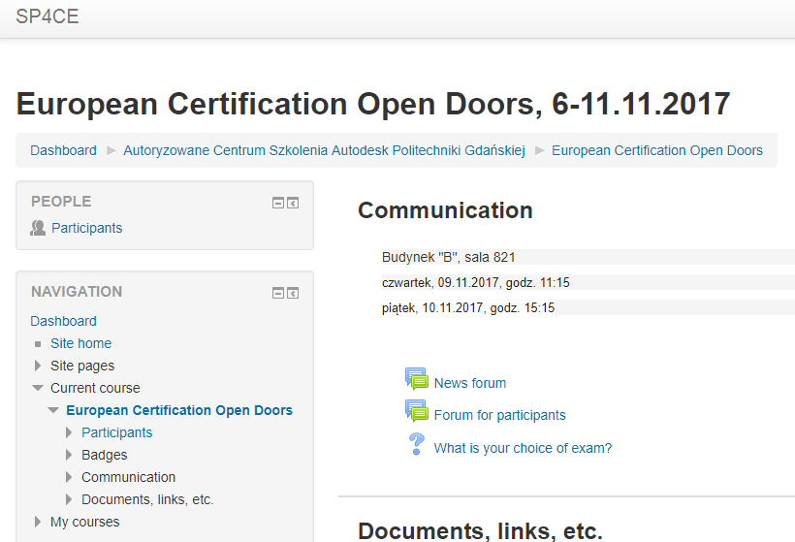
Learning rooms
Notes:
Funded under ERASMUS+ SP4CE stands for Strategic Partnership for Creativity and Entrepreneurship
Each room is dedicated to different problem with limited number of users
portal provides the space for teams creation
problem solving,
mentoring and coaching,

Slide 13
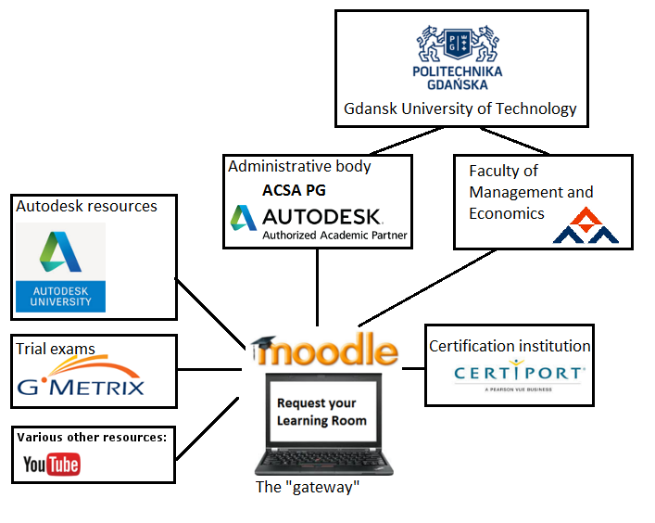
Notes:
A model for supporting online certification at the Authorized Training Center
It all starts by creating Moodle Learning Room aimed at specific exam

Slide 14
Notes:
Since preparing for the exam is crucial, all users will be offered access to Autodesk University resources. Dealing with the vast amount of learning materials in the limited time learners have is challanging so users will be asked to recommend the best sources, upload their own work

Slide 15
Notes:
Registered users will be granted admission to GMETRIX system which provides educational tools and mock exams

Slide 16
Notes:
Certiport system where their knowledge will be tested and certificates issued. Additionally after each exam participants will be asked to fill up a survey. That way the model will get a chance to improve.

Slide 17
Welcome to ACSA PG
nka@pg.gda.pl

