Slide 1
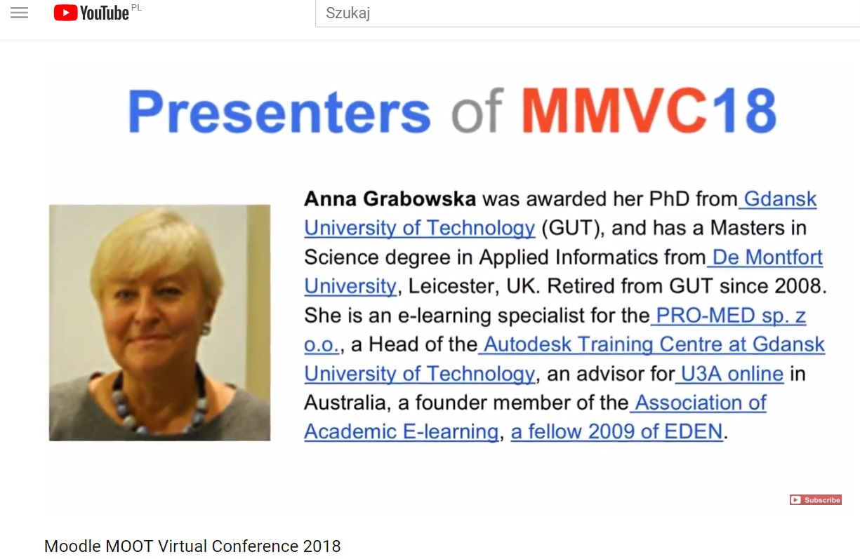
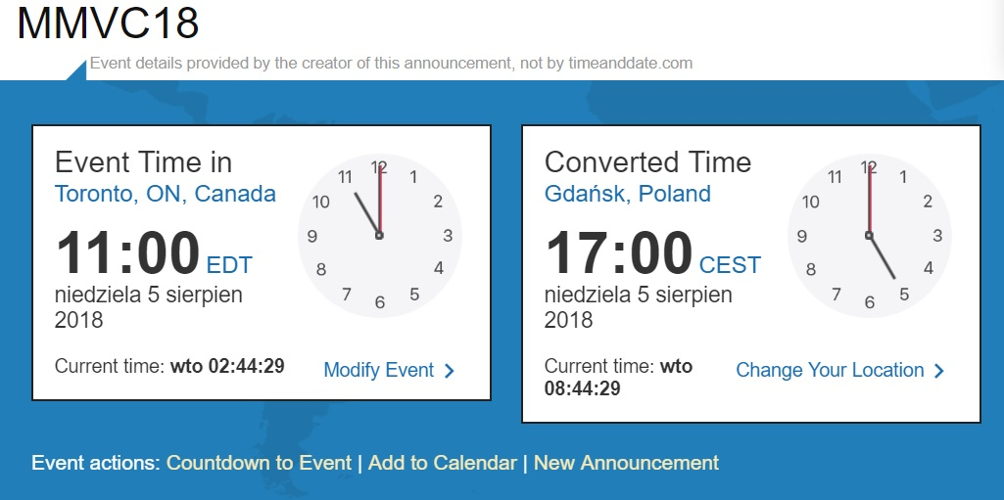
Call a SPADE a SPADE

Slide 2
Call a SPADE a SPADE?
Calling something „as it is”, by its right or proper name,
being outspoken about it, frankly, and directly…
Please stop beating around the bush
and tell me what the problem is!

Slide 3
Let’s start from ERASMUS+

Slide 4
SP4CE ERASMUS+

Slide 5
SPADE ERASMUS+

Slide 6
SPADE in FB

Slide 7
SPADE in SP4CE (1)

Slide 8
SPADE in SP4CE (2)

Slide 9
MATURE in SPADE

Slide 10
SPADE in mobile app - steller.co

Slide 11
SPADE in MoodleMoot 2018

Slide 12
SPADE in Sintra

Slide 13
SPADE in utw.pg.gda.pl

Slide 14
SPADE in youtube

Slide 15
11 Links
https://www.youtube.com/watch?v=ap2guv2PFco
http://sp4ce.eu/en/wlcome-to-sp4ce
https://erasmusplusakcjaka2.wixsite.com/besmart
https://www.facebook.com/pg/SPADE-a-partnership-for-digital-inclusion-870429146462082/posts/?ref=page_internal
http://sp4ce.moodle.pl/
http://sp4ce.moodle.pl/course/index.php?categoryid=14
http://sp4ce.moodle.pl/course/view.php?id=144 (guest, spade2018)
https://steller.co/s/89buh3wTs9c
https://steller.co/s/8942Fg629qr
http://utwpg.gda.pl/?dir=2018SPADE
https://youtu.be/EDvXwxj5rIc

Slide 16
Dziękuję

