Slide 1

Be Smart - Strategic Partnership for Digitally Excluded
Sintra Tour
Group 2: Marisol, Anka, Ania
Lisbon, 22-26 May 2018
This project has been funded with support from the European Commission. This publication only reflects the views the author, and the Commission cannot be held responsible for any use which may be made of the information contained therein.

Slide 2
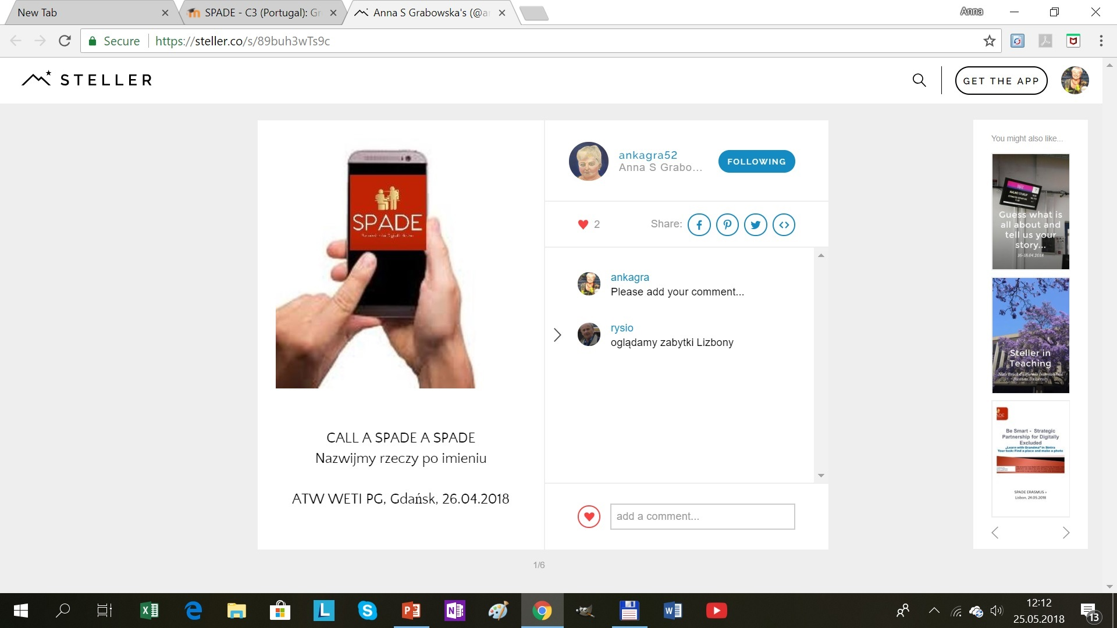
How about steller.co…

Slide 3
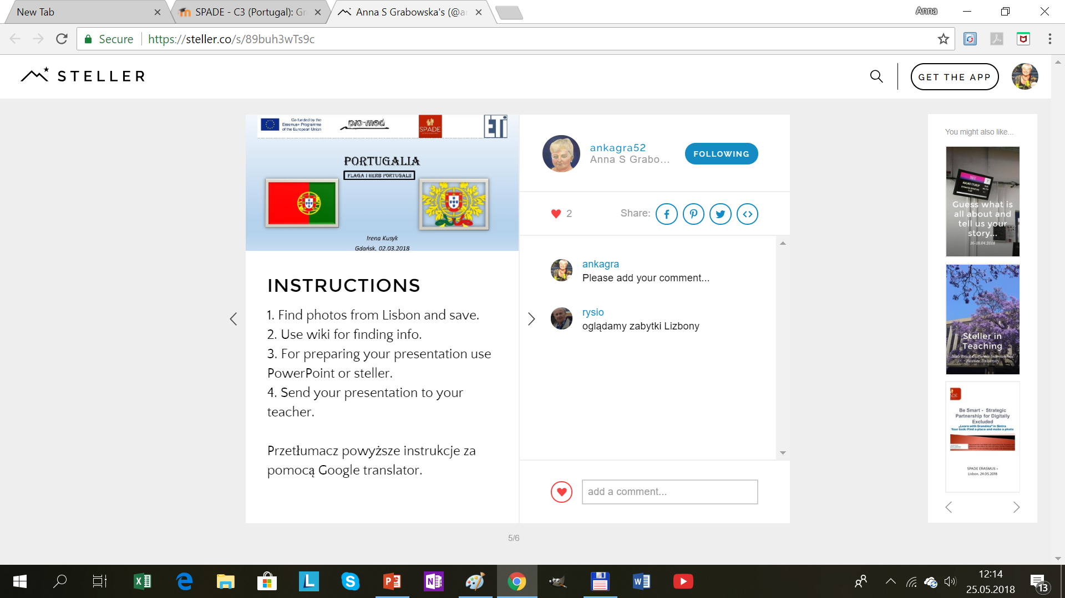
Instructions for 60,79,80+

Slide 4
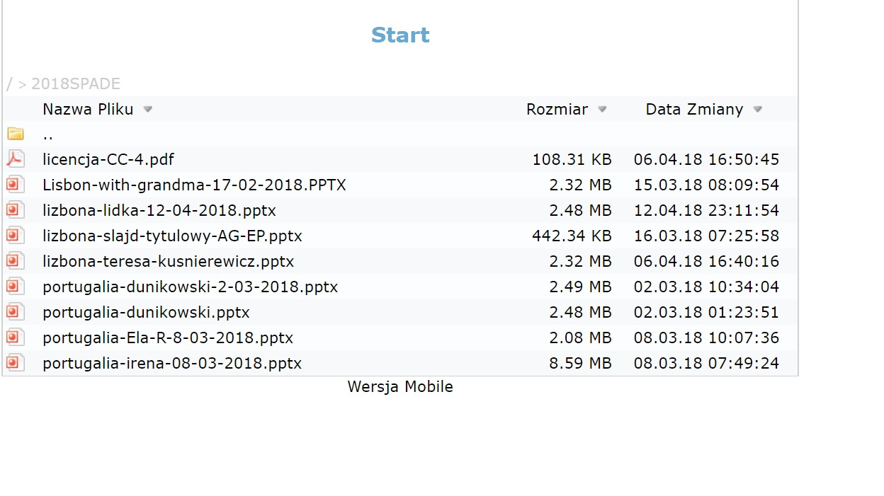
The presentations about Lisbon are here http://utwpg.gda.pl/?dir=2018SPADE

Slide 5
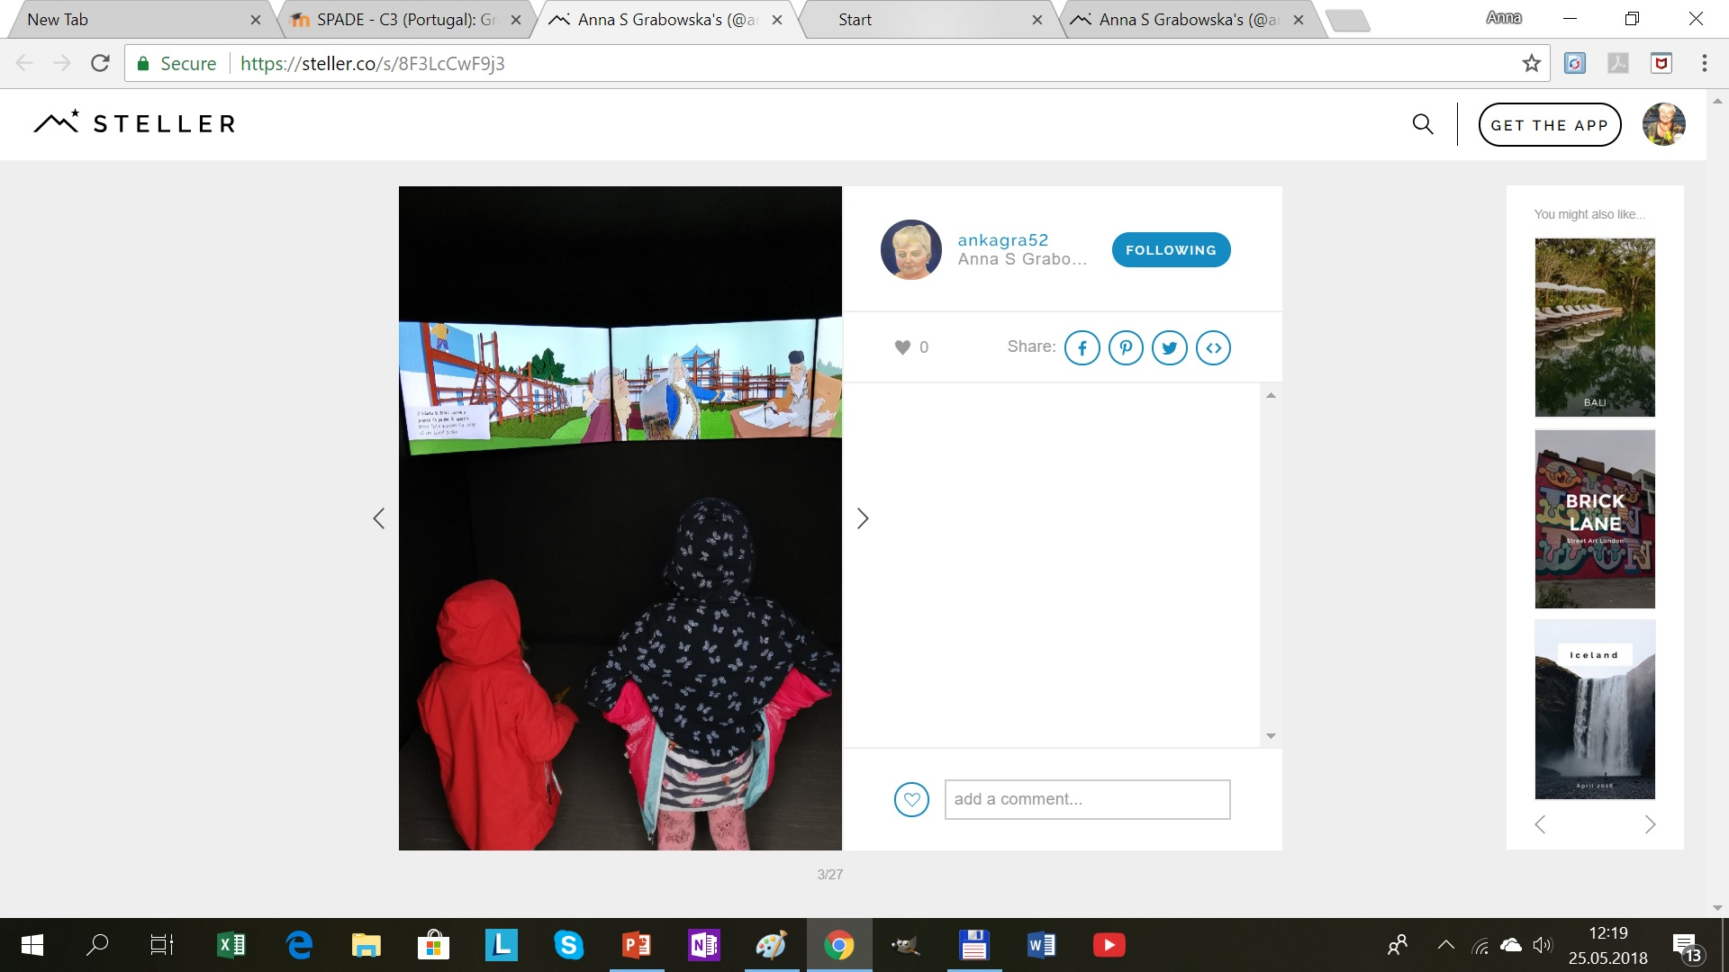
The National Palace of Queluz

Slide 6

Sintra Tour

