Slide 1
City Games – churches in Augsburg
LTT Activities in Augsburg, 23-25.02.2019
Dr Anna Grabowska, Ewa Kozłowska
PRO-MED, Poland

Slide 2
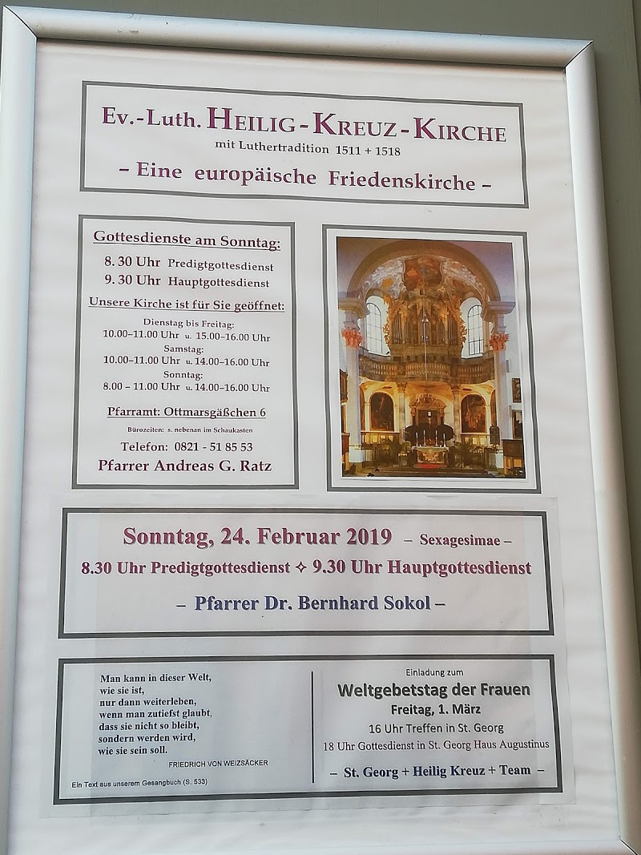
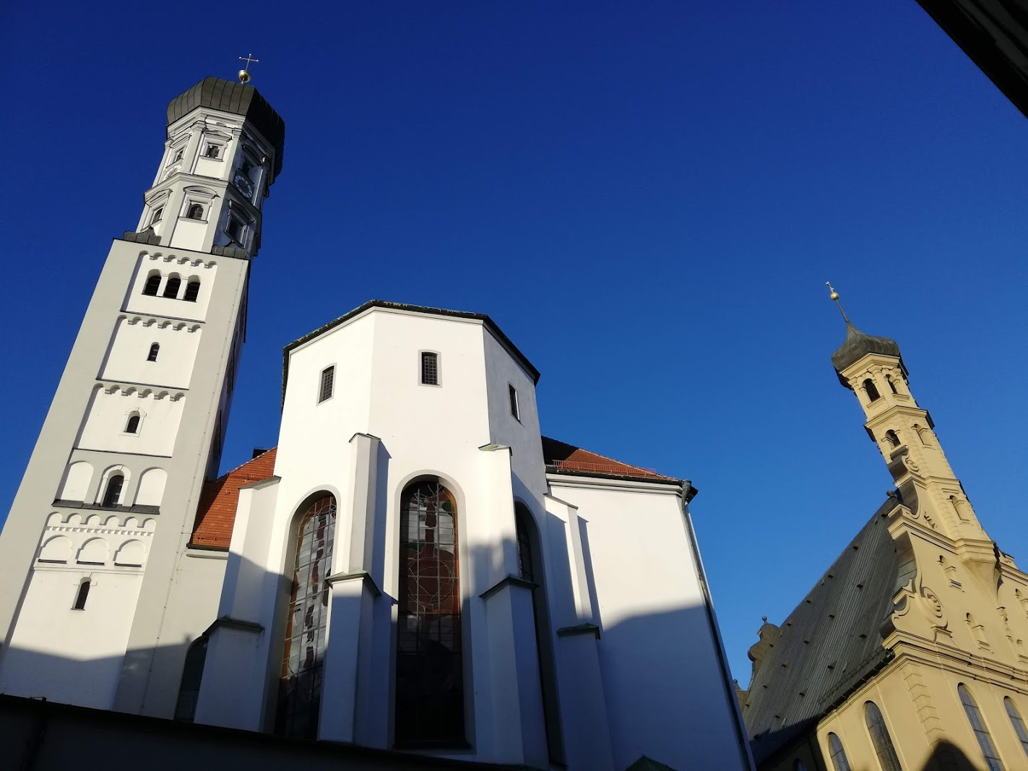
Heilig Kreuz Kirche in Augsburg
Monastery of the Holy Cross

Slide 3
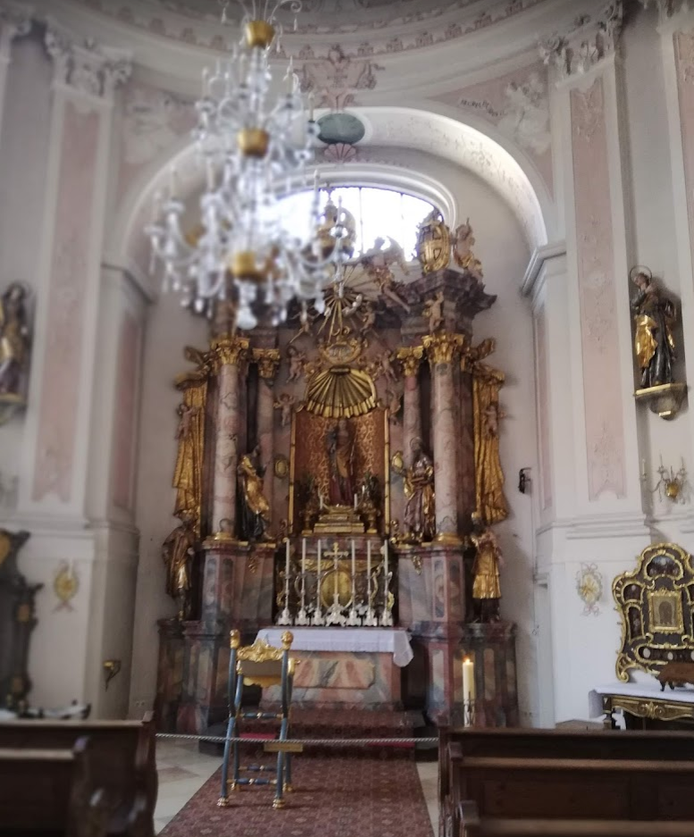
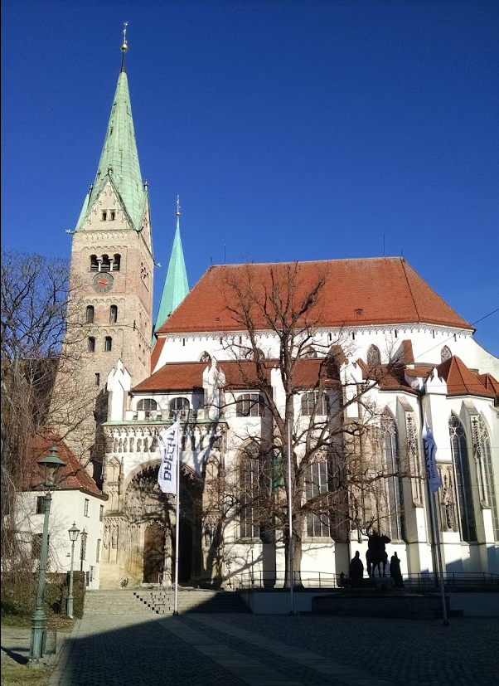
Der Hohe Dom zu Augsburg
Augsburger Dom

Slide 4
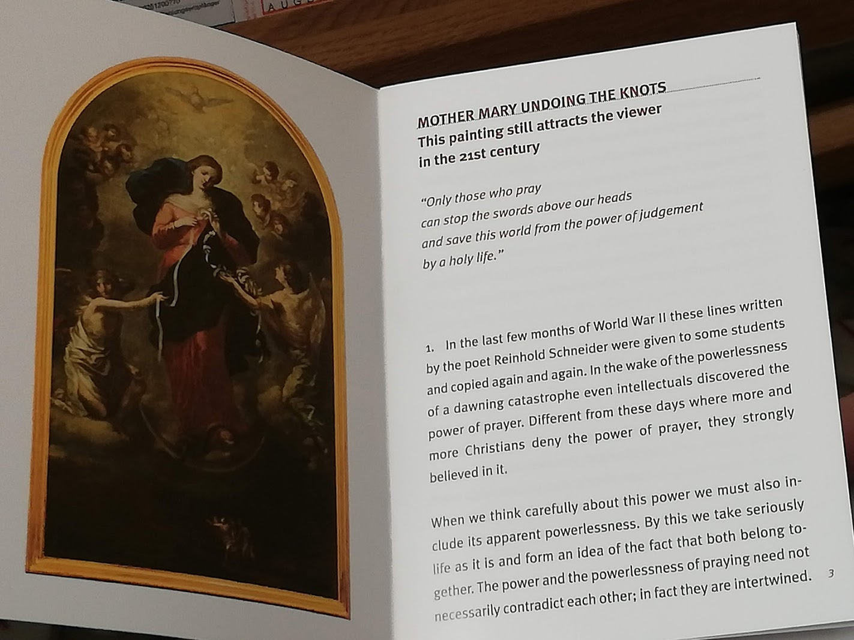
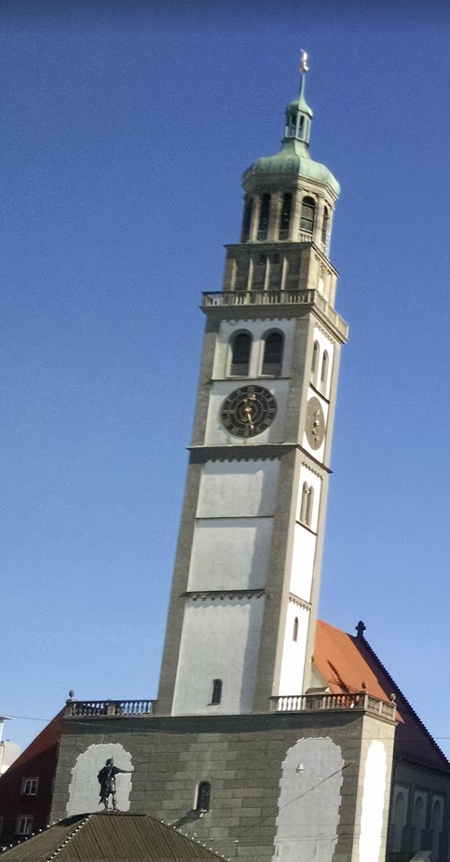
St. Peter am Perlach
St. Peter on the Perlach

Slide 5
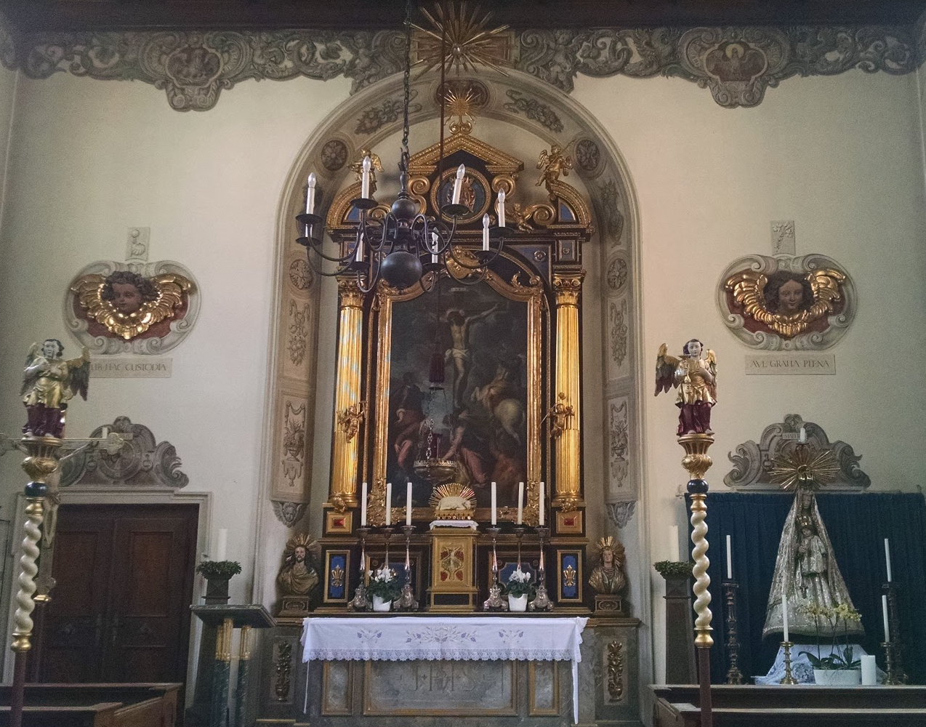
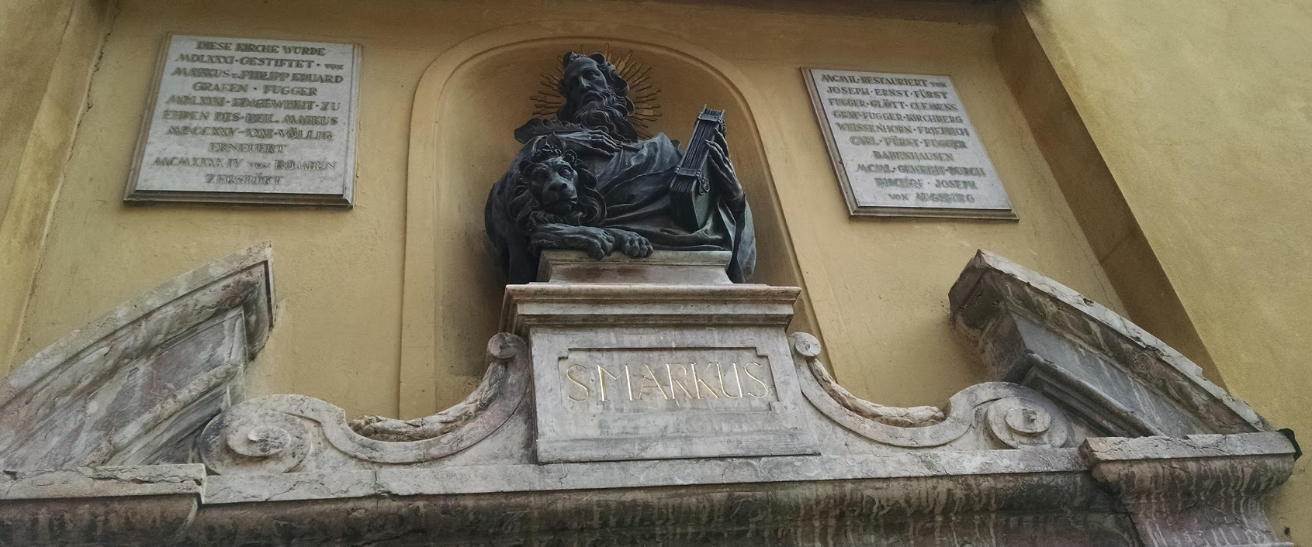
Markuskirche
Chiesa di San Marco

Slide 6
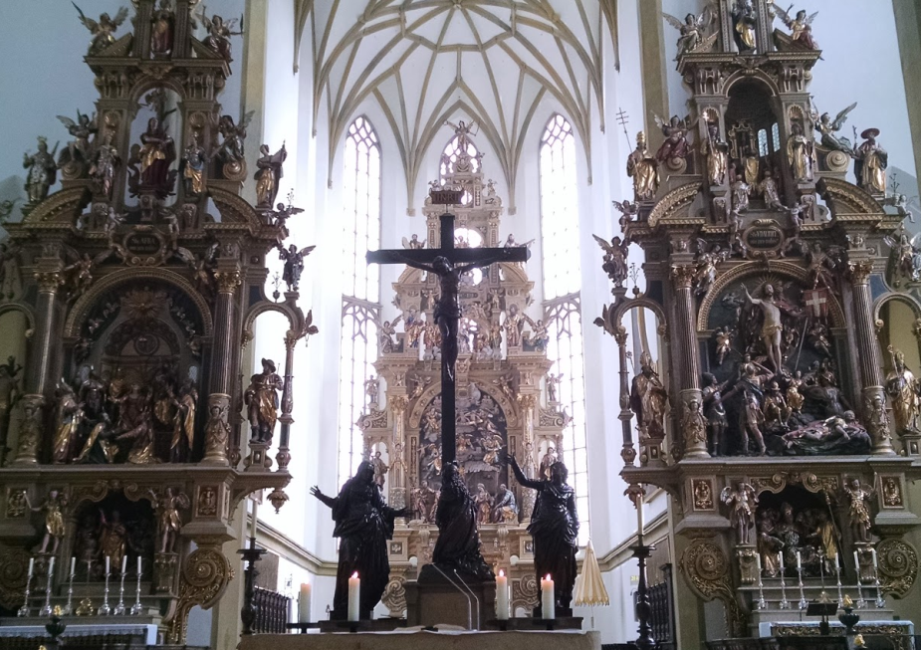
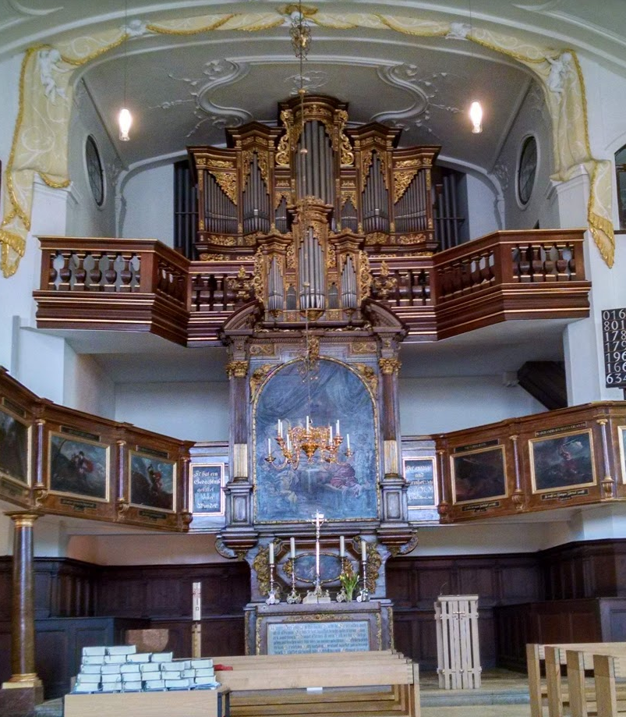
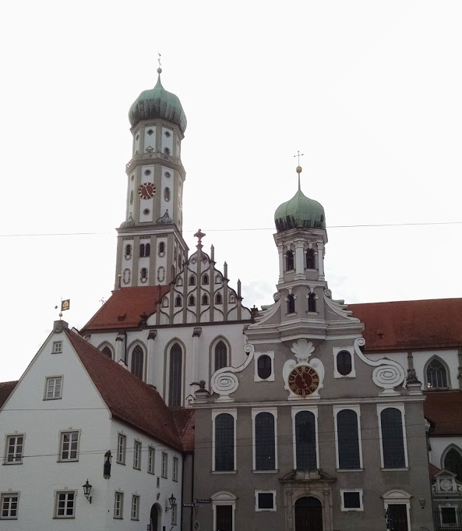
St. Ulrich und Afra

Slide 7
