Slide 1
Sunday in Augsburg
City Games
LTT Activities in Augsburg, 23-25.02.2019
Ewa Kozłowska, PRO-MED, Poland
The project ERASMUS + "Strategic Partnership for Older People’s Inclusion into the Digital World" (1.10.2018 – 30.09.2020) has been funded with support from the European Commission. This publication only reflects the views the author, and the Commission cannot be held responsible for any use which may be made of the information contained therein.

Slide 2
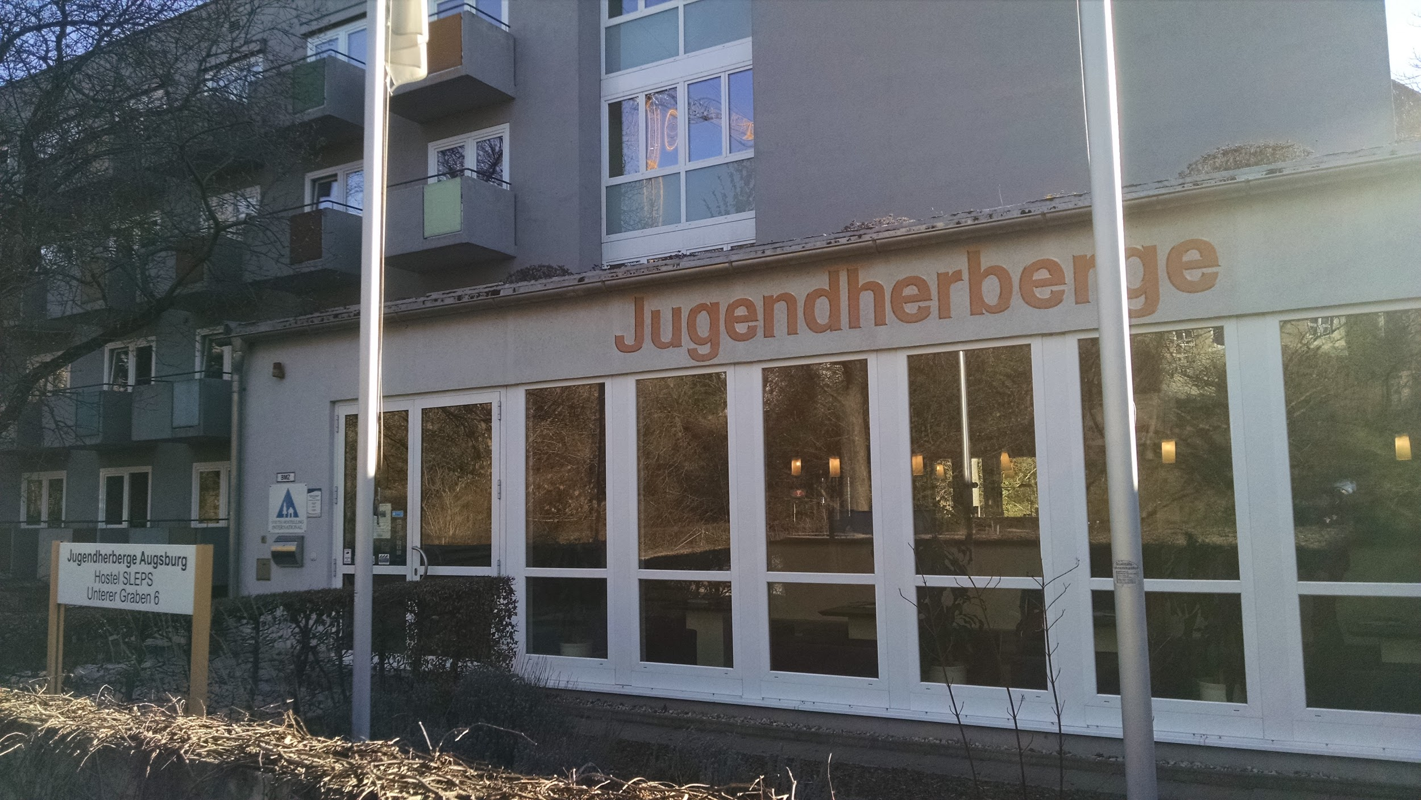
That’s our hostel. What's the name of a coffee-cinema-bar right next to it?
Take a picture when you find it.
☕🍻🍹

Slide 3
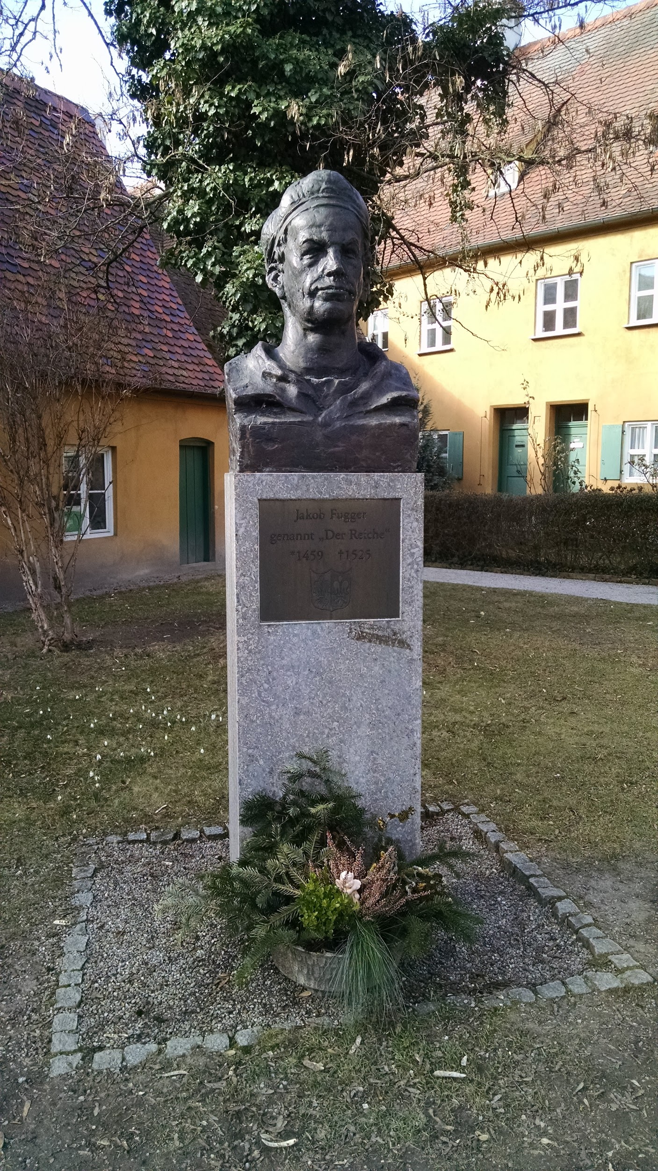
Who’s that guy and why is he so famous?
Can you find this statue? Take a picture!
⬅🔍❔❓❔

Slide 4
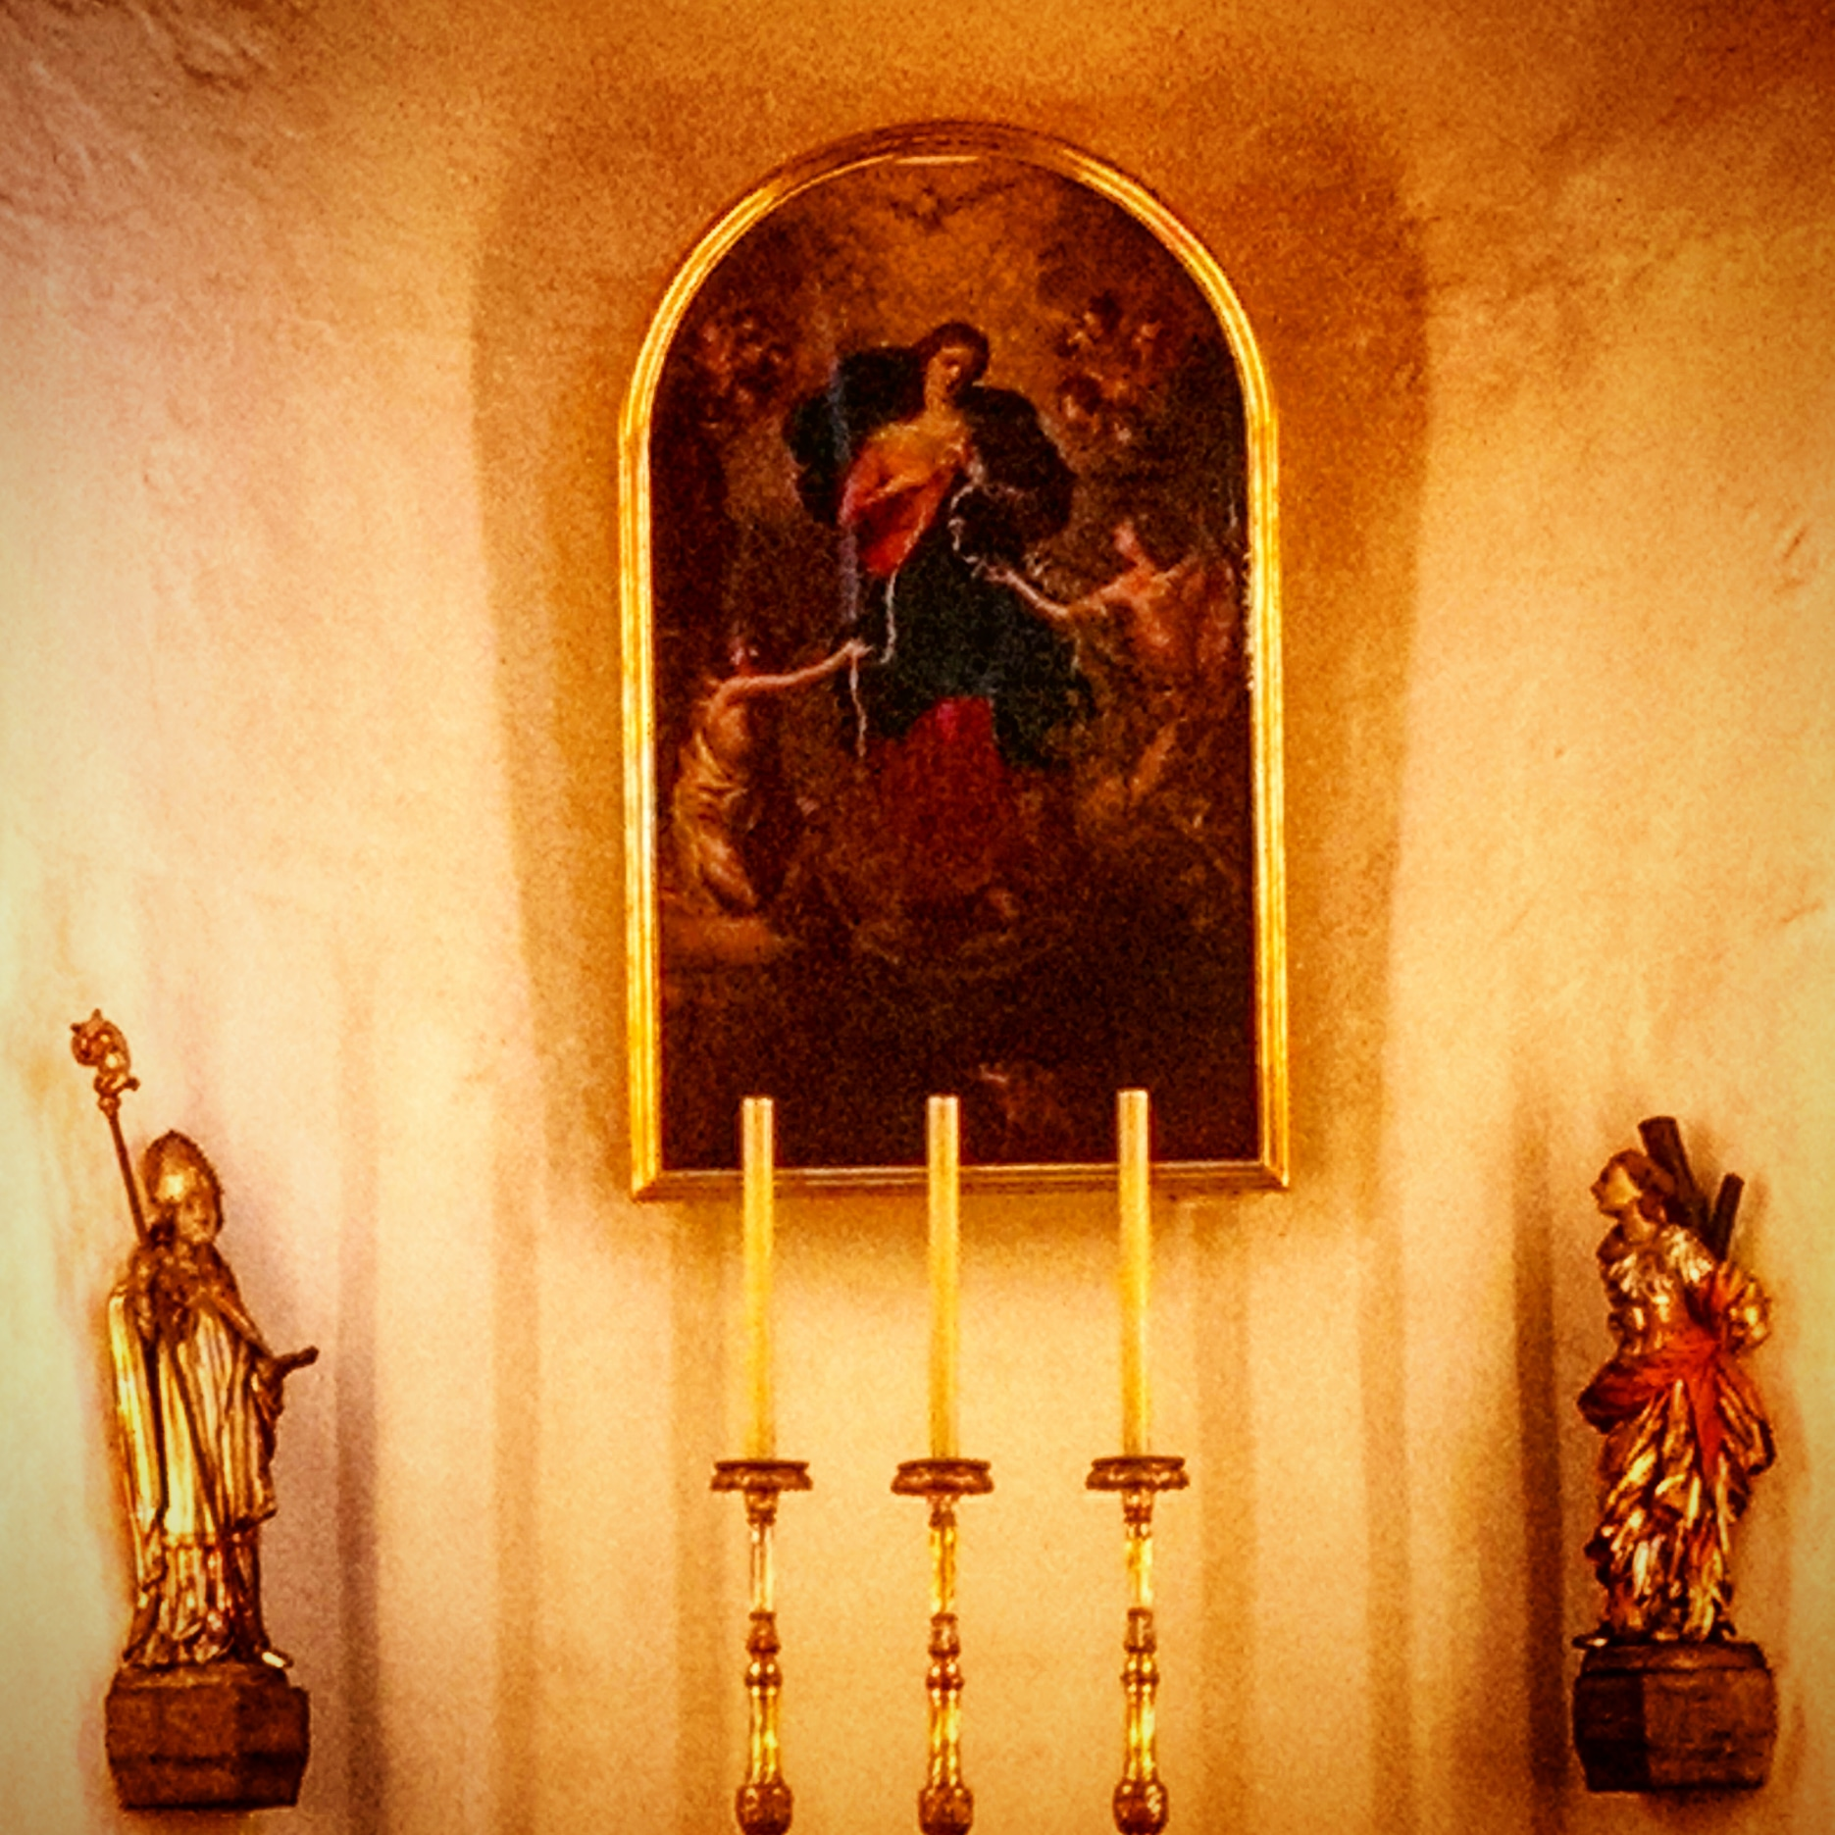
In Polish we call this painting “Matka Boska Rozwiązująca Węzły”.
How would you call it in your language?

Slide 5
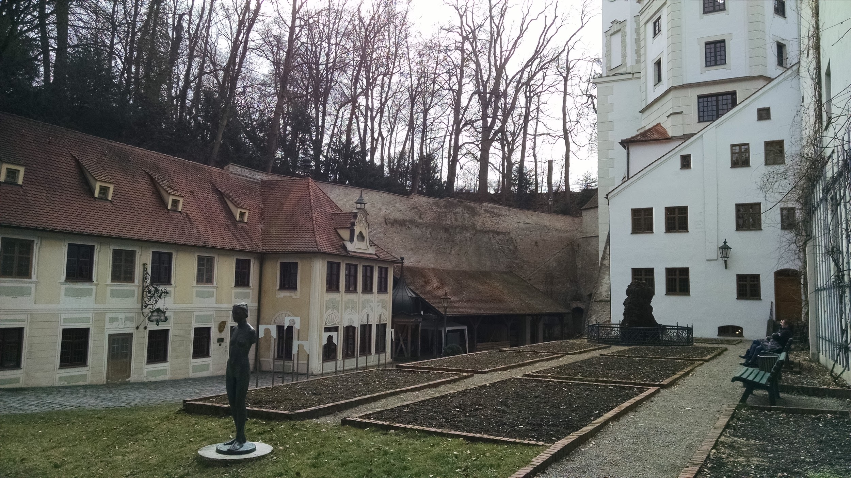
What museum can you find in this area?

Slide 6
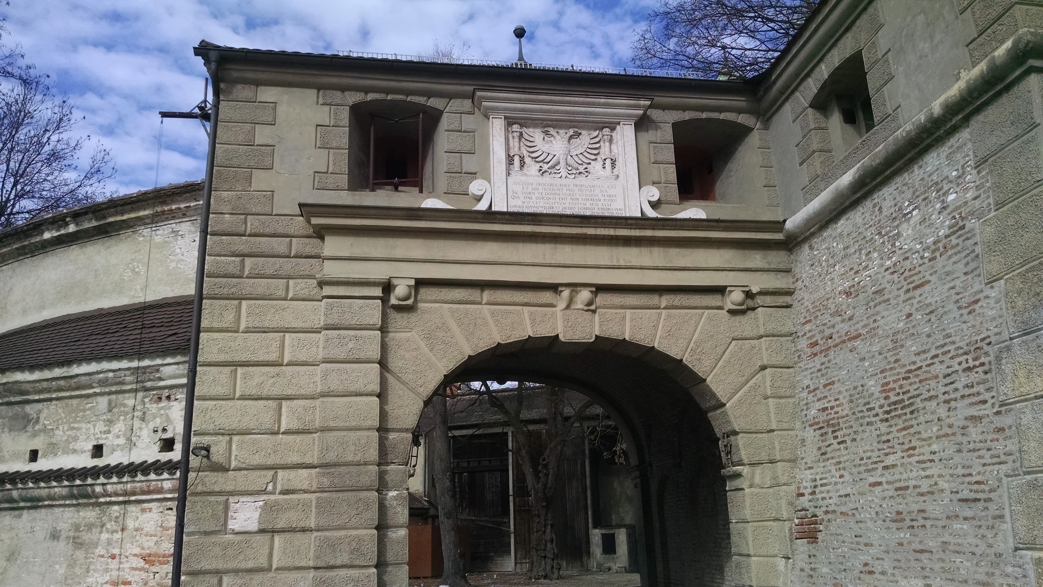
What a nice gate! It's right next to the pupets theatre. Can you find it on a map? 🌍🔎

