Slide 1

Fusion 360 - Learning in Clouds
Dr. Anna Grabowska
Autodesk Authorized Academic Partner
Gdańsk University of Technology
Gdańsk, Poland

Slide 2
Our diary
1995 – Authorized Autodesk Training Centre (ACSA PG)
1996 – 1998 TeleCAD created
1998 – 2003 TeleCAD platform usage
2003 – Moodle replaces TeleCAD
2003 – 2017 ACSA PG issues 1802 Autodesk certificates
2016 – ACSA PG gets a status of the Authorized Academic Partner
2017 – SP4CE, Autodesk Open Doors at Gdańsk University of Technology
2020 – CoLED, Cerificates of attendance, Certiport (ACU, ACP)
Notes:
Authorized Autodesk Training Centre at Gdansk University of Technology (ACSA PG) was established in 1995.
AutoCAD course was delivered since 1996 in Open Distance Learning mode for students from
Civil Engineering Department at Gdansk University of Technology.

Slide 3
Our diary
1995 – Authorized Autodesk Training Centre (ACSA PG)
1996 – 1998 TeleCAD is created
1998 – 2003 TeleCAD platform usage
2003 – Moodle replaces TeleCAD
2003 – 2017 ACSA PG issues 1802 Autodesk certificates
2016 – ACSA PG gets a statute of the Authorized Academic Partner
2017 – SP4CE, Autodesk Open Doors at Gdańsk University of Technology
2020 – CoLED, Cerificates of attendance, Certiport (ACU, ACP)
Notes:
The idea of the TeleCAD course evolved from an AutoCAD course.
project was co-financed by European Union Leonardo da Vinci Programme and developed by Gdansk University of Technology in co-operation with four institutions from Greece (IDEC, ZEUS), Finland (Pekkala Software Oy), Italy (ARGO) and Poland (Young Digital Poland S.A.).
main objectives:
to develop a Learning Management System (LMS),
to use this newly created environment to produce an AutoCAD training
Course materials consisted of 10 modules that covered basic skills of drawing in AutoCAD. Every module included a set of exercises with description of an appropriate solution. Course materials were prepared as HTML pages available both on and off-line. The participants had to hand over the final project sending it by e-mail through LMS TeleCAD to the assigned instructor. To prove authorship, students were asked to make changes in their projects in the presence of the instructor.

Slide 4
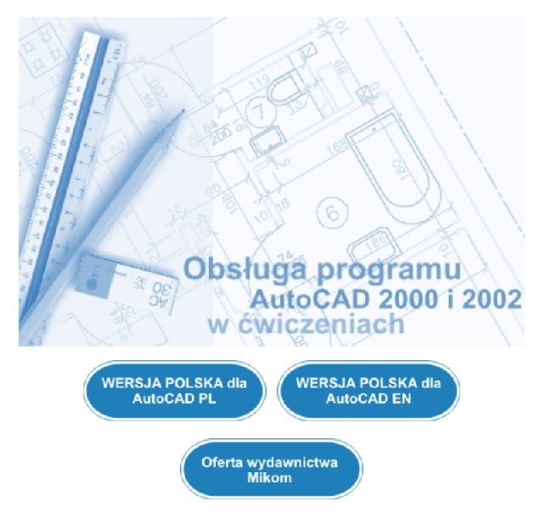
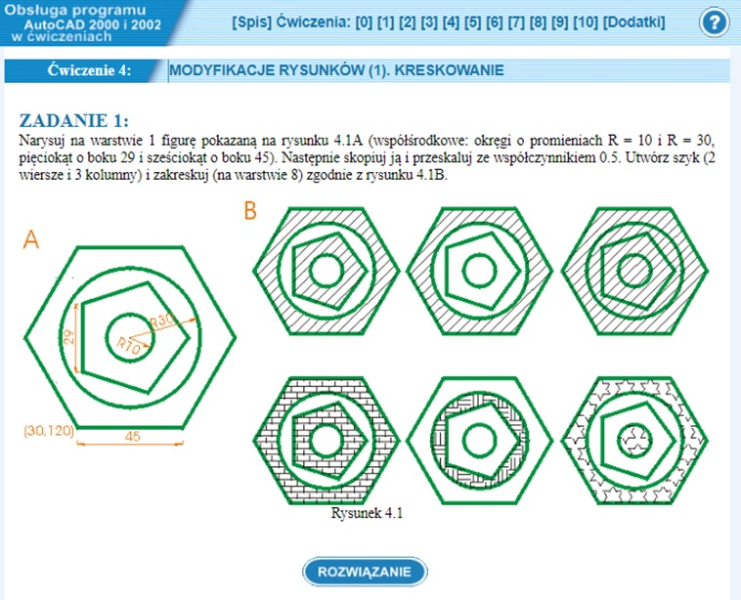
10 modules – online/off line/printed
Notes:
Course materials consisted of 10 modules that covered basic skills of drawing in AutoCAD. Every module included a set of exercises with description of an appropriate solution. Course materials were prepared as HTML pages available both on and off-line. The participants had to hand over the final project sending it by e-mail through LMS TeleCAD to the assigned instructor. To prove authorship, students were asked to make changes in their projects in the presence of the instructor

Slide 5
Our diary
1995 – Authorized Autodesk Training Centre (ACSA PG)
1996 – 1998 TeleCAD is created
1998 – 2002 TeleCAD platform usage
2003 – Moodle replaces TeleCAD
2003 – 2017 ACSA PG issues 1802 Autodesk certificates
2016 – ACSA PG gets a statute of the Authorized Academic Partner
2017 – SP4CE, Autodesk Open Doors at Gdańsk University of Technology
2020 – CoLED, Cerificates of attendance, Certiport (ACU, ACP)
Notes:
Even though they were not free of charge, online AutoCAD trainings became quite popular.

Slide 6
919 students in 2000-2002
TeleCAD platform usage | Students
AutoCAD pilot course in English - 2000 | 89
AutoCAD pilot course in Polish - 2000 | 35
ICT exams for students - 2000/2001 | 468
ICT exams for students - 2001/2002 | 323
AutoCAD summer course 2002 | 4
Notes:
There were more than 900 students taking part in the testing and implementing phase of TeleCAD platform.

Slide 7
Our diary
1995 – Authorized Autodesk Training Centre (ACSA PG)
1996 – 1998 TeleCAD is created
1998 – 2003 TeleCAD platform usage
2003 – Moodle replaces TeleCAD
2003 – 2017 ACSA PG issues 1802 Autodesk certificates
2016 – ACSA PG gets a statute of the Authorized Academic Partner
2017 – SP4CE, Autodesk Open Doors at Gdańsk University of Technology
2020 – CoLED, Cerificates of attendance, Certiport (ACU, ACP)
Notes:
In 2003 we replaced TeleCAD with Moodle.

Slide 8

From 2003
Notes:
It was the best choice.

Slide 9
Notes:
In the period 2003 – 2016 ACSA PG issues 1802 Autodesk certificates

Slide 10
Our diary
1995 – Authorized Autodesk Training Centre (ACSA PG)
1996 – 1998 TeleCAD is created
1998 – 2003 TeleCAD platform usage
2003 – Moodle replaces TeleCAD
2003 – 2016 ACSA PG issues 1802 Autodesk certificates
2016 – ACSA PG gets a statute of the Authorized Academic Partner
2017 – SP4CE, Autodesk Open Doors at Gdańsk University of Technology
2020 – CoLED, Cerificates of attendance, Certiport (ACU, ACP)
Notes:
Which means that for educational purposes participants can have a free access to Autodesk’s design software, creativity apps and learning resources (Autodesk University).

Slide 11
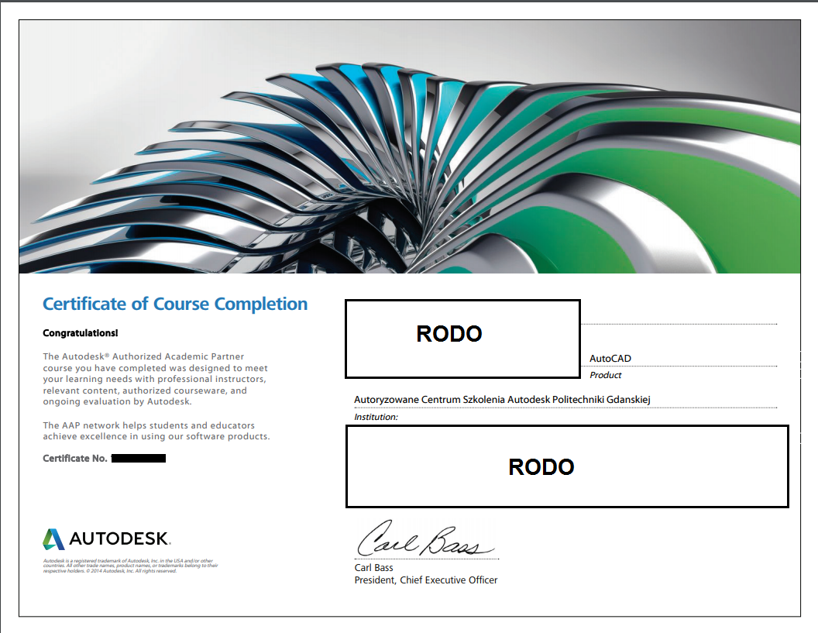
2003 – 2016
>1.800 Autodesk certificates
Notes:
In the years 2003 - 2016, more than 1800 AutoCAD certificates were issued.

Slide 12
Our diary
1995 – Authorized Autodesk Training Centre (ACSA PG)
1996 – 1998 TeleCAD is created
1998 – 2003 TeleCAD platform usage
2003 – Moodle replaces TeleCAD
2003 – 2017 ACSA PG issues 1802 Autodesk certificates
2016 – ACSA PG gets a statute of the Authorized Academic Partner
2017 – SP4CE, Autodesk Open Doors at Gdańsk University of Technology
2020 – CoLED, Cerificates of attendance, Certiport (ACU, ACP)
Notes:
Since 2016 ACSA PG has had a statute of the Authorized Academic Partner, which means that for educational purposes participants can have a free access to Autodesk’s design software, creativity apps and learning resources (Autodesk University).

Slide 13

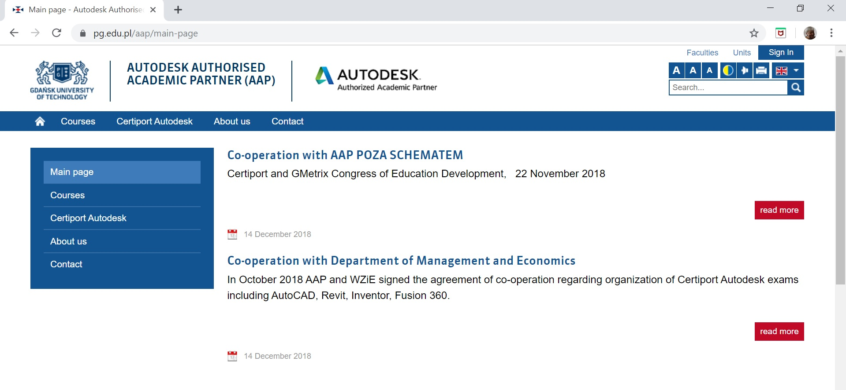
2016

Slide 14
Our diary
1995 – Authorized Autodesk Training Centre (ACSA PG)
1996 – 1998 TeleCAD is created
1998 – 2003 TeleCAD platform usage
2003 – Moodle replaces TeleCAD
2003 – 2017 ACSA PG issues 1802 Autodesk certificates
2016 – ACSA PG gets a statute of the Authorized Academic Partner
2017 – SP4CE, Autodesk Open Doors at Gdańsk University of Technology
2020 – CoLED, Cerificates of attendance and Certiport (ACU, ACP)
Notes:
In 2017, Autodesk Open Doors was held at the Gdansk University of Technology. The event was related to conducting a series of examinations from individual Autodesk programs: Autodesk Certified User (ACU) or Autodesk Certified Professional (ACP). If they passed, students received certificates issued by Certiport.
Certiport has a network of over 14,000 Authorized Testing Centers in 148 countries and is a world-recognized certification brand. Among Certiport‘s associates are Microsoft, Adobe, Autodesk and Quickbooks
Faculty of Management and Economics with representatives of Autodesk as well as institutions like Certiport that deal with online certification. Preparations for the exam took place in a specially prepared learning room on the SP4CE platform. The examinations were carried out in the computer laboratories of the Faculty of Management and Economics of the Gdansk University of Technology under the supervision of proctors.

Slide 15
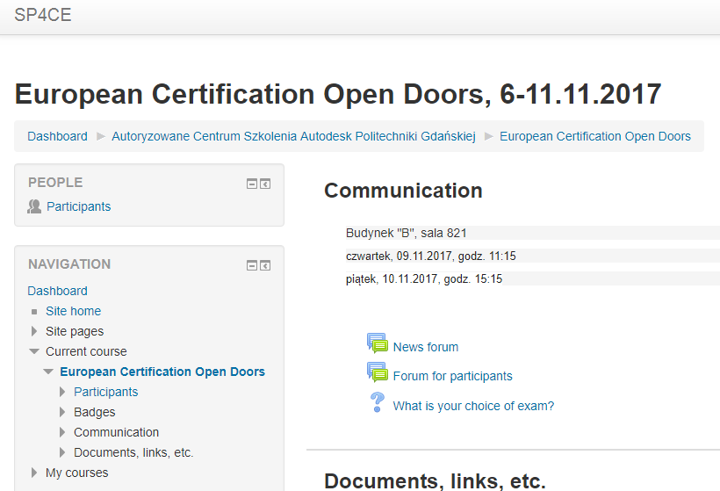
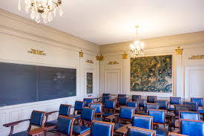
ERASMUS+ SP4CE Learning Rooms - sustainability
Notes:
The passive methods of lecturing do not promote skills such as: problem solving and creativity. As Weigel stated in virtual "knowledge rooms" rather than just accumulating knowledge, students learn how to manage it.
Funded under ERASMUS+ SP4CE stands for Strategic Partnership for Creativity and Entrepreneurship
Each room is dedicated to different problem with limited number of users
portal provides the space for
teams creation
problem solving,
mentoring and coaching,

Slide 16


2017
Autodesk Open Doors
Notes:
Another joint venture was participation in Autodesk Open Doors. The purpose of the event was to improve the qualifications of instructors and test the new system before making it available to students.

Slide 17
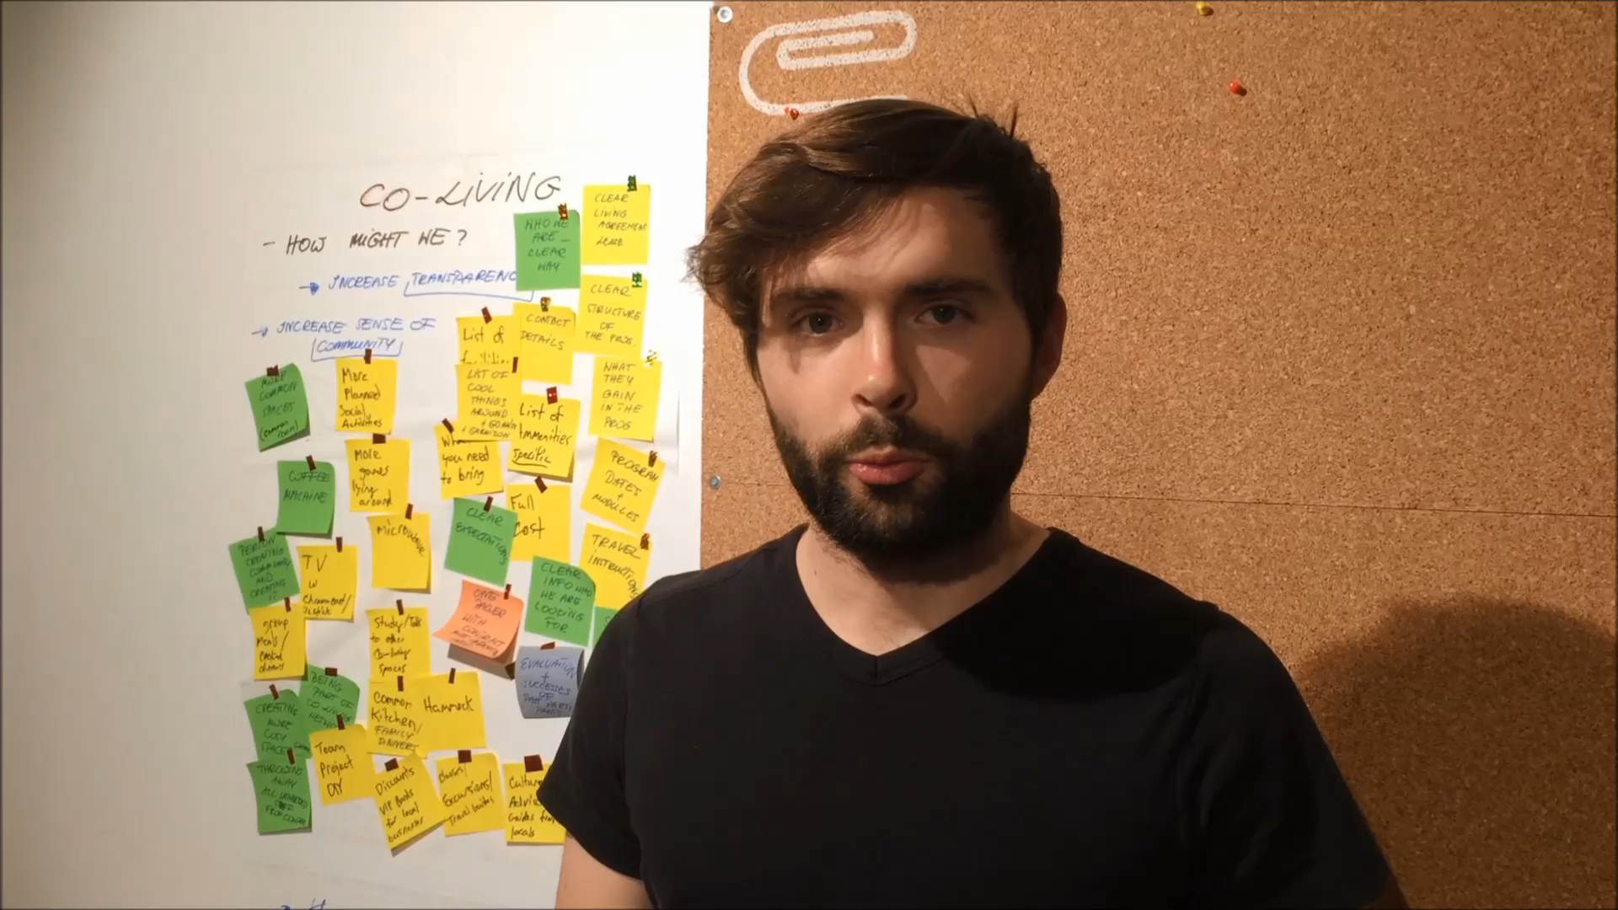
https://youtu.be/HehrabsxW90
https://youtu.be/HehrabsxW90
Notes:
Let introduce our partner…

Slide 18
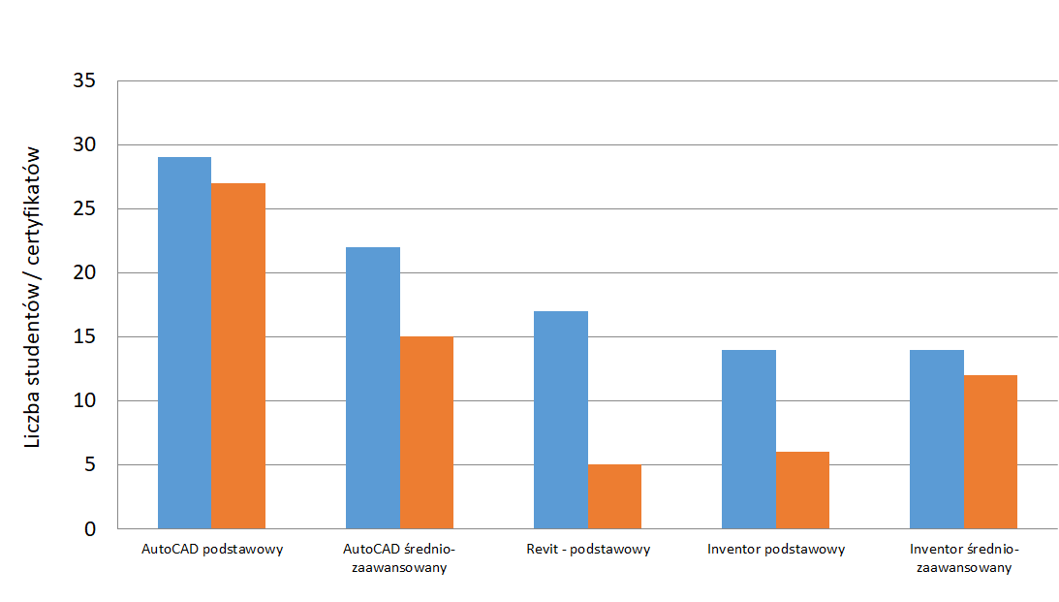
AAP at GUT - courses and exams statistics in summer 2017

Slide 19
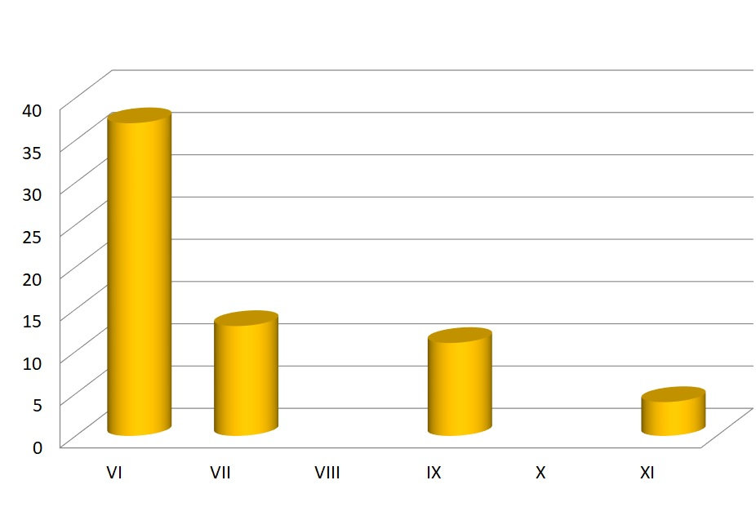
AAP at GUT - certificates for students summer 2017
Notes:
As the course took place in the summer, during the holiday season, in addition to two basic dates in June and July, students were also offered an additional opportunity to take the exam and receive the certificate in September. Three students applied in November. However, the chart shows that the vast majority decided to receive the certificate in June, immediately after completing the training.

Slide 20
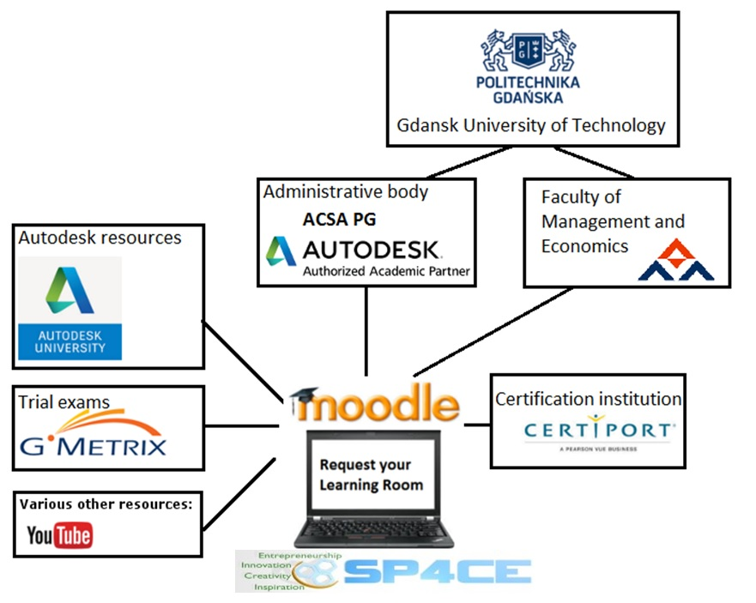
The model of co-operation based on LR concept
Notes:
A model for supporting online certification at the ACSA PG was created by creating Moodle Learning Rooms aimed at specific exam
Since preparing for the exam is crucial, all users will be offered access to Autodesk University resources. Dealing with the vast amount of learning materials in the limited time learners have is challanging so users will be asked to recommend the best sources, upload their own work
Registered users will be granted admission to GMETRIX system which provides educational tools designed to prepare individuals for the effective use of technology in the business environment. This way they will have the oportunity to take a few mock exams
Certiport system where their knowledge will be tested and certificates issued. Additionally after each exam participants will be asked to fill up a survey. That way the model will get a chance to improve.

Slide 21

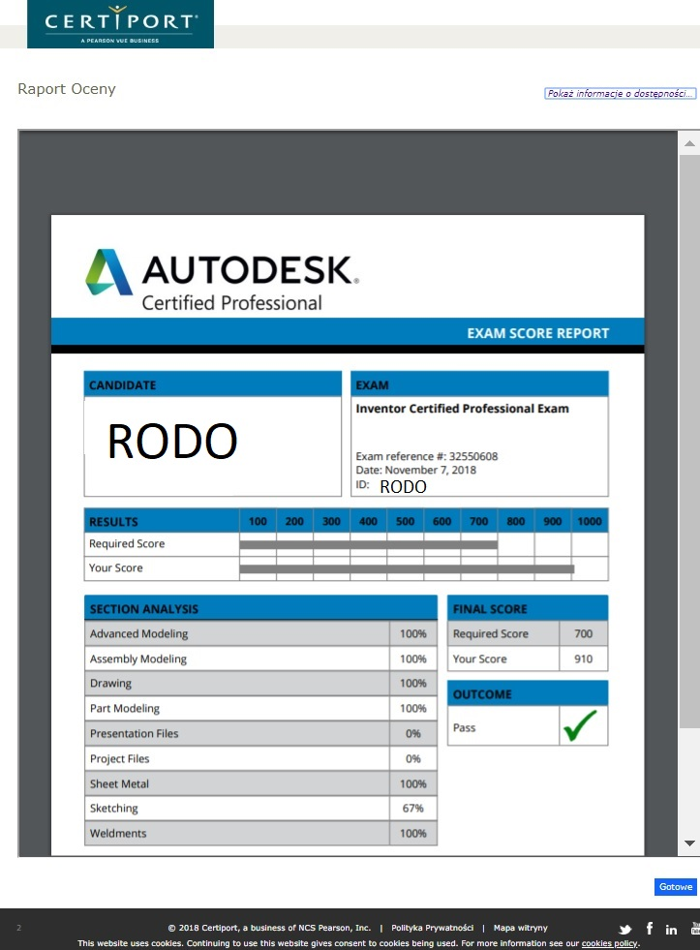







Slide 22
Results of examination between
1st November 2017 and 18th July 2018
Exam | Number of passed | Number of failed attempts
Inventor Certified Professional Exam |  | 1
3d Max Certified Professional Exam |  | 1
Certified Professional: Revit for Mechanical Building Systems - Metric Exam | 1
Autodesk AutoCAD Certified User Exam | 2
AutoCAD Certified Professional Exam | 4 | 2
Fusion 360 Certified User Exam | 1 | 1
Source: Own work
Notes:
Owing to Autodesk course offer students have a chance to familiarize themselves with important software solutions that are not included in their formal academic study programme. Through Certiport, their hard-earned certificates will be widely recognized in the industry. Unfortunately, as can be seen, learning independently is challenging and does not always lead to gaining a certificate. After Open Door event we held interviews.
it is difficult to gather sufficient number of participants,
establish exam date that fits everyone
give support student‘s need to successfly finish the training.

Slide 23
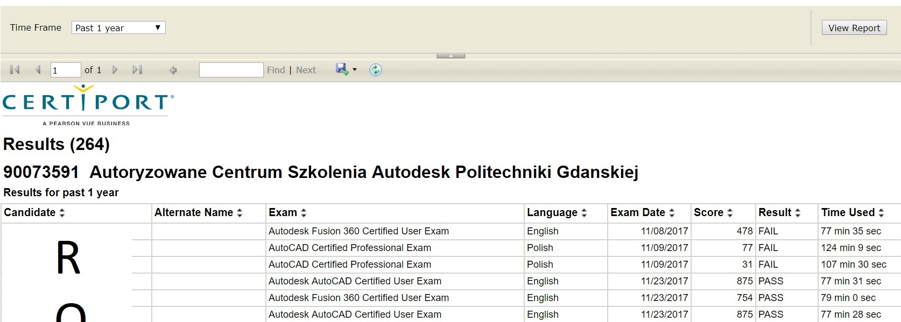
Notes:
The first meeting with the Certiport console turned out to be quite a challenge for the ACSA PG and Beyond Scheme instructors, and the exam results were much lower than expected. Difficulties were, among others, a kind of "familiarity" with the console itself, which blocks all computer functions except the selected program and itself and significantly slows down the system. The tasks are very complex and the time is limited.

Slide 24
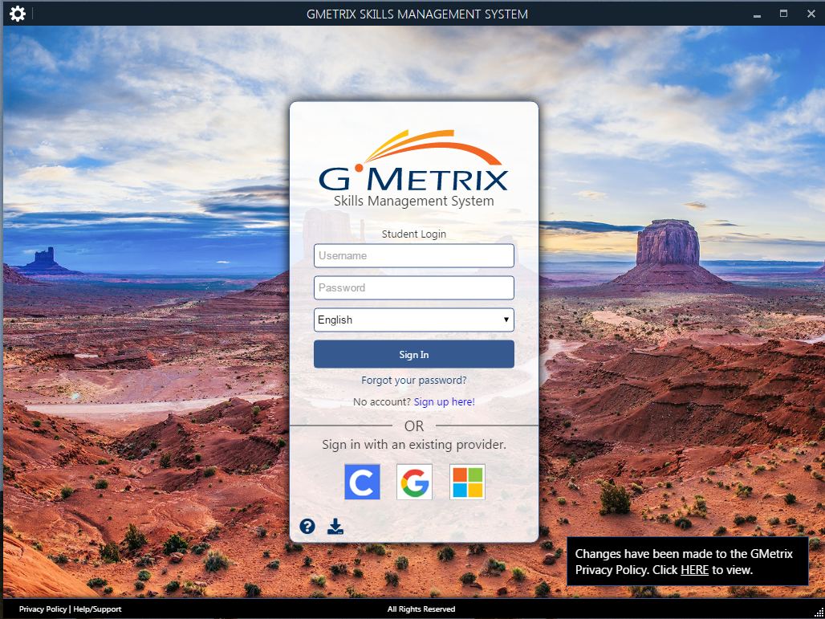
Notes:
Therefore, further actions were taken to improve cooperation and preparation for the exam. It was decided to introduce the GMetrix console, a tool designed to practice tasks comparable to Cetriport exams using a similar console.

Slide 25
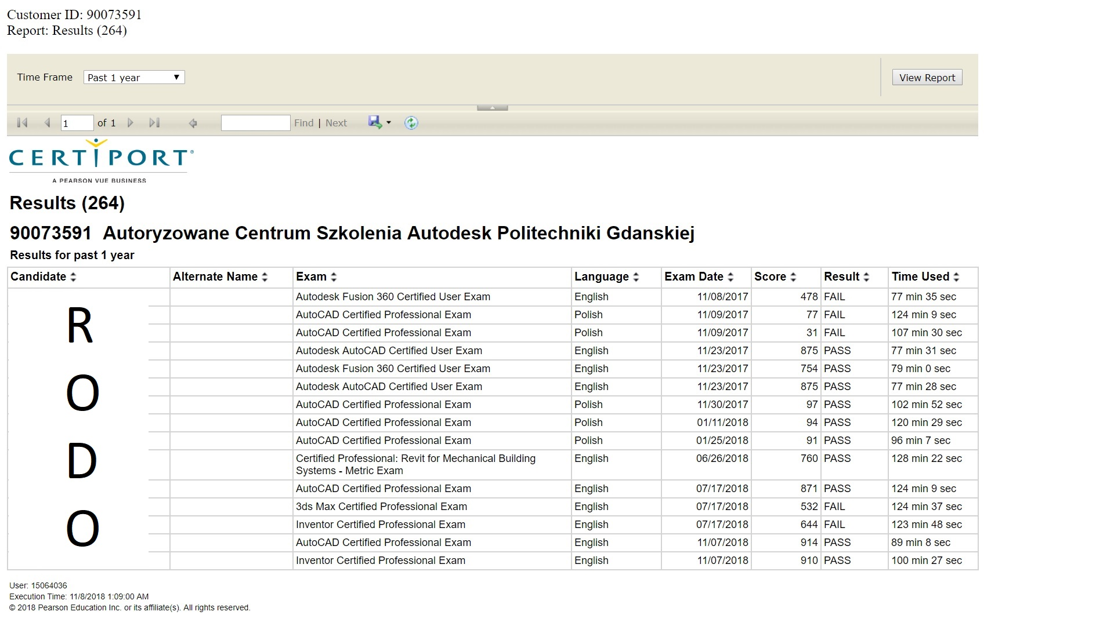
Notes:
In the next series of exams, average results have improved.

Slide 26
Notes:
We managed to get results from professional exams at 91, 94, and even 97%!

Slide 27
Our diary
1995 Authorized Autodesk Training Centre (ACSA PG)
1996 – 1998 TeleCAD is created
1998 – 2003 TeleCAD platform usage
2003 Moodle replaces TeleCAD
2003 – 2017 ACSA PG issues 1802 Autodesk certificates
2016 ACSA PG gets a statute of the Authorized Academic Partner
2017 SP4CE, Autodesk Open Doors at Gdańsk University of Technology
2020 CoLED, Cerificates of attendance, Certiport (ACU, ACP)
Notes:
.

Slide 28
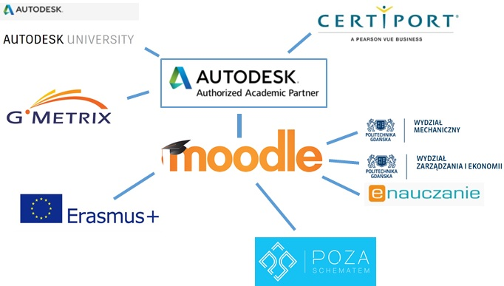
Let’s co-operate and share
Notes:
The proposed model of co-operation is shown on the slide.

Slide 29
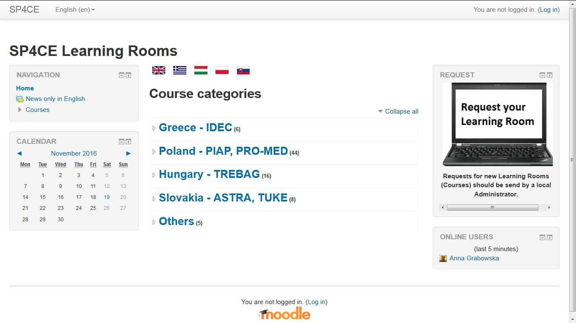
Learning Rooms in Moodle (ERASMUS +SP4CE)
Notes:
Coming back to the past – sustainability of previous ERASMUS+ project SP4CE

Slide 30
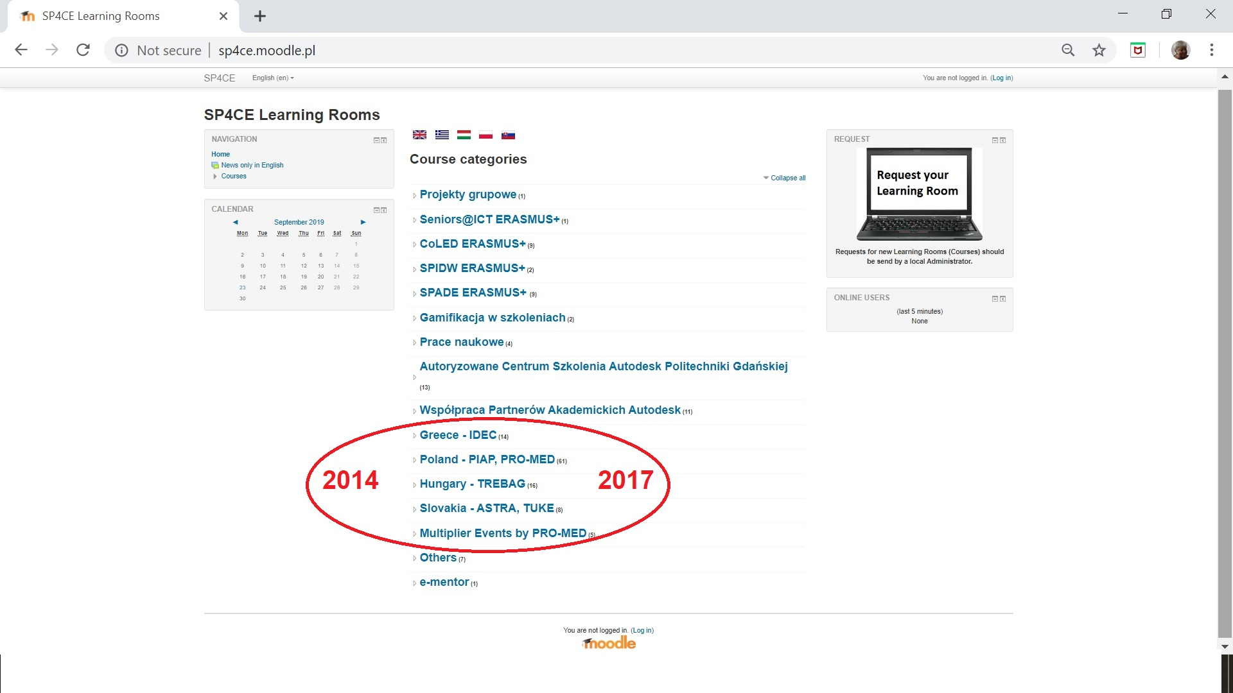
ERASMUS + SP4CE – Strategic Partnership for Creativity and Entrepreneurship (2014-…)

Slide 31
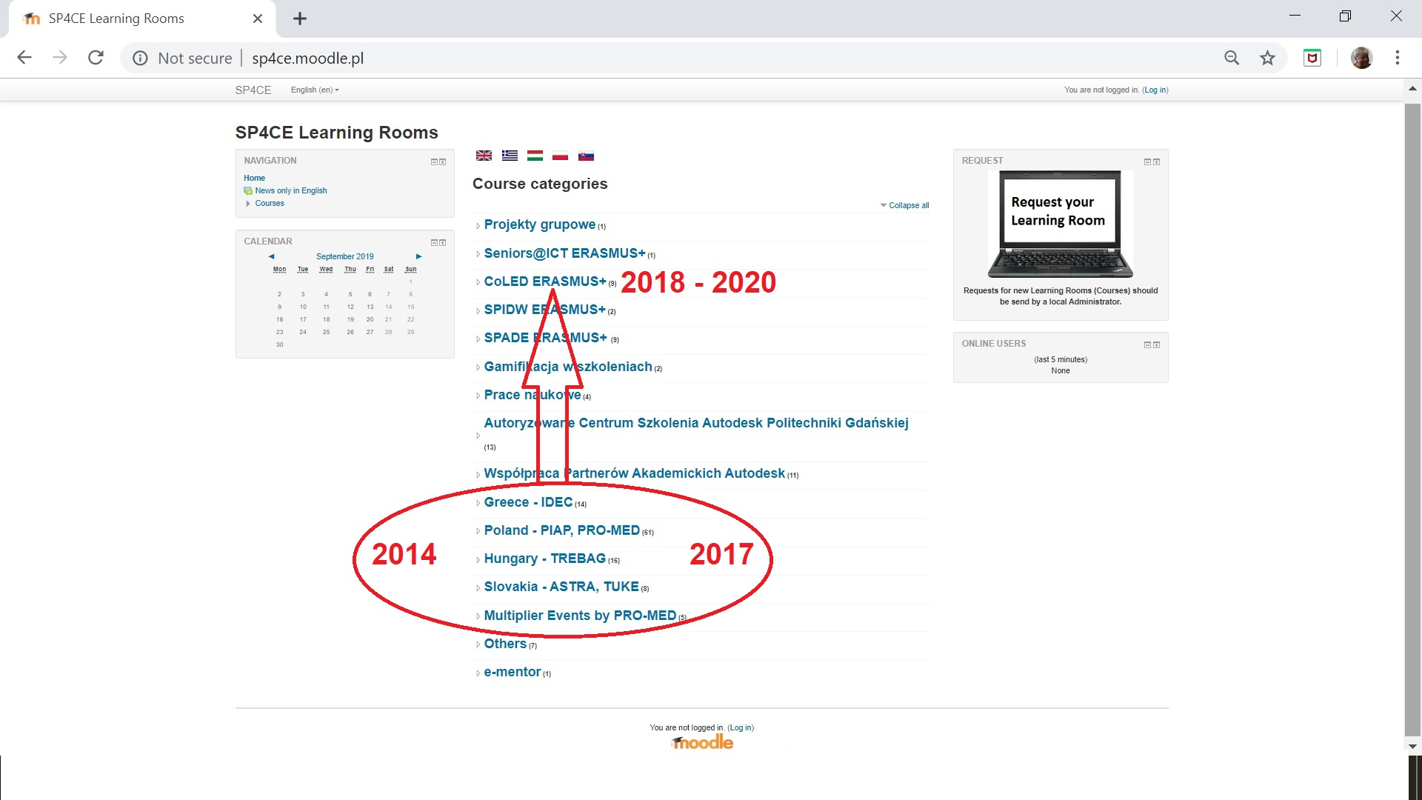
CoLED – Collaborative Learning Environment for Engineering Education

Slide 32
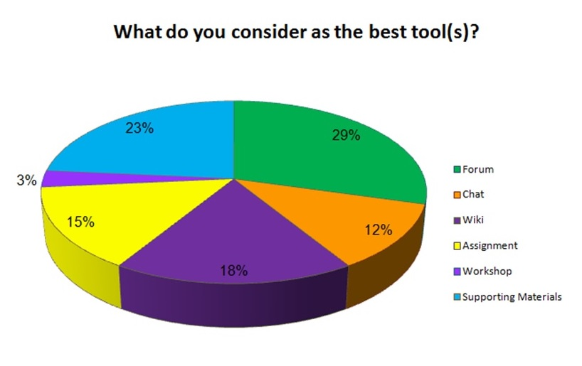
The best tools for communication that can be used in Learning Rooms (SP4CE ERASMUS+)

Slide 33
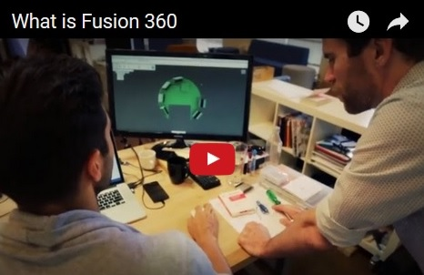
Case study - What is Fusion 360?
Fusion 360 is a cloud-based CAD/CAM tool for collaborative product development.
Fusion 360 is free for students, educators, and academic institutions.
Using Fusion 360, students can develop their skills in order to become tomorrow’s engineers, product designers, and industrial designers.

Slide 34
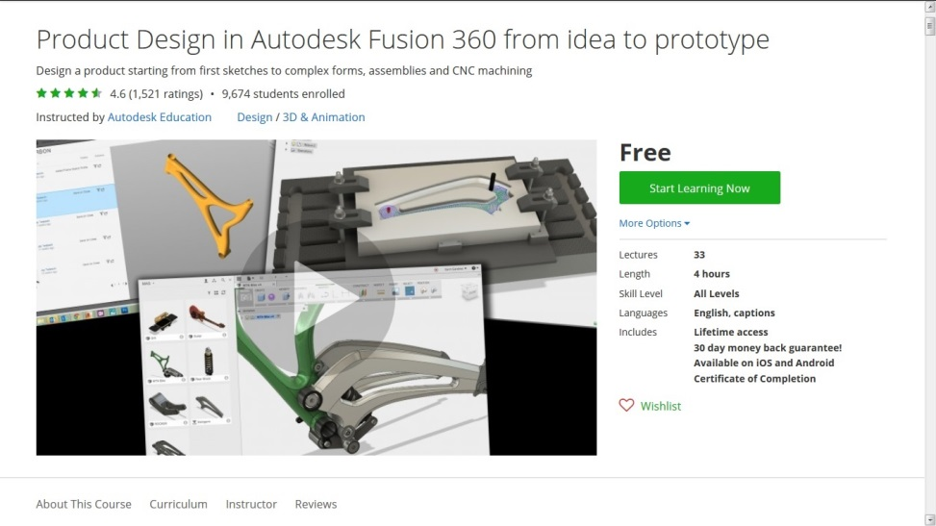
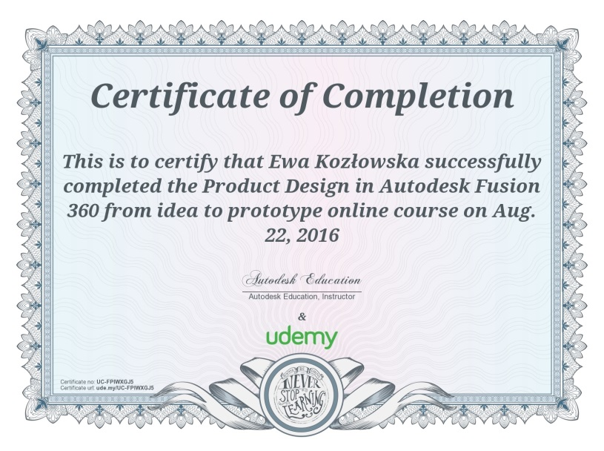
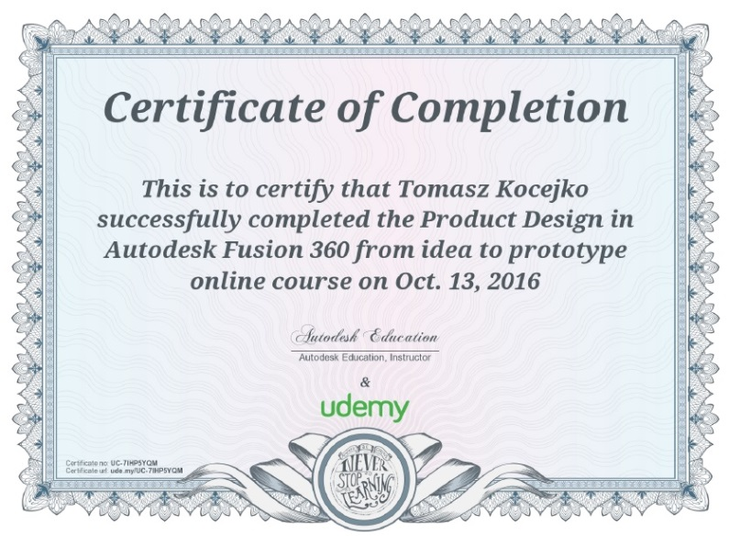
Fusion 360 MOOC https://www.udemy.com/product-design-fusion-360/
Lectures - 33
Length - 4 hours
Skill Level - All Levels
Languages - English
Available on iOS and Android
Certificate of Completion

Slide 35

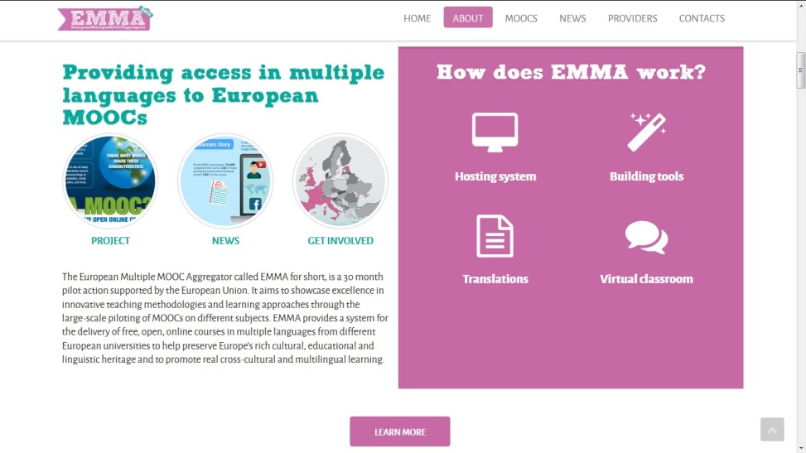
MOOC Fusion 360 in EMMA
The European Multiple MOOC Aggregator called EMMA for short, was a 30 month pilot action supported by the European Union.
It aimed to showcase excellence in innovative teaching methodologies and learning approaches through the large-scale piloting of MOOCs on different subjects.

Slide 36
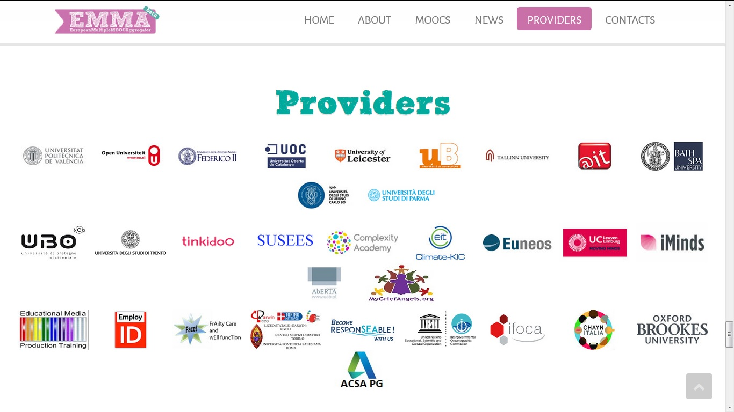
EMMA providers

Slide 37
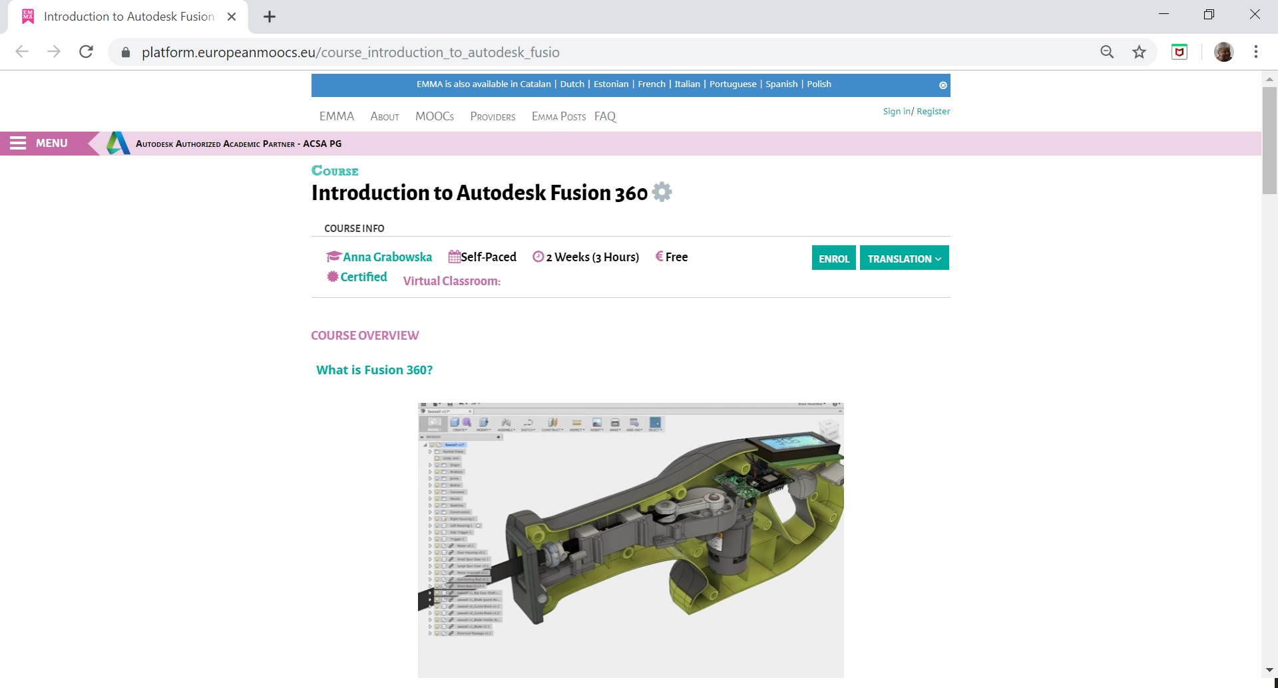
Fusion 360 in EMMA https://platform.europeanmoocs.eu/course_introduction_to_autodesk_fusio

Slide 38
Let’s co-operate in clouds (Fusion 360 & moodlecloud)
Creating projects in a cloud and using an idea of distance communication give the possibility of interdisciplinary cooperation between medical academic centres and technical institutions.
Transferring the communication and work to the cloud reduces the time of the project's creation and realization.
Working in clouds enables diagnostics and medical consultation, treatment planning, creating new solutions and methods, discussing the use of biocompatible materials etc.

Slide 39
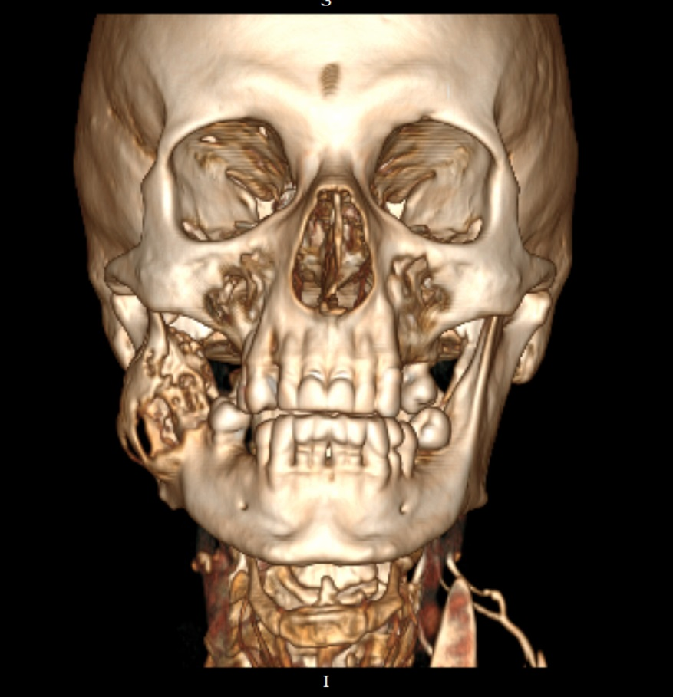
Case Study
The patient comes to the doctor having the asymmetry
within the right side of the face, it is probably tumor.
MDCT - MultiDetector ComputedTomography examination must have been done.

Slide 40
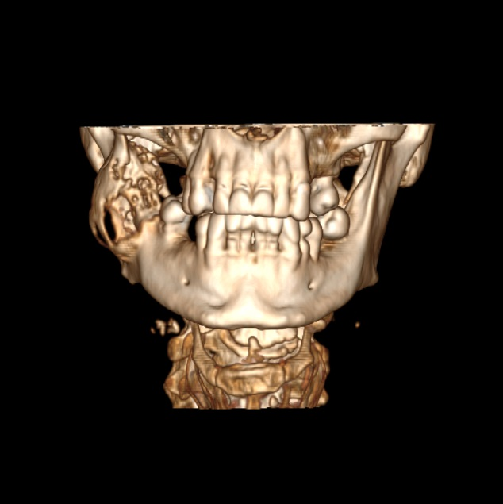
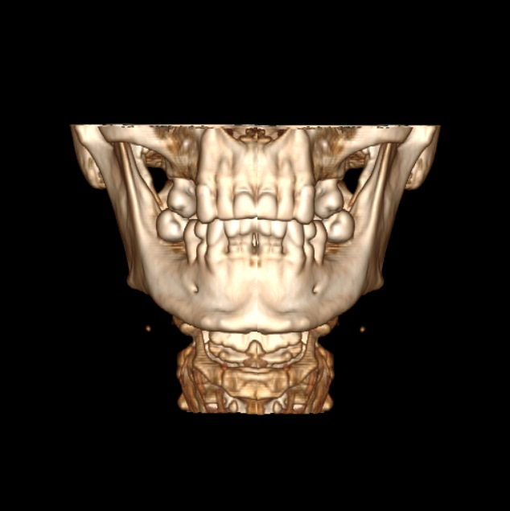
Modelling treatment - surgeons and engineers propose a solution that will remove the tumor

Slide 41
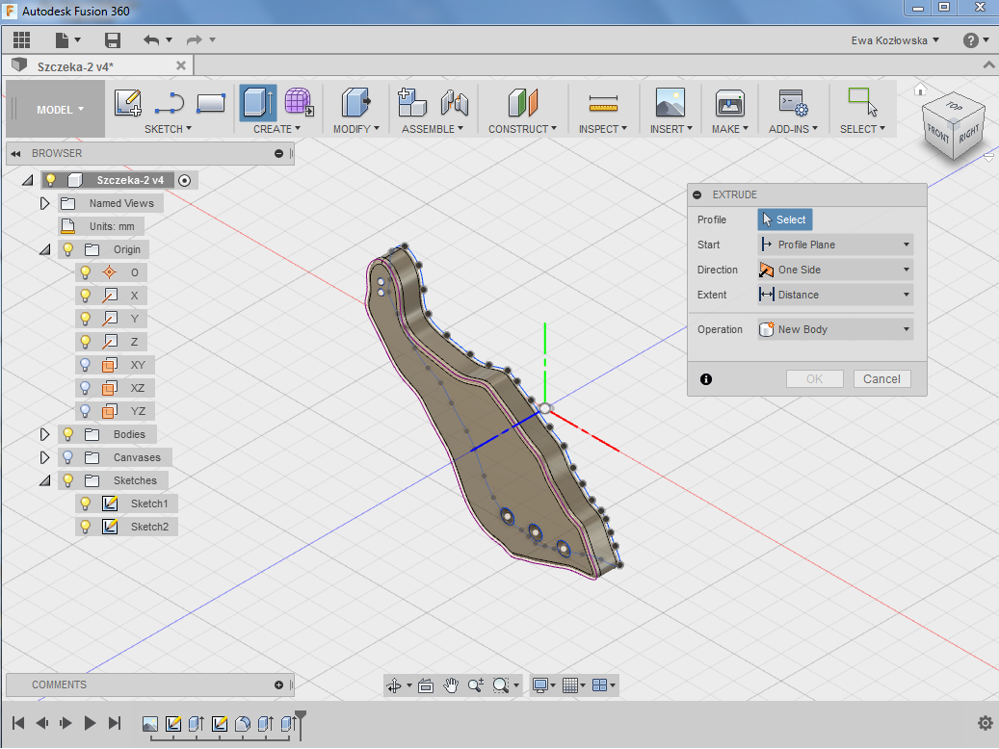
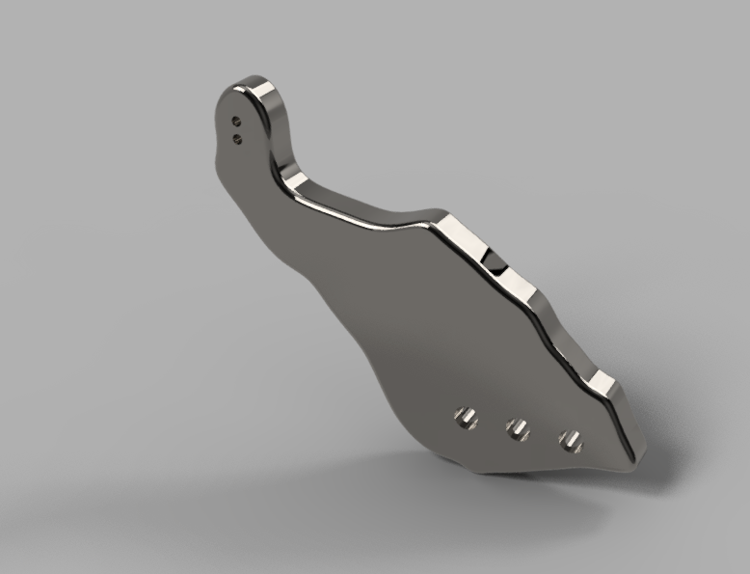
Designing and printing the implant
Designing in Fusion 360
3D printing

Slide 42

From concept to prototype, an engineer is coming to a doctor… Famelab- 3 minutes presentation http://www.kre.edu.pl/kre_2016/

Slide 43



From EMMA and Millionlights to moodlecloud
Notes:
Thanks to the experience gained during cooperation with online training centers such as EMMA European Multiple MOOC Aggregator and Millionlights, an outline of the training from the Autodesk Fusion 360 program based on the Moodle Cloud platform has already been created.

Slide 44
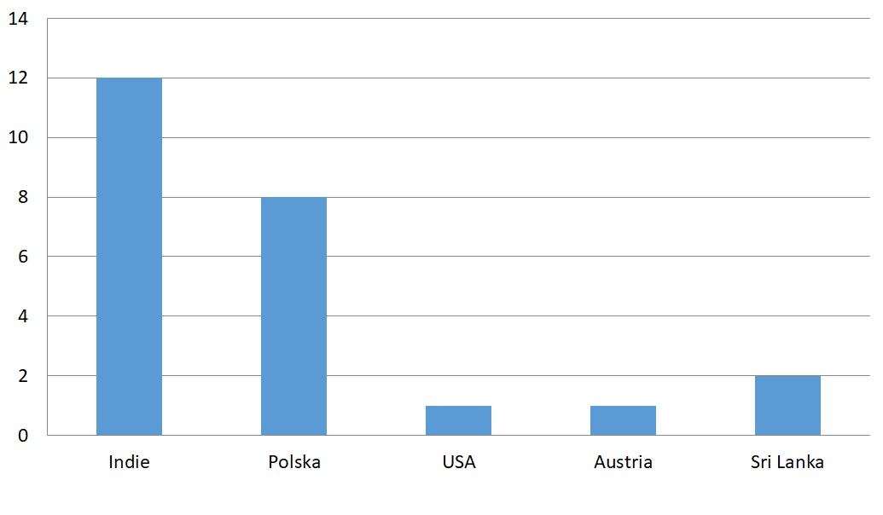
Number of participants of the
MOOC - Autodesk Fusion 360
Notes:
Designing a course for Millionlights has enabled us to gather feedback from trainee testers from around the world, mainly from India.
Several Polish students were also involved in testing the platform.

Slide 45
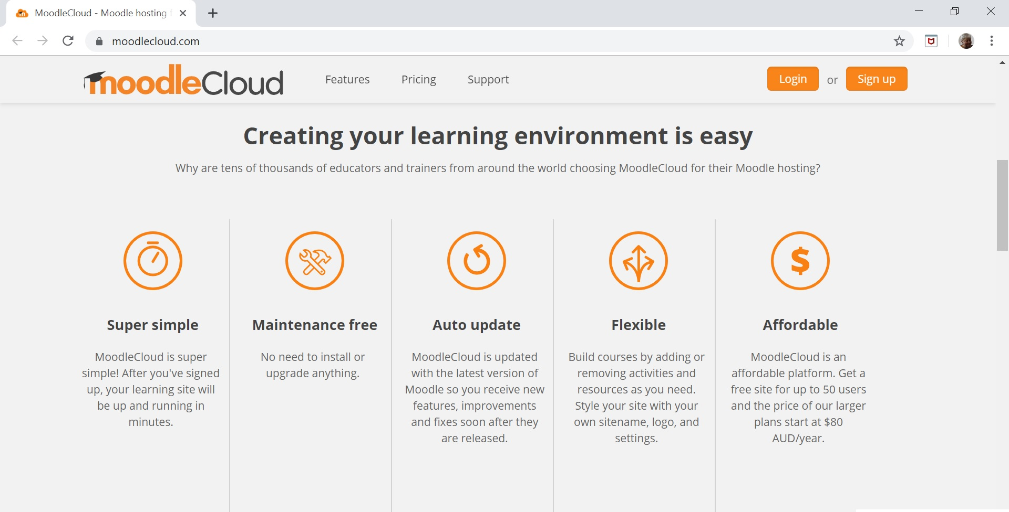
About moodlecloud https://moodlecloud.com/

Slide 46
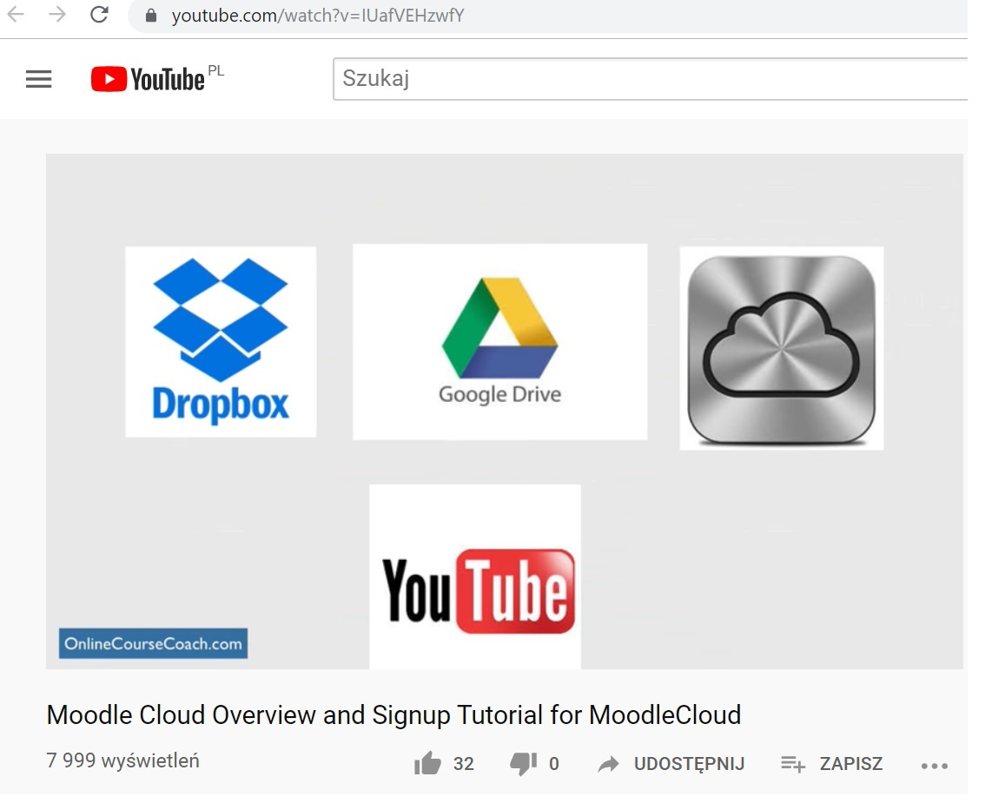
Introduction to moodlecloud https://www.youtube.com/watch?v=IUafVEHzwfY

Slide 47
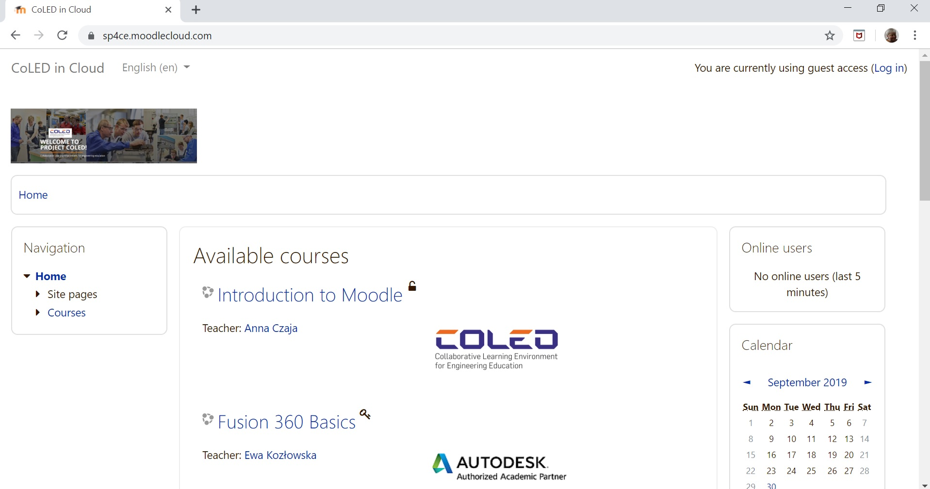
Welcome to CoLED in
Notes:
Based on the experience and opinions taken during testing the course, an outline of the Autodesk Fusion 360 training course on the Moodle Cloud platform has already been created. It is currently available in English - identical to the program language and tested, mainly by students from science clubs.

Slide 48
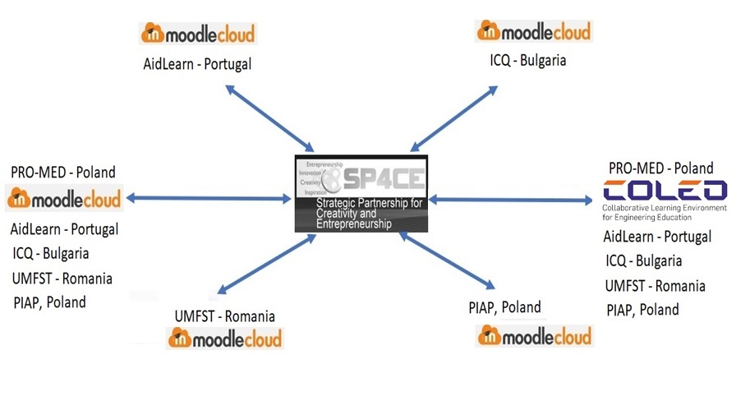
The concept of CoLED system

Slide 49
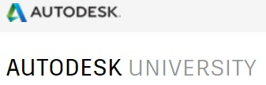










Notes:
Currently, cooperation can be illustrated in this way. The scheme may seem a bit confusing, but everything consists in a logical whole and is based on the assumption of cooperation using the Moodle platform. Two EU projects are supporting. The SP4CE program has already been completed and the new CoLED program.

Slide 50
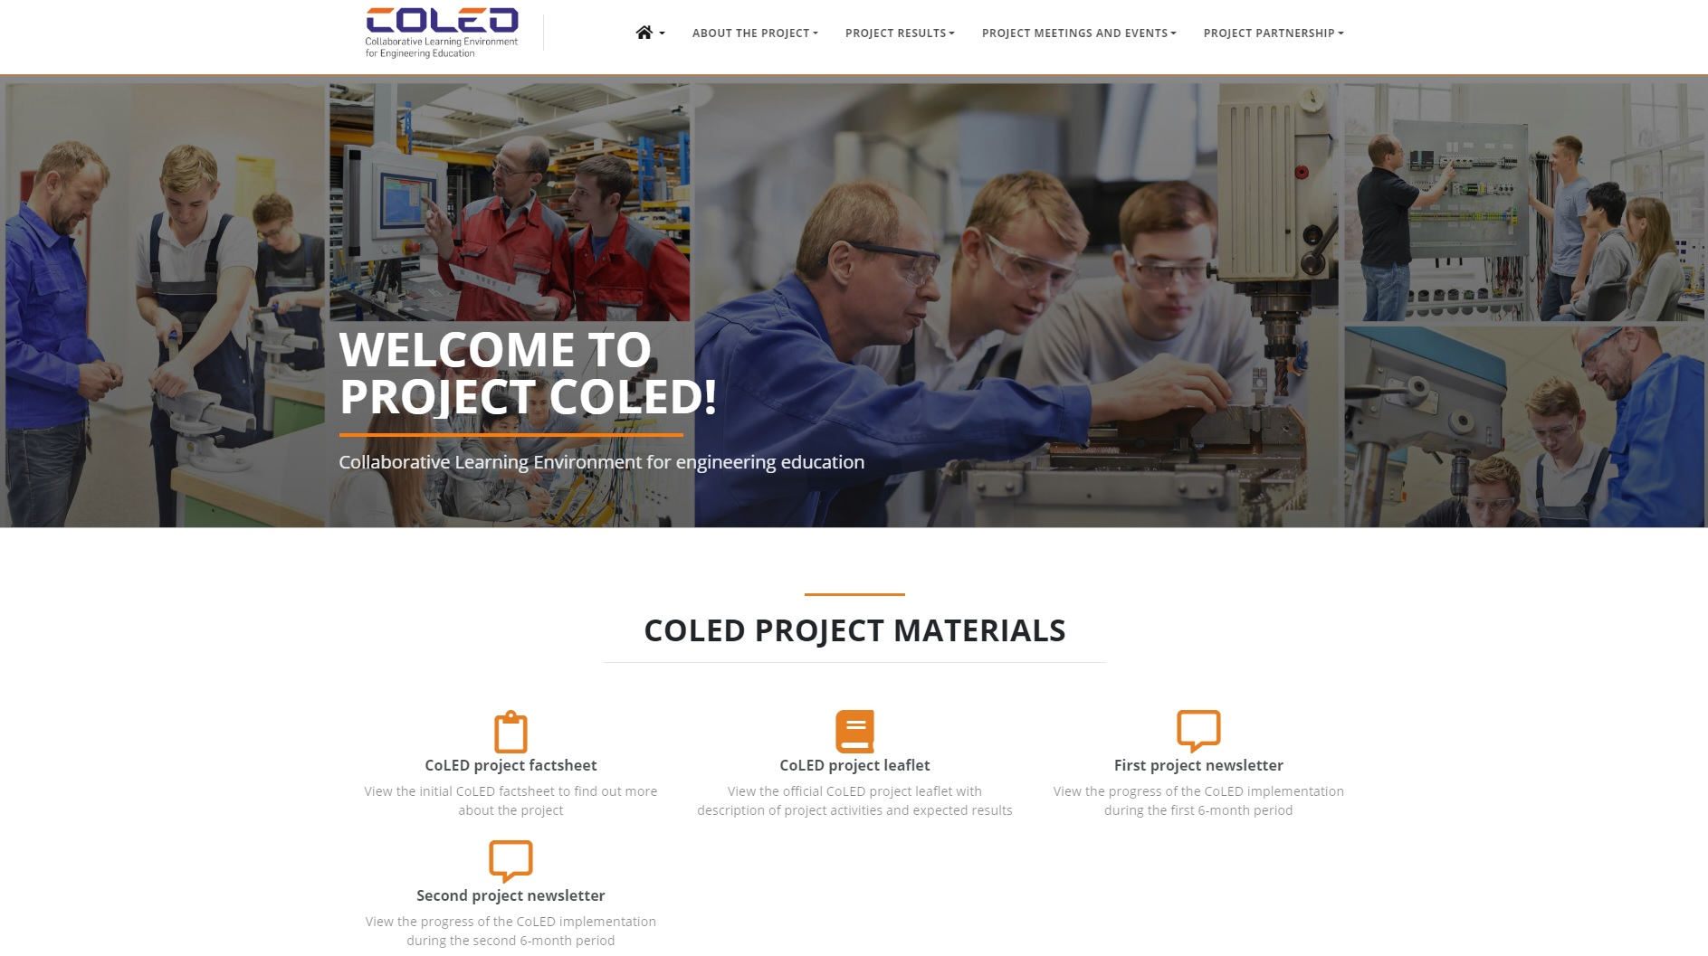
Welcome to ERASMUS + CoLED http://coled-project.eu/
Notes:
Collaborative Learning Environment for engineering education (CoLED) is an European project implemented within the framework of Erasmus+ Programme, Key Action 2: Cooperation for innovation and the exchange of good practices. The CoLED consortium consist of 5 partners from 4 different European countries – Bulgaria, Poland, Portugal and Romania, all of which have extensive expertise and relevant experience in developing transnational projects. The project activities are scheduled to be implemented between October 2018 and September 2020.

Slide 51

anka.grabowska@gmail.com

