Slide 1
Should the name "University of the Third Age" be changed?
U3A FORUM - Sunday 3rd March 2019
Perhaps it's time to describe what we really are…
Anna Grabowska
anka.grabowska@gmail.com
http://jatobym.moodle.pl/

Slide 2
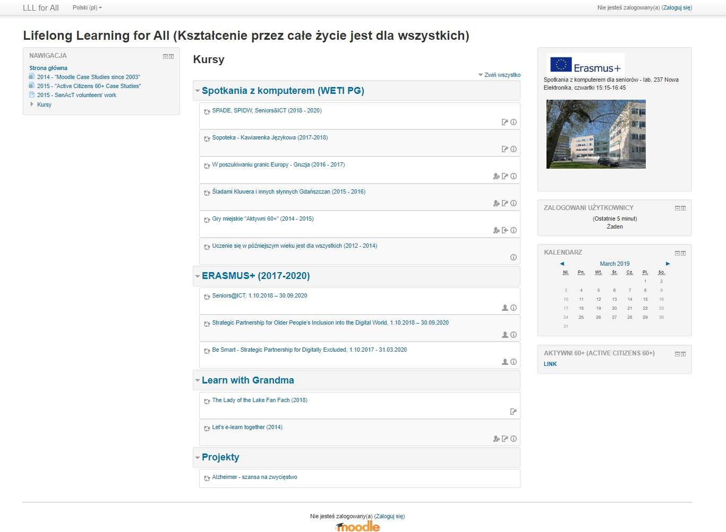
Lifelong Learning for All – LLL4All

