Slide 1
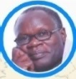
PROFESSIONAL DEVELOPMENT DIGITAL IMAGERY by Peter Omal
„Today’s special moments. Tomorrows priceless treasures”
Notes by Annna on Saturday, 22 August 2020

Slide 2
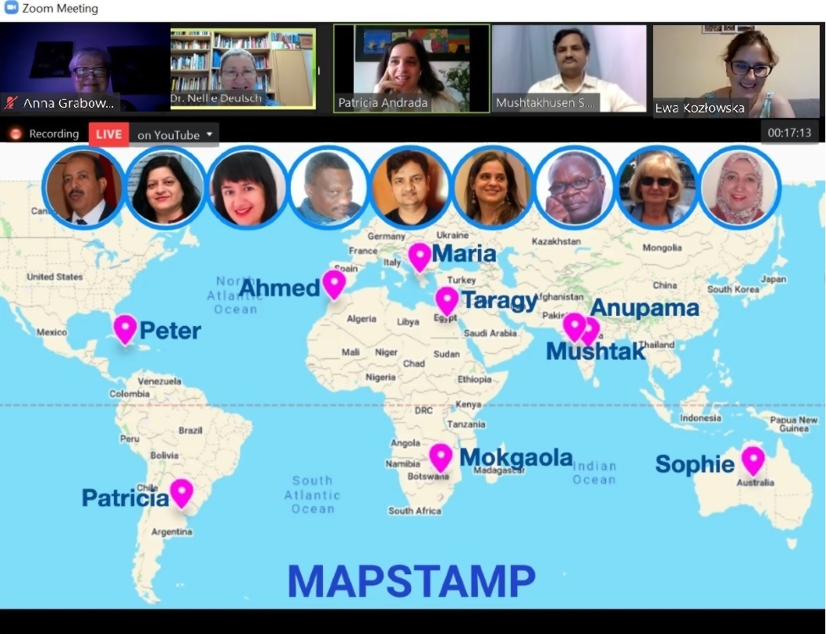

Slide 3
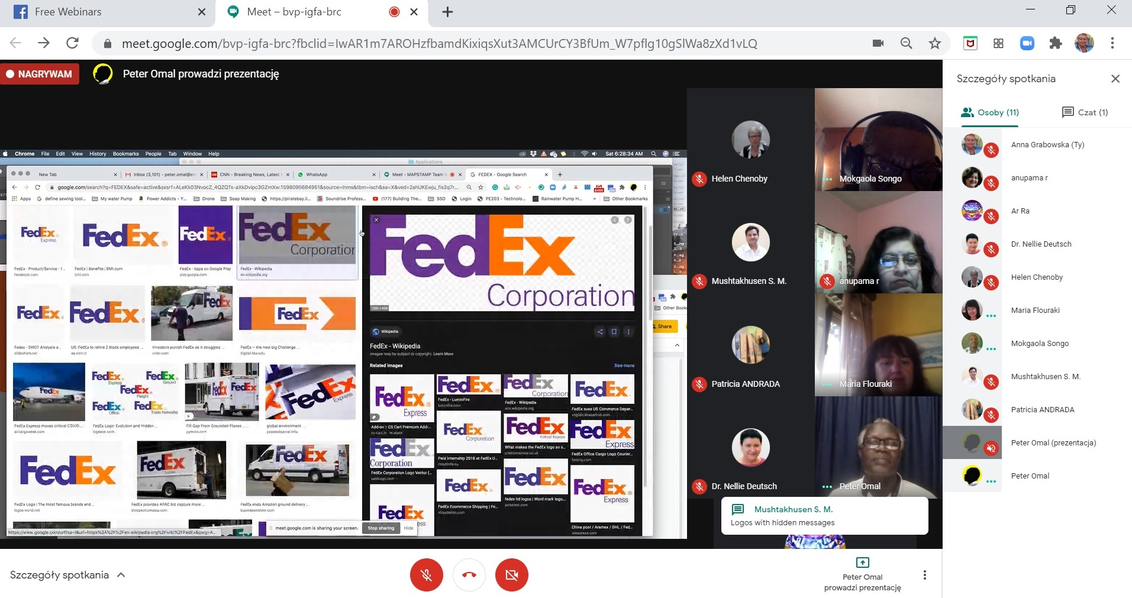

Slide 4
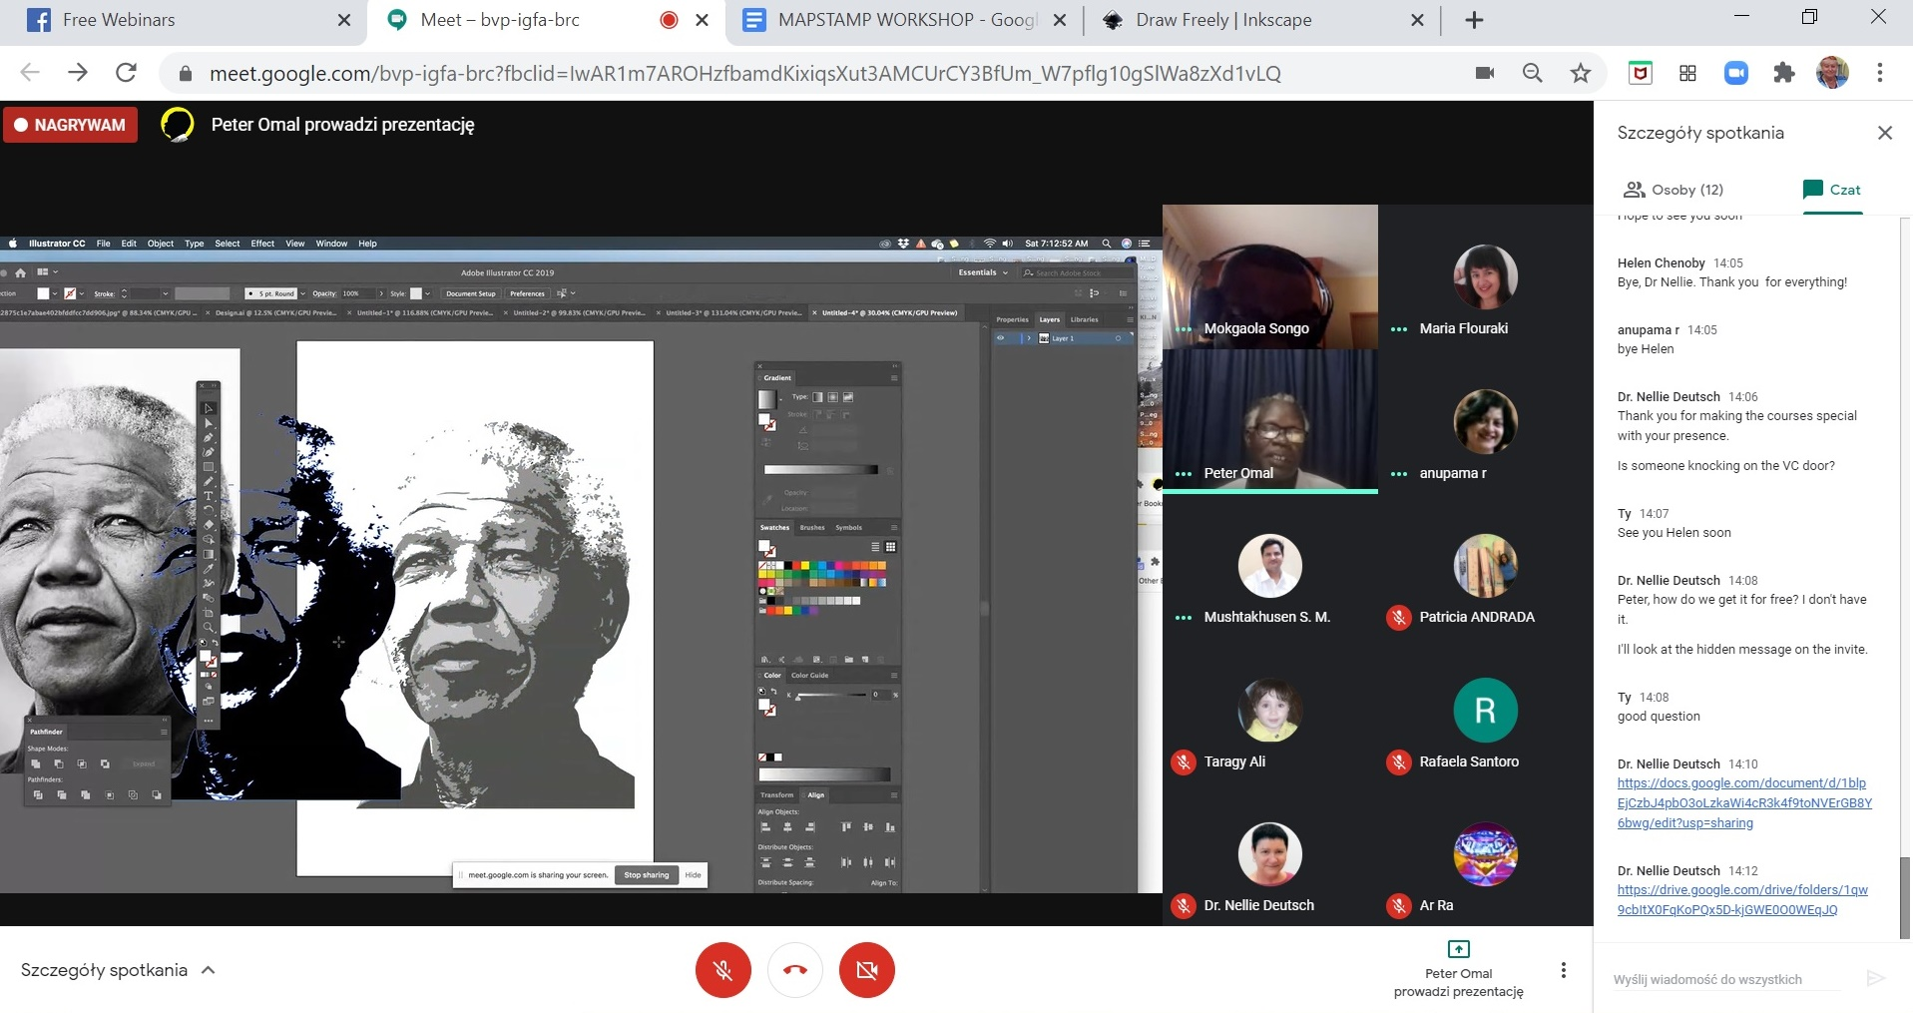

Slide 5
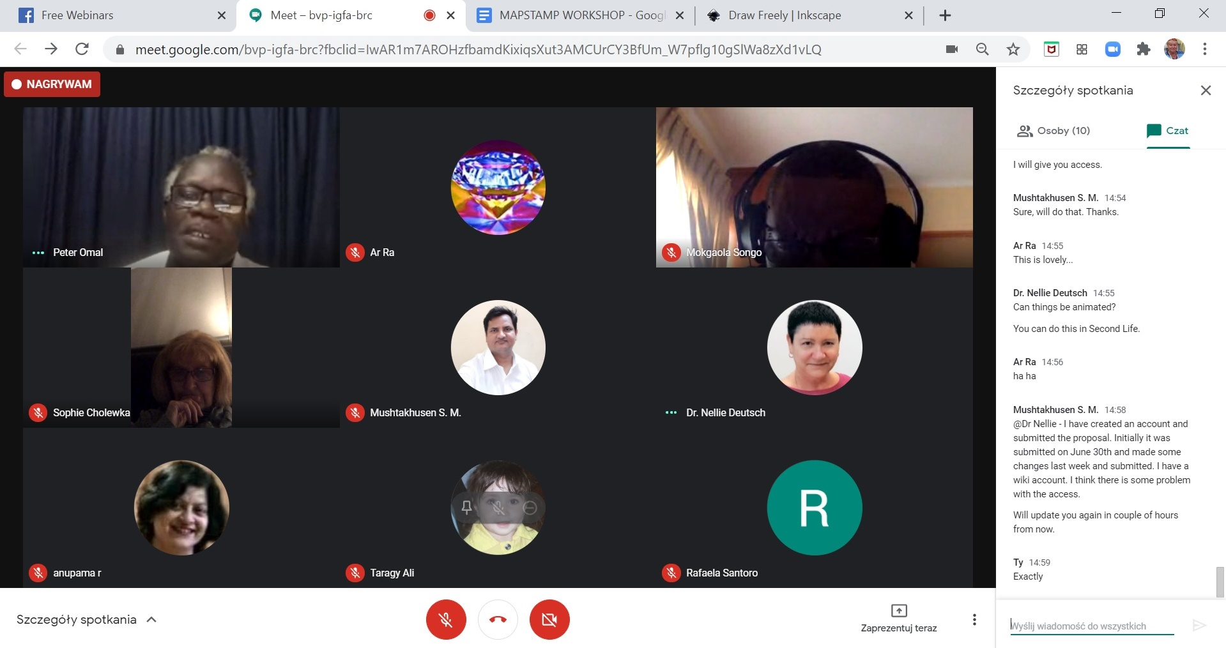

Slide 6
