Slide 1
Travel Club for Elderly - TRACE
Anna - Poland
Ania - Poland
Ewa - Poland
Aleksander - Poland
Andreas - Germany
Karolina - Sweden
Notes:
Let me introduce us briefly, we are an international team coming from Poland, Germany and Sweden.

Slide 2
Why?
Anna (68) said
„50 years ago when I was young I used to travel a lot usually with my friends. I would like to continue travelling with whom I like and how I like.”
Notes:
Traveling in the digital era can be difficult for analog generation. Booking flights is easy for millennials but it may be difficult for the seniors.
Travel agencies for older people force their clients to accept the ready-made offers. As we know no size fits all. Our service gives seniors the freedom to plan their own trip.

Slide 3
How?
website
free tools and apps
social software
Zoom
Notes:
We will teach how to organize a trip, providing help on each step of the planning process. Explaining how to use different free apps to organize a dream trip. For example how to use social software to meet like minded travelers. By connecting seniors and giving them tools, we provide them with the sense of empowerment.

Slide 4
What?
Seniors want to be responsible for their choices regarding destination, means of transport, places to stay, sites to visit.
Notes:
Our final product will be a website, with two main purposes. First,a guide for seniors. Second, a social platform for planning trips. To the best of our knowledge no such service currently exists.

Slide 5
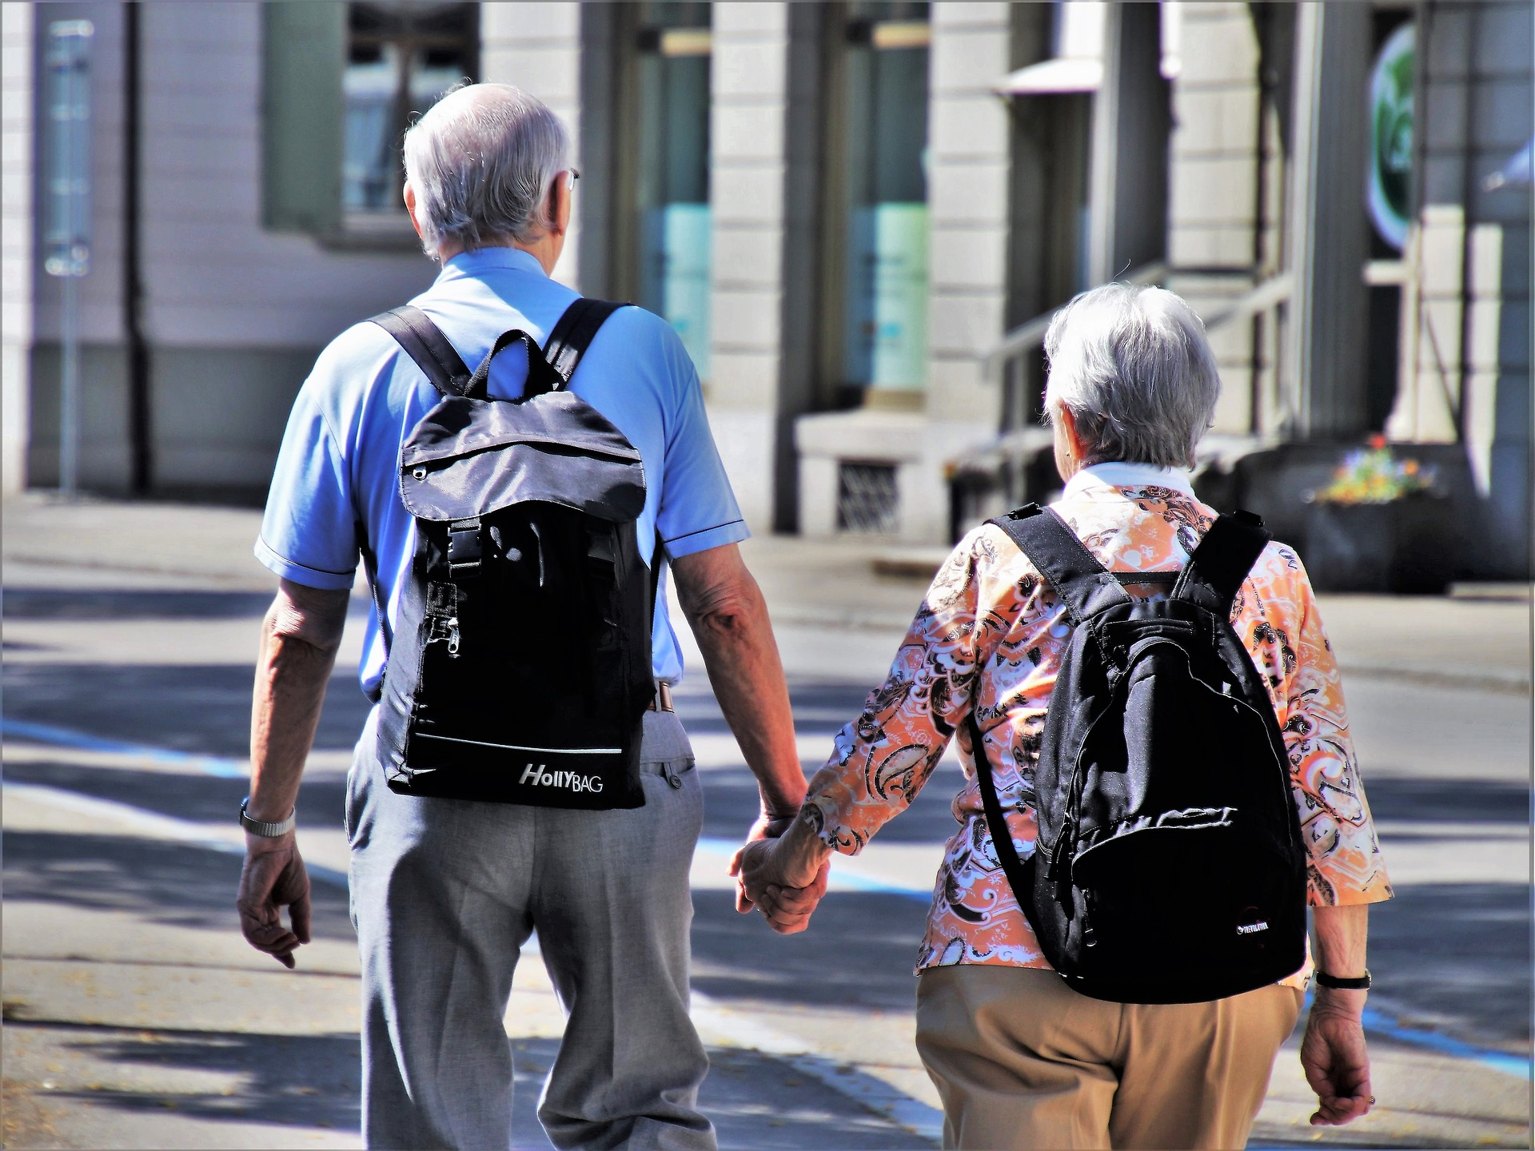
TRACE
How to start
Hit the road
Notes:
Our site will be easy to navigate. As previously said, it will have 2 main components, “How to start” is aimed towards teaching seniors, and “Hit the road” is the platform for seniors to organize themselves.

Slide 6
How to start
The more the merrier - how to find your travel companions
How to book a plane ticket
Getting around the city - how to buy bus/metro tickets
Accommodation - how, where and how much is it going to cost
Sightseeing plan
Organizing your spare time
High culture - how to buy a ticket to the theatre, check the museum’s opening hours etc.
Where to eat
Few words about insurance policies
Notes:
These are the topics we will be teaching the seniors

Slide 7
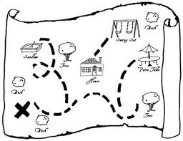
Hit the road
Notes:
Our portal enables collaboration between seniors. Sharing work means everyone is responsible for planning the trip. For example one person books theatre tickets, another chooses places to eat, etc. Being engaged in the planning process makes everyone feel important.

Slide 8
Notes:
An example of how it could be done in padlet.

Slide 9
Links
Notes:
Our product may ultimately be funded by affiliated links

Slide 10
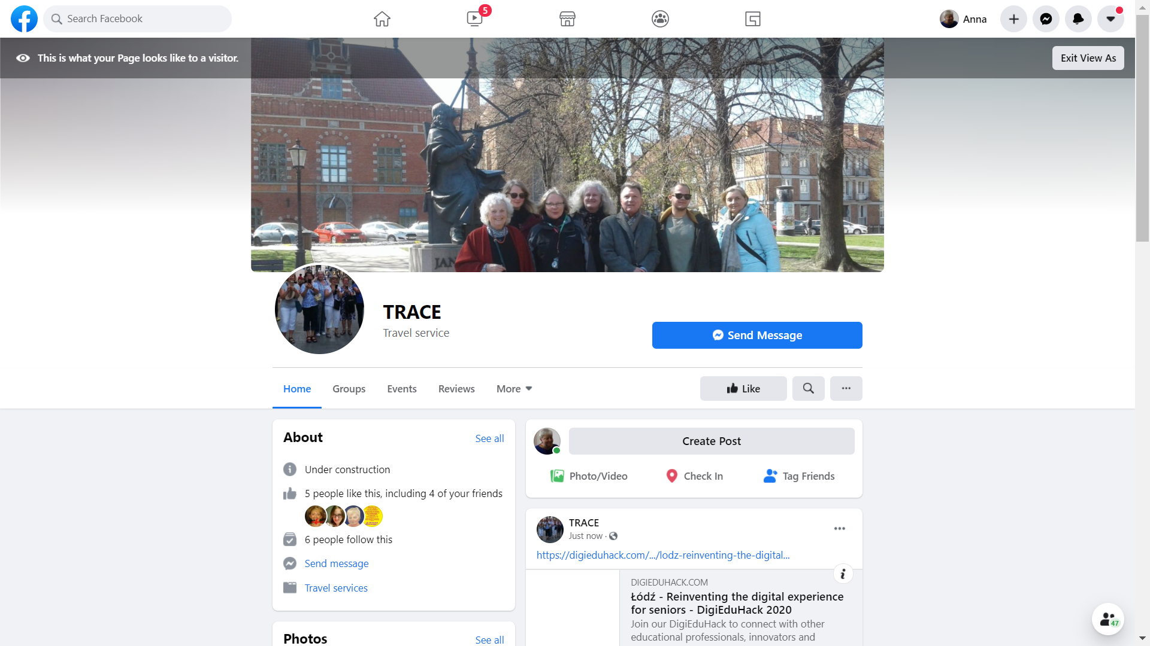
snapshots
Notes:
We plan on promoting our project on social media.
This is an example of our facebook fan page
Information will also be spread to universities of third age in Poland but also abroad.

Slide 11
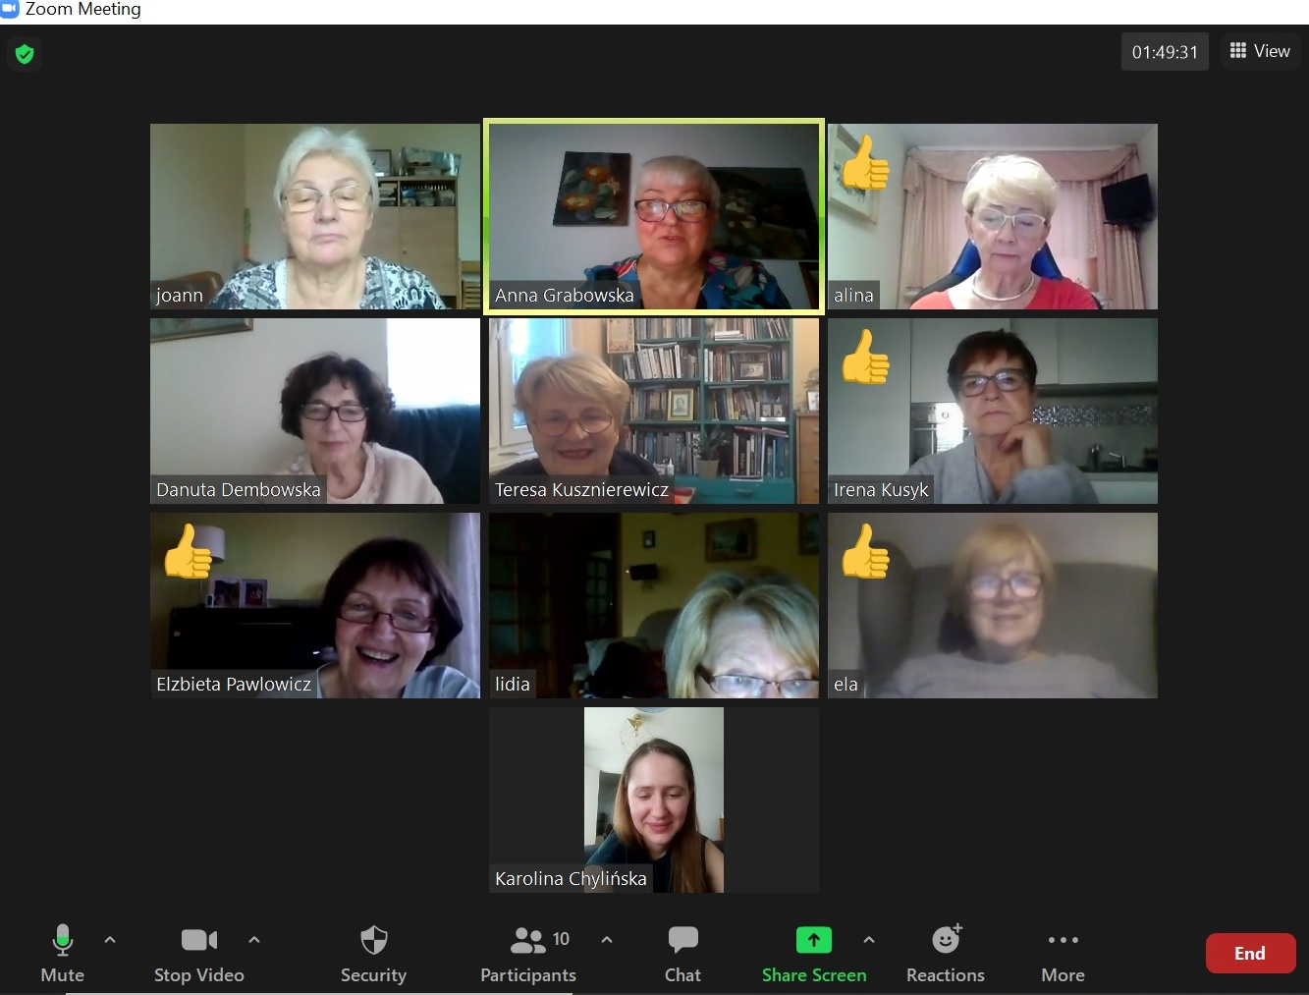
Organized every 2 months
Takes place on ZOOM
Speakers talk about their travels
Notes:
To maintain sustainability and inspire seniors we will organize meetups using zoom.

Slide 12
Notes:
Age should not be a limit. The only limit should be one’s imagination.

