Slide 1



UNIVERSITIES OF THE THIRD AGE IN POLAND IN 2018
U3A Forum, 1.03.2020
The presentation for U3A Forum, 1.03.2020 is based on the document prepared
by Katarzyna Adamska, Statistical Office in Gdańsk
Tel: +48 58 768 31 53
e-mail: k.adamska@stat.gov.pl

Slide 2
599 out of 640 operating U3A took part in the statistical survey carried out in 2018
In 2018, 640 universities of the third age operated in Poland, i.e. entities whose main goal is educational activity, integration and activation of older people in order to improve the quality of life and increase their participation in social life.
U3A operated in all voivodships.
The majority of U3AW (80) were located in the Mazowieckie voivodship (12.5% of the total number of U3A), and the smallest numer in Lublin, Opole and Świętokrzyskie voivodships (2.5% each)

Slide 3
Organizational and legal form of the Polish U3A
Polish U3A have a diverse organizational and legal form, i.e. they operate in the structure of various organizations or institutions.
Over 56% of universities for seniors functioned in the structure of NGOs, of which 44.7% were associations founded solely for the purpose of running U3A.
In addition, U3A also operate primarily in the structure of universities - 21.5% and cultural centers - 17.7%.

Slide 4
Educational offer of Polish U3A
The task of the Polish U3A is primarily to organize and conduct lectures, seminars, regular classes, including workshops, courses, interest groups, cultural and artistic activities, as well as social activities people in need.
Of the U3As that took part in the statistical survey, 575 units had lectures and seminars in their educational offer.
Slightly less, 526 units, offered students regular classes, among which sport and movement classes (88.2%), language courses (81.4%) and artistic classes (73.0%) dominated.
Nearly 70% of U3As offered students computer classes.
On a national scale, average attendance of listeners in regular classes it was over 63%, and nine U3As showed 100% attendance.

Slide 5
Dividing U3As according to the forms of conducted educational and other activities
Lectures and seminars
Courses, workshops, interests groups
Cultural and artistic activities
Social activities on demand

Slide 6
More statistic regarding U3A offer
Another form of U3As activities are cultural and artistic events offered by 550 units.
Trips and tourism were the most popular, organized by 98.8% of U3A, as well as going to the cinema, theater, museum or other cultural institutions (92.1%).
Social activities for the benefit of people in need from outside U3A were carried out by 285 units. The help of U3A students was directed mainly to the elderly (67.7%), the local community (63.7%) and children and youth (52.3%).

Slide 7
U3A teaching staff and students
Among nearly 14 thousand lecturers, the largest group were academic teachers (without teachers and foreign language teachers) - over 4.1 thousand
Some 41.1% of the teaching staff worked for UTW for free. The largest group of free lecturers or lecturers were themselves (85.1%), while U3A most often incurred expenses to pay professional instructors and trainers - over 77% of them received remuneration for work.
In all U3A a total of 113.2 thousand students, including 95.4 thousand women.
The majority of studying seniors are people aged 61-75 (71.9%).
In terms of the level of education, people with secondary education dominated (50.5%), and in cross-section according to the status on the labor market the majority of students had the status of a pensioner (87.9%).
The largest U3A in Poland had 2,536 students.

Slide 8
U3A students by age
Up to 60 years old
61-75 years old
76 years old and more

Slide 9
U3A students by education level
Primary school
Vocational school
Secondary school
High school

Slide 10
U3A students by status on the labor market
Retirees
Pensioners
Working people
Unemployed people

Slide 11
U3A fees
U3As in Poland were primarily supported by funds collected from candidates and students.
95.5% of U3A charged fees to students
Student fees (enrollment, tuition, class fees) for 35.9% of units were the main source of income.
For 24.7% of universities, the main source of financing were subsidies from local government funds.
The budgets for running universities in the third century varied widely from PLN 110 to over PLN 2 million.
355 U3As (59.3%) charged the student with an annual tuition or basic fee for general lectures and program classes of PLN 1.

Slide 12
U3A fees
entry fee
membership fee
tuition or basic fee
payment for optional classes
partial payments for group events (e.g. theater, trips)

Slide 13
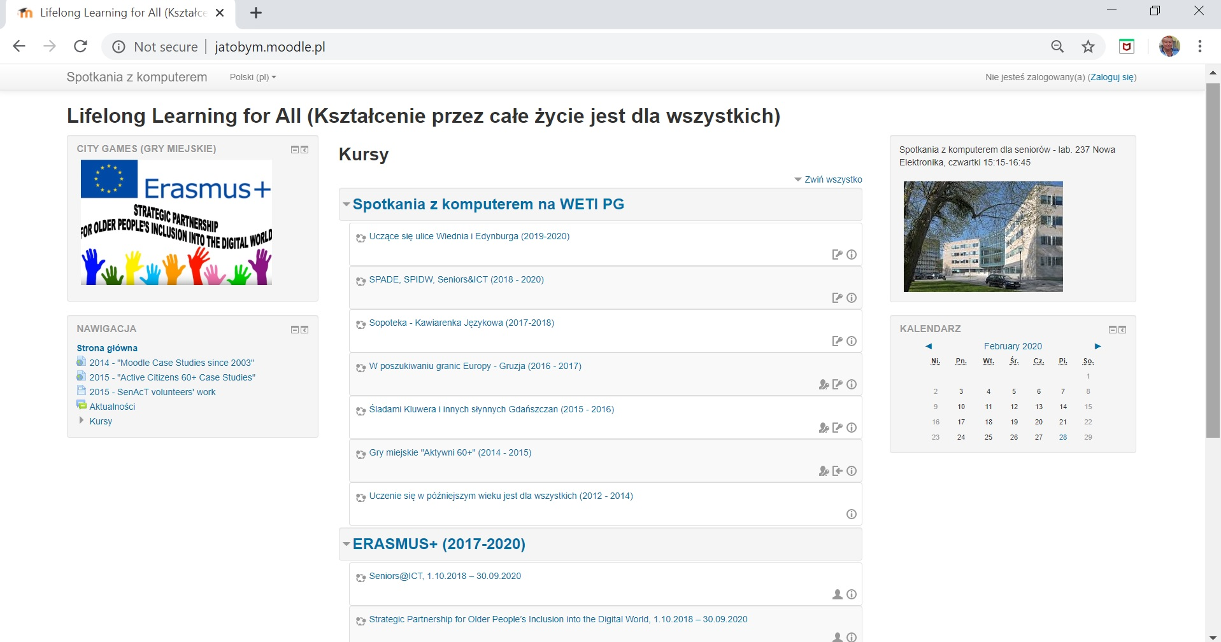
An example Case Study at A3A at Gdansk University of Technology (ETI Department)

Slide 14
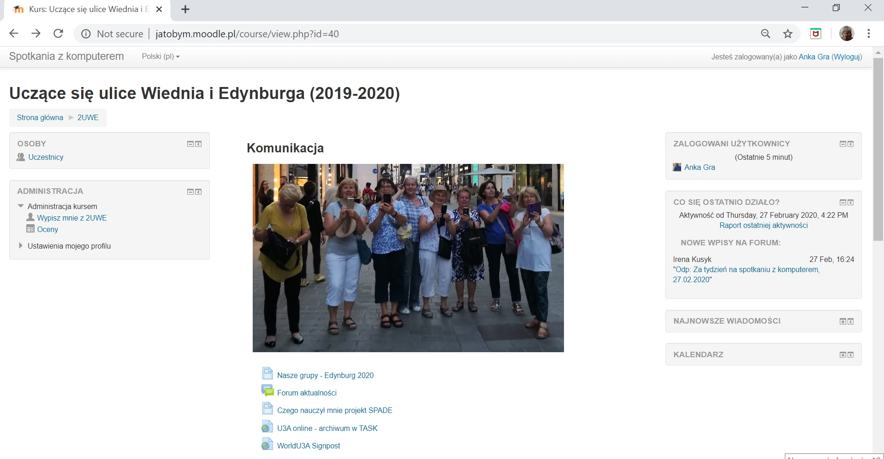
Learning streets in Vienna and Edinburgh (1)

Slide 15

Learning streets in Vienna and Edinburgh (2)

Slide 16
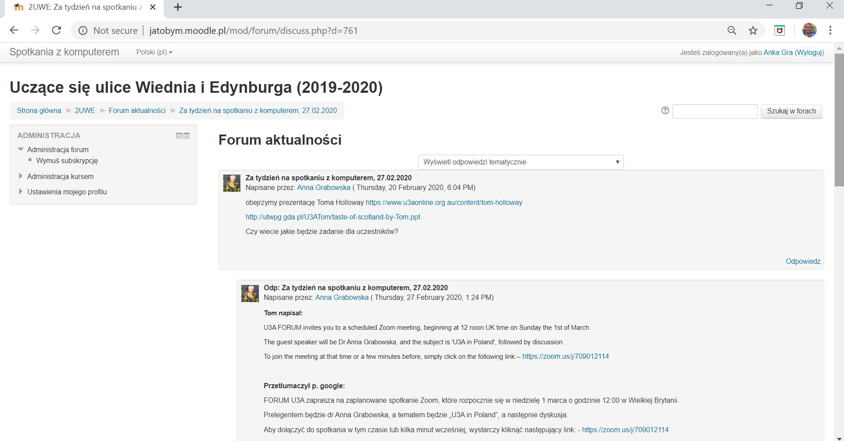
Learning streets in Vienna and Edinburgh (3)

Slide 17
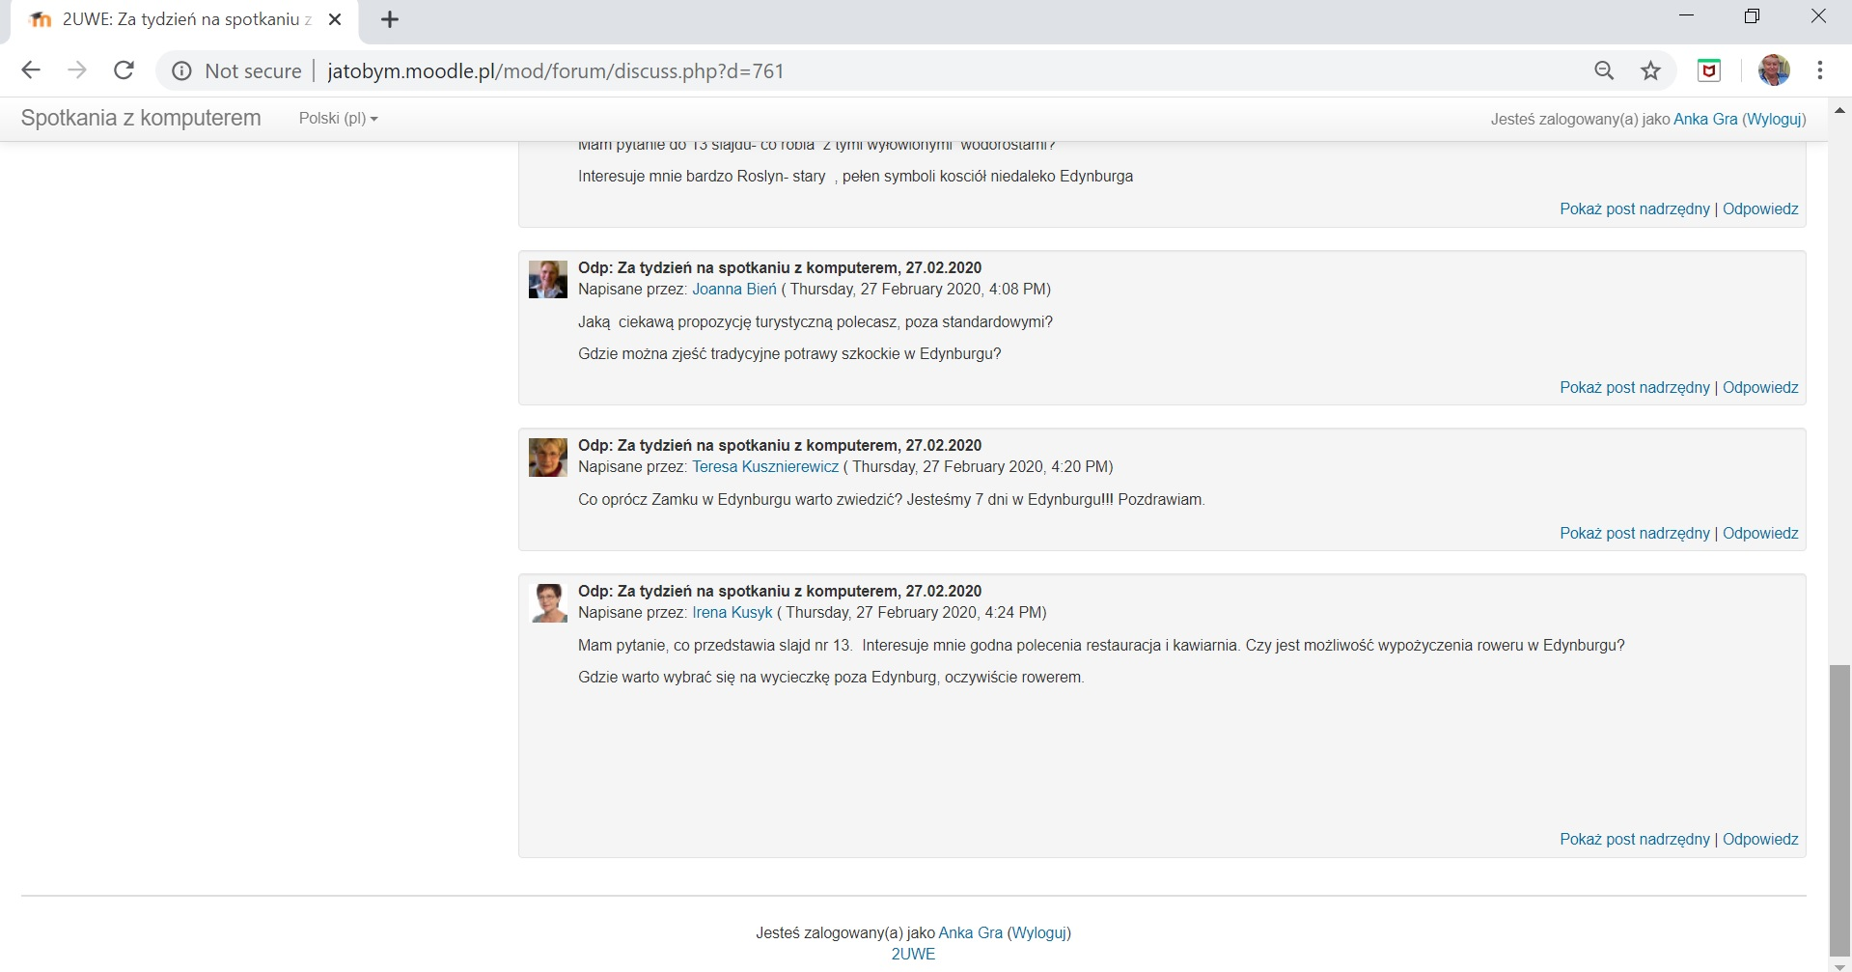
Learning streets in Vienna and Edinburgh (4)

Slide 18
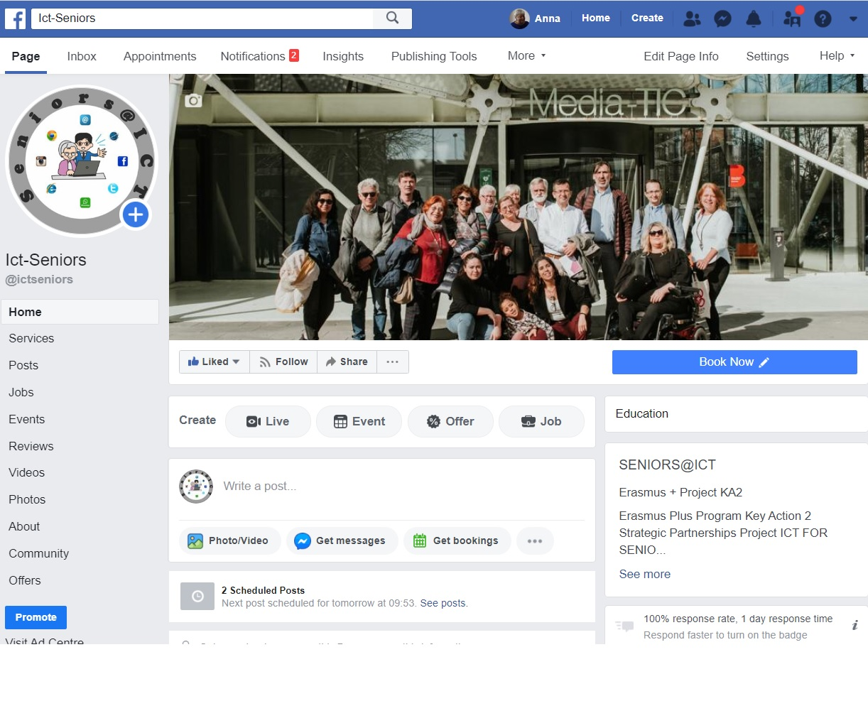
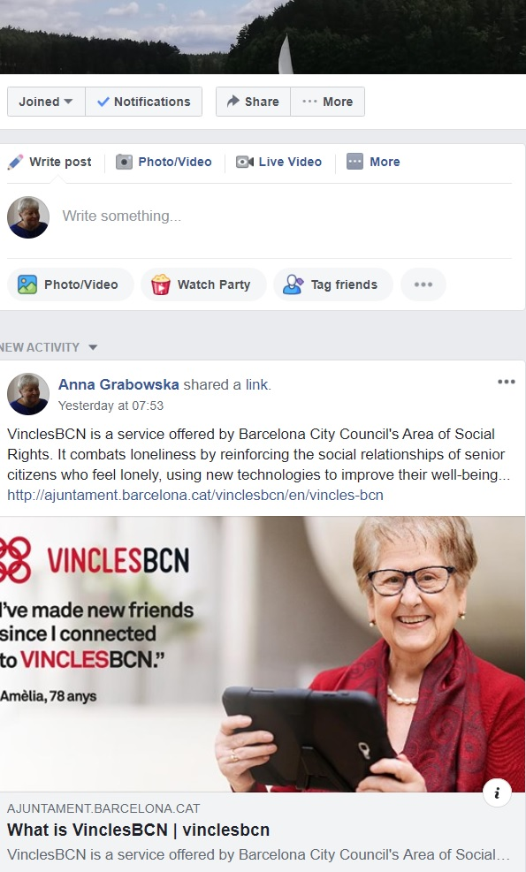
Welcome to https://www.facebook.com/ictseniors/ https://www.facebook.com/groups/LwGinClouds/

Slide 19


Thank you for your attention.
Any questions?
e-mail: anka.grabowska@gmail.com
The ERASMUS+ Seniors@ICT project has been funded with support from the European Commission.
This publication reflects the views only of the author, and the Commission cannot be held responsible for any use which may be made of the information contained therein.

