Slide 1


Approaches to Language Instruction and Learning
Week 1
Anna Grabowska
Gdansk, Poland, 2.03.2021

Slide 2
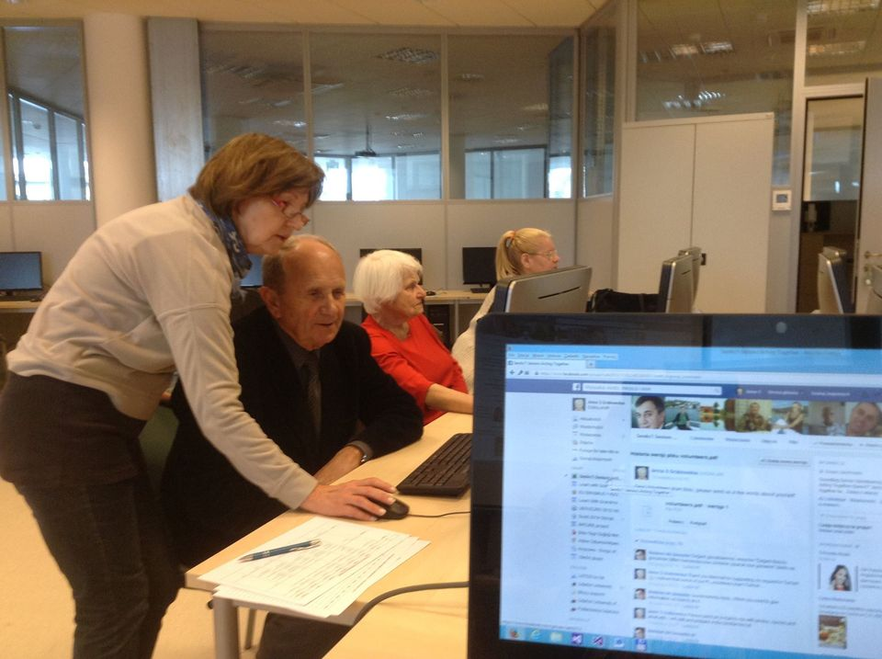
Should I teach English people over 70
if I do not know even generally
something about the relationship between language and cognition,
writing systems,
nonverbal communication,
sociolinguistics,
first language acquisition?

Slide 3

Can TESOL help?
Teachers of English to Speakers of Other Languages
The TESOL in its Guidelines for the Certification and Preparation of Teachers of English to Speakers of Other Languages in the United States (1975), cited the necessity for the teacher to "understand the nature of language, the fact of language varieties - social, regional, and functional, the structure and development of the English language system".
Notes:
https://flipgrid.com/grabowska1995

