Slide 1
ATW WETI PG https://jatobym.moodle.pl/
Notes:
What is the age range of your U3A members
What are the proportions of active speakers, participants, and just listeners
What subjects seem most attractive and relevant
Are there particular backgrounds which are attracted to U3A
What problems,if any, do members have with being part of your U3A
Are there things which discourage potential members

Slide 2
What is a typical profile of your U3A members?
We are a group of approx. 20 people, friends, classmates 60,70,80+.
14 years ago all members were retired personnel from Gdansk University of Technology.
But not any more…

Slide 3
What is a typical profile of your U3A members?
We have different temperaments, characters and interests.
But we share the need to be phisicaly active and we want to keep up with new technologies.

Slide 4
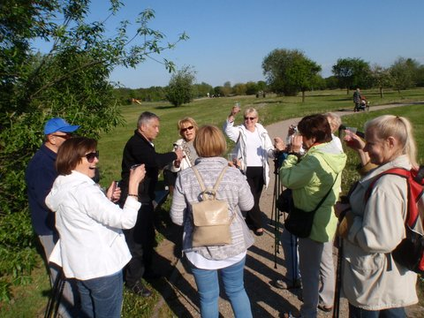
We like physical activities e.g. Nordic walking
It happens that someone in the group is excluded because of a disability (temporary or permanent).
ICT help us to stay in touch and communicate.
We have got Zoom meetings each week on Thursday.

Slide 5
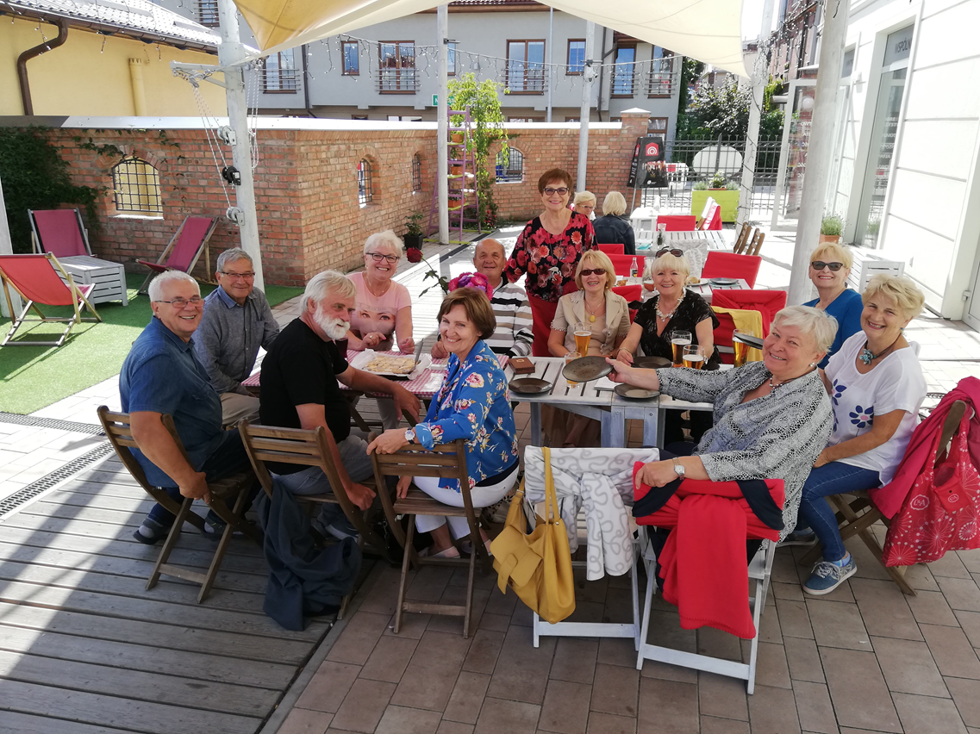
We celebrate together our Birthdays

Slide 6
The most attractive activities - taking part in EU projects
Bolu, Turkey 2014
Vienna, Austria 2019

Slide 7
What problems, if any, do members have with being part of your U3A?
Number of places in the computer’s lab.
Basic ICT knowledge.
Availability on each Thursday F2F/Zoom.

Slide 8
Are there things which discourage potential members?
Health problems, disability
Lack of basic ICT knowledge

Slide 9
Our motto in Polish is ROLKI. „Do what you love with who you like!”

Slide 10
Case Study - Padlet

Slide 11
Welcome to https://www.facebook.com/groups/LwGinClouds

