Slide 1
Connecting Online Conference - CO22
CO22 is the 13th anniversary of the free annual online event scheduled from 25 to 27 February 2022.
About CO22 | Webinars | About the Presenters | Conference Area | Reflection | Recordings
„Get Curious, Talk to People, Try Staff”
Dr Anna Grabowska
anka.grabowska@gmail.com

Slide 2
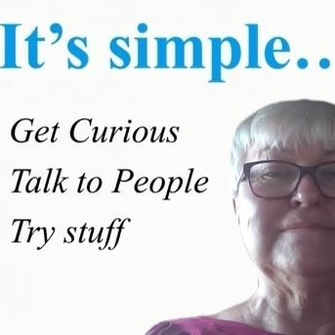
Connecting Online Conference - CO22
Dr. Eng. Anna Grabowska has long term experience in distance education. In 1994 she received a master's degree at the University De Montfort in Leicester in the UK. In 2001 she defended her doctoral thesis with the title of a doctor of technical sciences at Gdansk University of Technology. Since 1995 she has been the manager of Autodesk Authorised Training Centre at Gdansk University of Technology (Autodesk Academic Partner). In 1998-2004, she served as head of the Distance Education Centre at Gdansk University of Technology. She is a founding member of the Association of Academic E-learning, an advisor at U3A online. Since 2007 she has been conducting meetings with the computer for elderly at Gdansk University of Technology. She has been involved in educational European projects dedicated to Lifelong Learning for All. Since 2021 she is in a team behind U3a Communities.

Slide 3

Connecting Online Conference - CO22
https://hr.berkeley.edu/sites/default/files/general/design_your_life_workshop.pdf

Slide 4
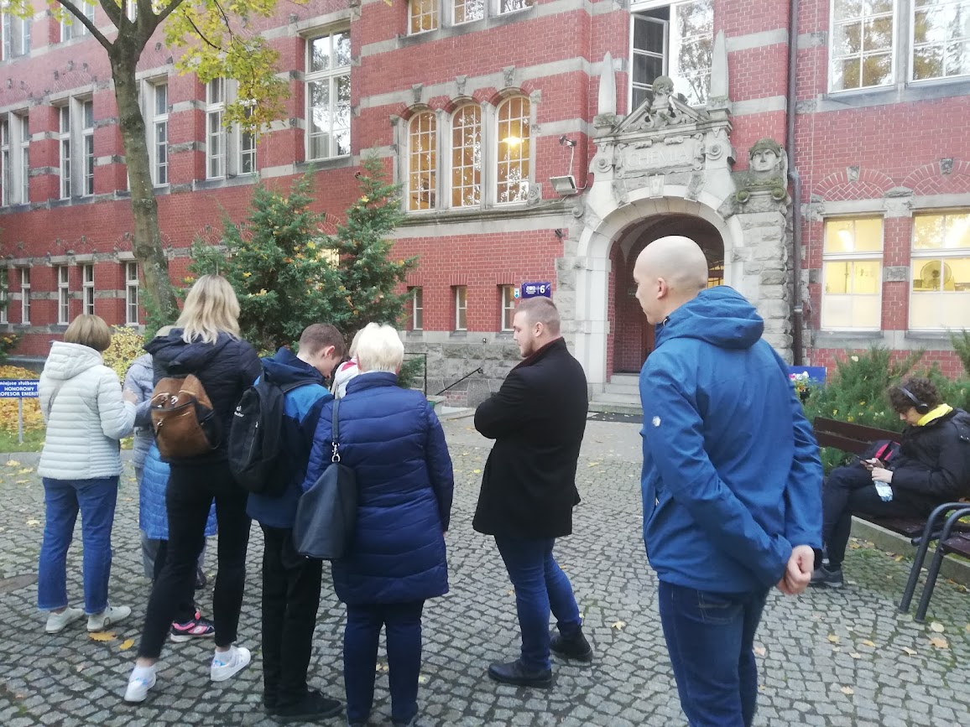
Connecting Online Conference - CO22

Slide 5
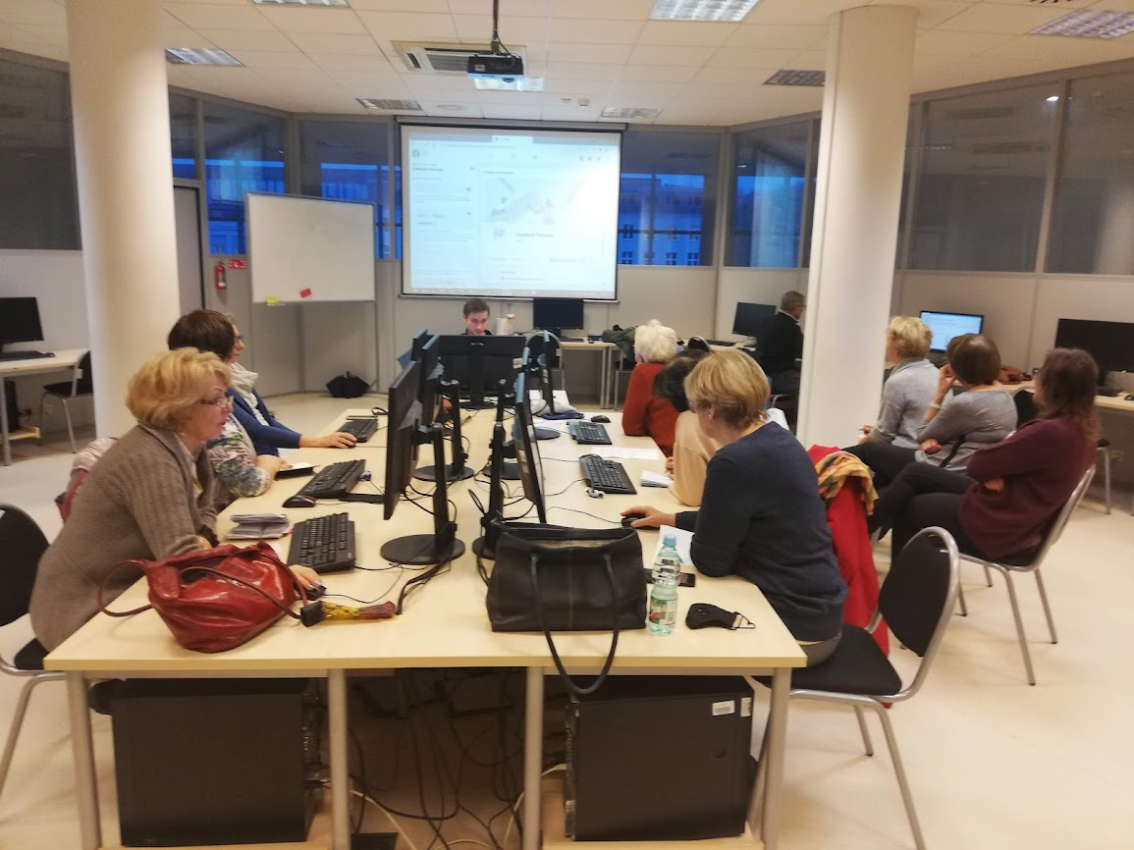
Connecting Online Conference - CO22

Slide 6
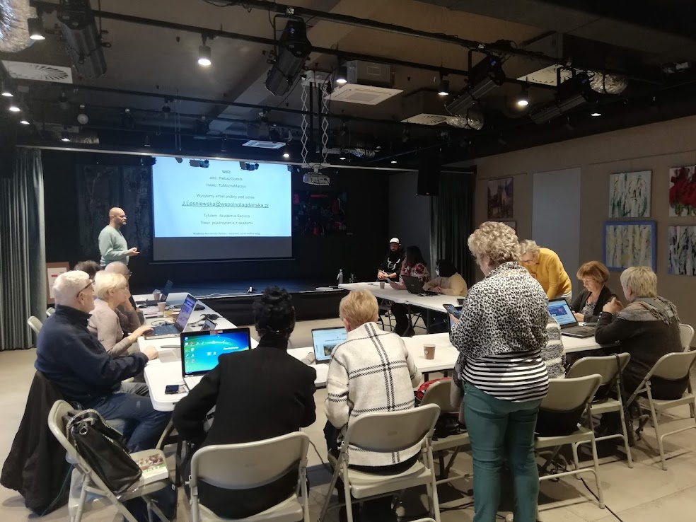
Connecting Online Conference - CO22

Slide 7
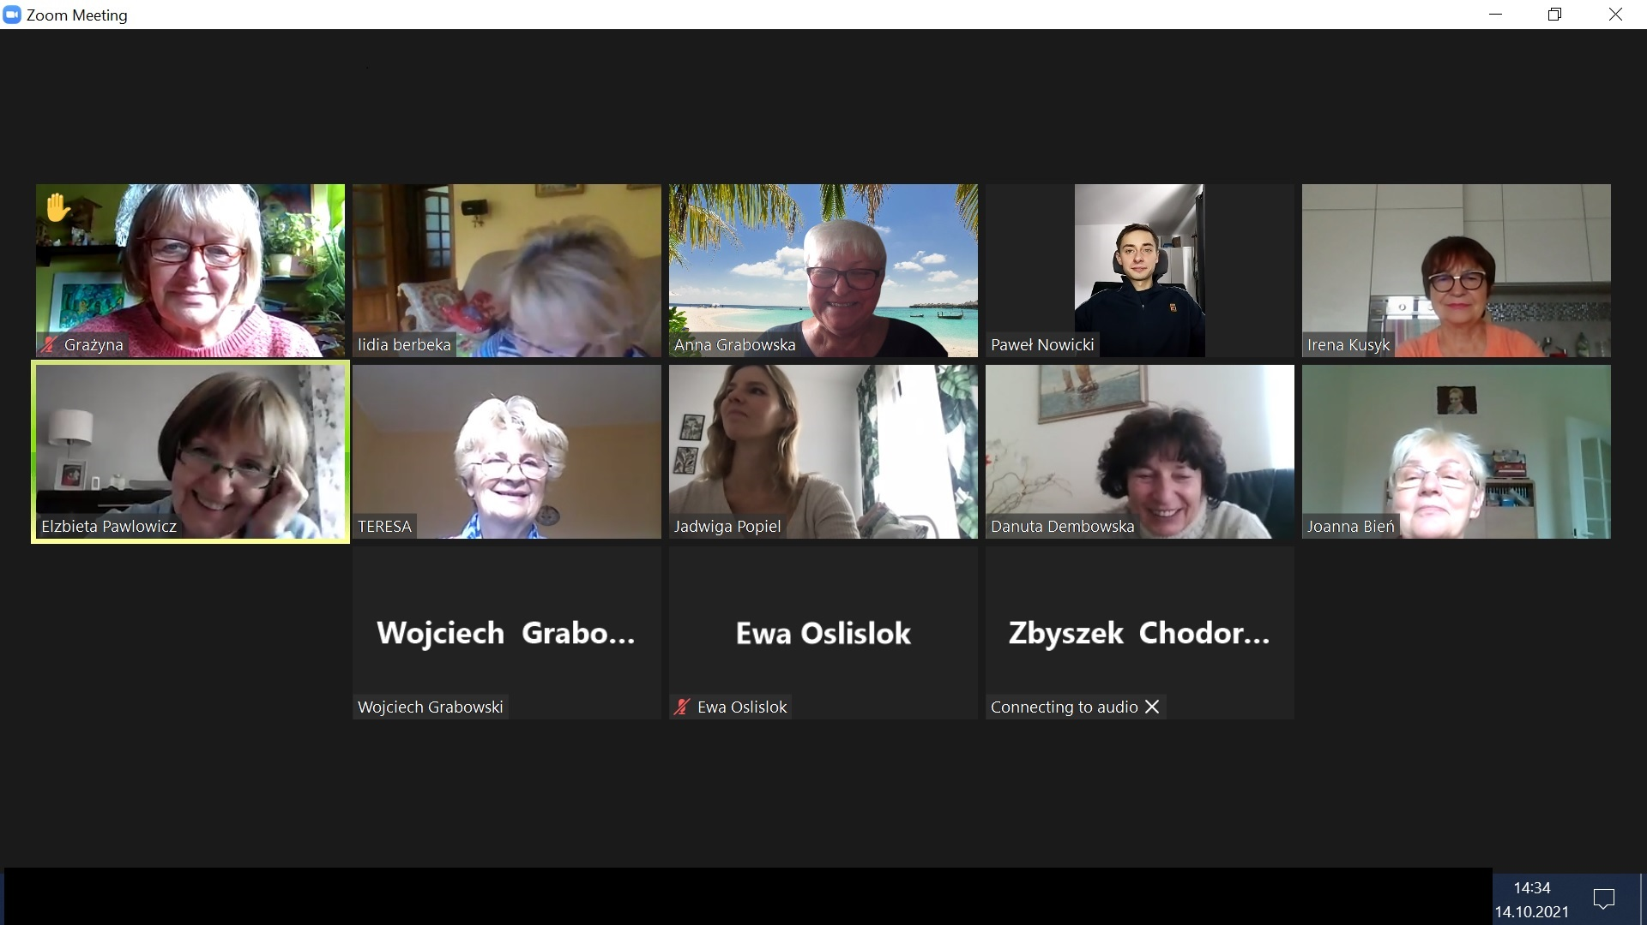
Connecting Online Conference - CO22

Slide 8
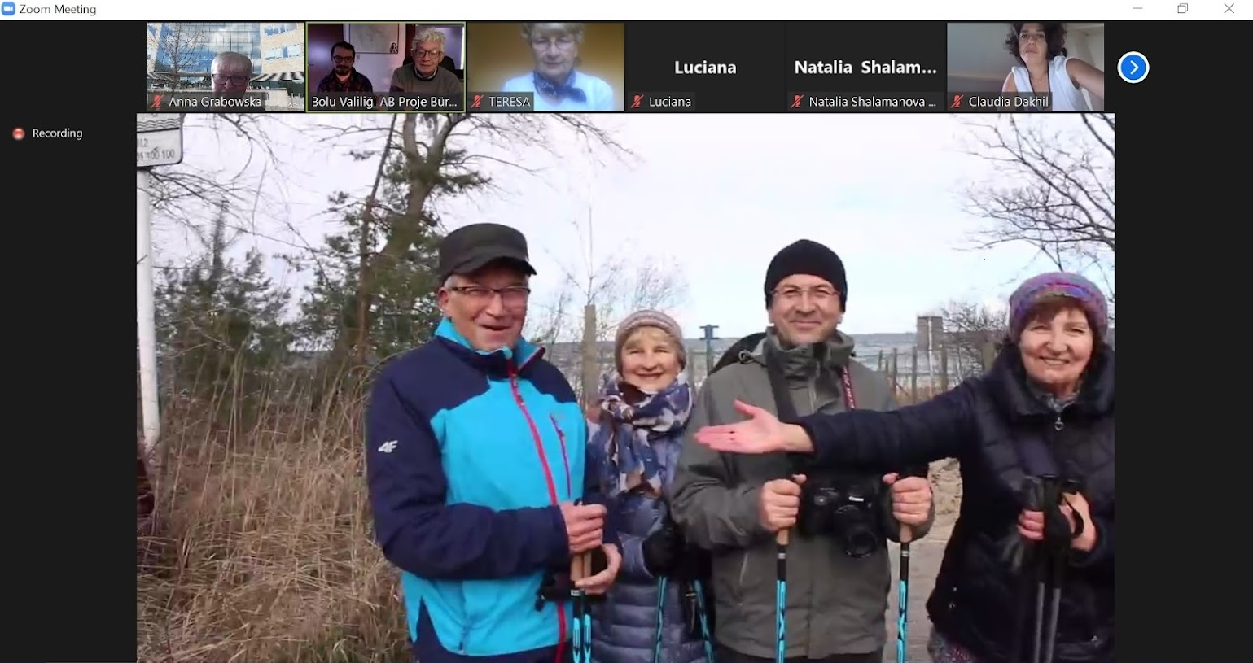
Connecting Online Conference - CO22

Slide 9
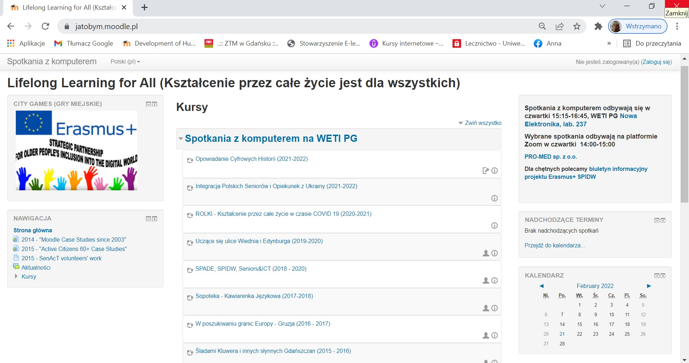
Connecting Online Conference - CO22

Slide 10
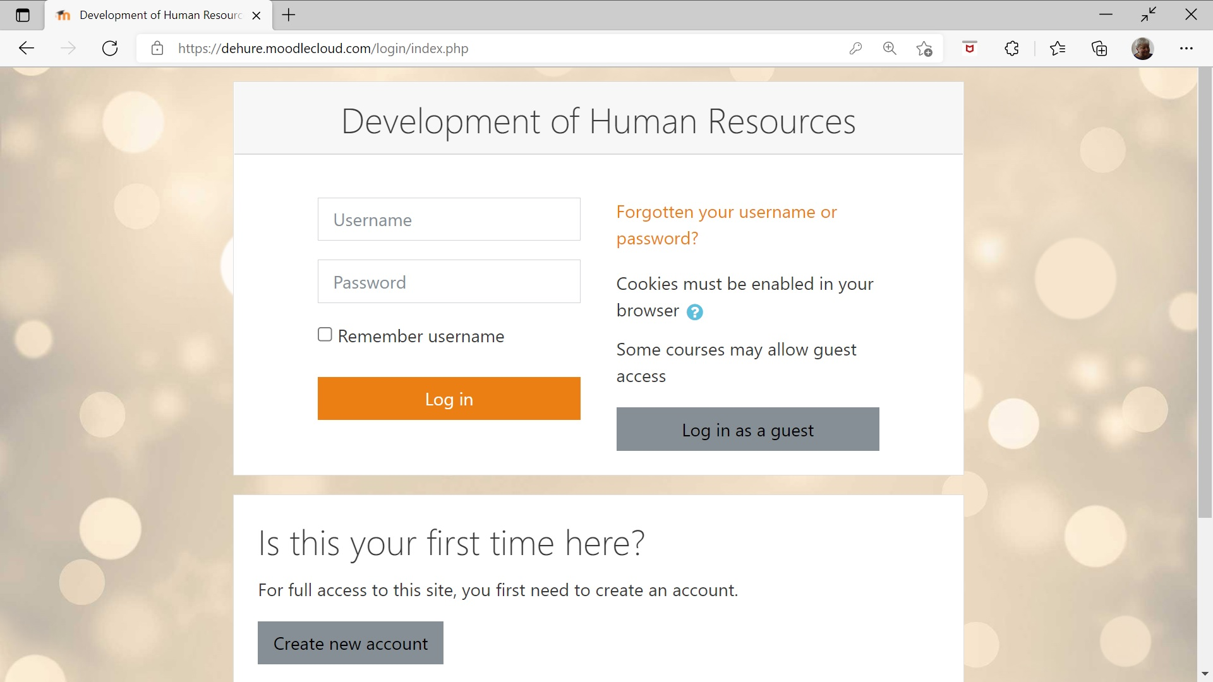
Connecting Online Conference - CO22
https://dehure.moodlecloud.com/

Slide 11
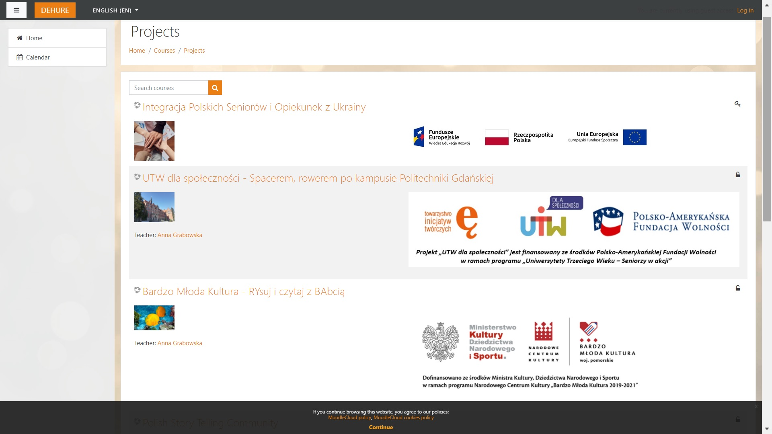
Connecting Online Conference - CO22
https://dehure.moodlecloud.com/

Slide 12
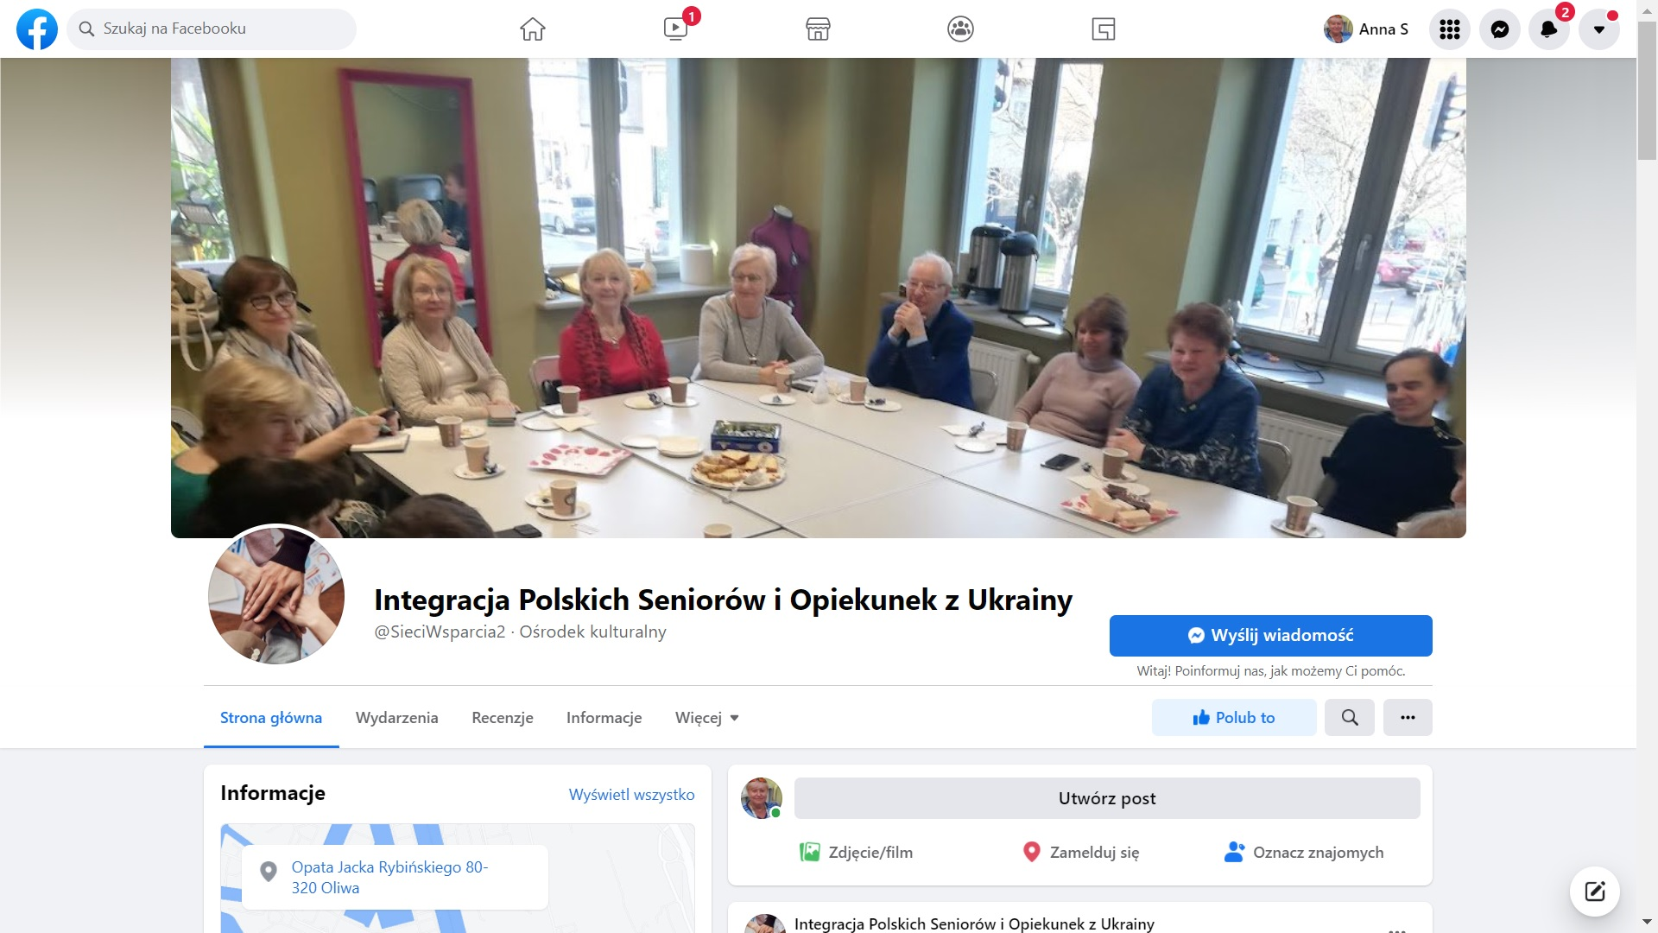
Connecting Online Conference - CO22
https://www.facebook.com/SieciWsparcia2

Slide 13
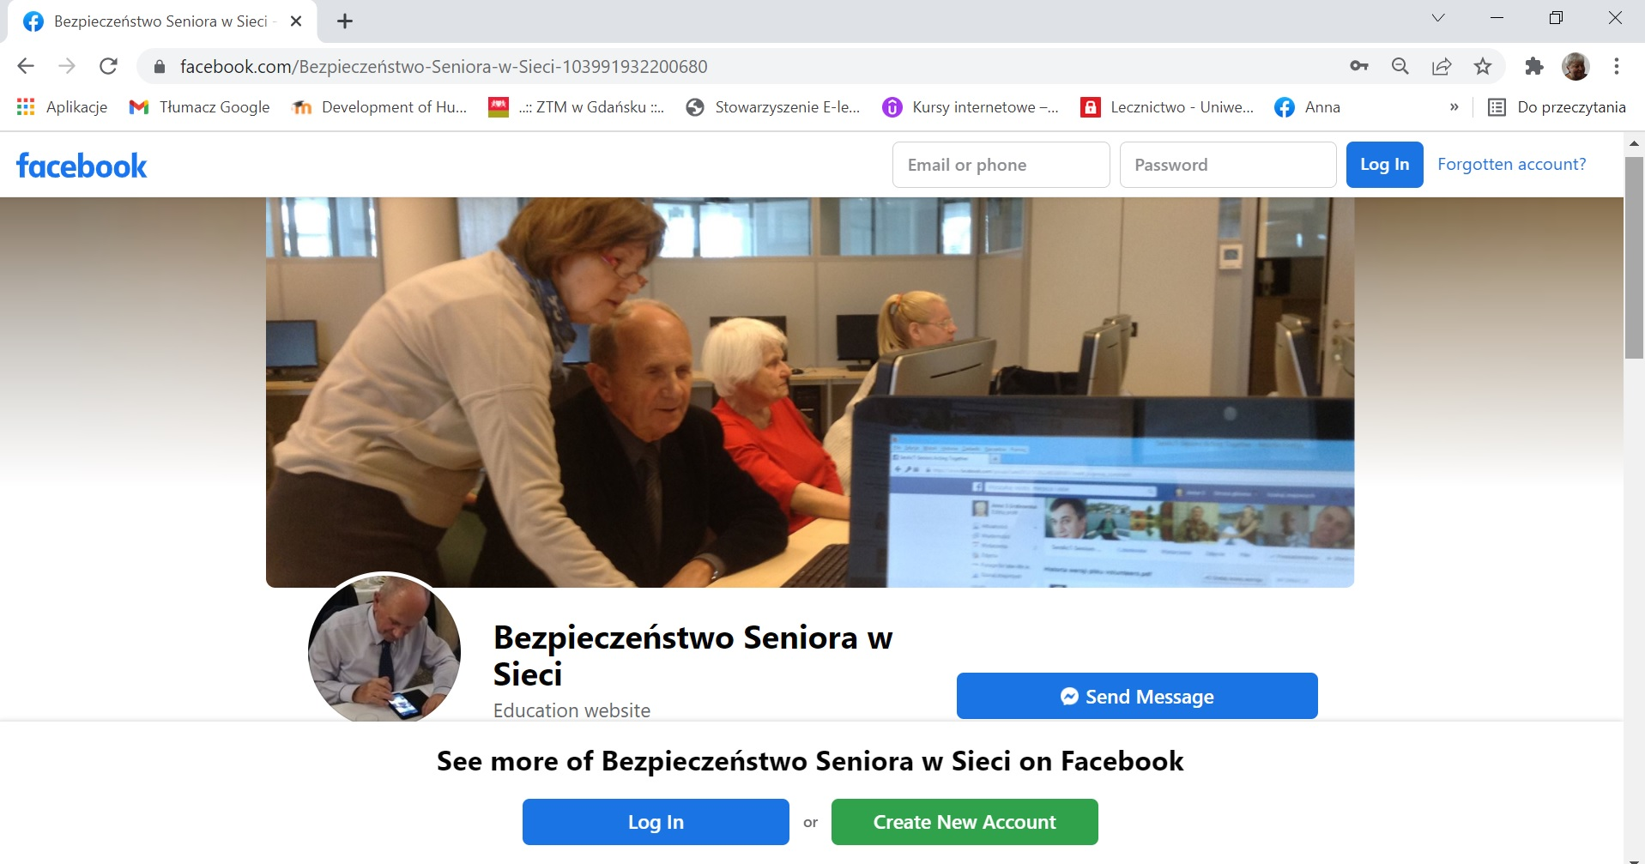
Connecting Online Conference - CO22
https://www.facebook.com/Bezpiecze%C5%84stwo-Seniora-103991932200680

Slide 14
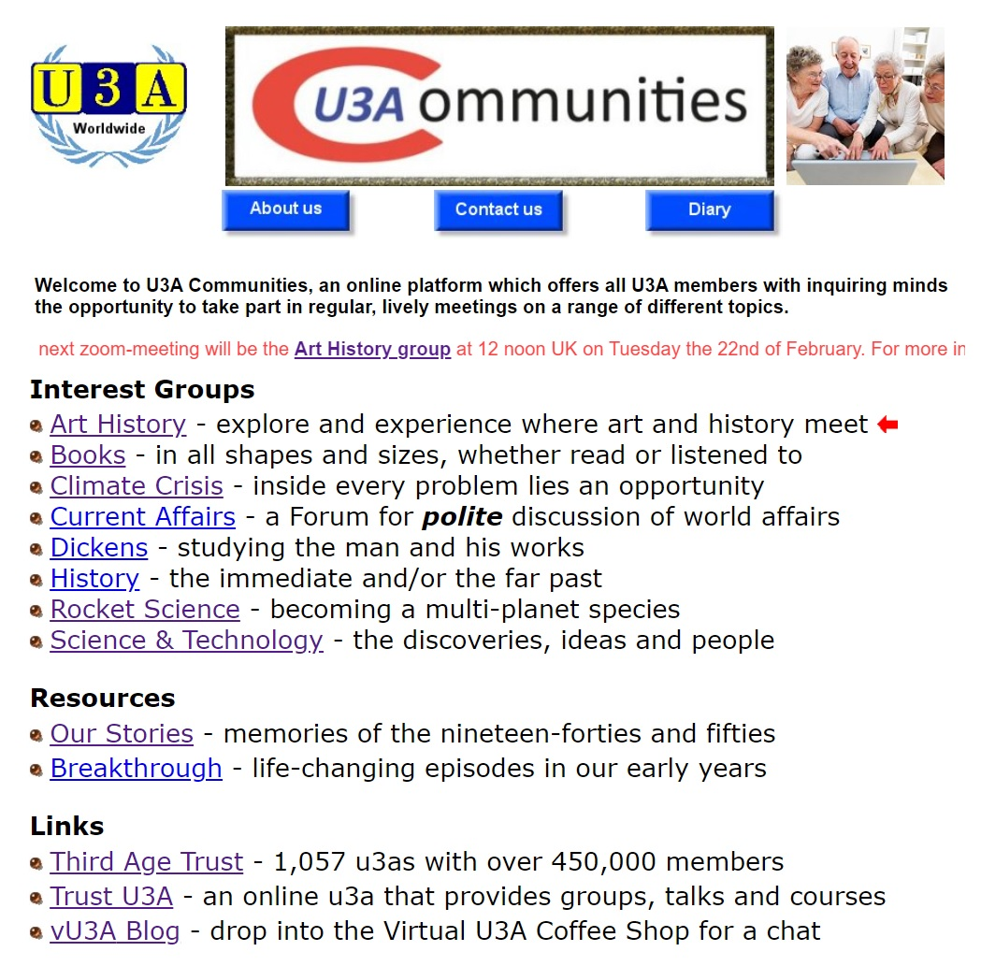
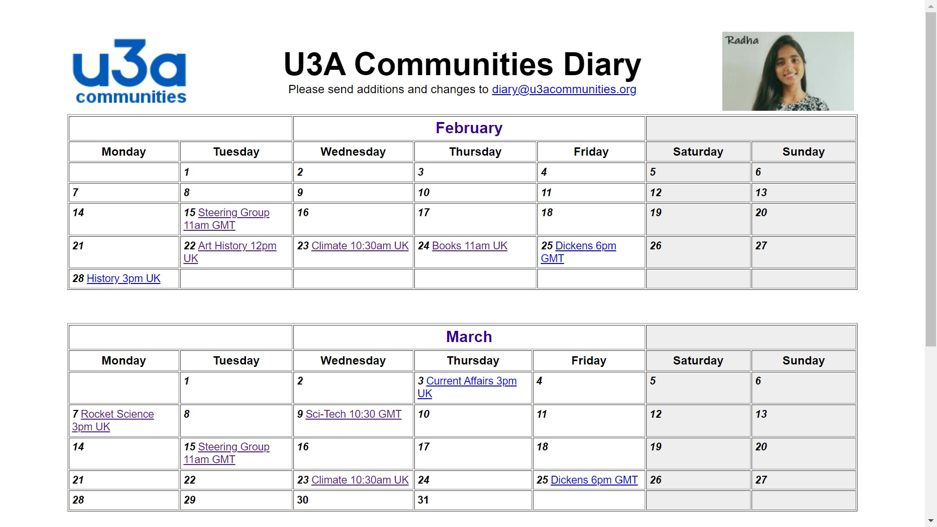
Connecting Online Conference - CO22
https://u3acommunities.org/

Slide 15
Thank you for your attention
Connecting Online Conference - CO22
anka.grabowska@gmail.com

