Slide 1
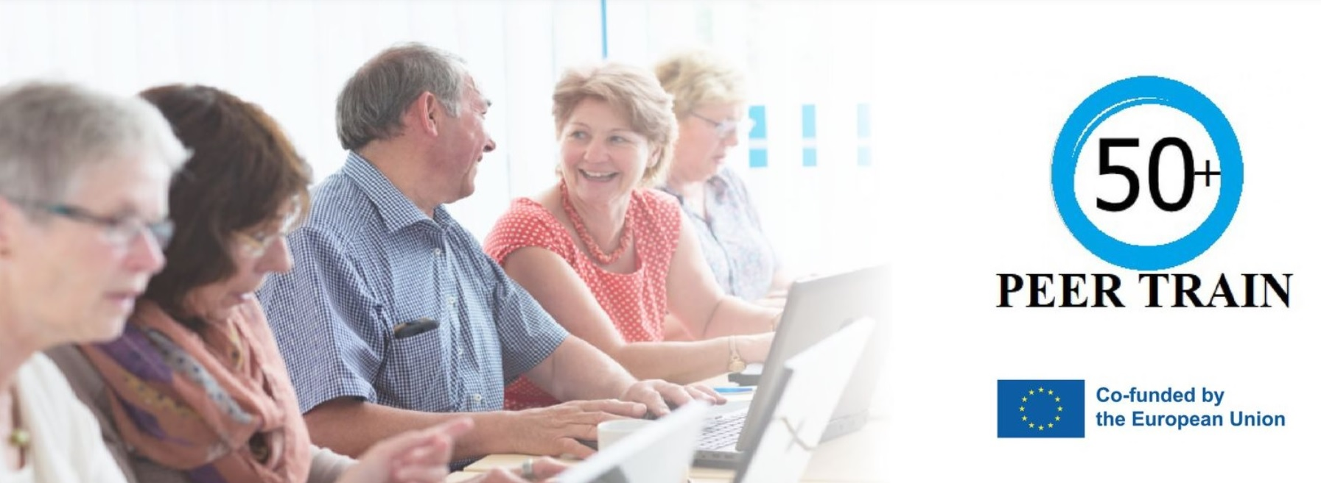
Flipped Classroom, Hybrid Learning, PEER TRAIN & ECOS

Slide 2
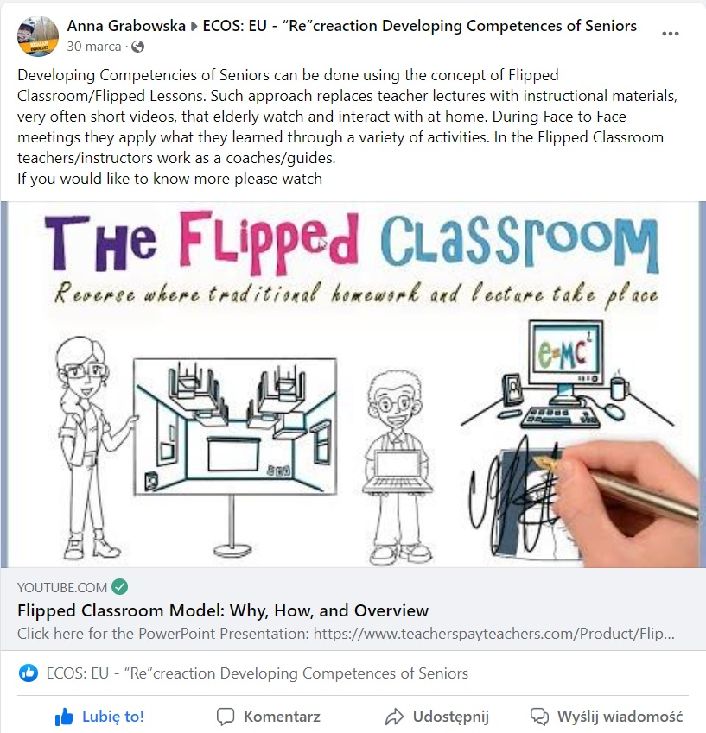
ECOS & Flipped Classroom

Slide 3
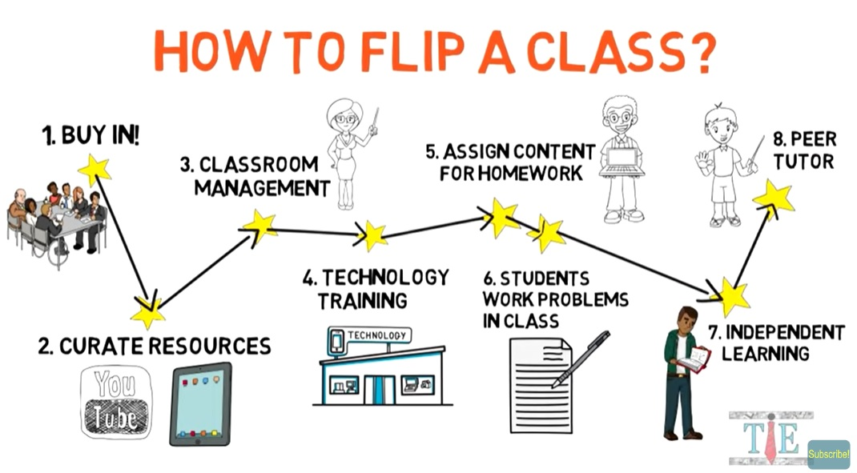
There is a method to this madness!

Slide 4
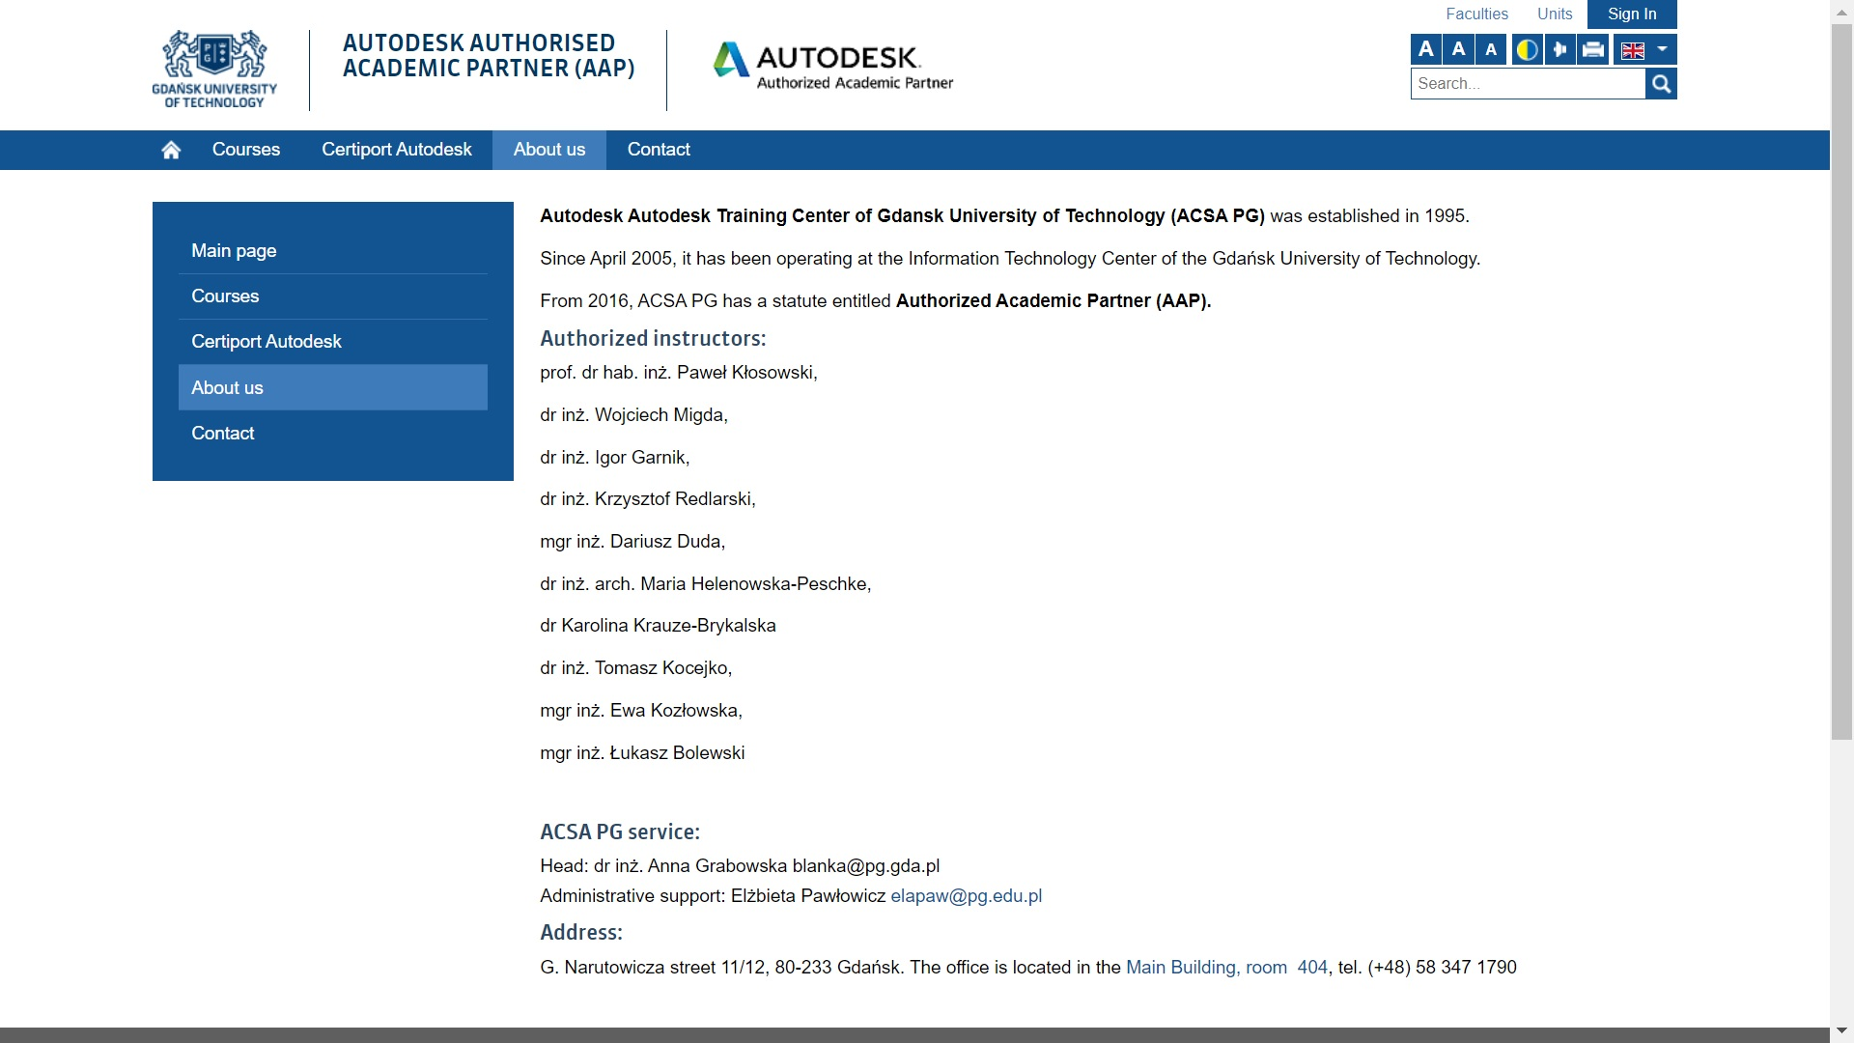
Flipped Classroom at GUT…

Slide 5
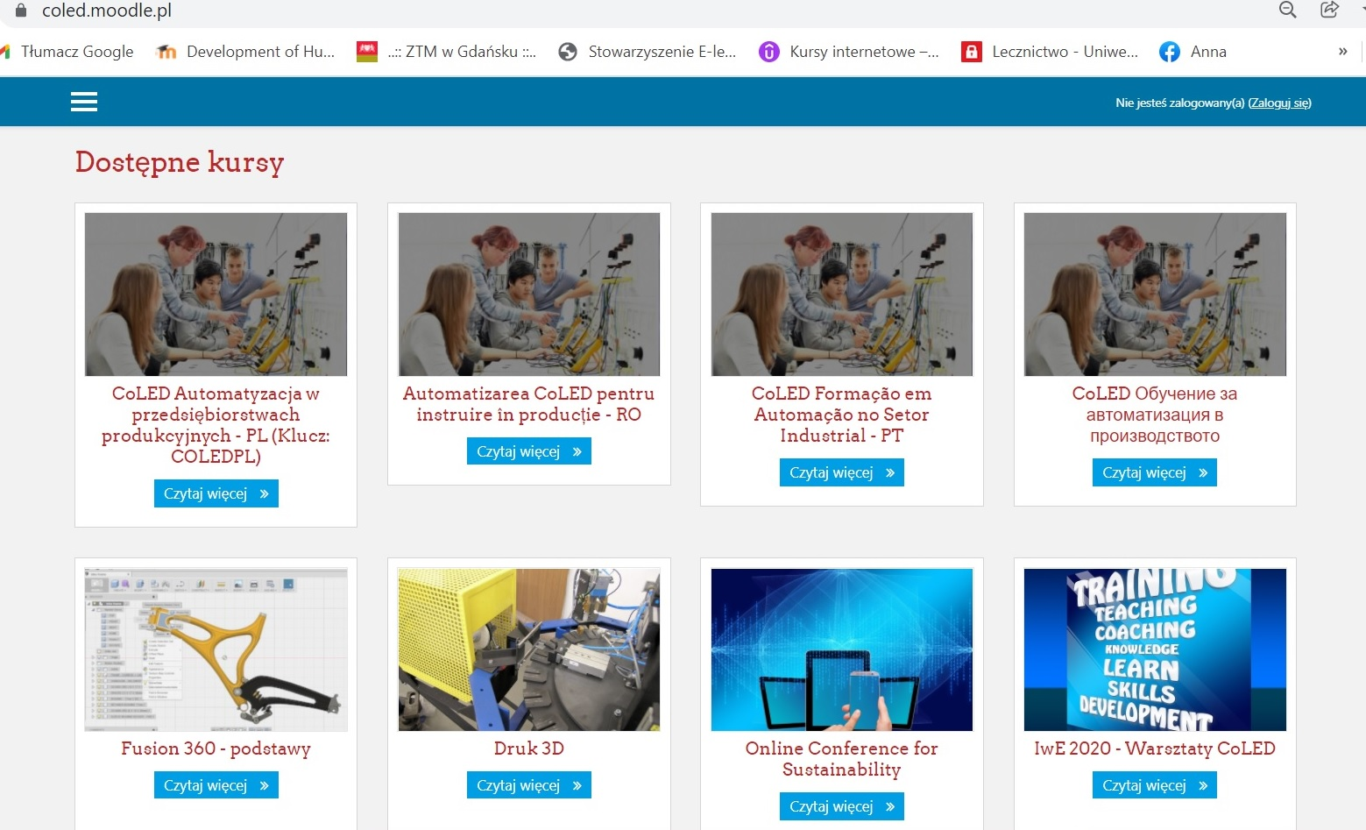
25 years later – hybrid learning in Erasmus+ CoLED
In the case of a flipped classroom, materials are recorded in advance and can be viewed at any time before meeting with the teacher.
Meetings (F2F, online) are used only for discussion on specific topics, checking knowledge, improving skills, etc.

Slide 6
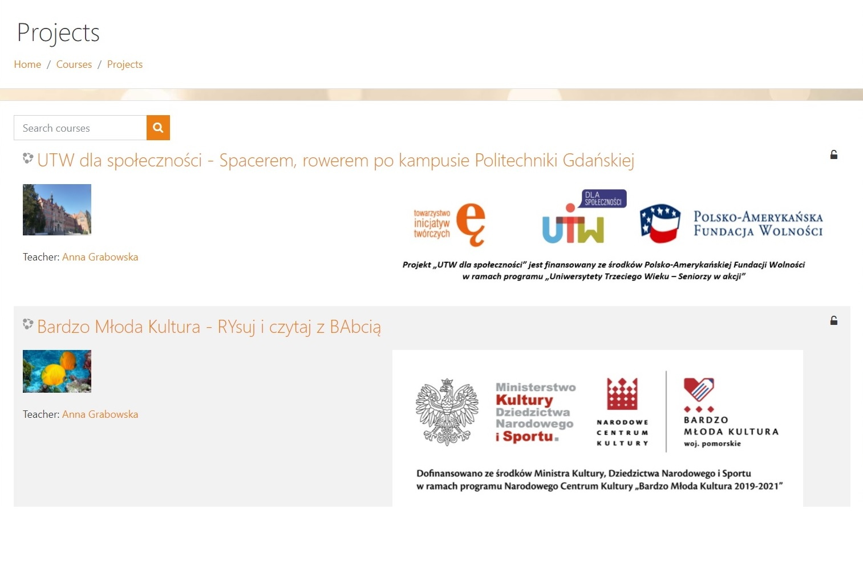
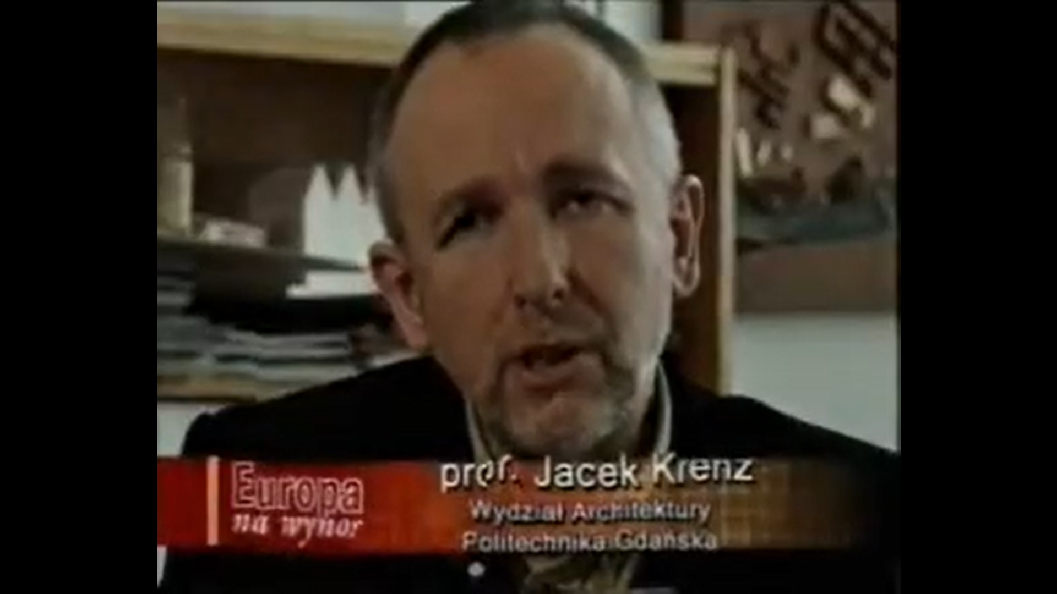
Resources for Flipped Classroom in MoodleCloud

Slide 7
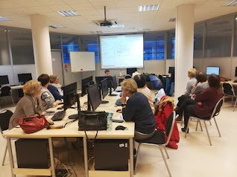
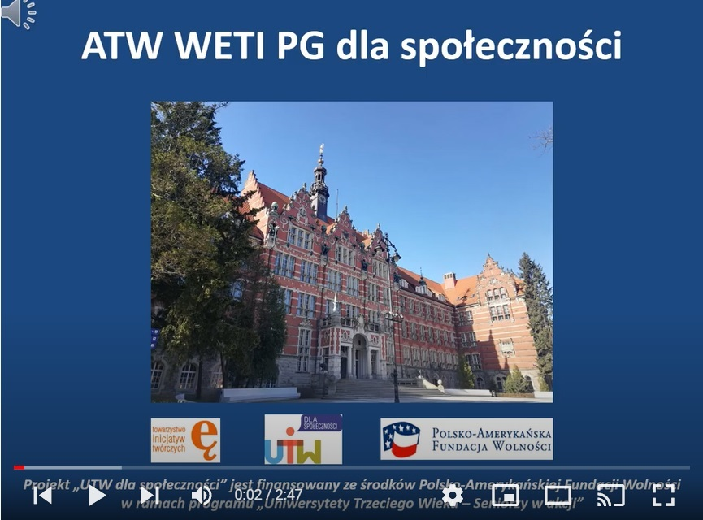
Flipped Classroom & ATW WETI PG

Slide 8

How to create digital stories using archives?
A digital story based on archival materials should be based on a consistent selection of elements that illustrate the theme and a narrative linking the selected objects.
Like every story, it should have an introduction, development, ending, and accents.
The way of presenting digital history should be appropriately matched to the topic, selected archival materials and their type.
The graphic design and background music should emphasize the character of the whole.
https://archiwa.org/sites/default/files/files/digital_storytelling_instruktaz.pdf

Slide 9
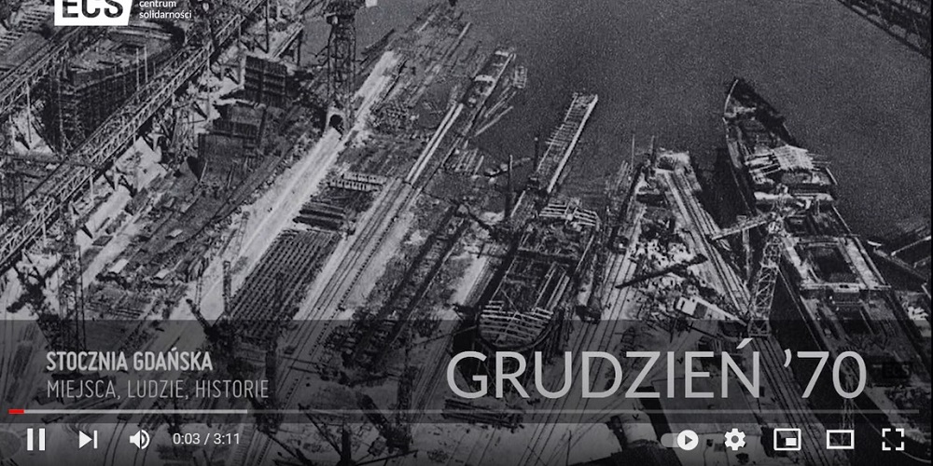
Archiwum ECS

Slide 10
Grudzień 1970 powrót do przeszłości
Anna Grabowska
ATW WETI PG, Gdańsk, grudzień 2021

Slide 11
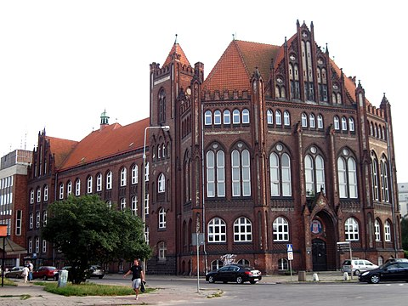
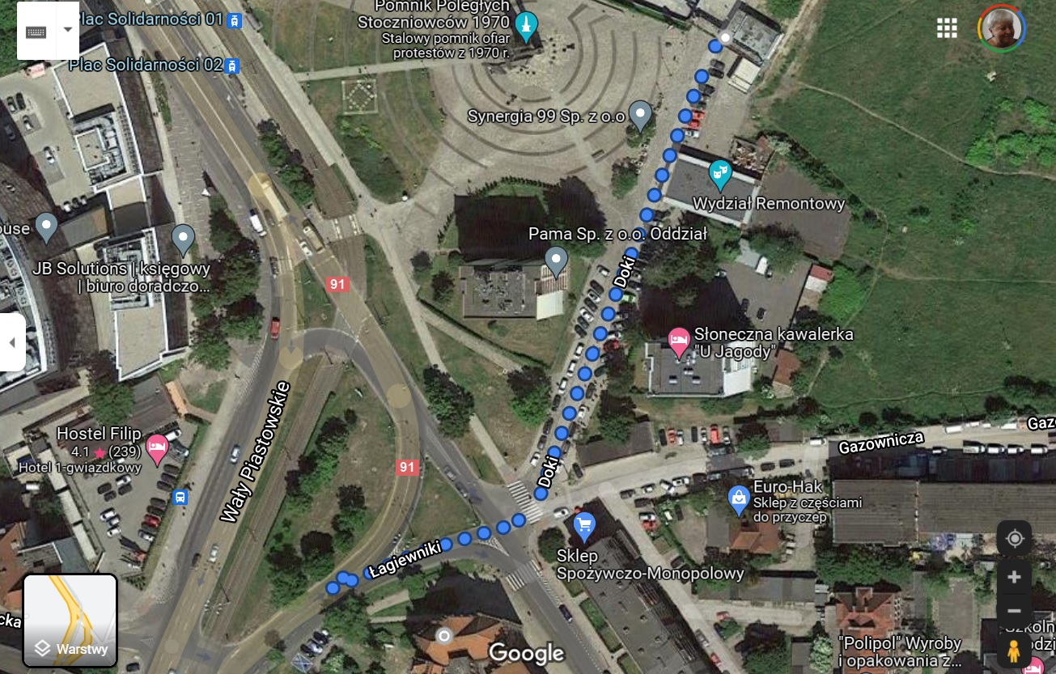
14 grudnia 1970
I LO - olimpiada
220 m od bramy

Slide 12
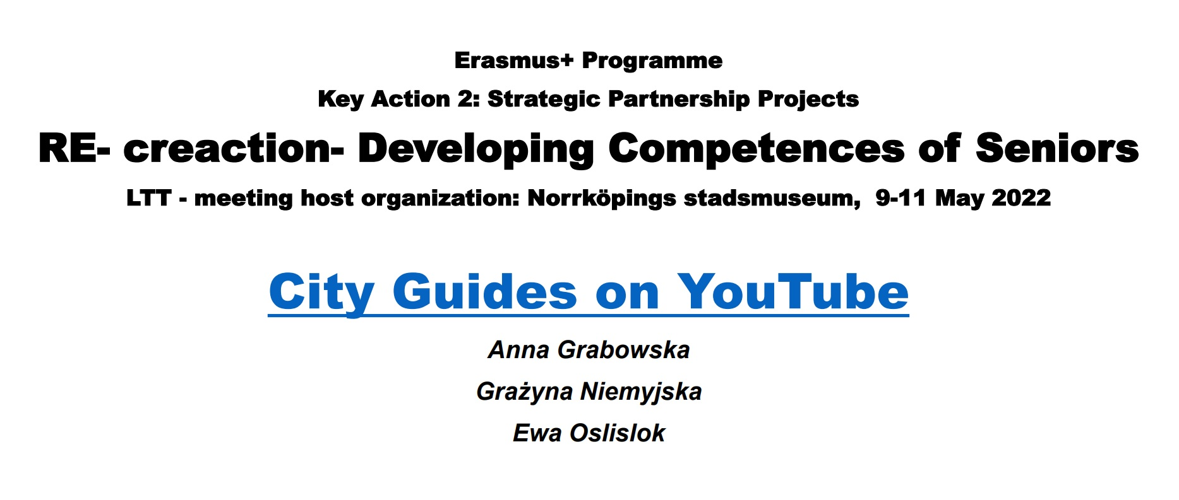
Telling Digital Stories…

Slide 13
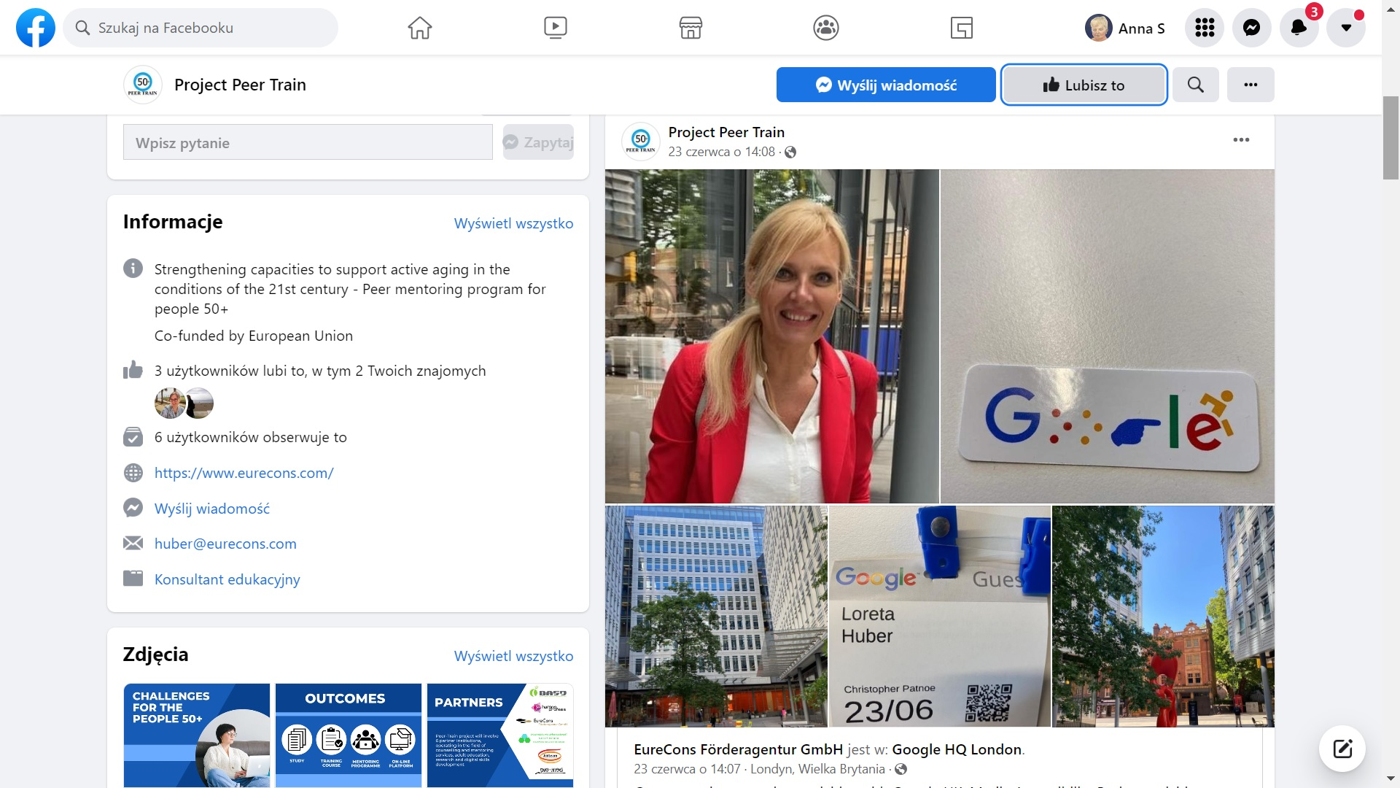
Invitation to ERASMUS+ PEER-TRAIN

Slide 14
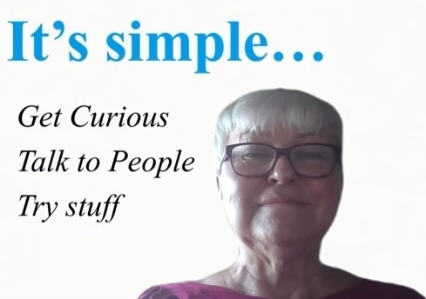
THANK YOU FOR YOUR ATTENTION
Dr inż. Anna Grabowska
anka.grabowska@gmail.com

