Slide 1
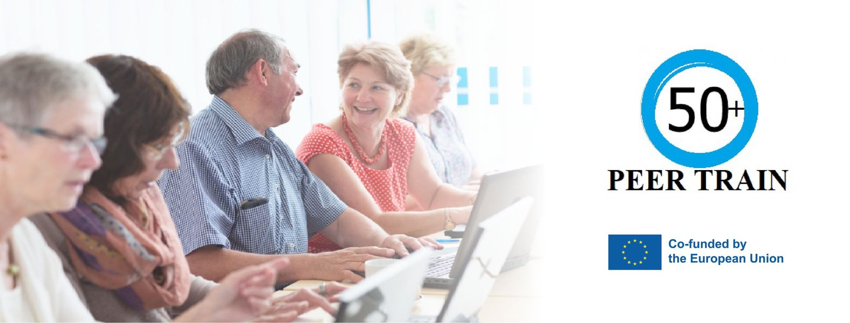
R3 - Mentoring programme for People 50+ in the form of Blended-Learning
LTT Hungary, 21-23.11.2022

Slide 2
Our team

Slide 3
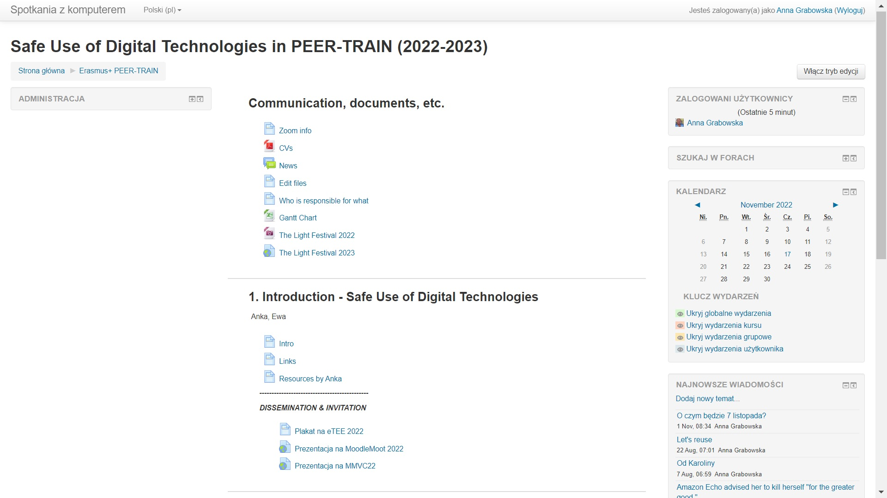
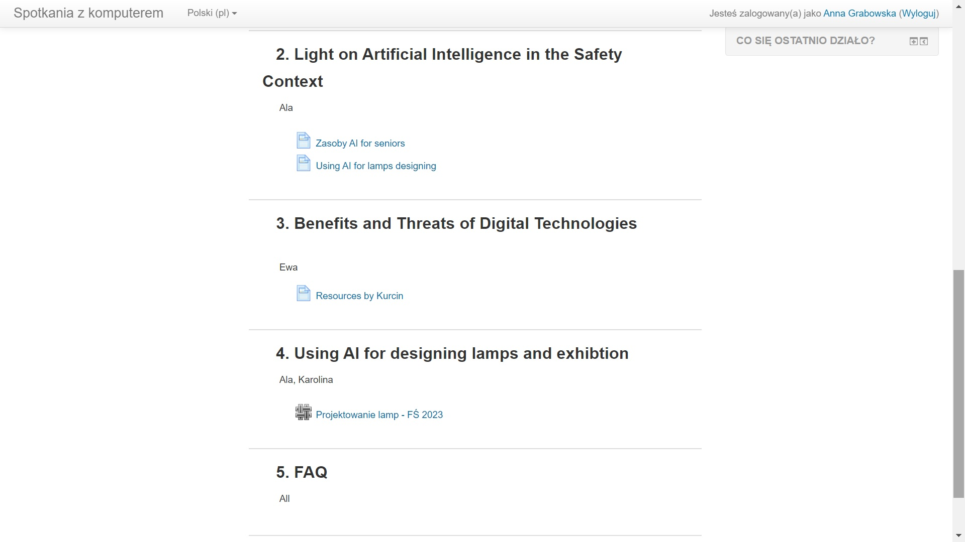
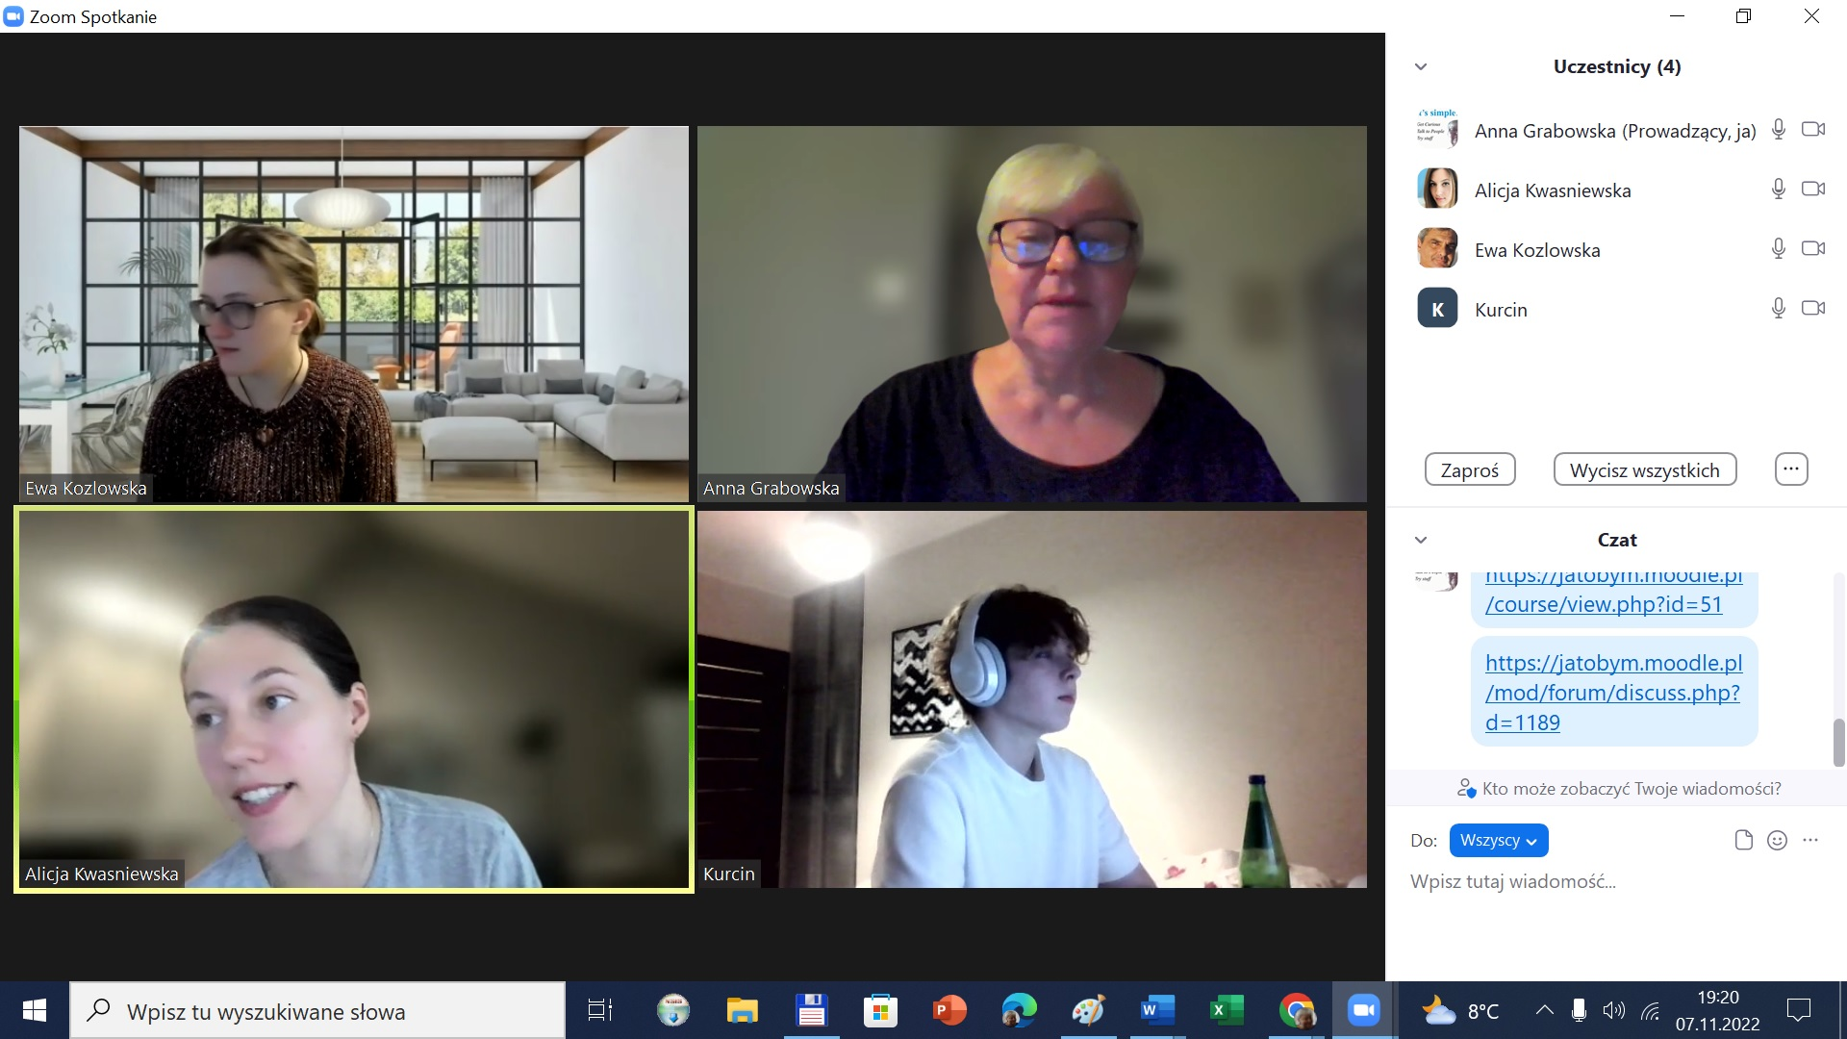
Module 6 Safe use of digital technologies how we have been working…

