Slide 1
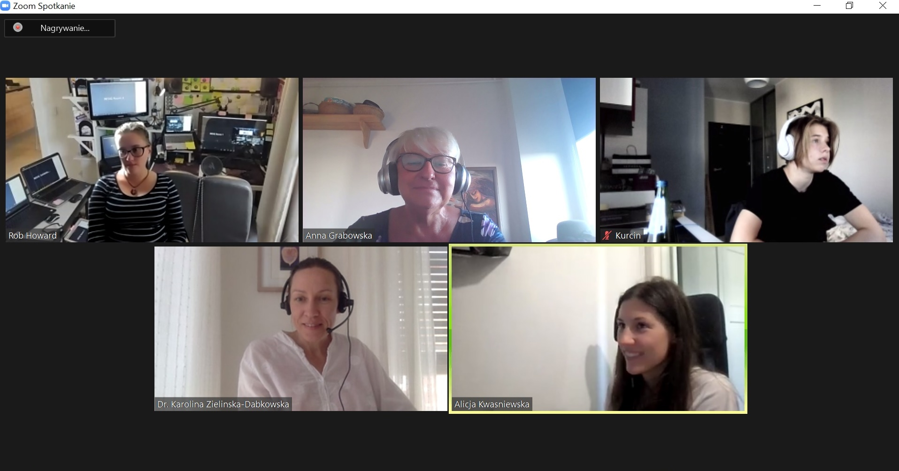
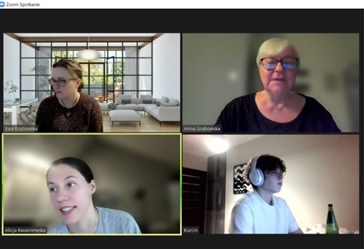
Lifelong Learning for Elderly – PEER-TRAIN Case Study Dr Anna Grabowska
February 17 - 19, 2023
https://peer-train.org/
https://festiwalswiatla.hs3.pl/
https://jatobym.moodle.pl/
https://dehure.moodlecloud.com/
https://zpasjami.net/
https://clickmeeting.com/pl
Light-on-AI

