Slide 1
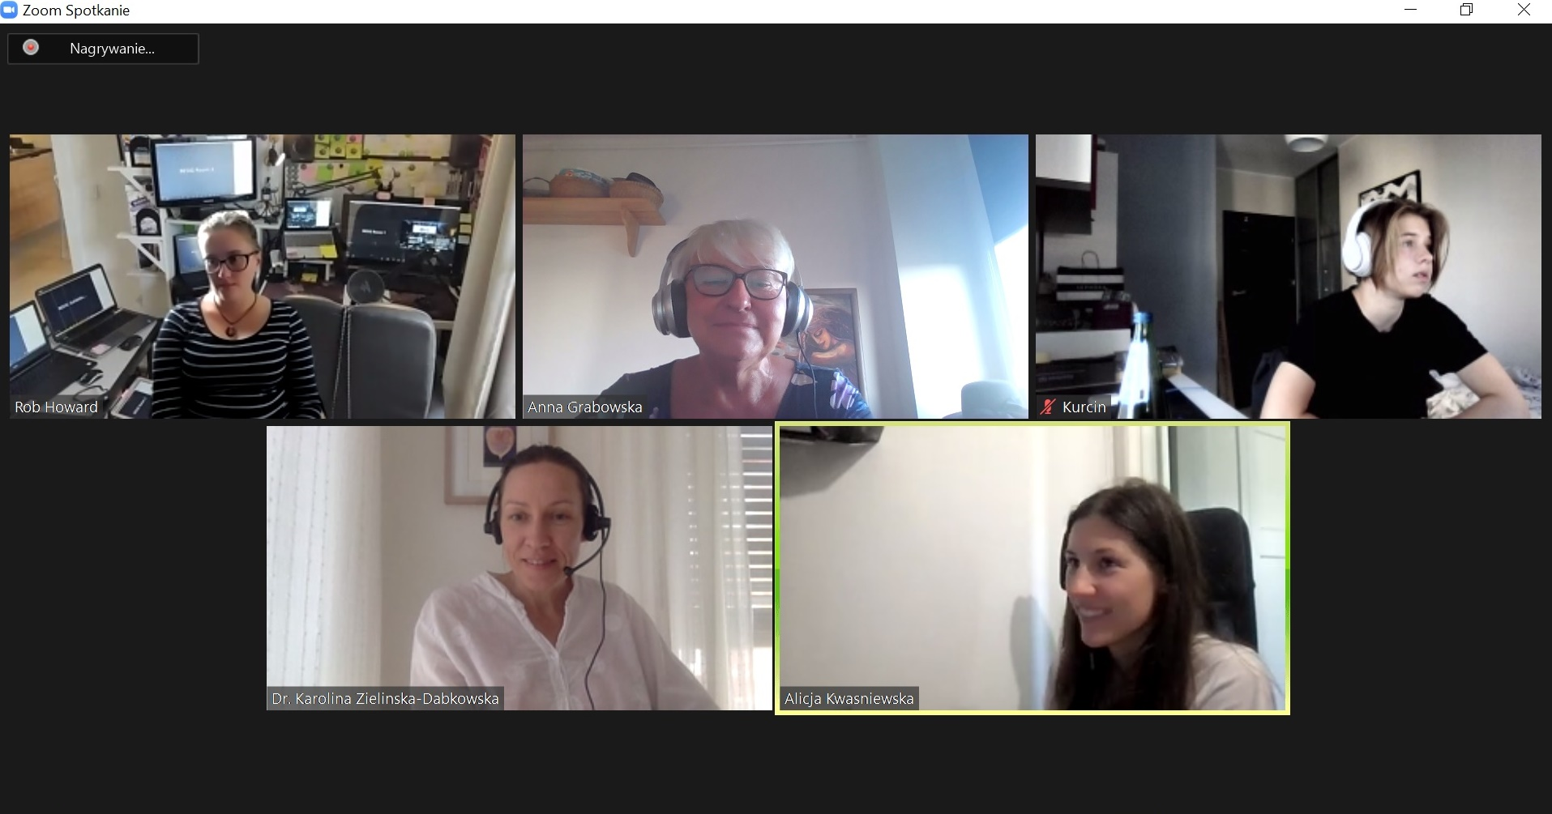
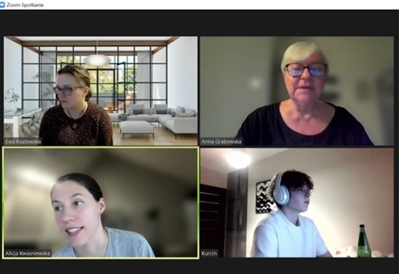
Lifelong Learning for Elderly – PEER-TRAIN Case Study dr anna grabowska
February 17 - 19, 2023
https://peer-train.org/
https://festiwalswiatla.hs3.pl/
https://jatobym.moodle.pl/
https://dehure.moodlecloud.com/
https://zpasjami.net/
https://clickmeeting.com/pl
Light-on-AI

Slide 2
https://peer-train.org/

Slide 3
https://jatobym.moodle.pl/

Slide 4
https://dehure.moodlecloud.com/

Slide 5
https://zpasjami.net/

Slide 6
https://zpasjami.net/

Slide 7
https://clickmeeting.com/free-signup

Slide 8
https://youtube.com/playlist?list=PLeOe3daa0qUxPcl2YaC04pF9ZIjr1IleE

Slide 9
Thank you for your attention
anka.grabowska@gmail.com

