Slide 1

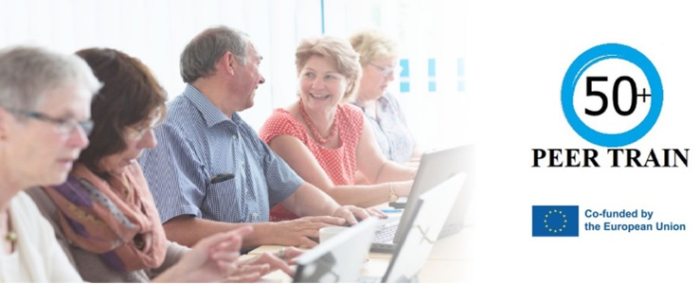
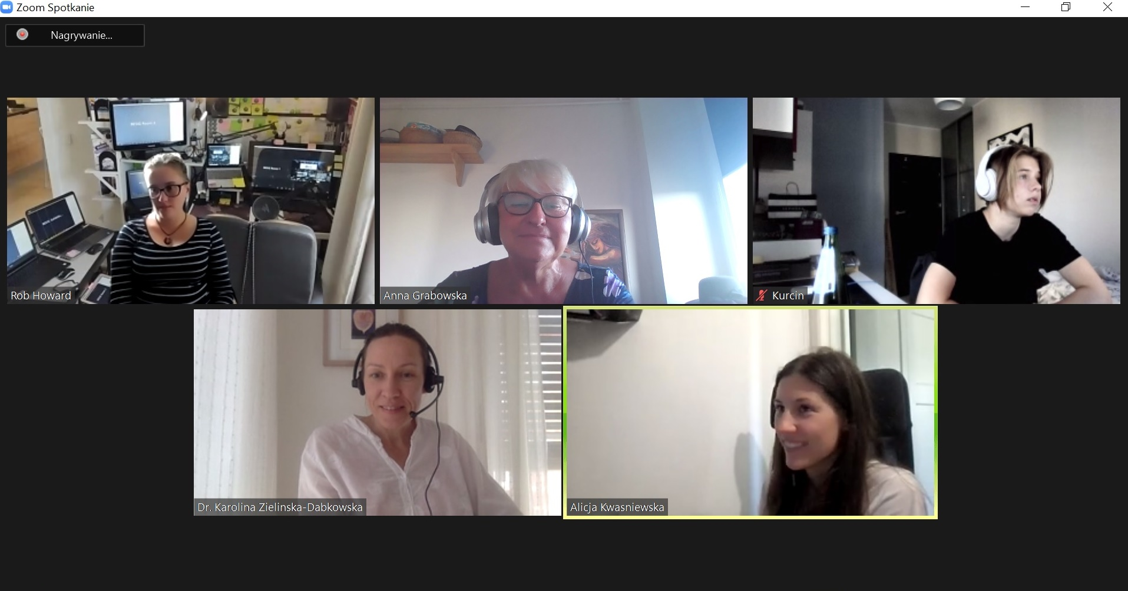
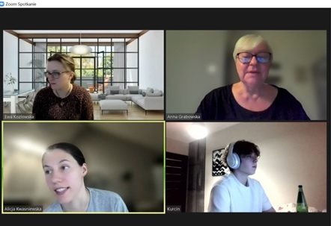
Lifelong Learning for Elderly –
PEER-TRAIN Case Study dr Anna Grabowska
February 17 - 19, 2023
https://peer-train.org/
https://festiwalswiatla.hs3.pl/
https://jatobym.moodle.pl/
https://dehure.moodlecloud.com/
https://zpasjami.net/
https://clickmeeting.com/pl
Light-on-AI

Slide 2
About me
Since 2001 I have been in projects for edlerly students (70, 80+).
This year together with volunteers we have been organising workshops Light on AI.
Welcome to https://festiwalswiatla.hs3.pl/.
I am looking forward to meeting you F2F
or online in Gdansk in May 2023

