Slide 1

WordPress for Seniors – 2 Case Studies
Dr Anna Grabowska
anka.grabowska@gmail.com
Webex link: https://unideb.webex.com/unideb hu/j.php?MTID=ma4514d01a7c186645be97b6c03841ded
Webex link: https://unideb.webex.com/unideb-hu/j.php?MTID=m618bf748bf530d6a94803a4c96071d58

Slide 2
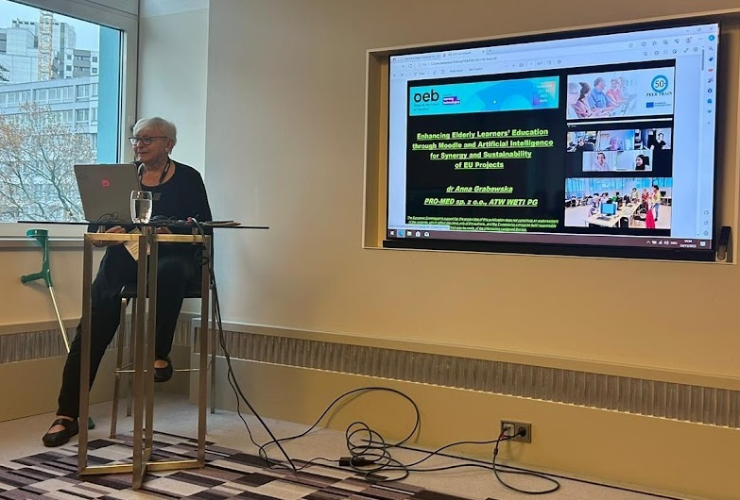
I have been retired since 2007 and have been managing meetings for elderly in a blended mode (F2F & Lifelong Learning for All).
Since 2021 I have been in a team behind U3A Communities.

Slide 3

Why WordPress (1)
1. Ease of Use and Accessibility:
  Intuitive Interface: WordPress offers a simple and intuitive interface, making it accessible for seniors who may not be tech-savvy. Its drag-and-drop features and visual editor simplify the process of creating and managing content.
  Accessibility Features: WordPress provides themes and plugins that enhance accessibility, catering to seniors with visual impairments or other disabilities. This includes screen reader support, high-contrast themes, and text resizing options.

Slide 4
Why WordPress (2)
2. Community Building and Social Engagement:
Blogs and Forums: Many seniors use WordPress to create blogs and online forums, enabling them to share their experiences, hobbies, and interests. This fosters a sense of community and reduces feelings of isolation.
Social Connections: Through blogging and commenting, seniors can connect with like-minded individuals, maintaining social engagement and building new relationships.

Slide 5
Why WordPress (3)
3. Lifelong Learning and Hobbies:
Educational Blogs: Seniors often use WordPress to start educational blogs, sharing their expertise and life experiences. This not only keeps them mentally active but also allows them to contribute valuable knowledge to younger generations.
Hobby Projects: WordPress supports various multimedia formats, enabling seniors to document and share their hobbies, such as photography, gardening, or travel, through dedicated websites.

Slide 6
Why WordPress (4)
4. Business Ventures and Volunteering:
Small Businesses: Some seniors use WordPress to launch and manage small business websites, leveraging their lifelong skills and interests. The platform’s e-commerce plugins facilitate online sales, appointments, and customer engagement.
Non-Profit Initiatives: Seniors involved in volunteering and non-profit work use WordPress to create awareness, raise funds, and organize community events. The CMS’s versatility supports event management, donation forms, and volunteer sign-ups.

Slide 7
Why WordPress (5)
5. Support and Training:
Workshops and Tutorials: Many communities and senior centers offer workshops and tutorials to help seniors get started with WordPress. These sessions cover basics like setting up a website, content creation, and managing site security.
Online Resources: There are numerous online resources, including video tutorials and forums, where seniors can find help and advice on using WordPress effectively.

Slide 8
Why WordPress – Summing up
Taking into account that WordPress empowers seniors by providing them with a platform to stay connected, share their knowledge, pursue hobbies, and even start new business ventures let’s have a look at 2 case studies:
1. https://u3acommunities.org/
2. https://zpasjami.net/

Slide 9
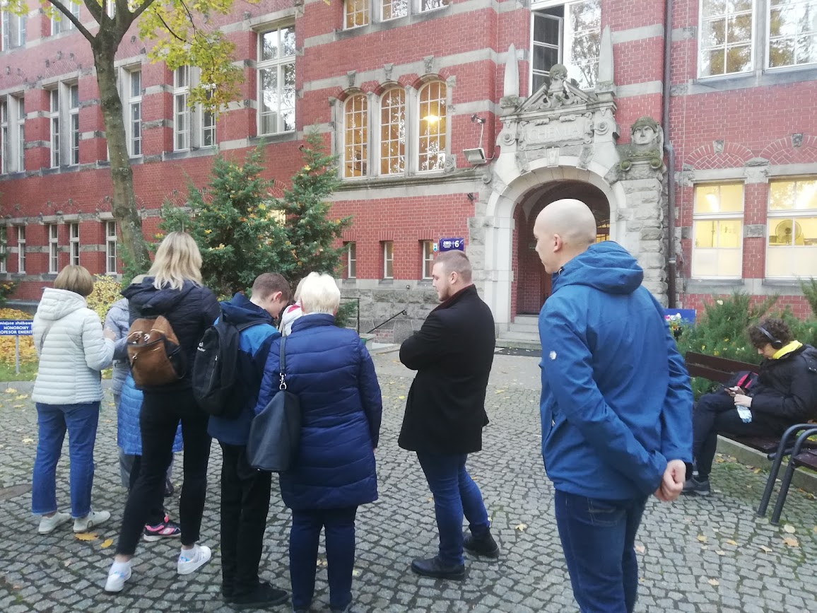
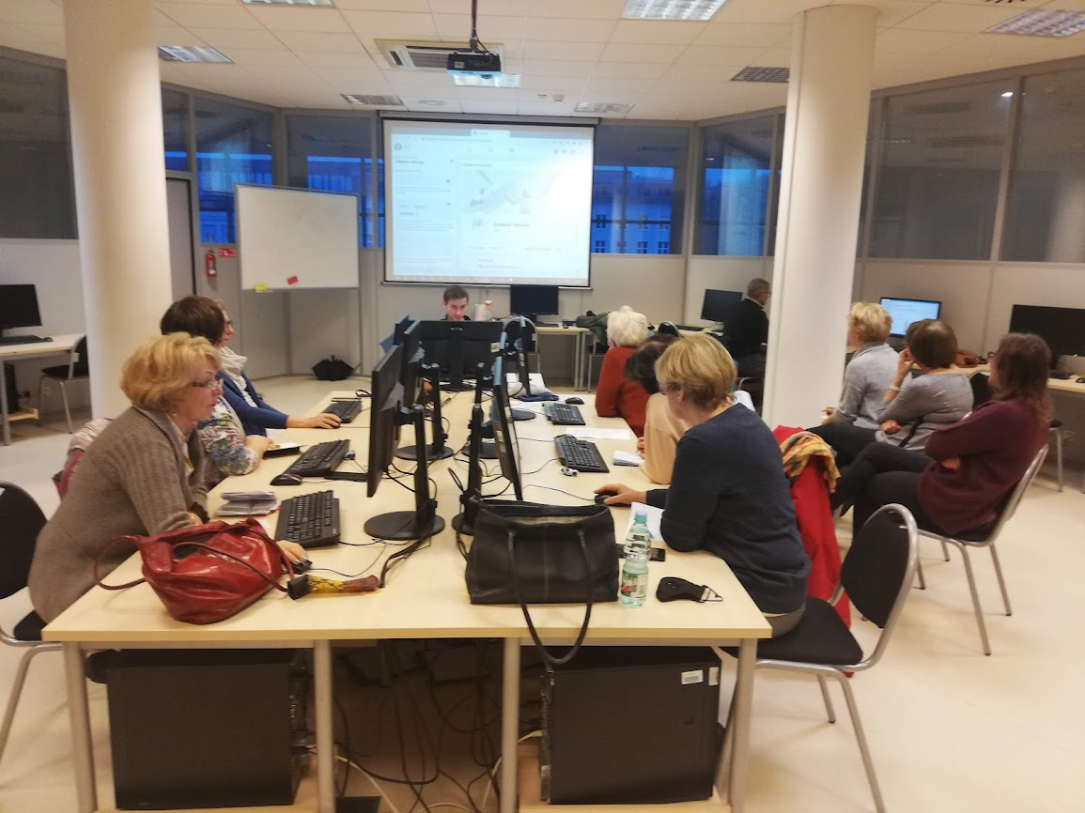
Prepare & Implement

Slide 10
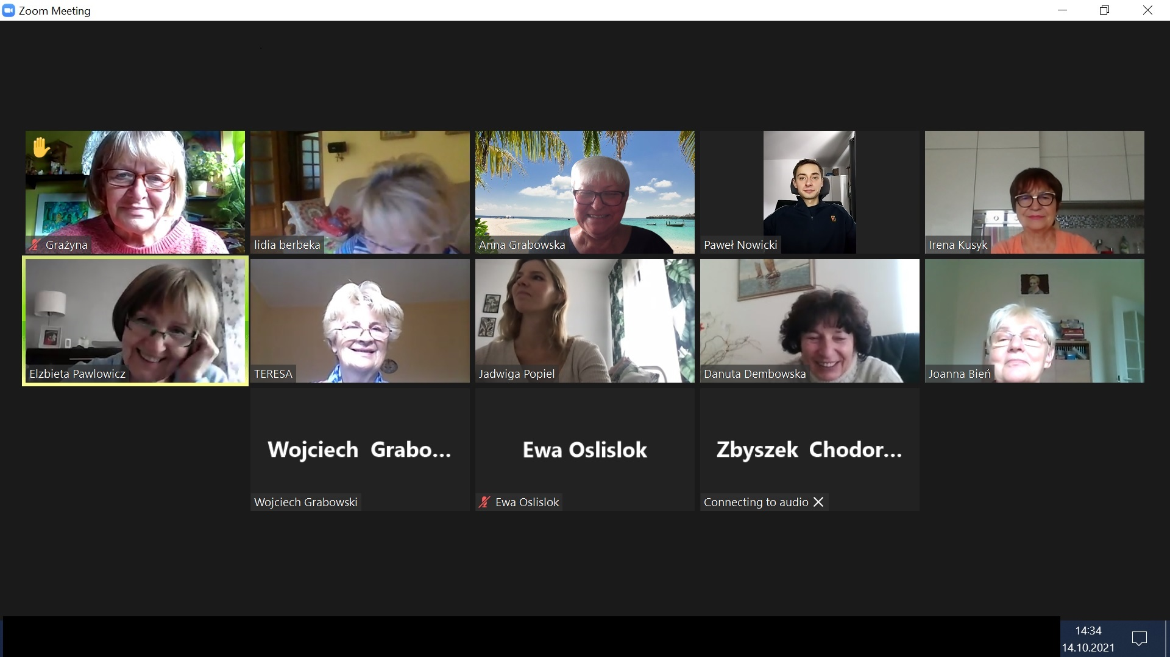
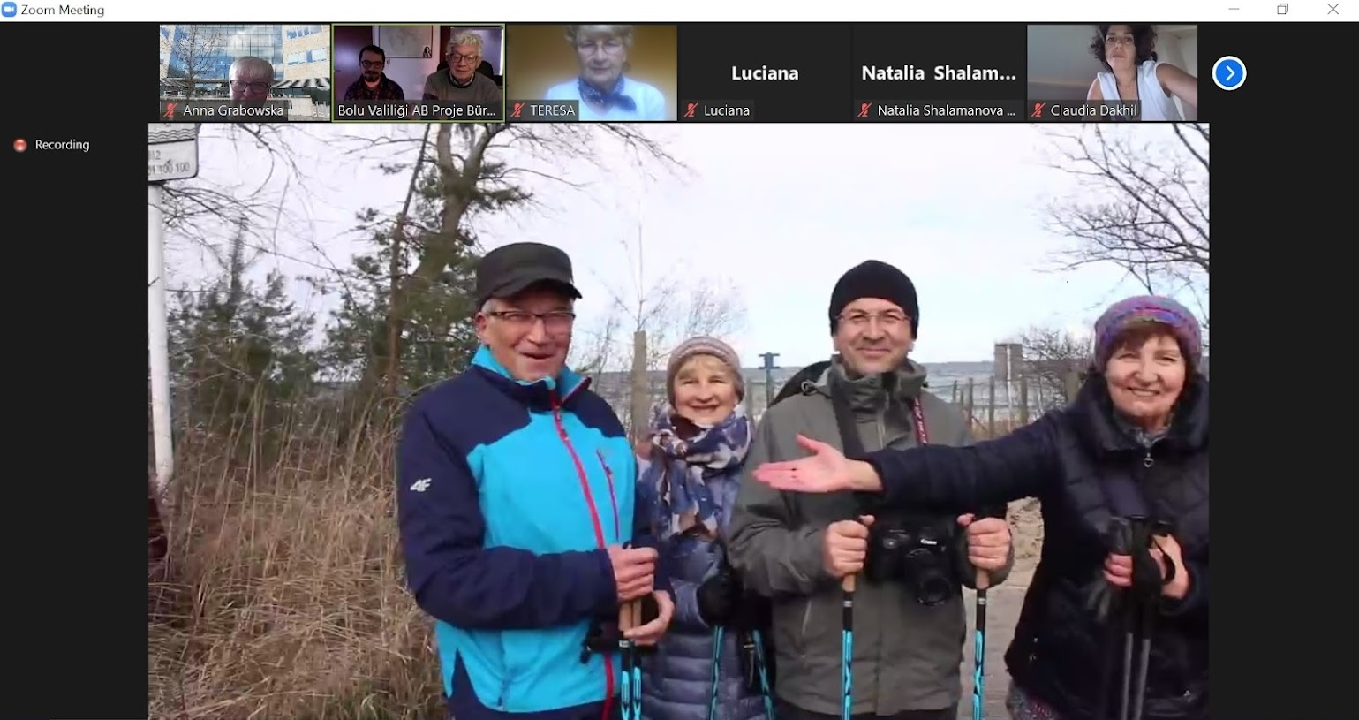
Online & F2F

Slide 11
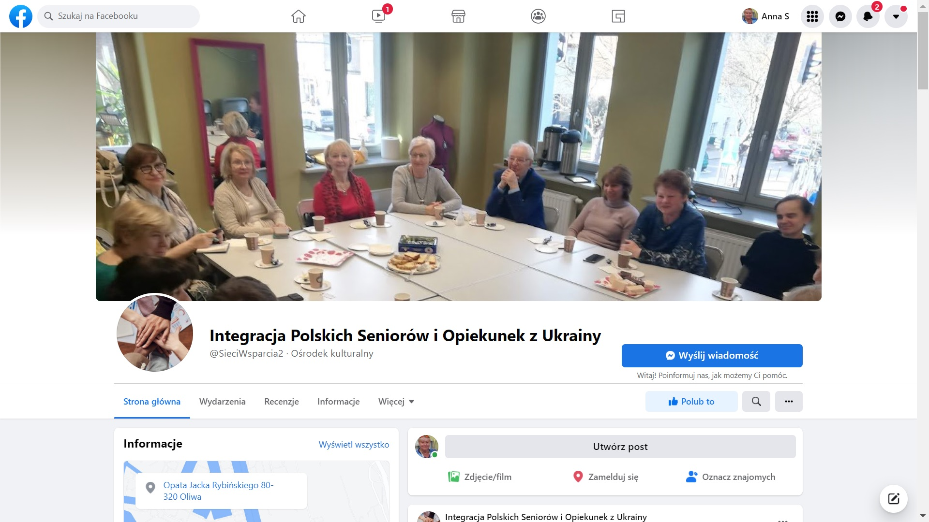
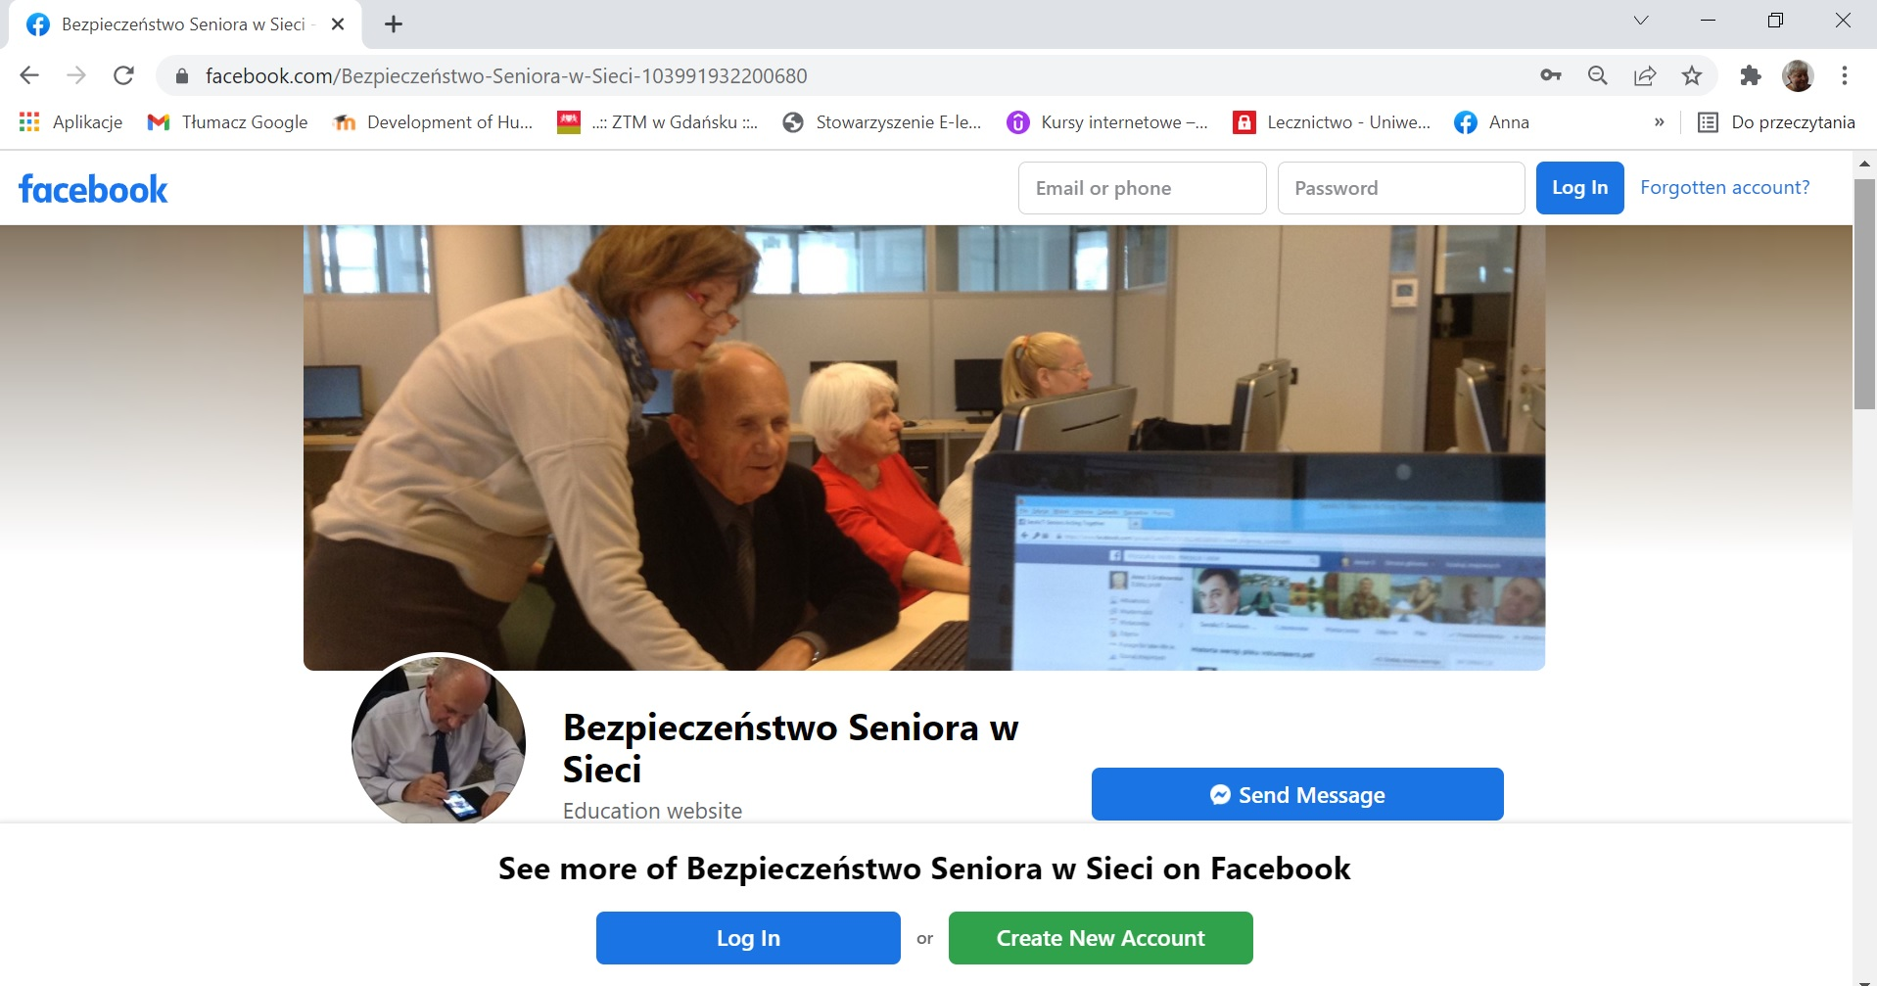
WordPress & Facebook

Slide 12
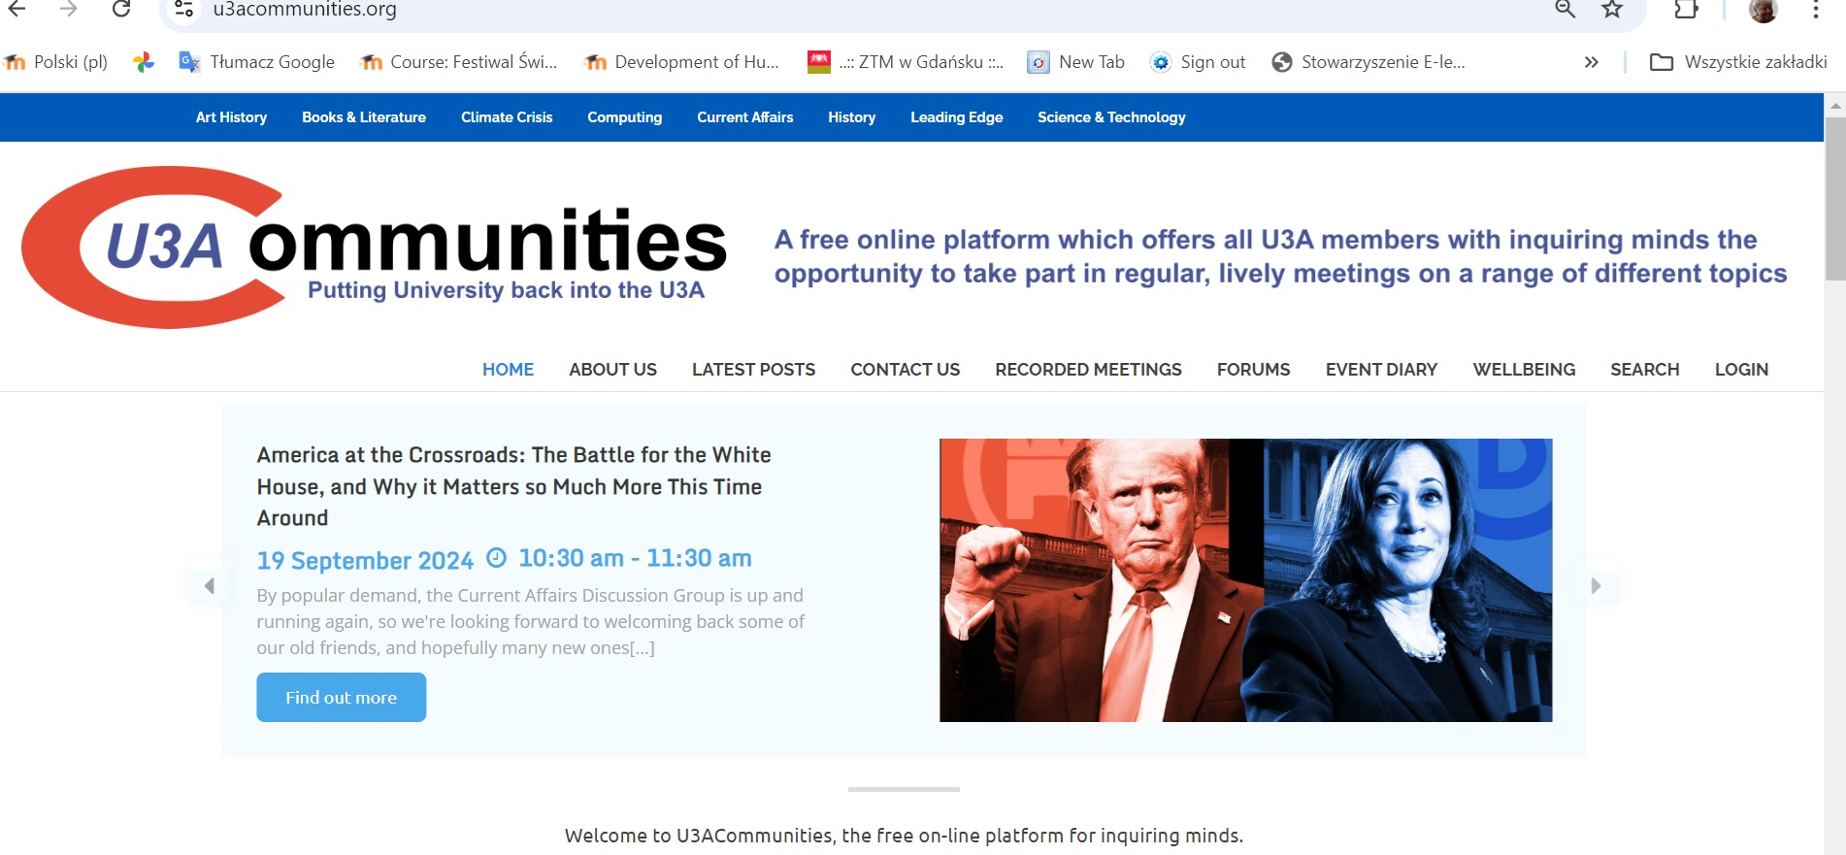
U3A Communities

Slide 13
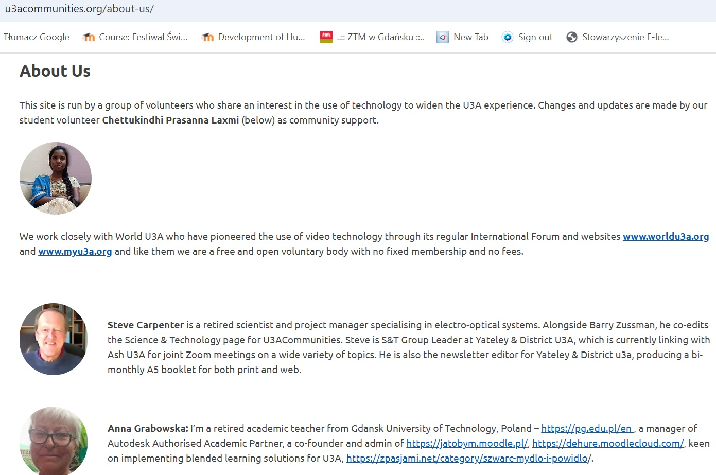
U3A Communities – People

Slide 14
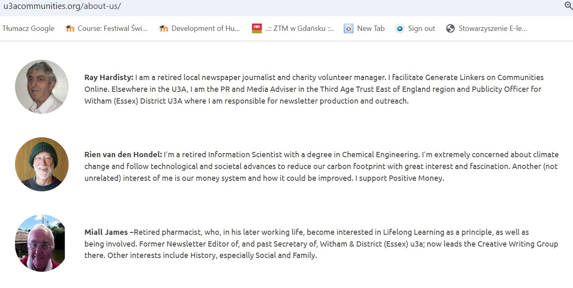
U3A Communities – People

Slide 15
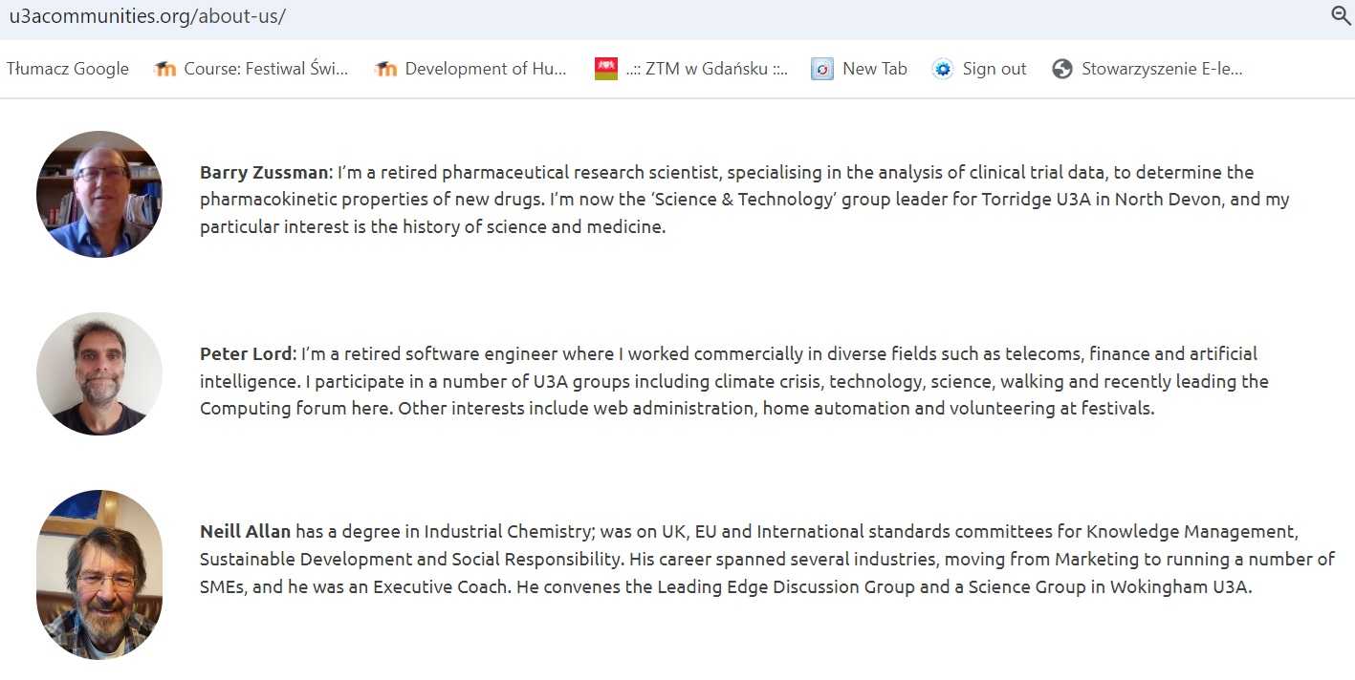
U3A Communities - People

Slide 16
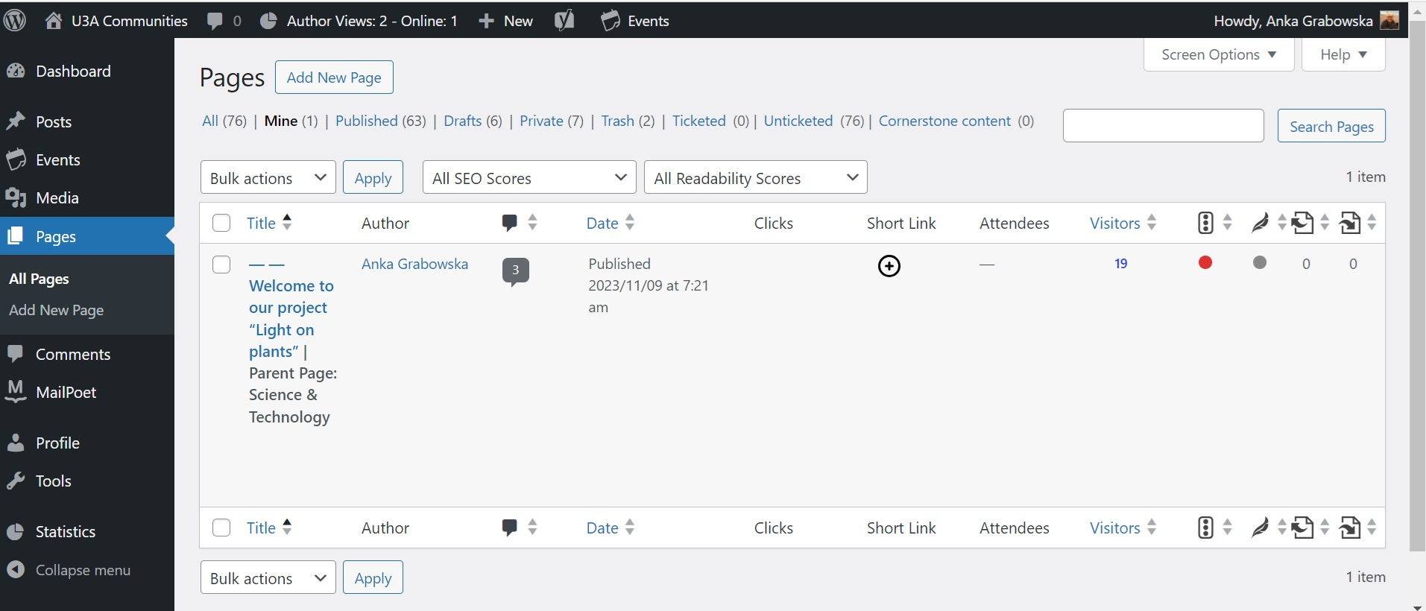
U3A Communities – my 1st page https://u3acommunities.org/interest-groups/science-technology/welcome-to-our-project-light-on-plants/

Slide 17
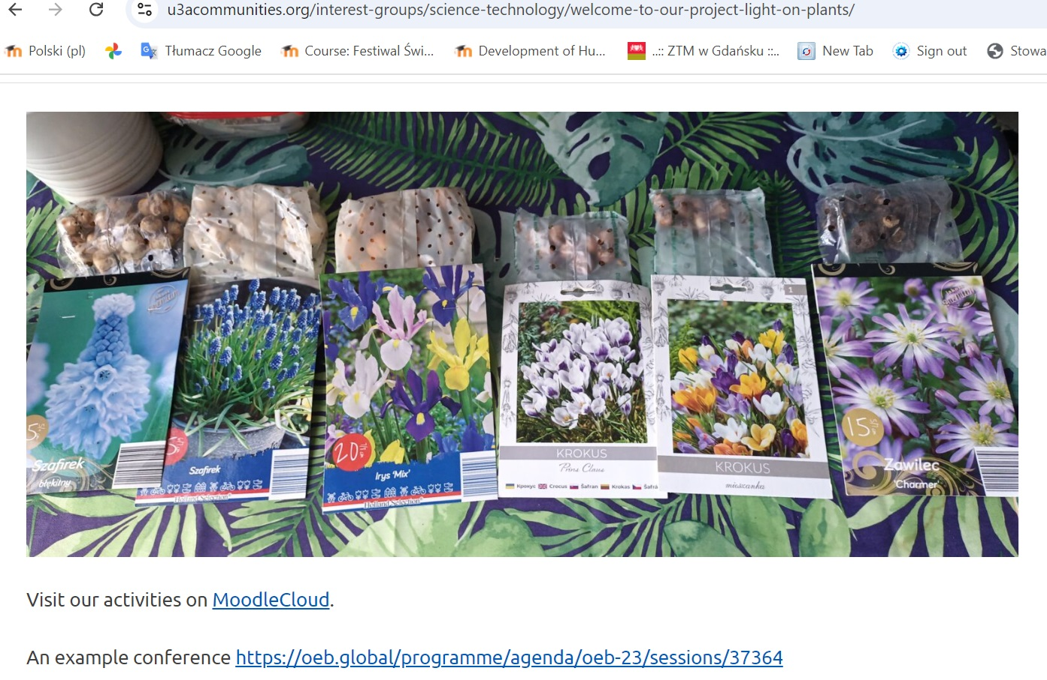
U3A Communities – my 1st page https://u3acommunities.org/interest-groups/science-technology/welcome-to-our-project-light-on-plants/

Slide 18
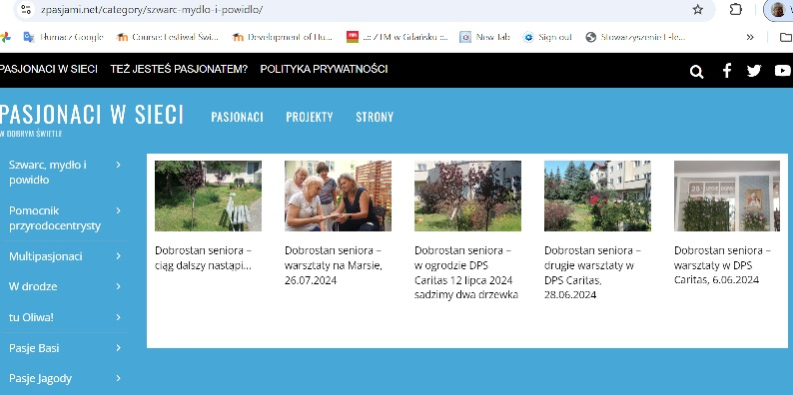
zpasjami.net – my blog https://zpasjami.net/category/szwarc-mydlo-i-powidlo/

Slide 19
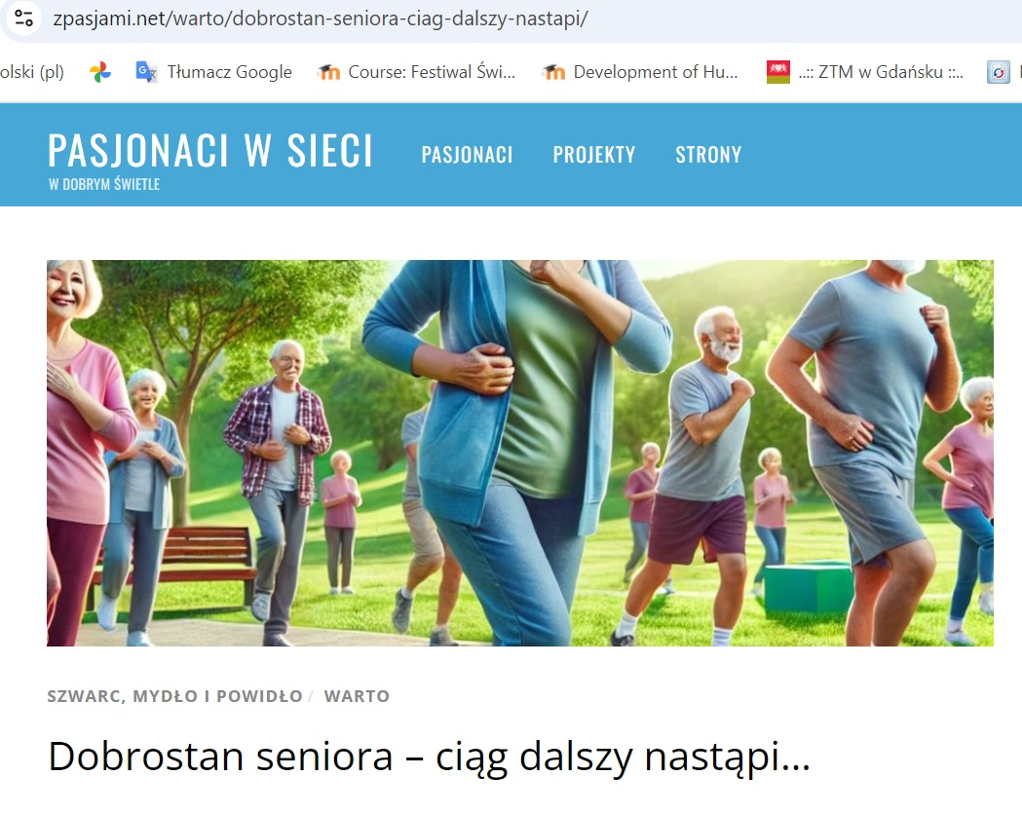
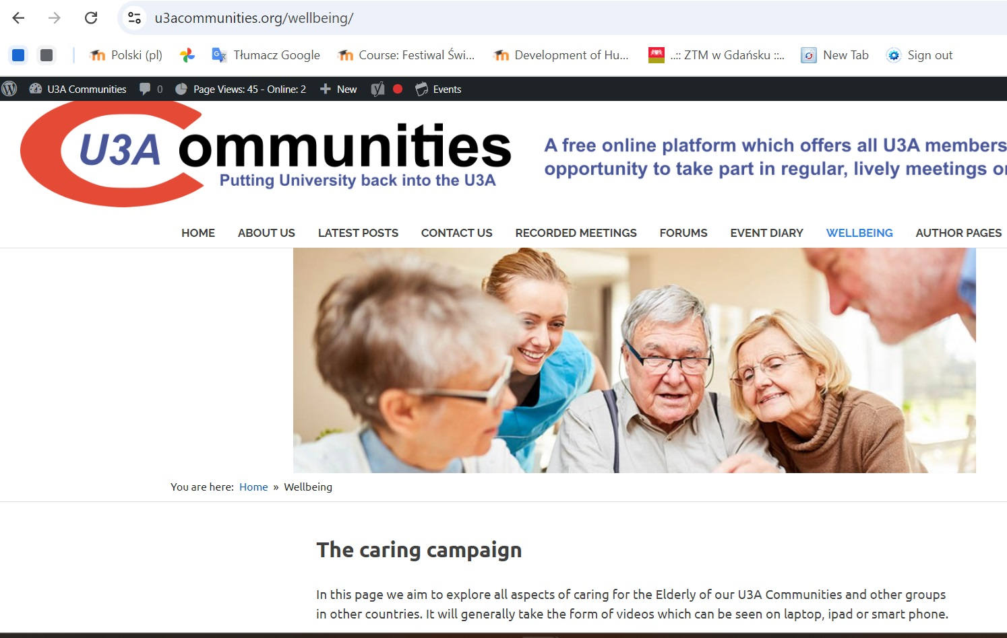
Senior’s Wellbeing– let’s continue

Slide 20
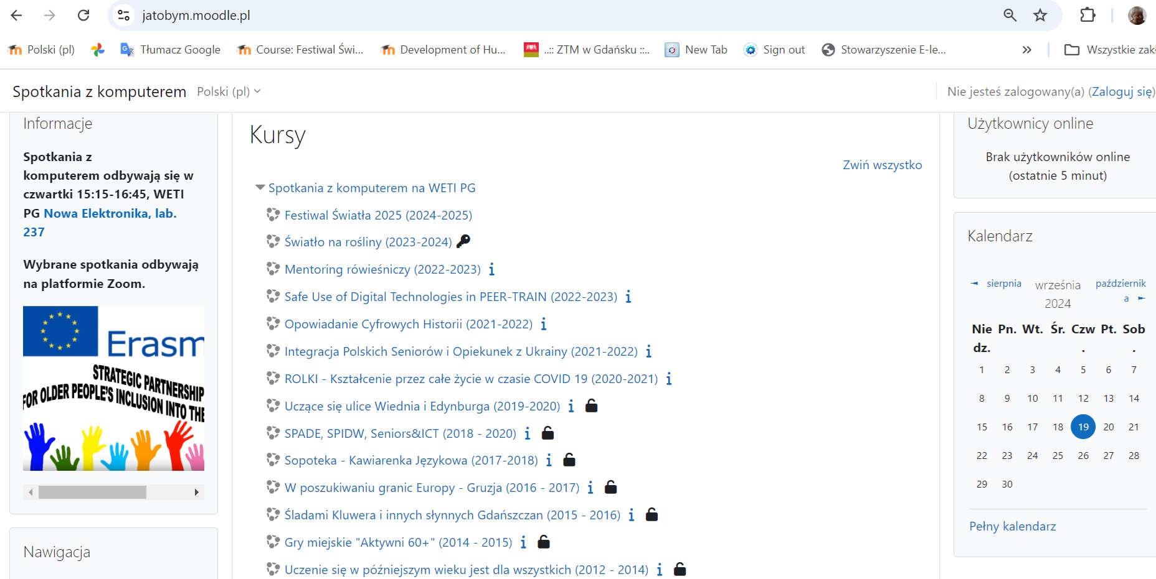
Light on Senior’s Wellbeing

Slide 21
Thank you for your attention
anka.grabowska@gmail.com

