Slide 1

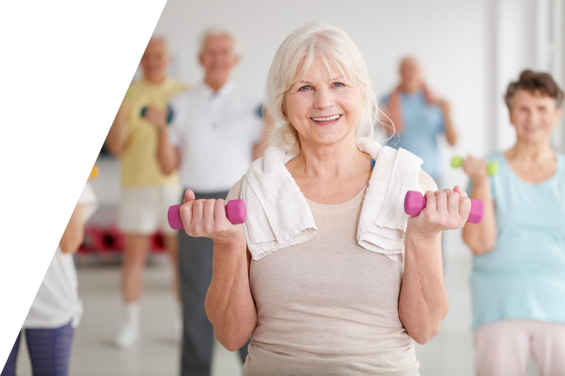

Activities
for
Seniors

Slide 2

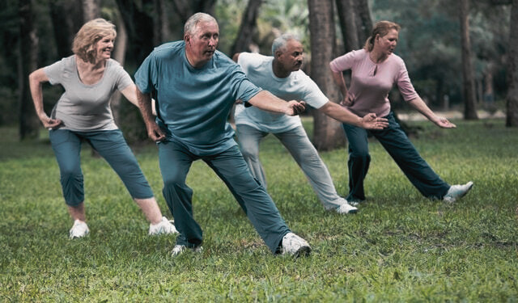
Physical Activities
01
Nordic walking
02
Exercise in Water
03
Dance
04
Tai chi

Slide 3
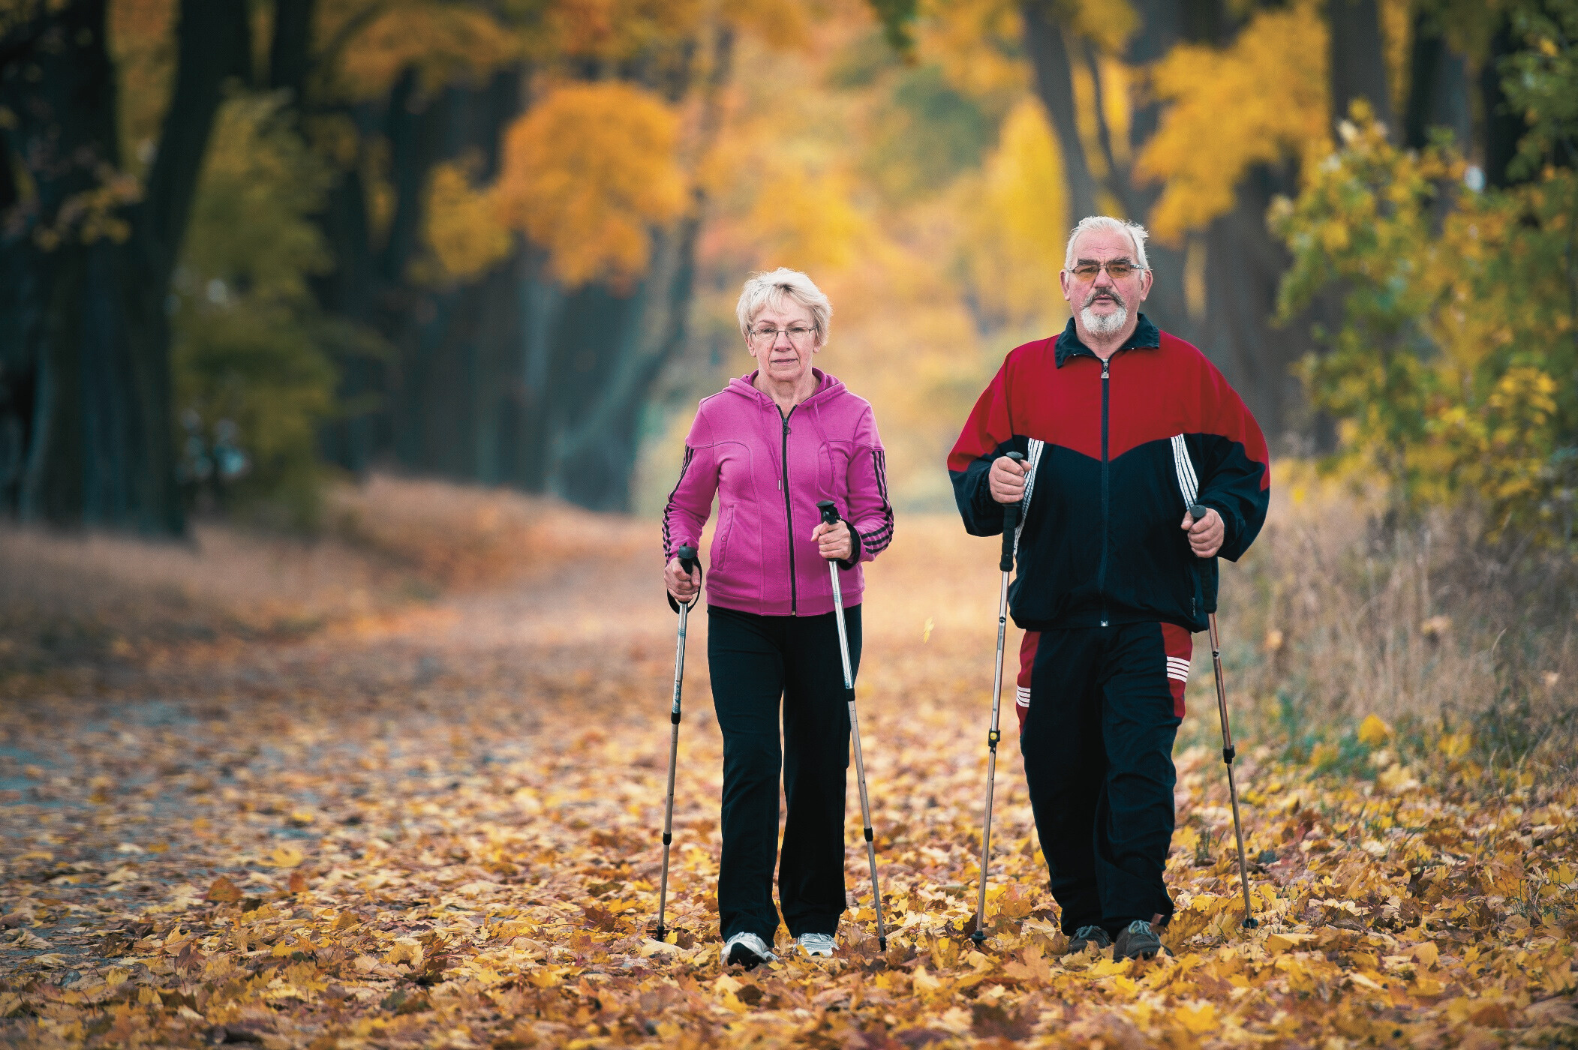
01
Nordic Walking
A form of dynamic walking using special poles that engage both upper and lower body muscles. This type of activity is gentler than running but more effective than traditional walking.
1
2
3
Improved Coordination and Balance
The poles help with stability, which is important for seniors to prevent falls.
Improved Fitness
Nordic walking strengthens the cardiovascular and respiratory systems, enhancing endurance.
Full-Body Engagement
The poles help exercise arm, chest, back, and leg muscles.

Slide 4
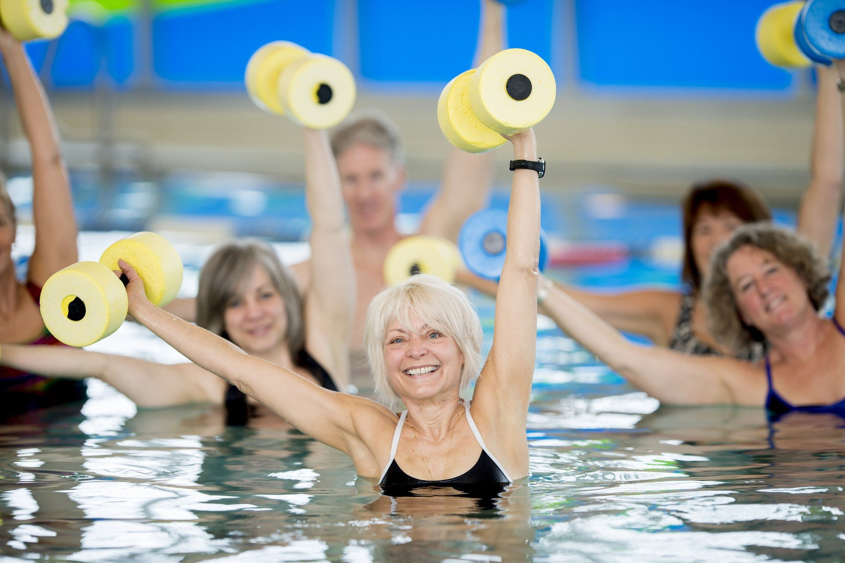
02
Aqua Aerobics
A type of exercise performed in water, usually in a pool. These exercises combine aerobics with the beneficial effects of water.
1
2
Low Intensity
Water reduces joint strain, making exercises gentler yet effective.
Muscle Strengthening
Water resistance helps build muscle strength without injury risk.
3
4
Improved Balance
Water exercises engage the whole body, enhancing balance and coordination.
Better Circulation
Aqua aerobics improves blood flow, supporting heart health.

Slide 5
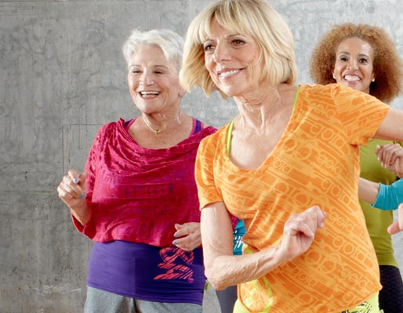
03
Taniec
Dance is an activity that engages both the body and the mind.
1
2
Increased Flexibility and Strength
Dance movements help stretch and strengthen muscles, improving overall fitness.
Brain Stimulation Remembering steps and rhythms engages the mind, supporting cognitive functions and slowing aging processes.
3
4
Stress Reduction
Dance has therapeutic effects, improving mood and reducing stress by releasing endorphins.
Social Activity
Group dancing encourages relationships.

Slide 6
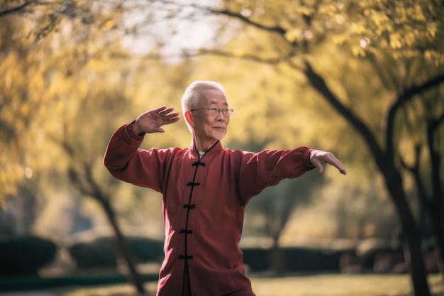
04
Tai chi
A traditional Chinese martial art combining meditation with gentle exercises. Although rooted in martial arts, Tai Chi is primarily practiced for health and relaxation
1
2
Improves Balance and Stability
Tai Chi’s slow, controlled movements can help enhance balance and coordination, reducing the risk of falls - a major concern for seniors.
Reduces Stress and Enhances Mental Well-being
The meditative aspect of Tai Chi helps reduce stress and improve mental clarity, supporting relaxation and potentially enhancing cognitive health over time.

Slide 7

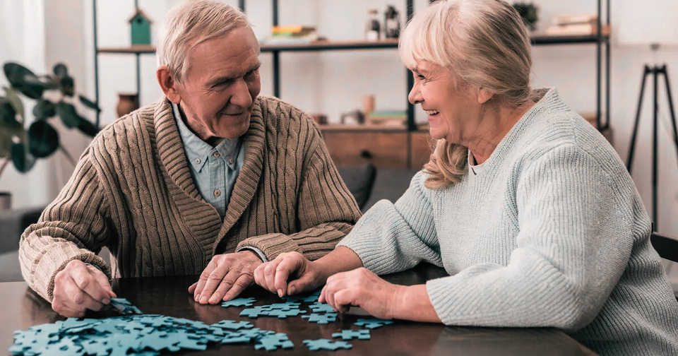
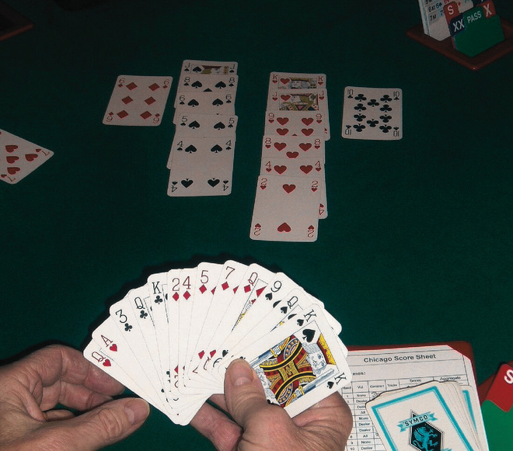
Mind-Engaging Seated Activities
01
Card Games
02
Painting
03
Crosswords and Puzzles
04
Learning New Skills

Slide 8
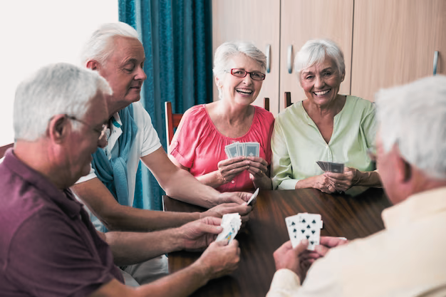
01
Card Games
Card games like bridge, poker, rummy, or canasta are popular group or partner activities.
1
2
3
Enhances Memory and Analytical Skills
Remembering cards, strategies, and opponents’ moves stimulates memory.
Encourages Strategy and Planning
Card games require anticipating other players’ moves, enhancing logical thinking.
Promotes Social Interaction
Social games encourage building relationships and spending time in a pleasant atmosphere.

Slide 9
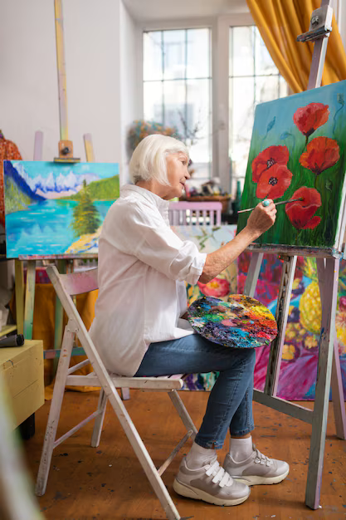
Painting
02
Drawing and painting are forms of artistic creativity. Creating works of art can include both simple sketches and more complex paintings.
1
2
Improves Motor Skills
Precise hand movements in drawing and painting help maintain manual dexterity.
Encourages Emotional Expression
Artistic creation provides a way to express emotions, which can be therapeutic, especially during difficult times.
3
4
Boosts Confidence
Completing an art piece can bring satisfaction and strengthen self-esteem.
Can help you meditate
The creative process can become a form of meditation, helping focus thoughts and improve mental well-being.

Slide 10
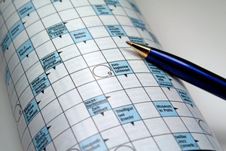
03
Crosswords and Puzzles
Solving crosswords, sudoku, and other mental puzzles is a great way to stimulate the brain and improve language skills as well as logical thinking.
1
2
Increases Language Skills Solving crosswords builds vocabulary and helps learn new words and phrases.
Promotes Healthy Competition
Solving puzzles in groups or shared challenges provides opportunities for friendly competition, making it fun and motivating.
3
4
Improves Problem-Solving Abilities
Puzzles require logical thinking and creativity in finding solutions.
Stimulates Concentration and Attention
Focusing on details and clues requires full attention, improving concentration skills in daily tasks.

Slide 11

04
Learning New Skills
Learning new skills is a great way to develop intellectually and creatively.
Handicrafts
Learning to sew, make jewelry, or create greeting cards are activities that develop manual skills and creativity.
Pot Gardening
Participants can learn to care for potted plants at home. Taking part in workshops or online gardening courses can help develop this skill.
Online Safety
Learning how to secure personal data, recognize online scams, and protect privacy.

Slide 12
Thank you
For
Your attention
Mikolaj Loewnau

